Slide 1
Usage Guidelines
The following slides will help you inform your colleagues about the availability of Slido to make their meeting more engaging and collaborative.
Before the use, please edit the slides to include your company name & to explain your internal process for requesting a Slido license (e.g. link to a request form, instructions on where to apply for a Slido license, …)
Include these banners in your slide decks, internal communication, newsletters, Intranet articles, etc. to ensure your colleagues are aware of Slido being available to them as a company approved tool and prevent them from using any unapproved software potentially jeopardizing your privacy & data security

Slide 2
Slido for Meetings at ‘Company Name’
Q&A
Polls
Slido is the easiest way to host meetings that are open, inclusive and engaging.
👉 Request Slido here.
Surveys
Live Quizzes
Analytics
www.slido.com

Slide 3
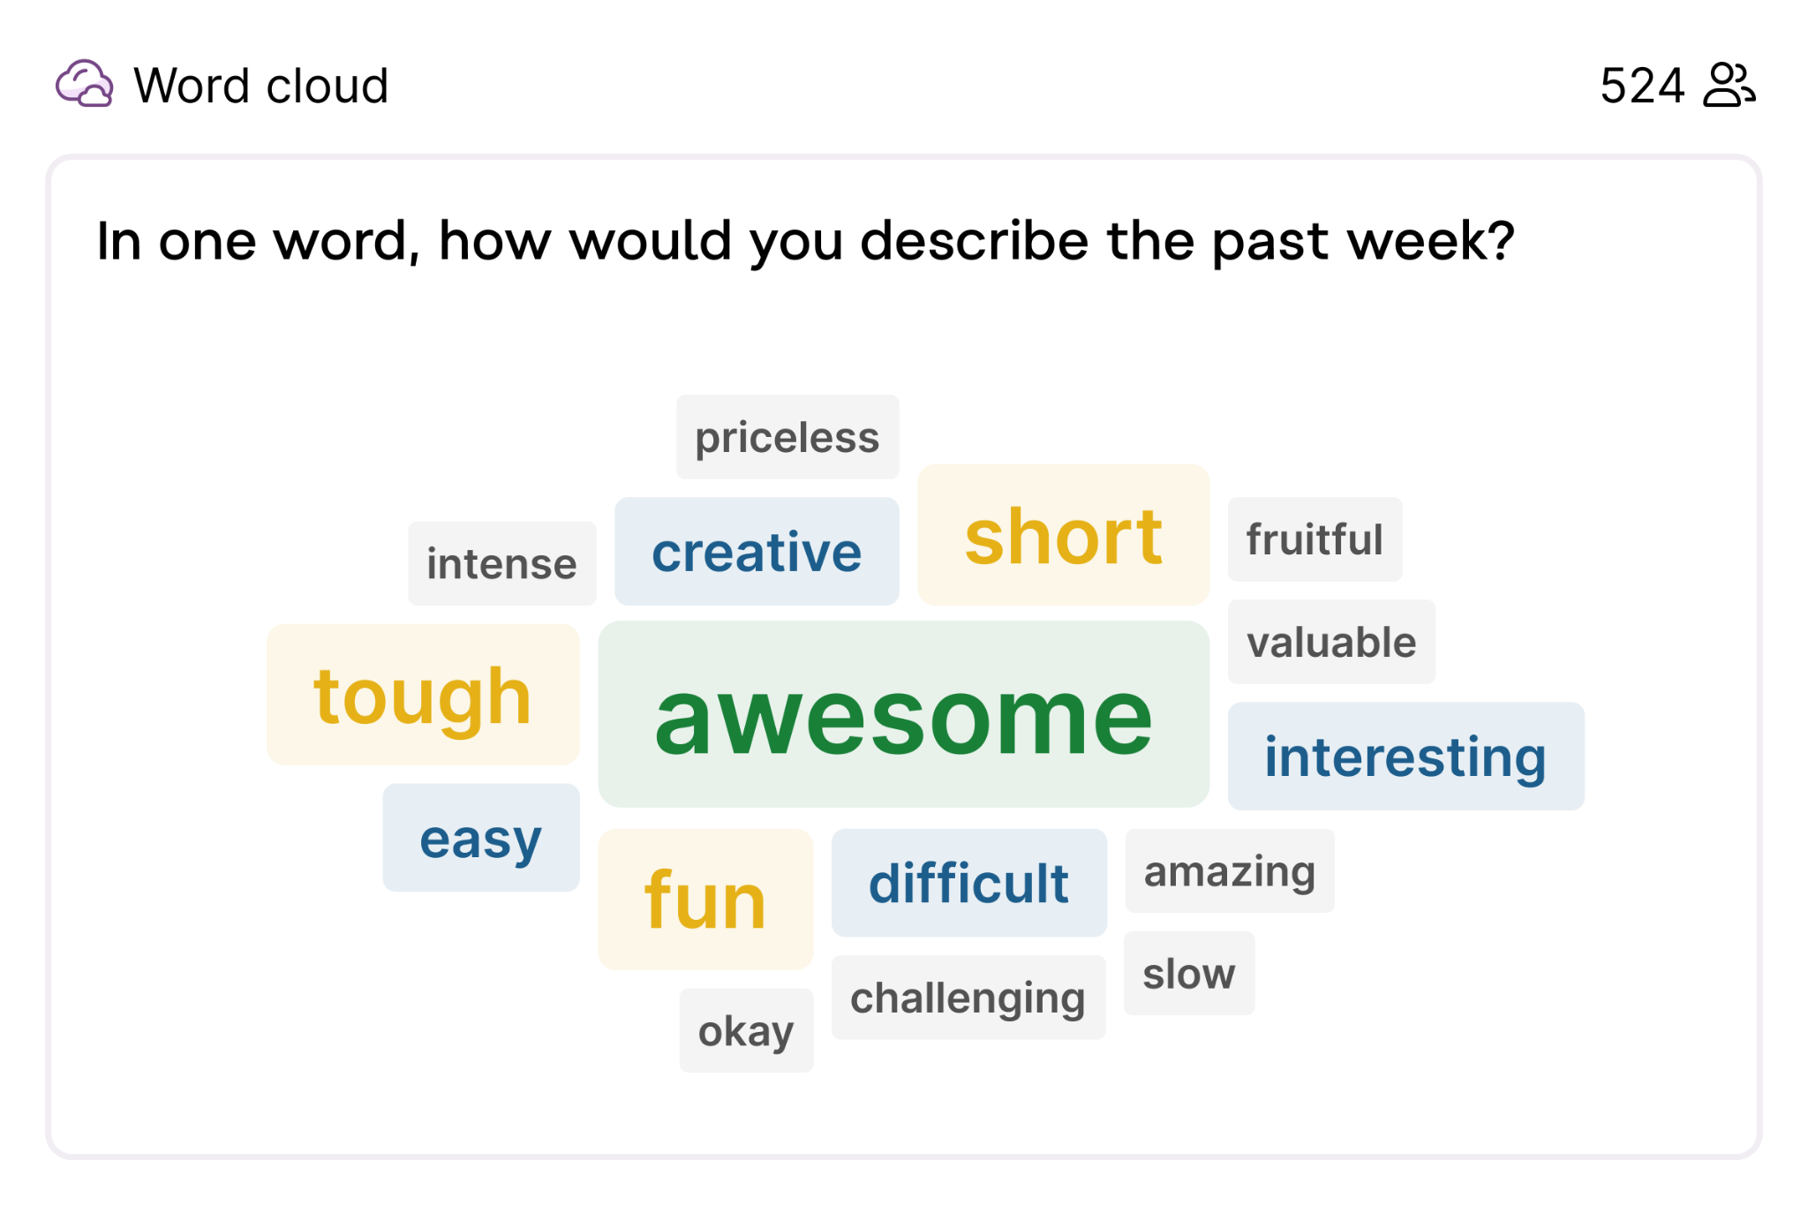
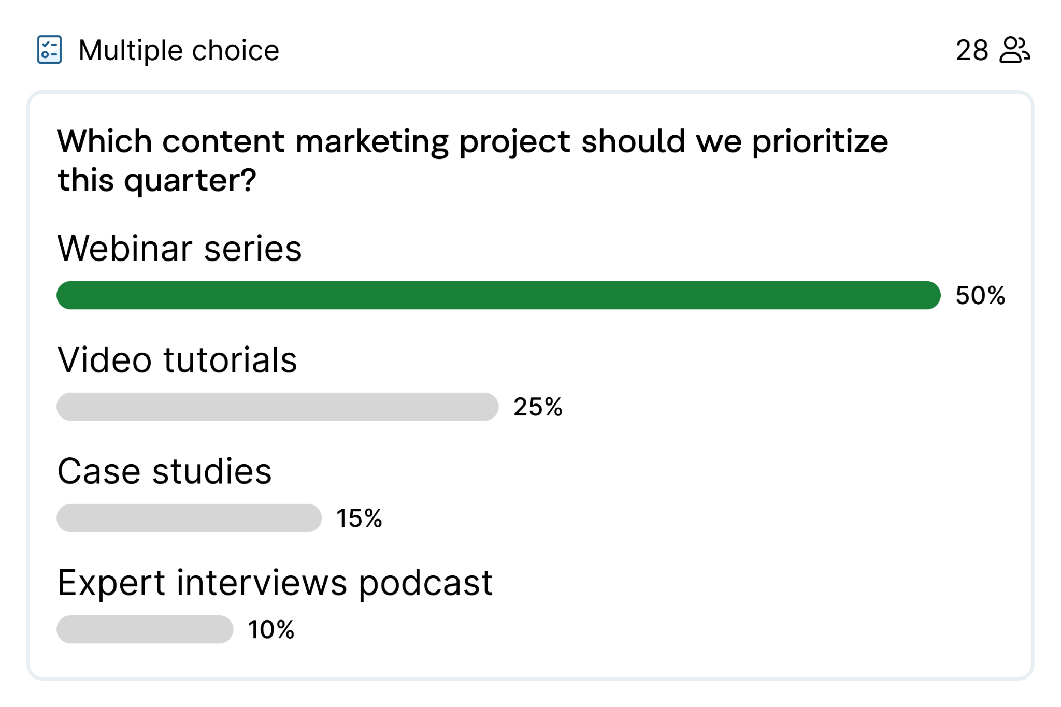
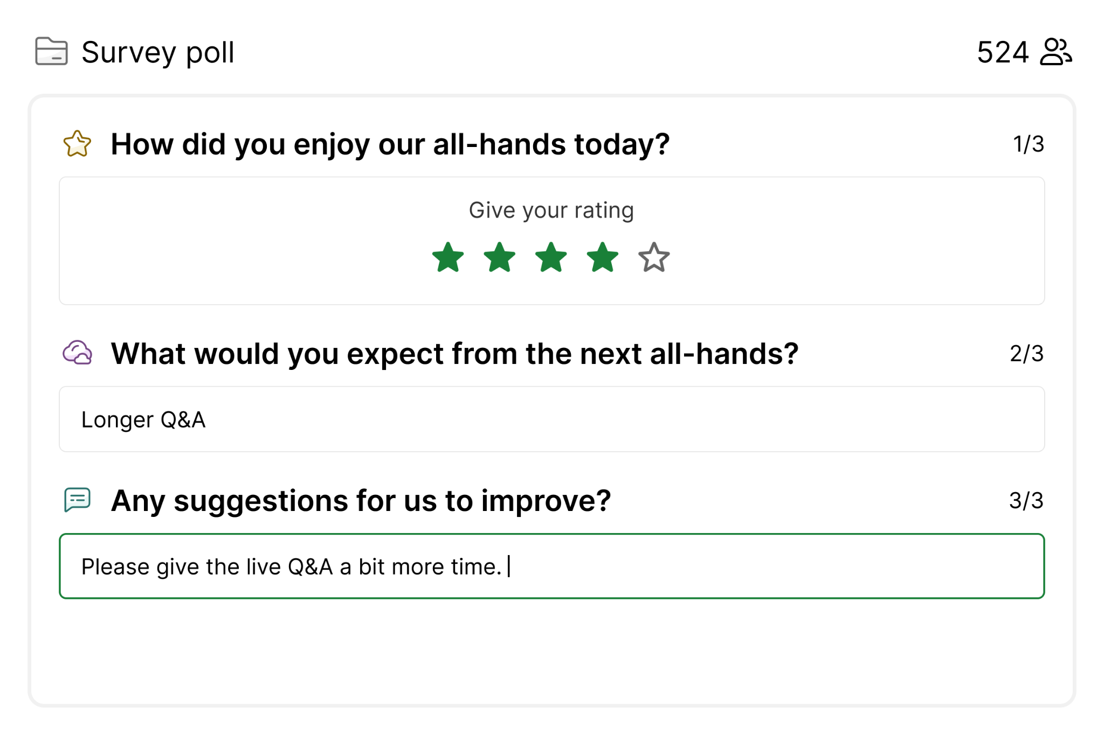
Transform your meetings with Slido
1.
Start your meeting with an icebreaker to engage everyone
2.
Use collaborative decision-making
3.
Collect feedback from your audience

Slide 4
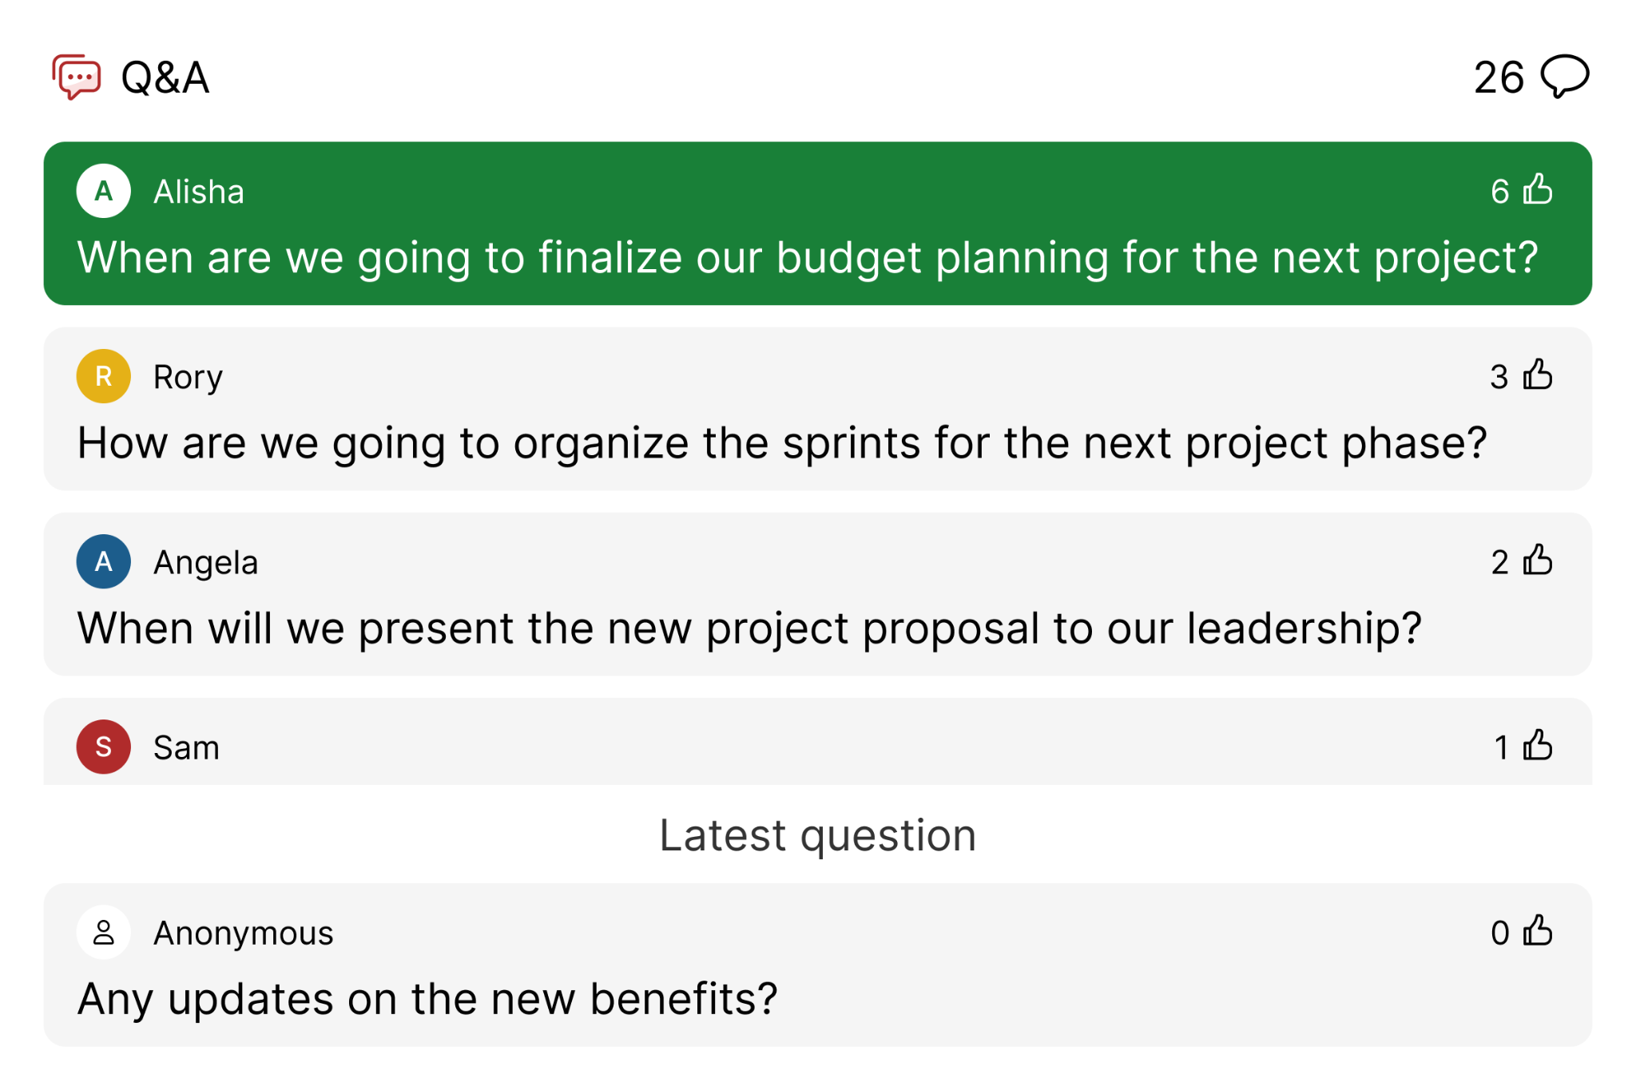
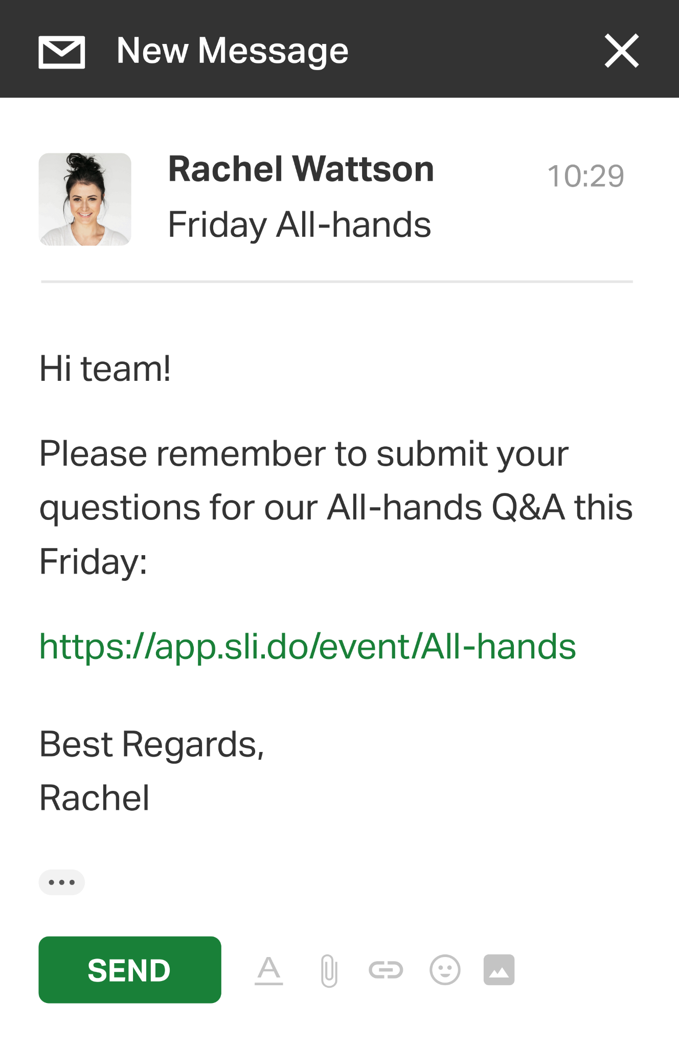
The ultimate Q&A tool for AMAs and Town Halls at ‘Company Name’
Slido empowers you to crowdsource the best questions from your employees, and get their honest feedback.
👉 Request Slido here.
www.slido.com

Slide 5
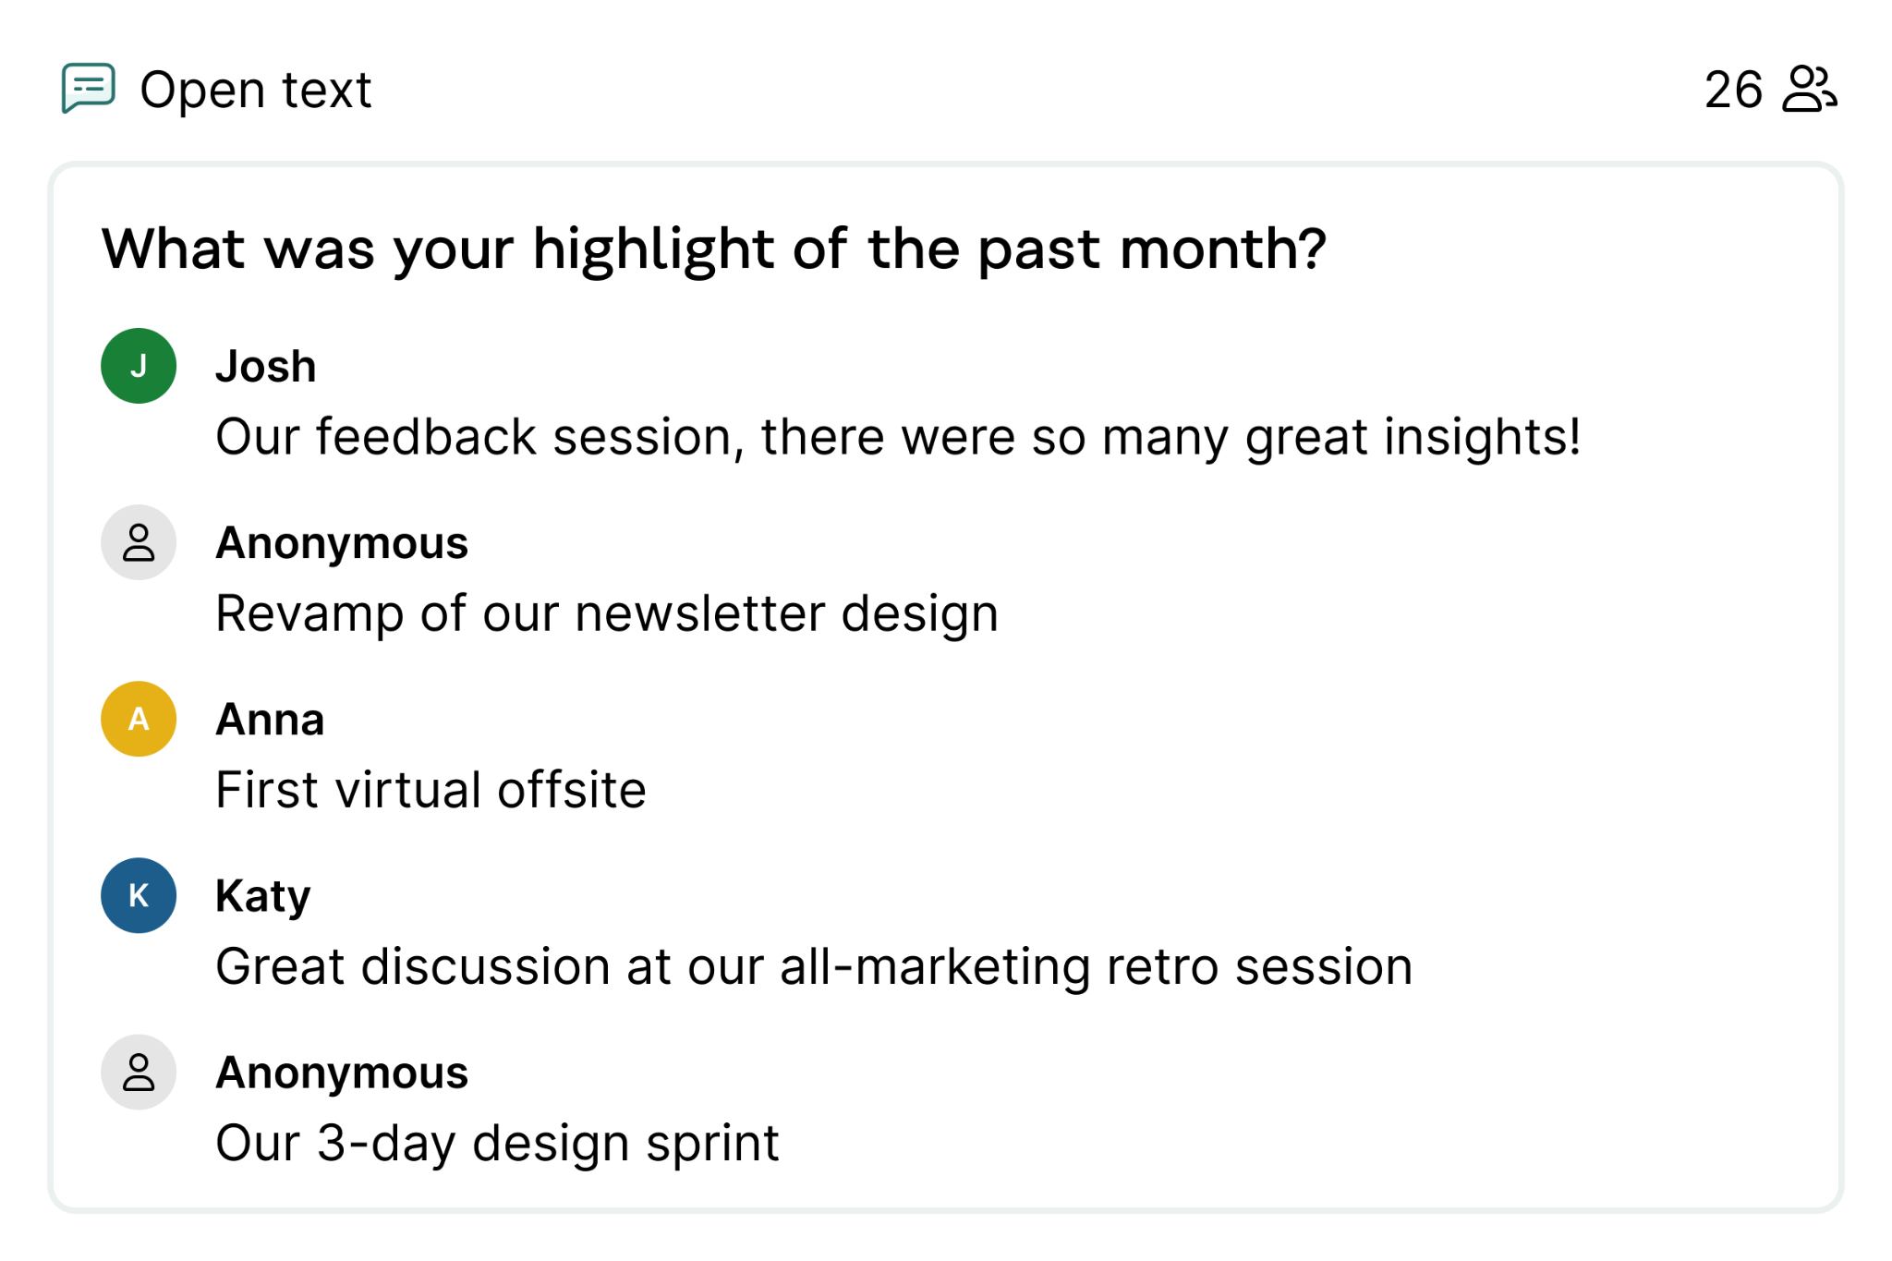
Empowering you to hear every voice 💪
www.slido.com
91% Of meeting organizers say that using Slido includes everyone in discussion and gets diverse opinions.
👉 Request Slido here.

Slide 6
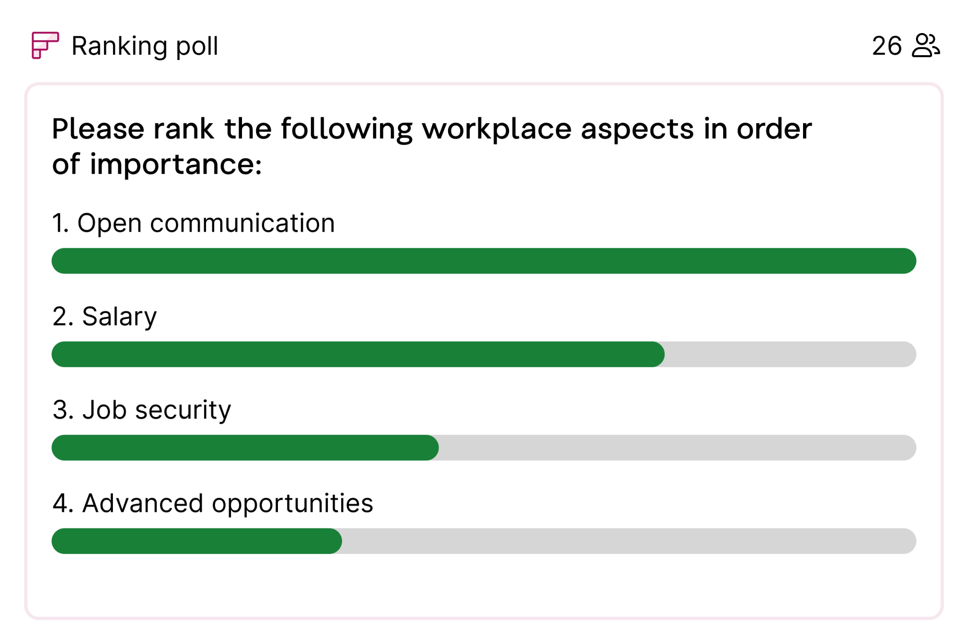
Empowering you to hear every voice 💪
www.slido.com
91% Of meeting organizers say that using Slido includes everyone in discussion and gets diverse opinions.
👉 Request Slido here.

Slide 7
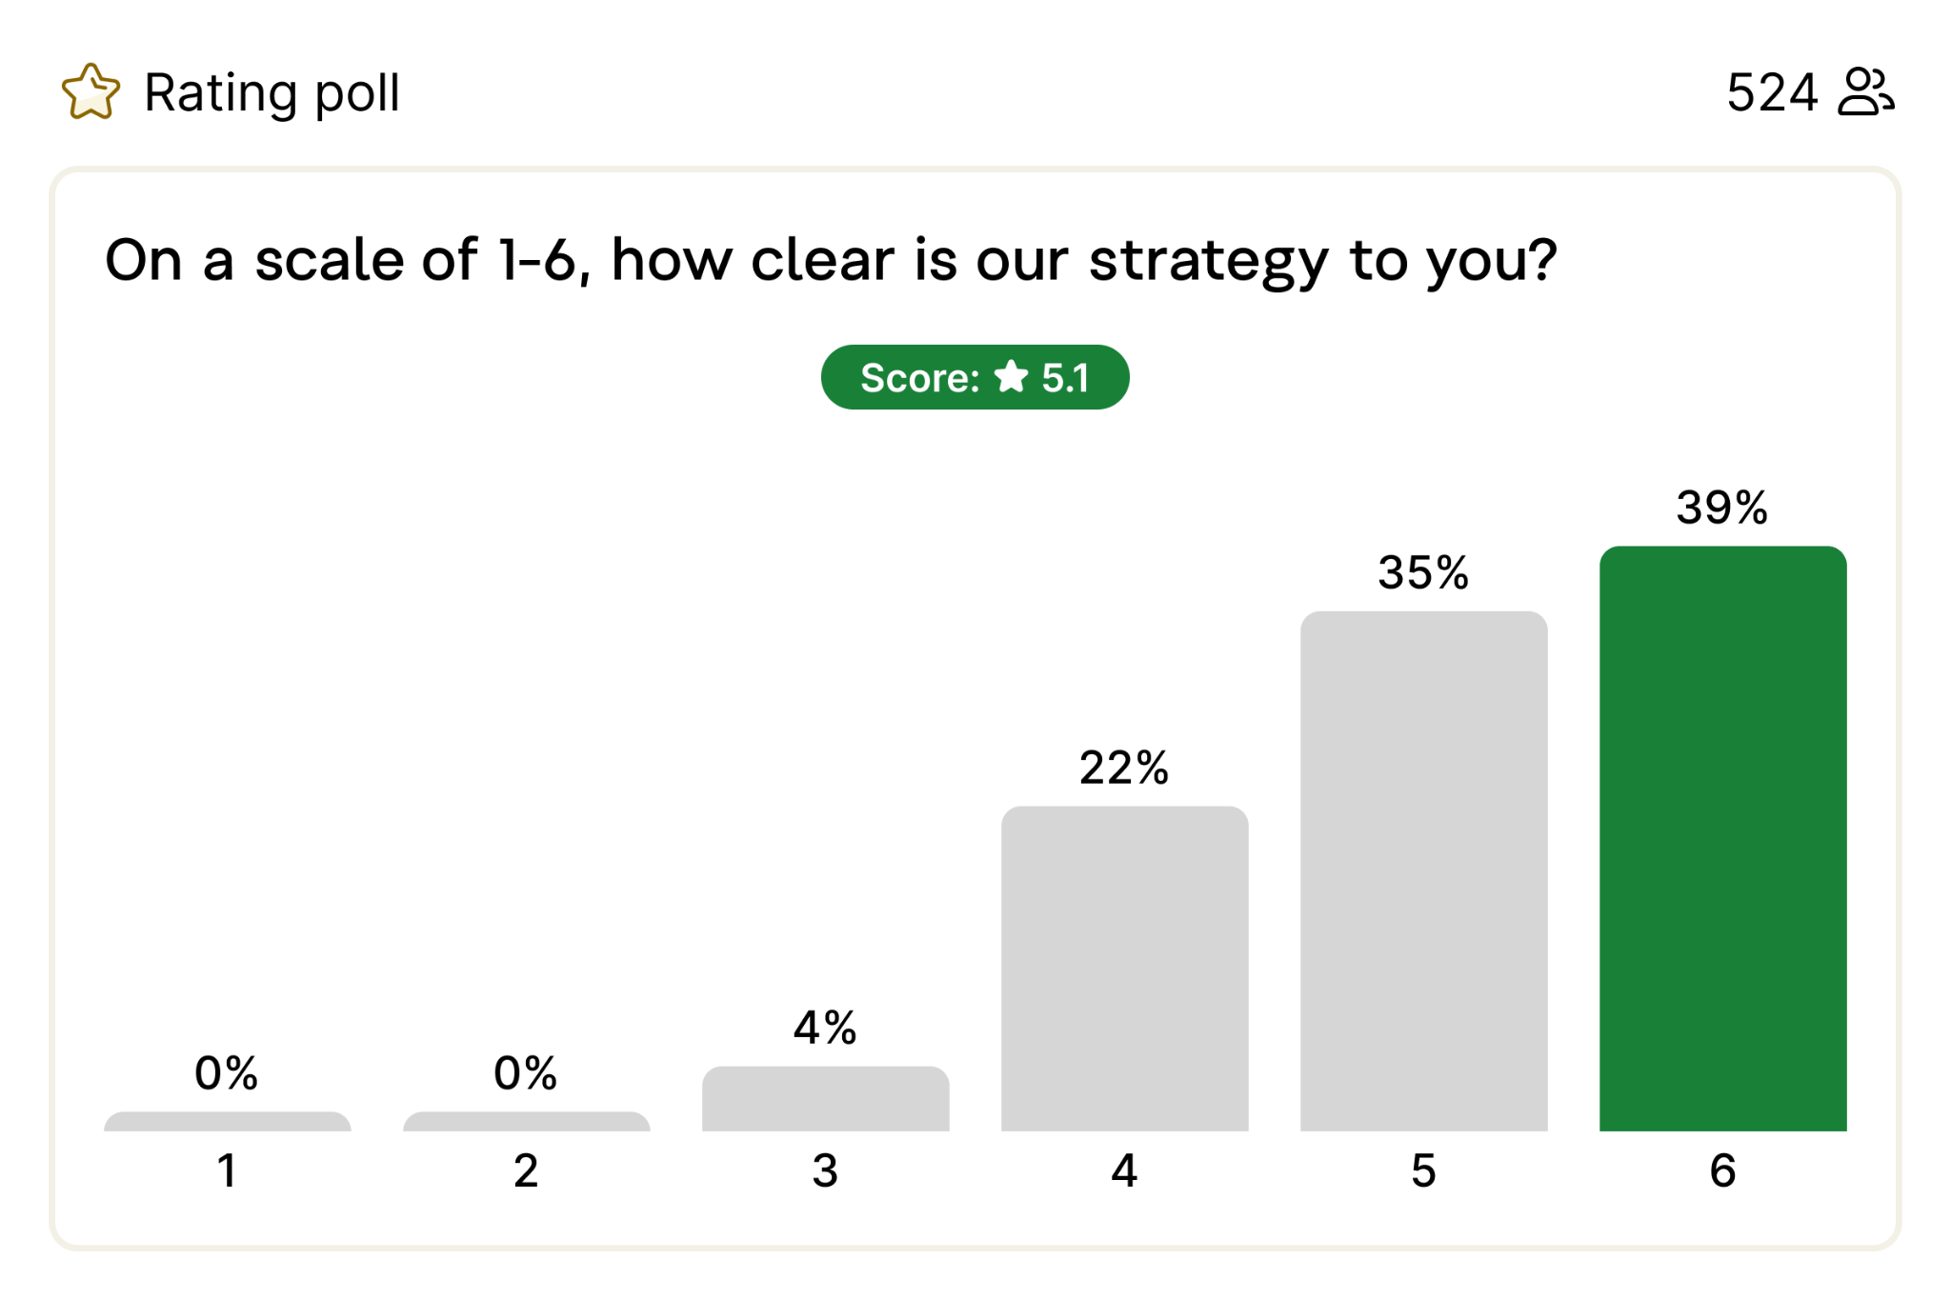
Empowering you to hear every voice 💪
www.slido.com
91% Of meeting organizers say that using Slido includes everyone in discussion and gets diverse opinions.
👉 Request Slido here.

Slide 8
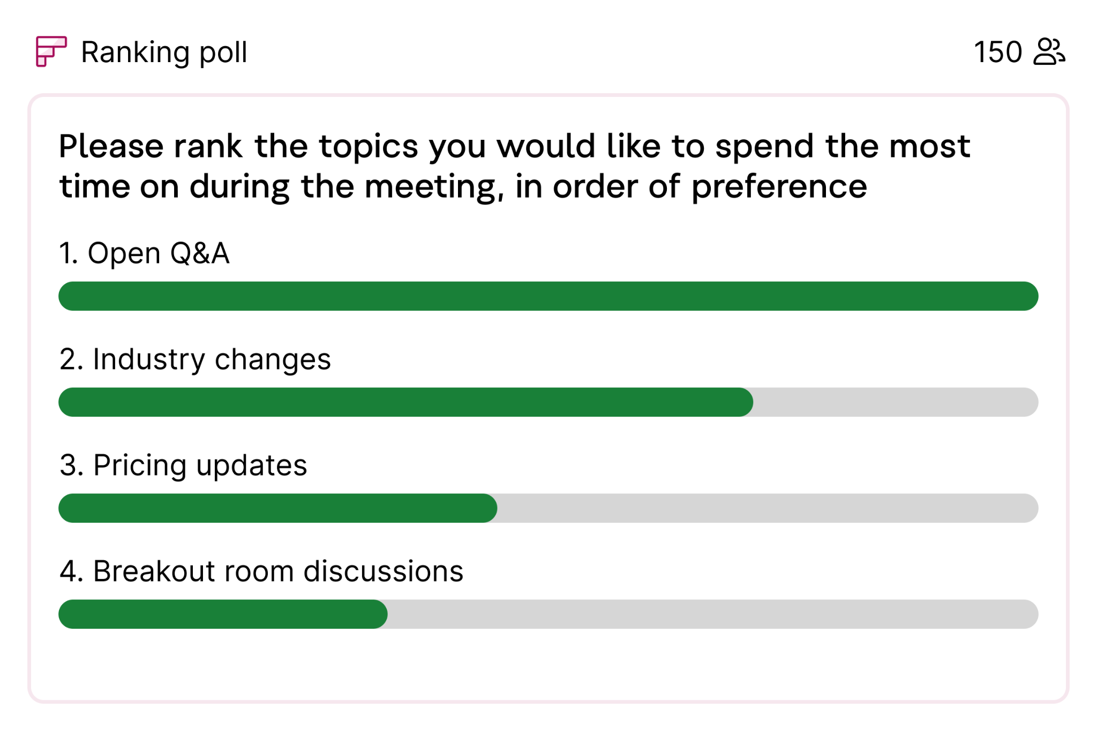
Empowering you to hear every voice 💪
www.slido.com
91% Of meeting organizers say that using Slido includes everyone in discussion and gets diverse opinions.
👉 Request Slido here.

