Slide 1
Session tips for Trainers
Sessions
This content is prepared for 45 min session
30 mins content / 15 mins buffer + Q&A time
If you can run this session with 2 trainers, below is recommendation on how to split the content:
Trainer one
Content: Intro, Slido overview, Integrations, closing
Trainer two
Content: Demo, Quiz host, Q&A host
Prep
Plan dry run (with a fellow trainer if you have one) prior to running this session
Make a copy of this deck to use. Add Slido interaction slides of choice to make it more engaging for your attendees. Check out how to use Slido built-in PowerPoint or Google Slides.
Right before the session
Join session 20 mins before start time to test tech and be ready to start right on time
Refresh decks right before session start & double check Slido is logged in/connected
Consider adding Slido also to your video conferencing tool if available. Check out how to use Slido in Webex, MS Teams, Zoom.
And share Slido event link in chat for browser joiners
Follow up
We recommend running a feedback survey at the end
10 mins before session end time (aka 35 min mark)
Share the deck and recording (if you decide to record) with attendees after the session

Slide 2
Session Timing
Intro
Slides 5-9
5 minutes
Slido Overview
Slides 10-17
7 minutes
Demo
Screen sharing for live demo
10 minutes
Use Cases
Slides 21-26
7 minutes
Integrations
Slides 33-36
3 minutes
Quiz
Slides 37-41
3 minutes
Q&A + Closing
Slides 42-end
10 minutes

Slide 3
Getting started with Slido
[Company name]
Let’s record 🎥
Notes:
Welcome to our our training session, let’s help you get started with Slido!

Slide 4
Your Trainers today
Name Surname Job title Company
Name Surname Job title Company
Notes:
We are your hosts today… please both introduce yourselves

Slide 5
Housekeeping
How to access Slido during this session
Recording & resources will be shared with you after the session 📹
🧩 Integration You should see Slido in the sidebar on the right… or click apps > Slido
🤳 Mobile Scan the QR code on the screen
🔗 Direct link Click on the Slido link in the chat
During the session, please use:
Slido Q&A for questions
Chat for any comments or if you are having any technical issues during the session
Notes:
A tiny bit of housekeeping for this session:
Recording will be shared with you afterwards [if possible]
For communications during the session, please use Slido Q&A throughout the session for any questions
For any comments or technical issues, please write into the meeting chat
We will be using slido during the session of course!
The ideal way to access it is through the integration in meeting [Webex/Teams/Zoom], you should see it in the sidebar or you will have a banner with an option to open it.
If for any reason you can’t/don’t want to use the integration or are joining via browser (no integration), you can scan the QR code and use your mobile device, or click on the link we dropped in the chat to open in your browser

Slide 6
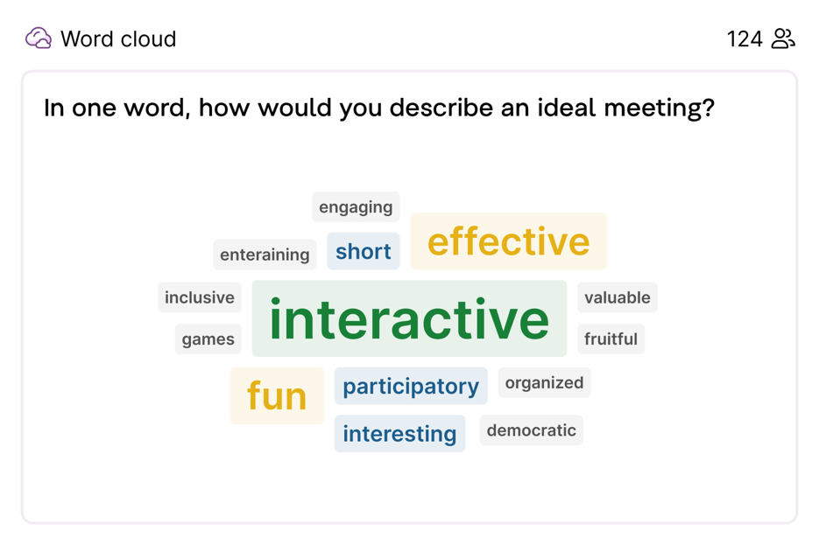
Word cloud
Replace this slide with your Slido interaction
You can open up your session with a question Where are you dialing from? or get inspired by 200 other Icebreakers 💡

Slide 7
What you’ll gain from this session…
🚀
The confidence to kickstart your Slido journey!
🔥
The desire to elevate your meetings and events through audience engagement and interaction.
🎓
More knowledge of Slido features and use cases… we’ll even put your knowledge to the test with a fun quiz!
Notes:
To make sure we’re all aligned, here is what you can expect to walk away with today…
The confidence to kick start your slido journey
The desire to elevate your meetings
More knowledge of Slido features and use cases… we’ll even have a quiz so hopefully you’re paying attention!

Slide 8
Slido at [Company]
Add your company’s specific instructions here
This is how you can get a Slido license at [company]
Please explain where they can ask for help if they run into any issues or have questions 💚
Notes:
Read slide

Slide 9
Agenda
01 Slido Overview
02 Demo
03 Use Cases
04 Integrations
05 Quiz
06 Q&A + Feedback Survey
Notes:
Here’s our agenda for the next 35 mins or so
We’ll all jump on the same page with an overview of Slido
We’ll walk you through a quick demo
We’ll touch briefly on our integrations
We’ll have a fun quiz to test your knowledge
And we’ll end with addressing all your questions and a feedback survey to gather your thoughts on the session

Slide 10
01 Slido Overview
Notes:
Brief Slido overview to make sure we’re all on the same page.

Slide 11
What is Slido?
Slido is the industry-leading interaction platform for all types of meetings.
We help give everyone a voice, even the quietest participant by engaging them with polls, surveys, quizzes and Q&As.
Notes:
Read slide

Slide 12
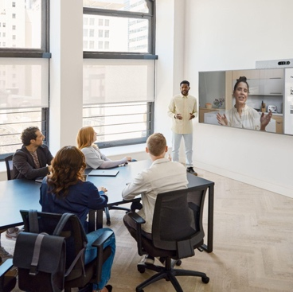
Works for all meeting setups
In-person
Hybrid
Online
Asynchronous
Notes:
Slido works for all meeting types, whether you’re in person, hybrid, online like we are today, or even asynchronous!

Slide 13
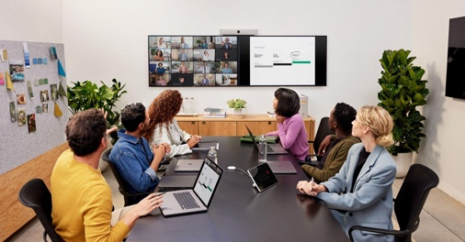
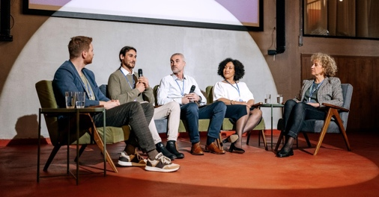
And across many meeting & event types💡
Team meetings
All Hands & Town Halls
Training L&D
Leadership AMA’s
Fireside Chat
Team Brainstorming
Notes:
And across many many meeting and event types. These are just a few of Slido’s most common use cases:
Team meetings
All hands & town halls
Training and L&D
Leadership meetings or AMAs
Fireside chats
And Team brainstorming

Slide 14
Slido features
Q&A Crowdsource the best questions from your participants
Polls Engage your participants with polls
Surveys Gather feedback from meeting attendees
Live Quizzes Make learning fun with live quizzes
Analytics Capture and analyze valuable insights from your meetings
Notes:
Let’s take a look at Slido’s features
Q&A to Crowdsource the best questions from your participants
Polls to Engage your participants with polls
Surveys Gather feedback from meeting attendees
Live Quizzes to Make learning fun and competitive
Analytics to Capture and analyze valuable insights from your meetings

Slide 15
Poll types overview
Multiple choice
Open text
Rating
Word cloud
Ranking
Quiz
Surveys (a combination of polls)
Notes:
Here is a look at our poll types:
Your classic multiple choice but you can also “mark a correct answer”
Open text like a free response question
Rating, like you are rating your meal or uber drive
Word cloud, which we used in the very beginning for the ice breaker
Ranking to drag and drop your options
And the quiz which also features a leaderboard and timer
Then you have surveys, which allows you to combine any number of the first five poll types to ask multiple questions at once

Slide 16
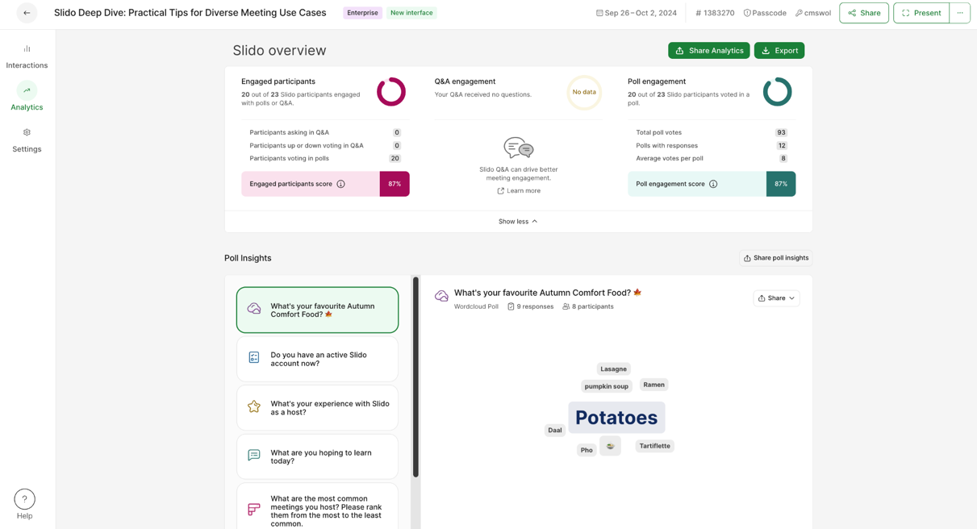
Gain valuable insights with Analytics
Discover which topics resonated the most with your audience
Collect valuable insights to improve your next meeting or presentation
Download exports or share Infographics report
💡 Learn more about Analytics
Notes:
And all of your data will be stored automatically in your event Analytics
You can take a look at general overview, trends and stats
Or you can dive deeper and work with the infographics report or download exports

Slide 17
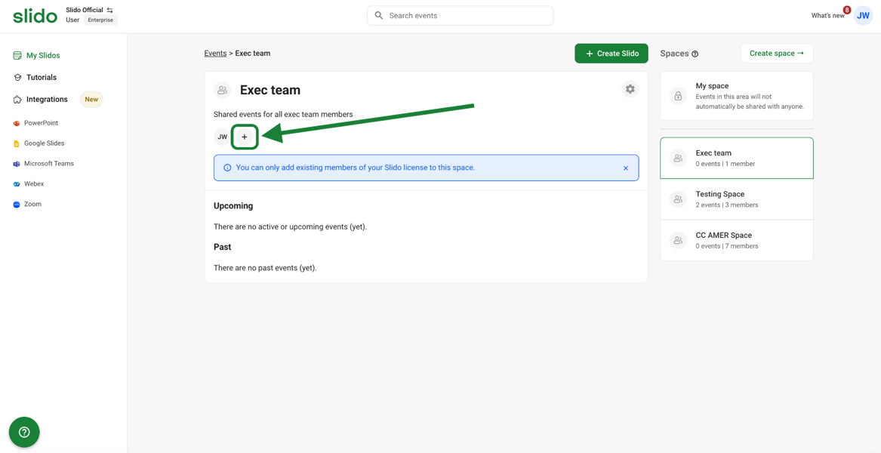
Collaborate in Slido Spaces
Categorize your events based on a team, meeting, project, client etc.
Easily collaborate on recurring meetings without having to share access every time
Notes:
And all of your data will be stored automatically in your event Analytics
You can take a look at general overview, trends and stats
Or you can dive deeper and work with the infographics report or download exports

Slide 18
02 Demo
Notes:
Now, let’s go into a quick demo to show you how to set your Slido up in the browser

Slide 19
Slido Demo - info for trainers
10 min
Note: the goal is to just cover the basics
Please log in to slido.com and share your screen. We recommend you use the event that you are already using with the session to keep it simple.
Go to Slido Host Mode
Go into event being used
Create poll
Poll (open text): How would you describe your role without using your job title? Feel free to get creative!
OR Poll (open text): What meeting & collaboration challenges do you face?
Launch and let attendees vote so they can see votes come in admin
Survey: Go into edit mode in already created feedback survey or create one on the spot
Run some test Q&A or ask audience to send in questions
Involve participants with testing / show participant share link
Show present mode (and mention integrations here, it’s in the drop down)
Analytics
Settings
Invite co-host (guest collaborator)

Slide 20
03 Use Cases
Notes:
Now, let’s go into a quick demo to show you how to set your Slido up in the browser

Slide 21
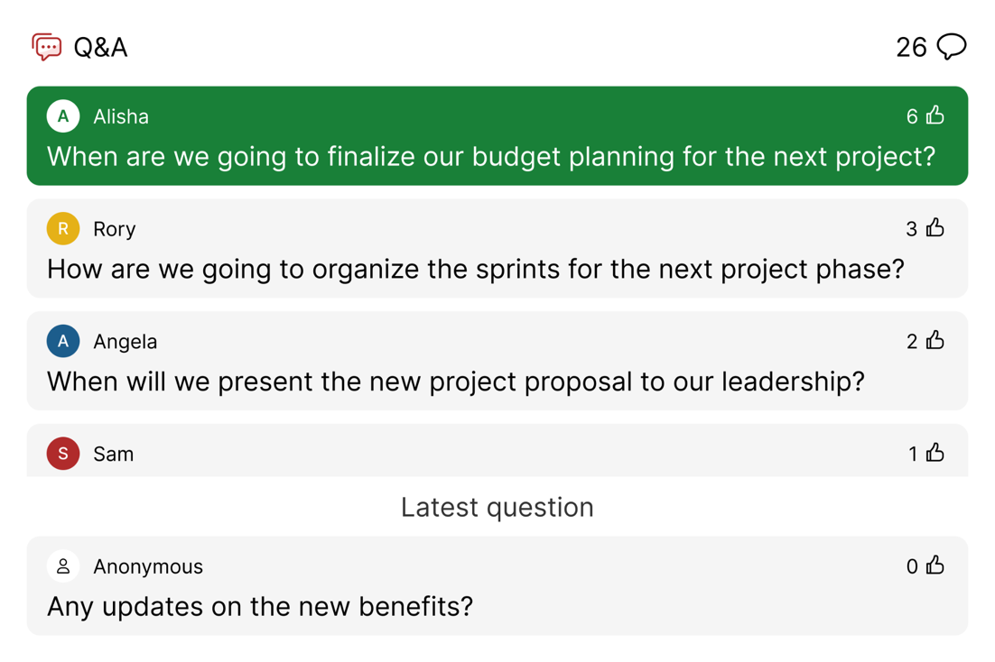
Maximize the effectiveness
of your Q&A time
Q&A
Dedicate time to address the Q&A
Enable moderation to review questions before everyone sees them
Motivate participants to upvote their favorite questions and consider anonymous questions for higher participation
Notes:
When we look closer at Q&A, this is a chance to maximize the effectiveness of your Q&A time.
We recommend dedicating time in the meeting to address the questions that you’ve gathered
Consider enabling moderation to review questions ahead of time
Motivate your participants to upvote their favorite questions
And consider anonymous questions for higher participation

Slide 22
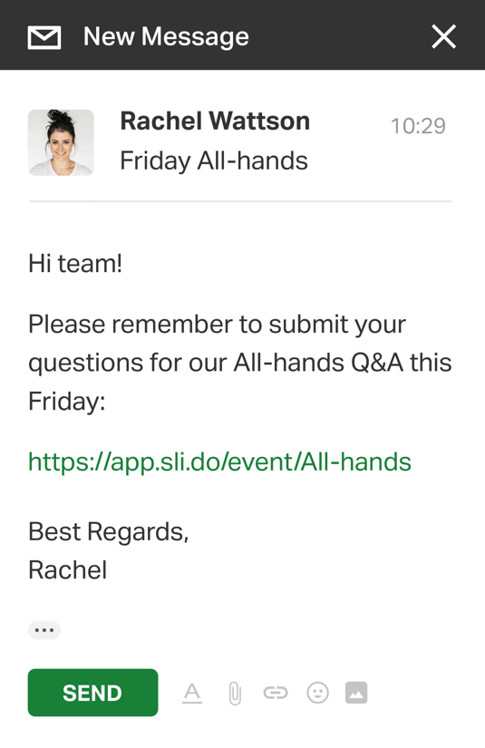
Open the Q&A in advance
Q&A
Share the link via calendar invite, email or a team space
Allow participants to submit questions and be heard even if they cannot attend the live meeting
Find out which topics are important before the meeting and prepare accordingly
💡 Share a link to your event, survey or poll
Notes:
Also with Q&A, you can consider opening it in advance to collect questions ahead of your meeting.
You can simply share the link in a message, calendar invite, or email
This can give people a voice, even if they can’t attend the meeting live
And it can help you find out which topics are important before the meeting, to help you prepare accordingly

Slide 23
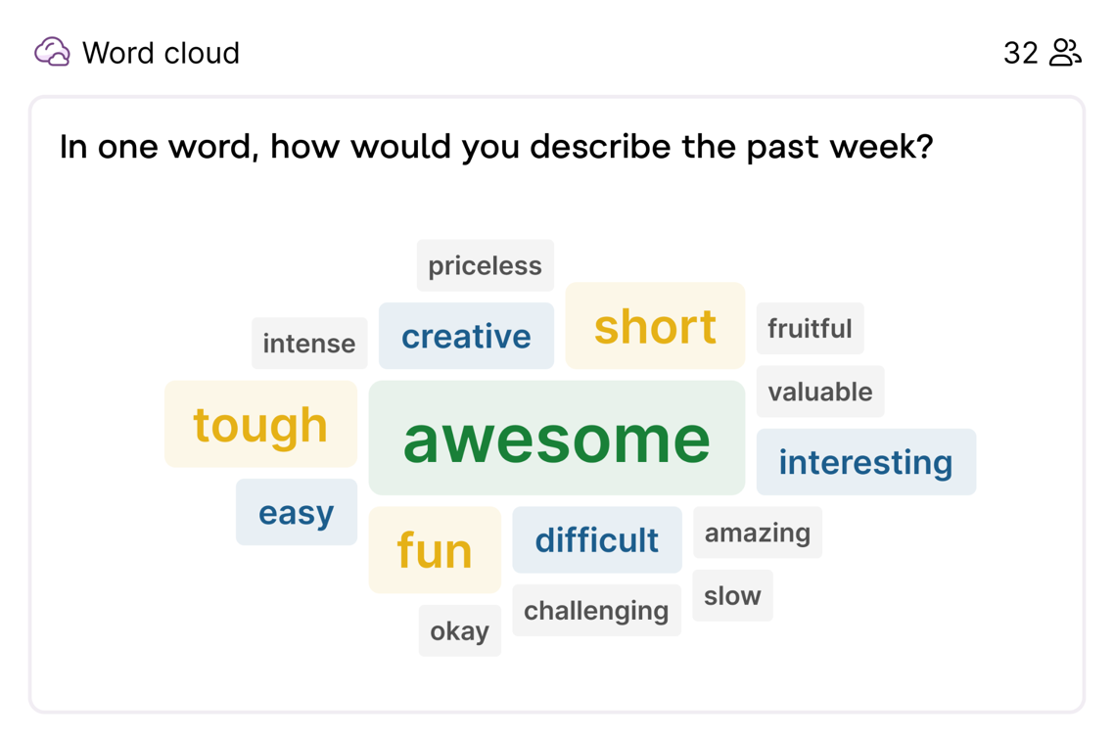
Use an icebreaker to ease into the meeting
Polling
Include everyone right from the start with a simple, fun activity
Encourage participants to be more active throughout the meeting
💡 35 Fun Icebreakers
Notes:
Sharing a few polling examples, starting with using an ice breaker to ease into your meeting
It helps include everyone from the start
And sets an interactive tone, encouraging participants to be more active throughout the meeting

Slide 24
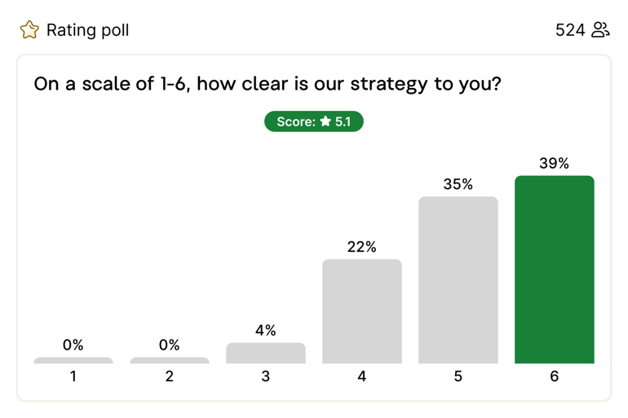
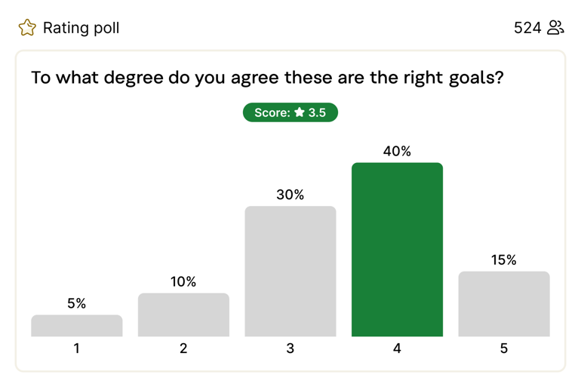
Check for understanding & alignment
Polling
Live checks will reduce future questions - clarifying in the moment eases application of the new info
If people didn’t understand, it’s a chance to explain further
Notes:
Use a poll to check for understanding and alignment.
Live pulse checks can help clarify in the moment and reduce future questions
If the scores are lower, this is your chance to explain further

Slide 25
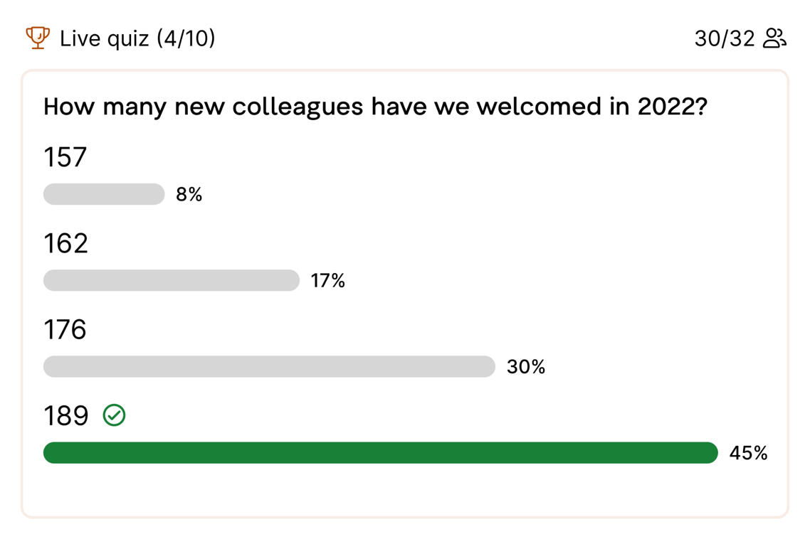
Present or review business updates
Quiz
Make business updates and metrics progress more interesting by presenting them in a quiz
Spark a healthy competition and engage your colleagues effectively
Use the quiz or multiple choice poll to reinforce the learning
Notes:
Switch it up by presenting business updates in a quiz!
This can make business updates more interesting and even exciting
Spark healthy competition between colleagues and engage your attendees in a different way
Use the quiz or multiple choice to reinforce learning in educational and L&D session

Slide 26
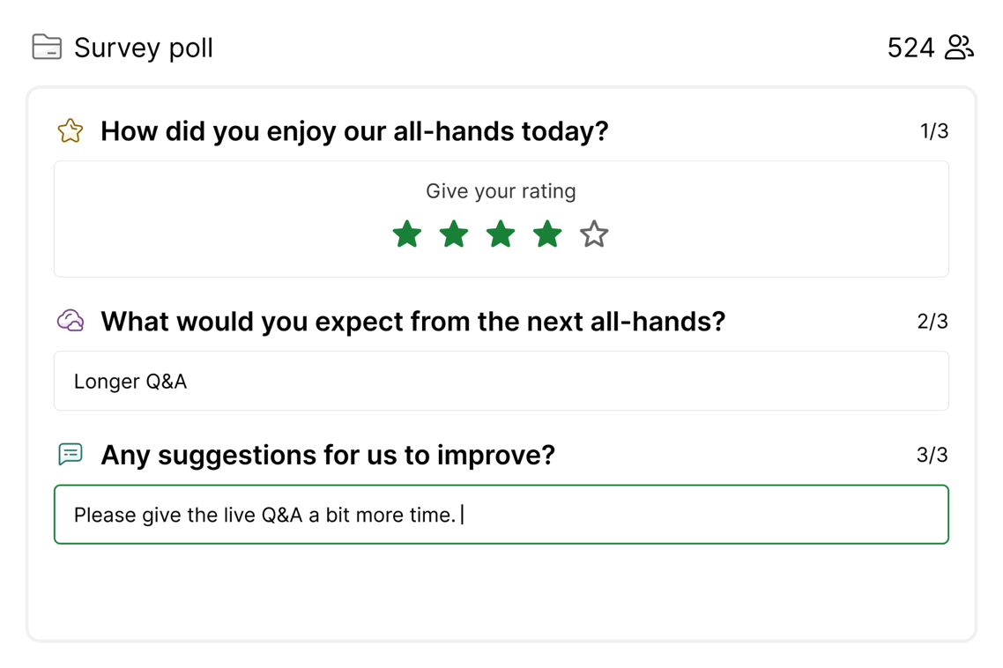
Meeting feedback survey
Survey
Create a simple survey to find out what went well and what areas could be improved
Run the survey 5-10 minutes before the end of the meeting to boost the response rate
Export and analyze the collected data afterwards
Notes:
We highly recommend a meeting feedback survey to see what went well and what can be improved
We suggest to run the survey 5-10 mins before the end of the meeting, this will help boost response rate
You can then work with the collected data afterwards

Slide 27
04 Integrations
Notes:
Let’s take a brief look at Slido’s seamless integrations!

Slide 28
Slido Integrations - info for trainers
3
min
Note: the goal is to raise an awareness of Slido integrations available and point people into the right resources available
Please cover only the integrations that are available at your company and remove the slides about integrations that are not available.

Slide 29
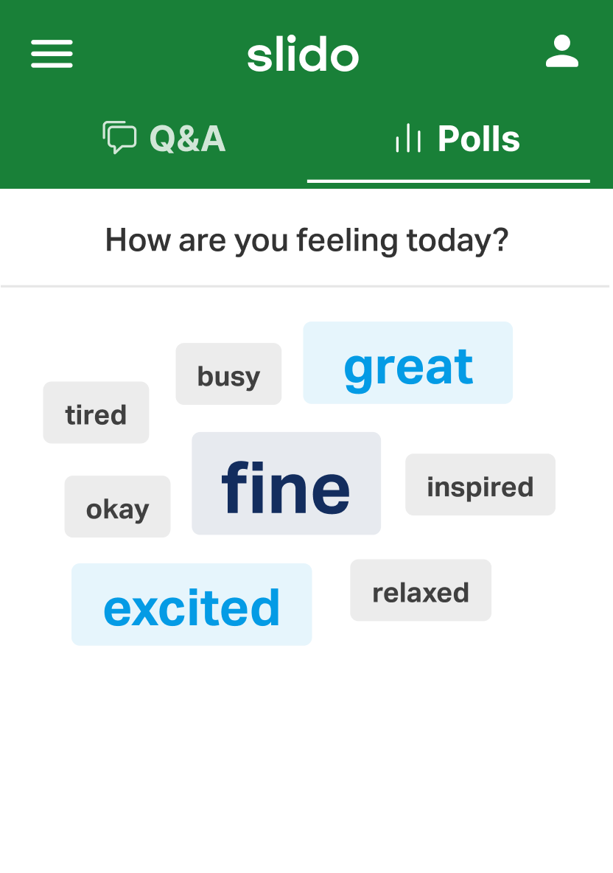
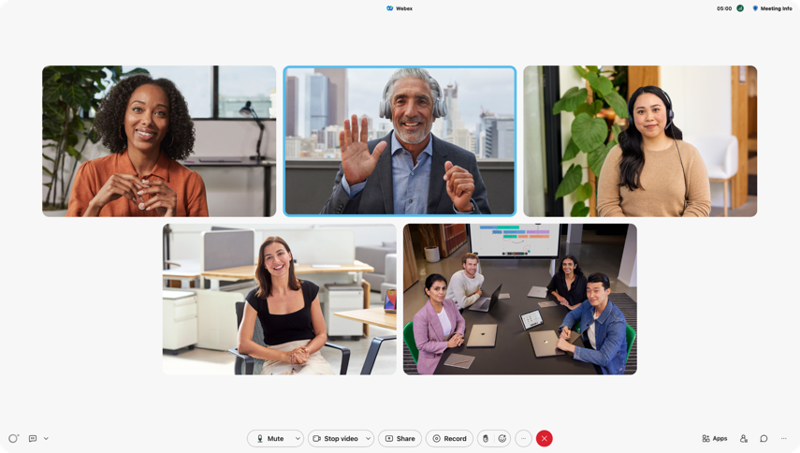
Integrate Slido for a seamless experience
Integrations make it easy to present, manage and join Slido wherever you meet. Try them now and say goodbye to switching. 👋
What do you value most about your culture?
Webex
Teams
Zoom
Inclusivity
Freedom
People
Trust
Flexibility
Diversity
Transparency
Collaboration
PowerPoint
Google Slides
Notes:
We have several integrations with your favorite presentation and video conferencing platforms to seamlessly integration Slido interactions into your meetings!
If your organization uses any of these tools, check with your IT team whether they’ve been enabled for you. Otherwise contact support@slido.com and we can connect you with your Slido POC.

Slide 30
Catch up…
Get Started with Slido for Powerpoint
Get Started with Slido for Teams
Watch recording
Watch recording
📺 Watch at slido.com/webinars
Notes:
Want to learn more? We’ll share these recordings with you in the follow up.

Slide 31
Catch up…
Get Started with Slido for Powerpoint
Get Started with Slido for Webex
Watch recording
Watch recording
📺 Watch at slido.com/webinars
Notes:
Want to learn more? We’ll share these recordings with you in the follow up.

Slide 32
Catch up…
Live Polling for Google Slides
Get Started with Slido for Zoom
Watch video
Watch recording
📺 Watch at slido.com/webinars
Notes:
Want to learn more? We’ll share these recordings with you in the follow up.

Slide 33
05 Quiz time!
Notes:
Alright, let’s see who was paying attention! Time for a quick 3 question quiz…. Get ready!

Slide 34
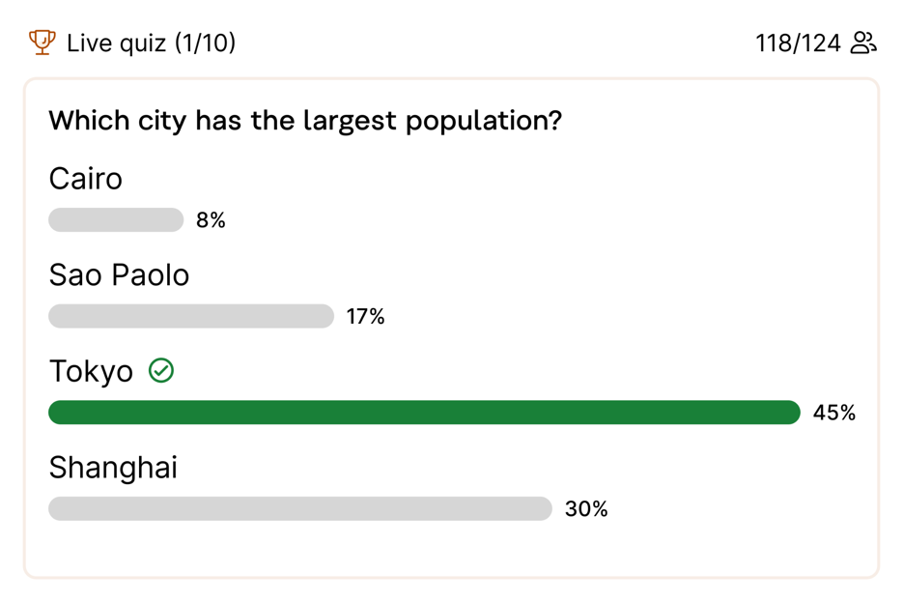
Quiz
Replace this slide with your Slido interaction
Add quiz to your training to make learning more engaging, dynamic and social!

Slide 35
Quiz - info for trainers
3
min
Example Quiz Questions We recommend to setup timer to 20 sec per question
How can Slido enhance audience engagement during meetings and events?
Virtual backgrounds
Real time polls, quizzes, surveys and Q&A
Video editing tools
True or false? You can use Slido outside of a live meeting?
True
False
Which poll types does Slido offer? Choose all that apply.
Multiple Choice
Open Text
Rating
World Cloud
Ranking
Quiz

Slide 36
06 Q&A + Feedback Survey

Slide 37
Q&A - info for trainers
Tips for running your Q&A session:
Dedicate enough time to Q&A
Remind attendees to submit questions throughout the session
Encourage attendees to upvote the questions (especially if you get many)
Read a question out loud (and assign it if you run it with 2+ trainers)
If you were not able to answer all questions live, we recommend you answer them in writing or shoot a short video after the meeting

Slide 38
Q&A
Replace this slide with your Slido interaction

Slide 39
Feedback survey - info for trainers
Activate a feedback survey 10 mins before end of session, toward the end of the Q&A session.
Example Feedback Survey Questions:
Rating 1-6: How valuable was this session for you? (out of 6 stars)
Multiple choice: When do you plan to start using Slido?
In the next 7 days
Within the next month
Within the next quarter
Sometime this year
Open text: Any feedback or comments for the trainers?

Slide 40
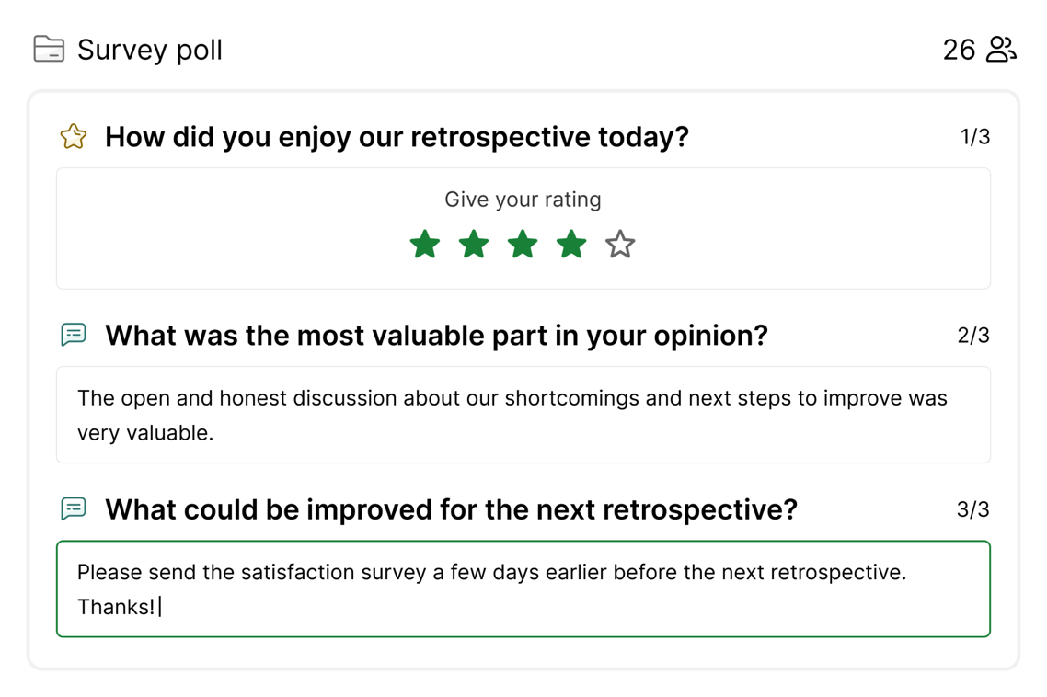
Collect feedback
on the spot
Replace this slide with your Slido interaction
Run a feedback survey 5 to 10 min before the end of the meeting to capture the insights right away
Learn your blind spots and improve your next meeting
💡 Post-meeting Feedback Survey: A Way to Measure Your Meeting’s Effectiveness

Slide 41
Resources 💡

Slide 42
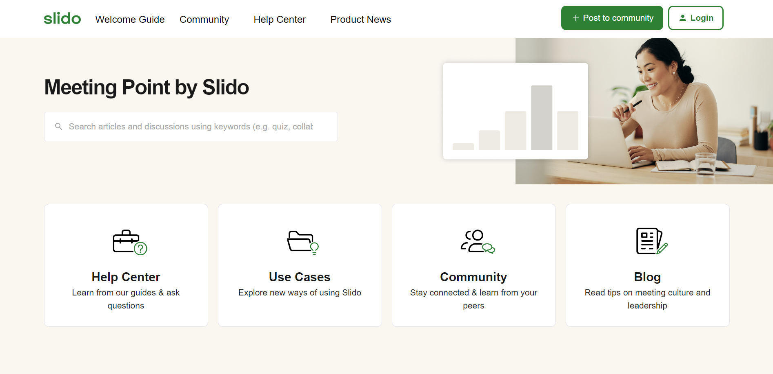
Go to community.slido.com

Slide 43
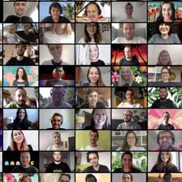
Resources & more…
Slido Help Center & Community https://community.slido.com/
Slido Webinars https://www.slido.com/events
Popular Use Cases https://www.slido.com/use-cases
Integrations https://www.slido.com/features-integrations
Recording & resources will be shared with you after the session 📹
Slido Support Team Available 24/5 live chat or email support@slido.com

Slide 44
Trust as innovation
Trust is the innovation to implement. Learn why and how US senior leaders lead with trust in this day and age. Find actionable strategies and insights in our report on fostering a high-trust culture.
https://www.slido.com/trust-report-2024

Slide 45
Thank you!
Happy Slido-ing 💚

