Slide 1
MARCH TRUCKLOAD MARKET INSIGHTS
Compiled by MoLo Yield
3.31.26

Slide 2
NEAR-TERM OUTLOOK(Q2 2026)
FREIGHT TRENDS
CDL POLICY UNCERTAINTY
SPOT PRICING MARKET
Southern markets should experience a traditional produce season beginning in April as both refrigerated and van capacity tighten.
Tariff policy impacts are expected to persist, despite the Supreme Court overturning IEEPA tariffs.
Housing starts remain soft; manufacturing expanded for the second consecutive month.
Enforcement of language-proficiency and non-domiciled CDL rules could accelerate as Congress debates Delilah’s Law.
Carriers continue to face cost headwinds with wages, equipment costs, and insurance premiums rising sharply since 2022. A sustained spike in fuel costs could force more carriers out of the market in the coming months.
Tender rejections expected to begin rising in May as the market approaches International Roadcheck, Memorial Day and the end of Q2.
Transit delays, increased spot pricing and reduced capacity are expected during International Roadcheck, scheduled for May 12-14.
Spot pricing is increasing as fuel costs rise. Current On-Highway Diesel Fuel Prices climbed 38.6% in March and are now 51.4% higher than the comparable report from 2025.

Slide 3
ADDITIONAL INFORMATION & SUGGESTED LINKS
Jason Miller – Eli Broad Endowed Professor of Supply Chain Management – Michigan State University
https://www.linkedin.com/in/jason-miller-32110325/
Operational Costs of Trucking – American Transportation Research Institute
https://truckingresearch.org/about-atri/atri-research/operational-costs-of-trucking/
Ken Adamo – DAT Chief of Analytics fuel impact commentary
https://www.linkedin.com/posts/ken-adamo-8481611a_the-trucking-rate-mirage-has-reappeared-activity-7438204112321650689-vsnF/?utm_source=share&utm_medium=member_desktop&rcm=ACoAAAcUz84BnQK2z34Aqd_7fe3An4KabP_74Cg
US Energy Information Administration Short-Term Energy Outlook
https://www.eia.gov/outlooks/steo/
Upcoming Key Dates Impacting Capacity and Volumes
Good Friday and Easter Sunday Apr 3, 5
Central CA and Southern AZ Produce Mid Apr
FL and South GA Produce Mid Apr
International Roadcheck May 12-14
Notes:
External

Slide 4
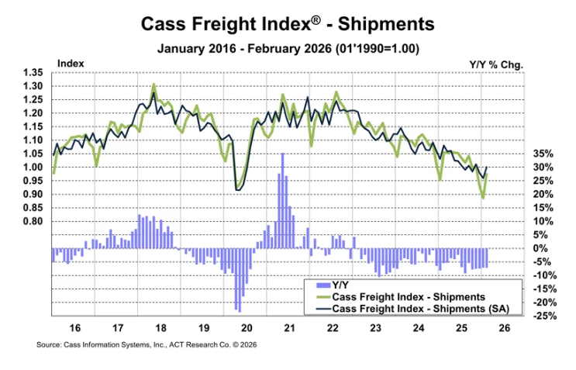
NATIONAL TENDER VOLUMES
CASS FREIGHT INDEX
The shipments component of the Cass Freight Index fell 7.1% YoY but rose 10.4% MoM in February.
In seasonally adjusted (SA) terms, shipments rose 4.3% MoM, recovering much of the weather disruptions of the past two months.
The normal seasonal trend would put the shipments component of the Cass Freight Index down 5% YoY in March.
Data within this index includes all domestic freight modes and is derived from 36 million invoices and $36B in spend processed by Cass annually.

Slide 5
DIESEL FUEL PRICES
Current On-Highway Diesel Fuel Prices as reported by the US Energy Information Administration are 51.4% higher than the corresponding report in 2025. This increase in fuel prices equates to approximately $0.36/mile YoY spot cost impact.
The Brent crude oil spot price rose sharply following the onset of military action in the Middle East. Brent settled at $94 per barrel (b) on March 9, up about 50% from the beginning of the year and the highest since September 2023. Crude oil prices rose as petroleum shipments through the Strait of Hormuz fell, and some Middle East oil production has been shut in.
The EIA forecasts the Brent crude oil price will remain above $95/b over the next two months, before falling below $80/b in the third quarter of 2026 and around $70/b by the end of the year. Prices are expected to average $64/b in 2027. This price forecast is highly dependent on the EIA’s modeled assumptions of both the duration of conflict in the Middle East and resulting outages in oil production.
Source: U.S. Department of Energy

Slide 6
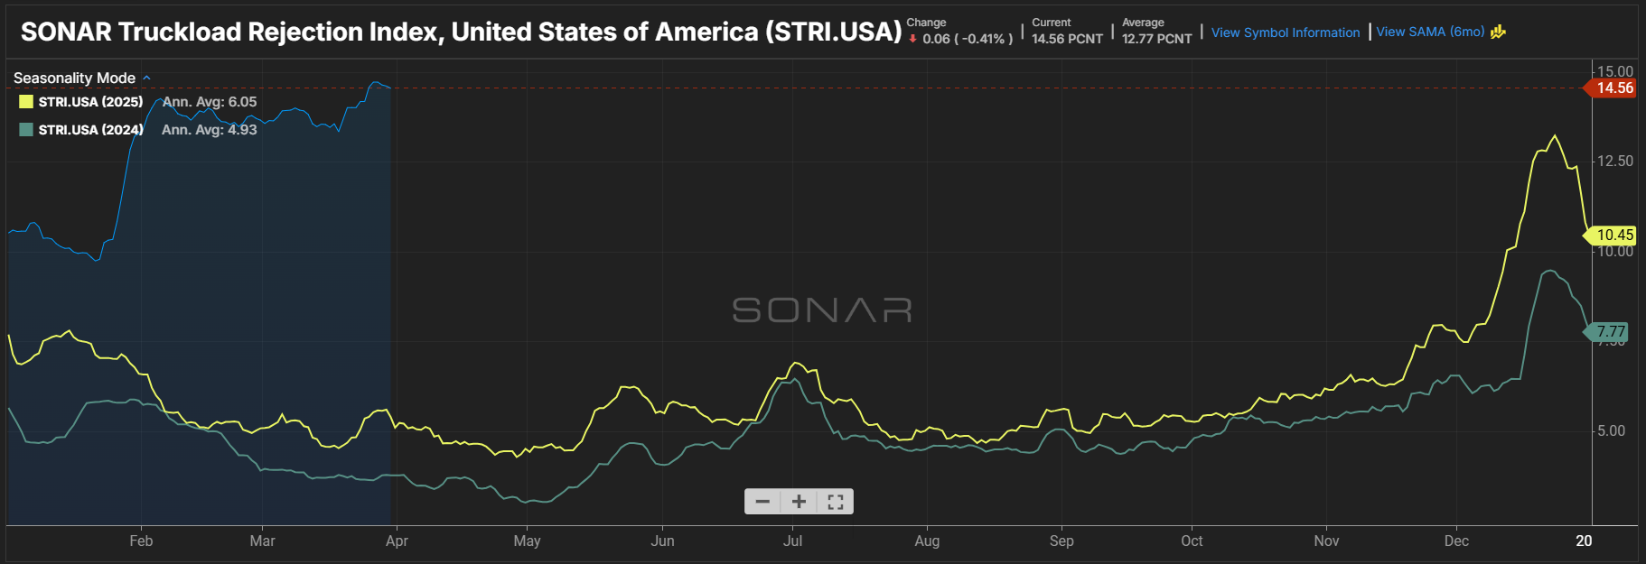
FREIGHT REJECTIONS
The current national tender rejection rate is 14.6%.
Rejection rates are up over the 2024 and 2025 reports of 3.8% and 5.4%, respectively.
Supply-side pressure is driving increased rejections.
Rejection rates in the 6%-8% range indicate a more balanced market.
Source: FreightWaves/SONAR Outbound Tender Volume Index – Symbol OTRI

Slide 7
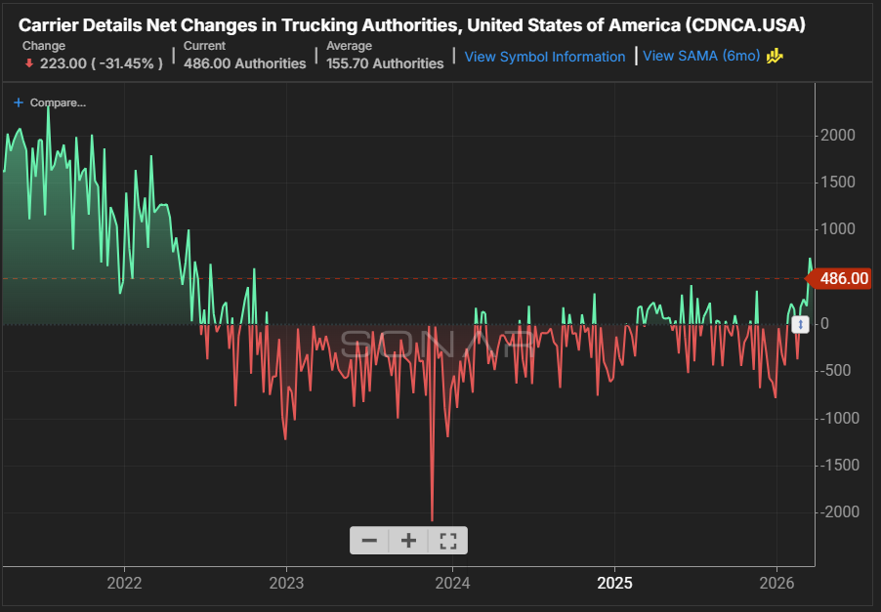
CAPACITY CONDITIONS
FMCSA projects the exit of 194,000 non-domiciled CDL holders over the upcoming years.
The rapid growth of non-domiciled CDL drivers from 2020-2024 with lower associated labor costs prolonged the 2022-2025 freight recession.
FMCSA’s final rule could extend non-domiciled driver attrition to up to five years; however, action from Congress on Delilah’s Law could shrink this timeline to 12 months.
While it is estimated that 30,000 – 40,000 non-domiciled drivers are leaving the market monthly, this alone does not explain overall tightening capacity conditions.
Analysis conducted by Pickett Research utilizing ATRI’s operational cost research indicates the truckload market is in its eleventh consecutive quarter of unprofitability as compared to the spot market.
Carrier costs continue rising—wages, equipment, and insurance remain elevated compared to 2022. A sustained spike in fuel costs could force more carriers out of the market in the coming months.

Slide 8
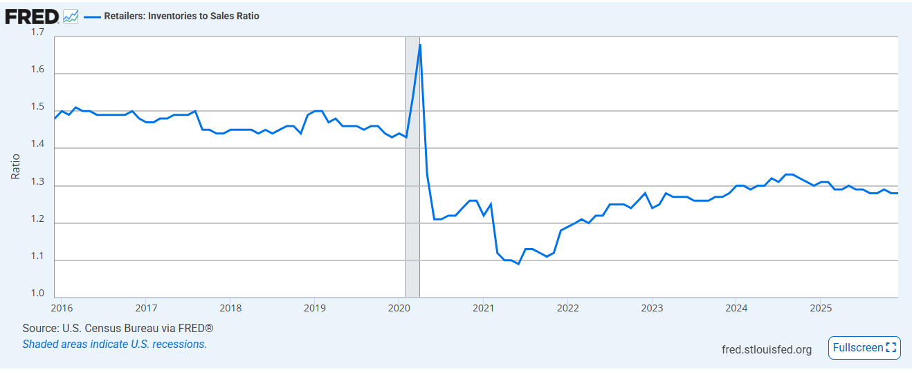
INVENTORY
RETAILERS: INVENTORIES TO SALES RATIO
December inventory to sales remained at 1.28.
Current inventory levels remain within the estimated optimal range.
Retailers appear to be operating a “just in time” inventory strategy.
FRED

Slide 9
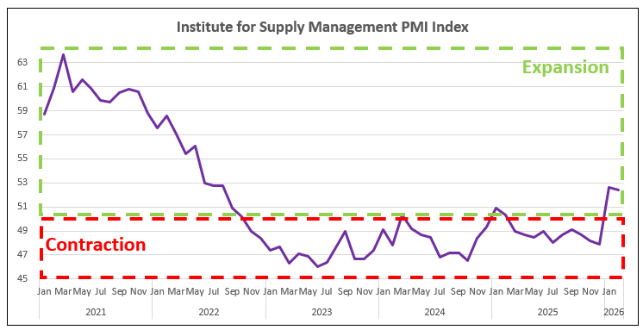
MANUFACTURING
Purchasing Managers’ Index
Measure of the prevailing direction of economic trends in manufacturing.
Manufacturing expanded in February for the second month following ten consecutive months of contraction.
The New Orders Index expanded for the first time since August, with a reading of 55.8%, down 1.3 percentage points over January.
Survey respondents continue to cite tariff impacts, cost increases, high interest rates and general economic uncertainty as factors driving decision-making.

