Slide 1
January
Truckload Market Insights
Compiled by MoLo Yield
1.29.26

Slide 2
Short-Term Outlook
Volume Outlook
Capacity Outlook
Pricing Outlook
Q1 volumes typically trend flat to down, and normal seasonal/geographic patterns are expected.
Winter weather may cause short-term surges, as network recovers; Southern states are vulnerable to weather-related disruptions.
Lunar New Year (Feb) slows West Coast imports, with impacts extending into April.
Winter weather and CDL policy will shape Q1 capacity.
Winter Storm Fern driving higher tender rejections, spot activity, and rates.
Weather in normally soft Q1 markets (TX/GA/Carolinas) creates volatility.
Additional cold and disruptions expected, increasing backlog and spot volatility.
FMCSA projects ~194K CDL exits (~5% of drivers) over two years; 11,500 already removed.
Spot rates decline outside weather-impacted regions.
Tender rejections typically fall from mid-January through Q1.
Rates expected to soften until late-March seasonal activity increases.

Slide 3
Near-Term Outlook (Q2 2026)
Freight Trends
CDL Policy Uncertainty
Spot Pricing Market
Southern markets should experience a traditional produce season beginning in April as both refrigerated and van capacity tighten.
Tariff policy impacts are expected to persist, with the National Retail Federation noting that resolution is unlikely in the near term.
Manufacturing activity and new housing starts are projected to remain subdued in the near term. ​
Matt Muenster, chief economist of Breakthrough Fuel, estimates that about 300 to 400 drivers on average have been removed from service nationwide each week since the enforcement of the English language proficiency and non-domiciled CDL holder rules commenced.
Carriers continue to face cost headwinds with wages, equipment costs, and insurance premiums rising sharply since 2022.
Tender rejections expected to begin rising in May as the market approaches International Roadcheck, Memorial Day and the end of Q2.
Transit delays, increased spot pricing and reduced capacity are expected during International Roadcheck, scheduled for May 12-14
Sustained improvements in demand and increased freight volumes will be necessary to drive rate recovery and broader market stabilization.

Slide 4
Rate Trends
Spot Van
Contract Van
The average DAT 7-Day van spot rate for December rose 8.8% higher than the corresponding month in 2024, with spot rates showing YoY growth for the 17th consecutive month.
Through 27 days, January DAT Spot Van rates are 4.2% higher than December and 10.0% above January 2025
December Contract linehaul rates reported 0.9% YoY growth on a 0.9% sequential increase from November.
Contract rates appear to be slowly moving from the cycle floor and are expected to slowly increase over the upcoming quarters.
Generally, contract rates trail spot performance by 60 to 90 days.

Slide 5
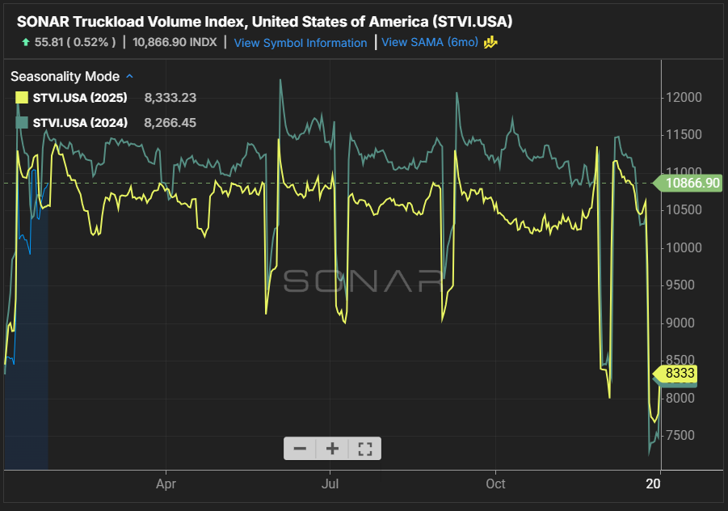
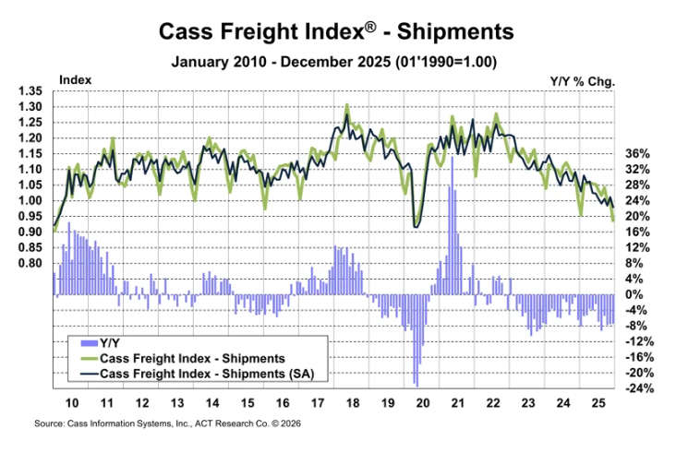
Freight Volumes
Sonar Outbound Tender Volume Index
Cass Freight Index
Current freight levels are 2.8% above the 2025 posting and -5.4% behind 2024 levels.
Cass Freight Index fell 7.2% m/m in December, or 3.2% m/m in seasonally adjusted (SA) terms, reaching a new cycle low.
Shipments declined 7.5% y/y in December compared to a full-year decline of 6.1%.

Slide 6
Diesel Fuel Prices
Current On-Highway Diesel Fuel Prices as reported by the US Energy Information Administration are 2.3% lower than the corresponding report in 2024 and 10.3% below 2023’s cost. This decrease in fuel prices equates to approximately $0.02/mile YoY spot cost impact.
The EIA expects oil prices to decline in 2026 as global production outpaces global demand, leading to rising oil inventories. Inventories are projected to keep increasing into 2027, though at a slower rate. The agency forecasts that Brent crude will average $56 per barrel in 2026—about 19% lower than in 2025—and then average $54 per barrel in 2027. While crude prices are expected to soften in the coming months, the EIA notes that OPEC+ production policies and China’s ongoing inventory accumulation will help limit the extent of those declines.

Slide 7
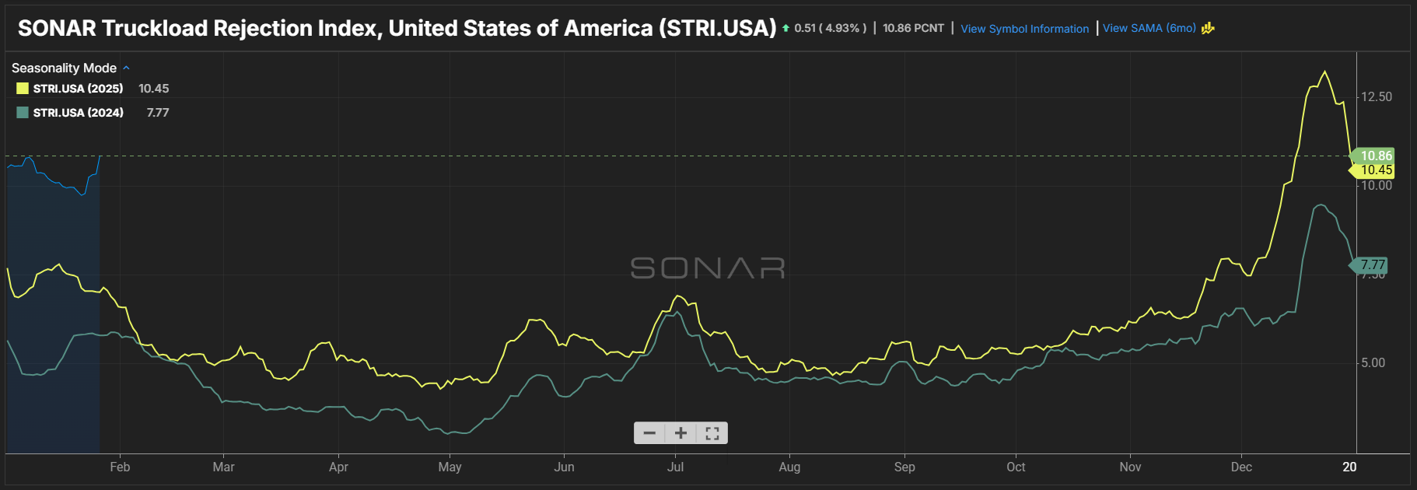
Freight Rejections
The current national tender rejection rate is 10.9%.
Rejection rates are up over the 2024 and 2025 reports of 5.8% and 7.0%, respectively, similar shipment volumes.
2026 rejection rates rose on weather disruptions last week, but they are expected to trend down through the remainder of Q1.
Rejection rates in the 6% - 8% range indicate a more balanced market.
Increasing rejection rates indicate a return to normality within the market as it enters a more balanced phase.
Source: FreightWaves/SONAR Outbound Tender Volume Index – Symbol OTRI

Slide 8
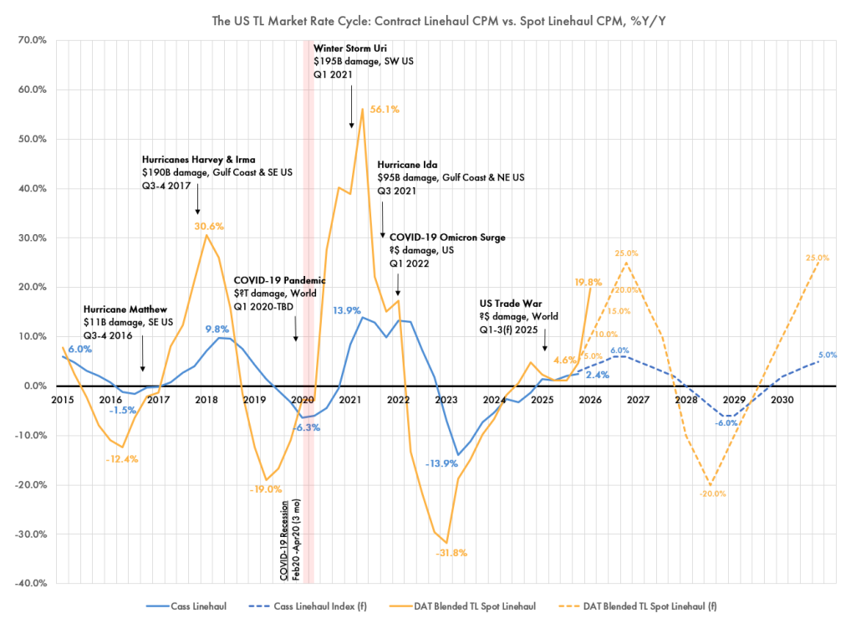
Industry Commentary
Q4 2025 spot linehaul rates were +4.6% Y/Y, nearly matching the forecast of +5% with December 2025 showing a +13.1% M/M spike in spot rates.
Q1 2026 rates are forecasted to increase +10% Y/Y, though early January data shows a much hotter +19.8% Y/Y. Analysts believe the market may be establishing a new breakeven point as marginal carriers exit.
Demand indicators are sending mixed signals. Overall consumption rose 2.6% Y/Y in Q3 2025. Services remain strong, but goods consumption, especially durables, are weakening. Industrial production rose +2.2% Y/Y in Q4, the strongest increase in years. Inventories remain at historically flat levels, providing no clear bullish signal yet.
Regulatory crackdowns on non-compliant drivers are expected to accelerate supply exits and tighten capacity.
Source: The Pickett Line

Slide 9
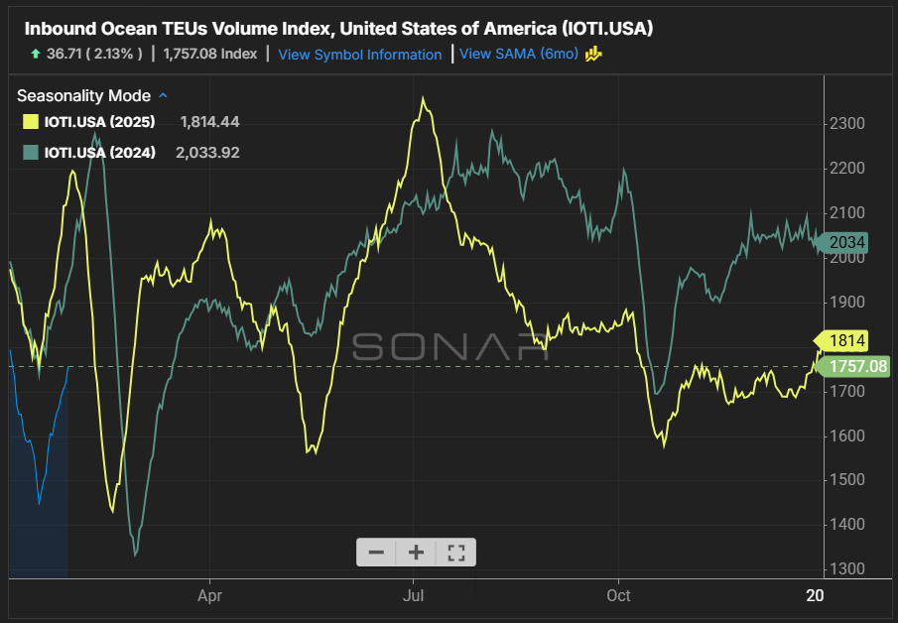
Imports
Imports continue to run below the three-year trend as tariff uncertainty looms for the foreseeable future.
Container volumes are expected to climb in advance of the Lunar New Year on February 17.
The Supreme Court continues to defer its ruling on the legality of IEEPA tariffs, suggesting that the case could be delayed for several more weeks — even months.
The data on the left highlights the 14-day rolling average of ocean freight departing the port of origin. Impacts of this volume is generally felt in port markets within 30-45 days as maritime orders are converted to domestic transportation.
Source: FreightWaves/SONAR Outbound Tender Volume Index - Symbol IOTI

Slide 10
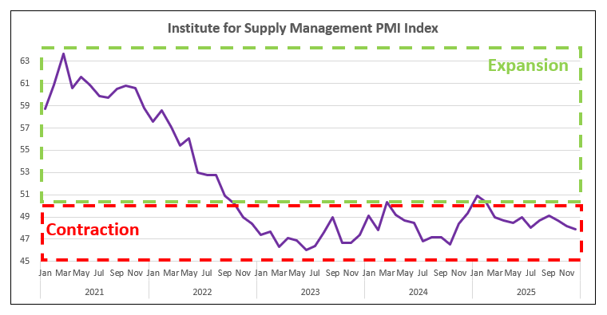
Manufacturing
Purchasing Managers’ Index
Measure of the prevailing direction of economic trends in manufacturing.
Manufacturing contracted in December for the ten consecutive month and the lowest point in 2025. This followed two months of expansion after 26 straight months of contraction.
Survey respondents continue to cite tariff impacts, cost increases, high interest rates and reduced consumer spending as factors.
New Orders Index remained in contraction for the fourth consecutive month after reporting one month of expansion in August.

