Slide 1
February Truckload Market Insights
Compiled by MoLo Yield
2.26.26

Slide 2
Short-Term Outlook
Volume Outlook
Capacity Outlook
Pricing Outlook
Q1 freight volumes expected to remain soft, following normal seasonal and geographic patterns.
Winter weather may cause short-term surges, as network recovers; Southern states are vulnerable to weather-related disruptions.
Lunar New Year (Feb) slows West Coast imports, with impacts likely extending into April.
Winter weather and CDL policy may shape Q1 capacity.
The Northeast bomb cyclone may drive significant rate and tender volatility over the next week.
Spot pricing should continue easing in stable regions until late-March end-of-quarter demand increases.
FMCSA projects ~194K CDL exits (~5% of drivers) over two years; 11,500 already removed.
Spot pricing should continue easing in stable regions until late March.
Tender rejections typically fall from mid-January through Q1, remain elevated due to weather-driven capacity disruptions.

Slide 3
Near-Term Outlook (Q2 2026)
Freight Trends
CDL Policy Uncertainty
Spot Pricing Market
Southern markets should experience a traditional produce season beginning in April as both refrigerated and van capacity tighten.
Tariff policy impacts are expected to persist, despite the Supreme Court overturning IEEPA tariffs.
Housing starts remain soft; manufacturing shows early signs of improvement, but sustainability is unclear.
Enforcement of language-proficiency and non-domiciled CDL rules is removing 300 to 400 drivers per week from service.
Carriers continue to face cost headwinds with wages, equipment costs, and insurance premiums rising sharply since 2022.
Tender rejections expected to begin rising in May as the market approaches International Roadcheck, Memorial Day and the end of Q2.
Transit delays, increased spot pricing and reduced capacity are expected during International Roadcheck, scheduled for May 12-14.
2026 spot rate forcecasts show pricing above 2025 levels and the five-year average.

Slide 4
Additional Information & Suggested Links
What the Supreme Court's tariff ruling changes, and what it doesn't – Peterson Institute for International Economics
https://www.piie.com/blogs/realtime-economics/2026/what-supreme-courts-tariff-ruling-changes-and-what-it-doesnt
Federal crackdown pulls thousands of foreign truckers off roads – Wall Street Journal
https://www.msn.com/en-us/news/us/federal-crackdown-pulls-thousands-of-foreign-truckers-off-roads/ar-AA1UL10V
Cass Transportation Index Report – January 2026
https://www.cassinfo.com/freight-audit-payment/cass-transportation-indexes/january-2026
Jason Miller – Eli Broad Endowed Professor of Supply Chain Management – Michigan State University
https://www.linkedin.com/in/jason-miller-32110325/
Operational Costs of Trucking – American Transportation Research Institute
https://truckingresearch.org/about-atri/atri-research/operational-costs-of-trucking/
Upcoming Key Dates Impacting Capacity and Volumes
Eid al-Fitr Mar 19 & 20
Good Friday Apr 3
Easter Sunday Apr 5
International Roadcheck May 12-14
Notes:
External

Slide 5
Rate Trends
Spot Van
Contract Van
The average DAT 7-Day van spot rate for January rose 9.7% higher than the corresponding month in 2025, with spot rates showing YoY growth for the 18th consecutive month.
Through 22 days, February DAT Spot Van rates are 3.2% higher than January and 21.6% above February 2025 (weather-impacted).
Rates will reset lower as capacity and shipping stabilize following Q1 weather disruptions; however, spot pricing is expected to run higher than the five-year avg rate.
January Contract linehaul rates reported 2.5% YoY growth on a 2.7% sequential increase from December.
Through 22 days, February DAT Contract Van rates are showing similar YoY growth (+3.2%).
Contract rates are expected to increase over the upcoming quarters.
Generally, contract rates trail spot performance by 60 to 90 days.

Slide 6
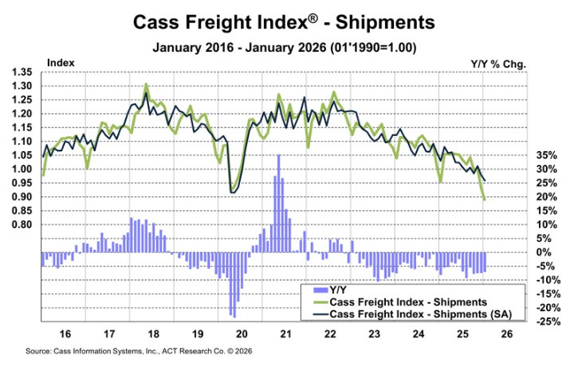
Freight Volumes
Cass Freight Index
The shipments component of the Cass Freight Index fell 7.1% y/y and 4.9% sequentially in January, or 2.0% m/m in seasonally adjusted (SA) terms, reaching a new cycle low.
The market is beginning to firm, not because demand is rising, but because supply is tightening – evidenced by higher tender rejections, more spot activity, and increasing operating costs.
Data within this index includes all domestic freight modes and is derived from 36 million invoices and $36B in spend processed by Cass annually.

Slide 7
Diesel Fuel Prices
Current On-Highway Diesel Fuel Prices as reported by the US Energy Information Administration are 1.3% higher than the corresponding report in 2025 and 9.7% below 2024’s cost. This increase in fuel prices equates to approximately $0.01/mile YoY spot cost impact.
The Brent crude oil price averaged $67 per barrel (b) in January, the highest since September 2025, as weather-related events disrupted the global crude oil supply and escalating tensions with Iran put upward pressure on prices. Despite these short-term events, the EIA expects oil prices will decline in 2026, as global oil production exceeds global oil demand, causing oil inventories to rise. The EIA forecasts the Brent crude oil price will average $58 per barrel (b) in 2026 and $53/b in 2027.

Slide 8
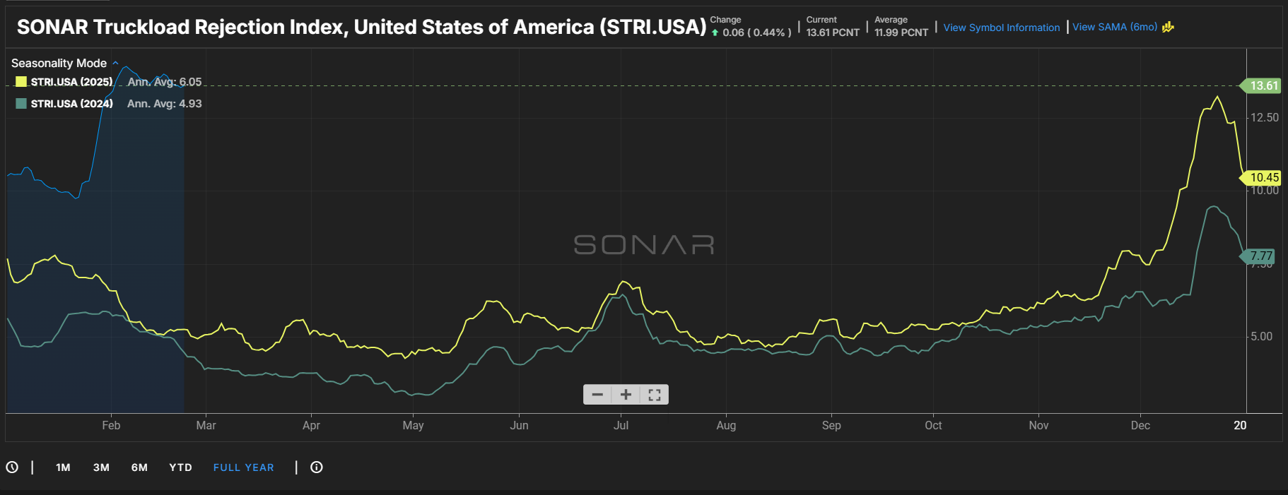
Freight Rejections
The current national tender rejection rate is 13.6%.
Rejection rates are up over the 2024 and 2025 reports of 4.6% and 5.3%, respectively, similar shipment volumes.
2026 rejection rates rose as Winter Storm Fern impacted southern markets and remained sticky through February.
Rejections are expected to trend down through the rest of Q1 but remain elevated relative to normal seasonal levels.
Rejection rates in the 6%-8% range indicate a more balanced market.
Source: FreightWaves/SONAR Outbound Tender Volume Index – Symbol OTRI

Slide 9
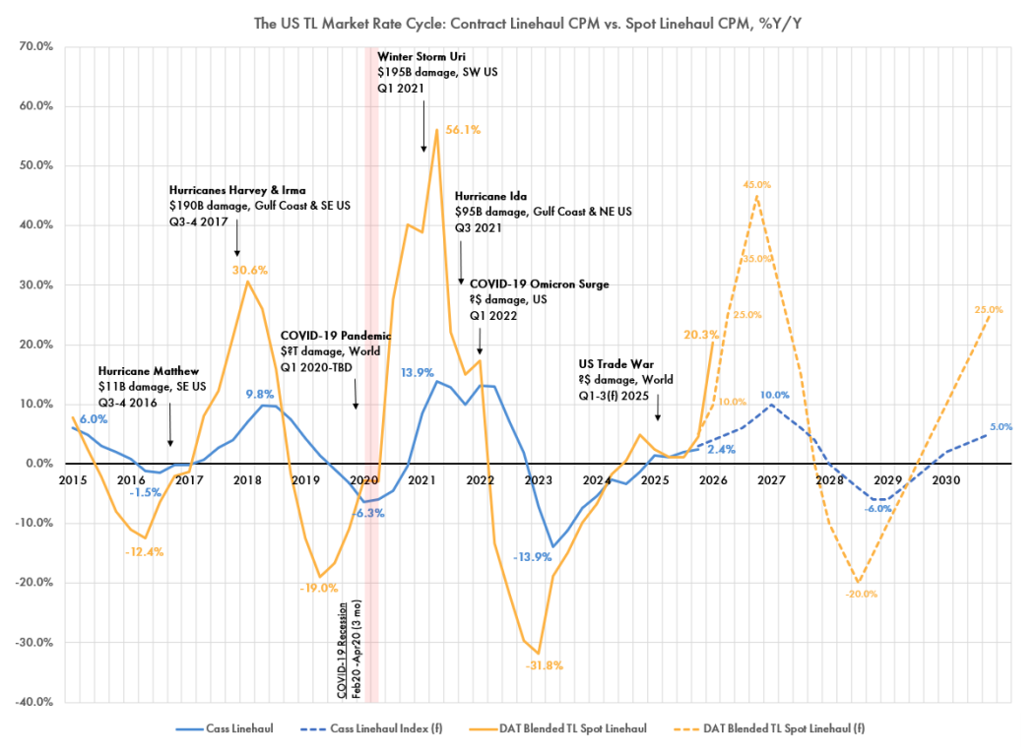
Industry Commentary
Q1 2026 is opening far hotter than expected at +20.3% Y/Y, more than double prior projections. Analysts believe the market may be establishing a new breakeven point as marginal carriers exit.
Regulatory crackdowns on non-compliant drivers are expected to accelerate supply exits and tighten capacity. According to Pickett Research, enforcement is rapidly removing low-cost capacity that previously depressed rates.
Supply contraction—not demand growth—is driving the recovery, and regulatory forces are accelerating the shift.
Spot TL Linehaul Index
Previous peak forecast: +25% Y/Y by Q4 2026.
New forecast: +45% Y/Y by Q4 2026.
With Q1 2026 already up +20%, the market is “halfway there.”
Contract TL Linehaul (Cass Index)
Expected to reach +10% Y/Y by Q1 2027, following spot’s lead by several quarters.
Source: The Pickett Line

Slide 10
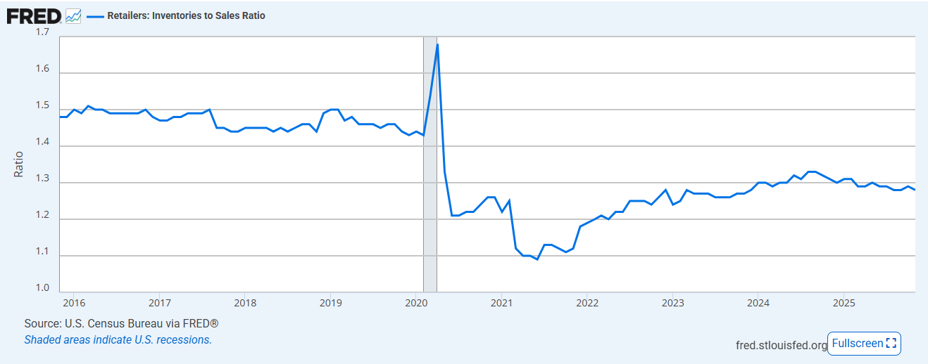
Inventory
Retailers: Inventories to Sales Ratio
November inventory to sales decreased to 1.28 down from 1.29 in October.
Current inventory levels remain within the estimated optimal range.
Retailers appear to be operating a “just in time” inventory strategy.
FRED

Slide 11
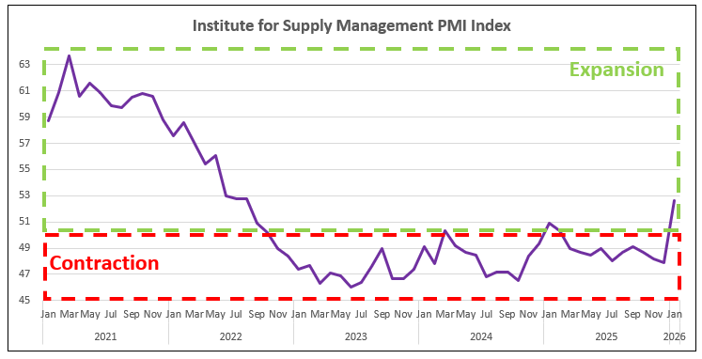
Manufacturing
Purchasing Managers’ Index
Measure of the prevailing direction of economic trends in manufacturing.
Manufacturing expanded in January following ten consecutive months of contraction.
The New Orders Index expanded for the first time since August, with a reading of 57.1%, up 9.7 percentage points over December’s 47.4% reading and its highest since February 2022.
Survey respondents continue to cite tariff impacts, cost increases, high interest rates and general economic uncertainty as factors driving decision-making.

