Slide 1
Say Sounds (A–B)
Say Sounds
Phonemic Awareness Listen to the sounds or word parts as your teacher says a word slowly. Then say the word.
Letter/Sound Associations Look at the letter. Say the sound.
  t s e l j
  u i h o a
  f a u d i
  l e m o b
  z e w g n

Slide 2
Read Words (C)
Read Words
New Words Say the sound. Sound out the word. Read the word.
  Bill huff dill
  doll less loss
  fuss mess hiss
  Jill mutt boss
  fill Bess fell

Slide 3
Read Words (D)
Word Families Read down. Read rapidly.
bell
tell
fell
well
sell
bass
mass
pass
Cass
sass
mill
sill
gill
Jill
till
10 Second Challenge
Cold Timing words read
Practice words read
Hot Timing words read

Slide 4
Read Words (E–F)
Multisyllabic Challenge Words Sound out the syllables. Read the whole word.
sunlit tennis suffix sadness unless
High-Frequency Words Say. Spell. Read.
  be have into with went
  play her down children said

Slide 5
Spell Words (G)
Spell Words
Spelling Journal Turn to the Spelling Journal on page 153.

Slide 6
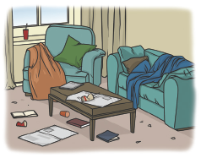
Read Text (H)
Read Text
Decodable Sentence Expansion Read each set of sentences. Then expand the last sentence by telling when or where. Select the picture that goes with each set.
  Liz will fill the box.
  Liz will fill the box and bag.
  Liz and her mom will fill the box and bag
  with dolls.
  . . . , Liz and her mom will fill the box and bag _____
  with dolls.

Slide 7
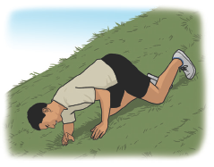
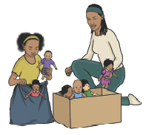
Read Text (H) — cont’d
  The den is a mess.
  The den is a very big mess.
  The den is a very big mess, and we will fix it.
  . . . , the den is a very big mess, and we will fix it. _____
  Jeff ran.
  Jeff ran on the hill.
  Jeff ran on the hill and fell.
  . . . , Jeff ran on the hill and fell. _____

Slide 8
Independent Practice (I)
Independent Practice
More Practice 1 Fill in each blank with the best word.
  1. Jill and ________ sat in the cabin.
Bill toss pass
  2. The man will ________ rugs.
sill sell fuss
  3. Fill my cup with a little ________ water.
less boss mitt
  4. Jan is Will’s ________ on the job.
toss boss bell
  5. Are the children ________?
ill hill tell

Slide 9
Independent Practice (I) — cont’d
  6. The hen sat on an ________.
doll egg will
  7. Jeff will ________ his mom.
jazz well kiss
  8. The big pig ran down the ________.
hill miss less
  9. Did you get water from the ________?
tell well fill
  10. Dad put a ________ on the cat.
till hiss bell

Slide 10
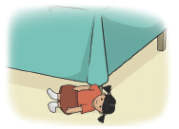


Independent Practice (J)
More Practice 2 Draw a line under the sentence that goes best with each picture.
1. The box fell off the cot.
The doll fell off the bed.
2. Bill fed the mutt.
The cat will hiss at the mutt.
3. Bess plays with her mitt.
Bess plays with her doll.

Slide 11

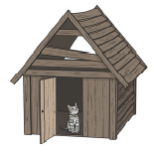
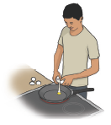
Independent Practice (J) — cont’d
  4. The hut is a big mess.
The cabin is on the hill.
  5. The little kitten is in the hut.
The little pup is in the bed.
6. Jeff will fill the can with dill.
Jeff will fill the pan with eggs.

Slide 12
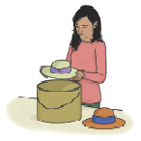

Independent Practice (J) — cont’d
7. Her boss will fuss at the loss.
Ann fills the hatbox with hats.
8. The children play with the kitten.
The children play tennis.

