Slide 1
Say Sounds (A–B)
Say Sounds
Phonemic Awareness Listen to the word your teacher says. Then say the sounds or word parts in the word.
Letter/Sound Associations Look at the letters. Say the sounds.
o ch m b p
s i d th u
sh t a r ck
e f l n g

Slide 2
Read Words (C)
Read Words
New Words Say the sound. Sound out the word. Read the word.
nest lamp must
last bump fist
sent cast send
desk went fund
sand mask mint

Slide 3
Read Words (D)
Word Families Read down. Read rapidly.
nest
best
rest
test
west
sent
went
tent
bent
rent
and
sand
hand
band
land
10 Second Challenge
Cold Timing words read
Practice words read
Hot Timing words read

Slide 4
Read Words (E–F)
Review Words Read a line of words. When your teacher gives a meaning, circle the correct word.
tuck tap pat pen
math loss sit kick
peck kit rash red
miss moth lock rod
Multisyllabic Challenge Words Sound out the syllables. Read the whole word. disgust contest discuss pocket jackpot

Slide 5
Read Words (G)
High-Frequency Words Say. Spell. Read.
have very are they you
long see her look children

Slide 6
Read Sentences (H)
Read Sentences
Sentences Read the sentences with phrasing.
Ann put the mint in her pocket.
Did you pack the lamp in a big box?
Beth went to get snacks for her class.
Max and Dev are set to put pens on the desks.
Can you see the little nest on top of the hut?

Slide 7
Spell Words (I)
Spell Words
Spelling Journal Turn to the Spelling Journal on page 155.

Slide 8
Decodable Text (Passage 1)
Decodable Text Read each passage. Answer your teacher’s questions and select the picture that goes with each passage.
Passage 1
The Lost Fish
Teacher Reads When people fish for fun, they usually use a fishing rod.
However, when people catch fish to sell, nets are used. Let’s learn what
happened on one fishing outing.
Some men go to the pond to fish with nets. They intend to fish for bass. The men cast the nets into the water and get a lot of fish. The fish cannot jump from the nets.
The men put the fish in a big bucket. Then a man bumps into the bucket and dumps the fish back into the pond!
“No! No! We just lost the fish!” the man said.

Slide 9
Comprehension Questions Passage 1
What do the men use to catch fish?
The men use ________________.
Why were the fish in the bucket lost?
The fish in the bucket were lost because ________________.

Slide 10
Decodable Text (Passage 2)
Passage 2
In a Cast
Teacher Reads Cal, the main character in this story, has a broken leg, so
he cannot explore the nearby woods with his best friends.
Cal is upset. His leg is in a cast, and he must rest and let his leg mend. He cannot be with his best pals, Ken and Russ.
Cal and his pals have a lot of fun. They invent fun contests, such as the hunt for big bugs and the best jump ramp. Cal will miss the fun they have with contests. He bets his pals will miss him as well.
Get well, Cal.

Slide 11
Comprehension Questions Passage 2
Why was Cal unable to have fun with Ken and Russ?
Cal was unable to have fun with Ken and Russ because ________________.
What do Cal and his friends usually do together?
Cal and his friends usually ________________.

Slide 12
Decodable Text (Passage 3)
Passage 3
Funds for Camp
Teacher Reads The children at the school in this passage love going to Outdoor Camp each spring. The school is planning a picnic to raise money for the camp. Let’s learn about the event.
The school intends to get funds to send kids to camp. The picnic will be held in a big tent. A band will play in the tent. The school will have fun contests for children.
People must get tickets to go to the picnic. Janet will sell tickets. She will ask her mom and dad to lend a hand.
With funds, a lot of kids will go to camp!

Slide 13
Comprehension Questions Passage 3
Why did the school want to get funds (money)?
The school wanted to get money so ________________.
How will Janet help?
Janet will help by ________________.

Slide 14

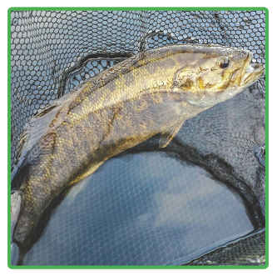
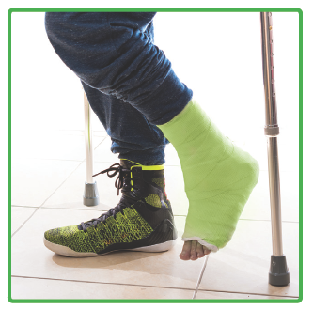
Picture Match
Passage ______
Passage ______
Passage ______

Slide 15
Independent Practice (K)
Independent Practice
More Practice 1 Read each group of words. The groups of words are not in the correct order. Change the order of the words to make a sentence. Write each sentence on the line. Read each sentence.
1. will dig Kit and Nat in the sand
2. in the nest The egg will fit

Slide 16
Independent Practice (K) — cont’d
3. Tom the box will send
4. must win the contest Bess
5. on the dock The band plays
6. went to his desk Bob

Slide 17
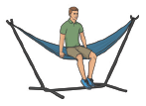


Independent Practice (L)
More Practice 2 Draw a line under the sentence that goes best with each picture.
1. The man can put up a tent.
The man sat on the hammock.
2. Kat must mend the net.
Kat has a cast on her leg.
3. The ticket is in Jack’s pocket.
The children got six tickets.

Slide 18
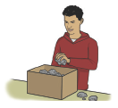


Independent Practice (L) — cont’d
4. Bill plays in a band.
Bill puts rocks in the box.
5. They have fun in the sand.
They jump off a log.
6. Rick has cash in his pocket.
Rick can dust his desk.

Slide 19


Independent Practice (L) — cont’d
7. The mask will fit Ron.
The lamp will fit in the box.
8. Nan has a puppet on her fist.
Nan will sell the fish.

