Slide 1
Say Sounds (A–B)
Say Sounds
Phonemic Awareness You will blend and segment sounds as you read and spell words.
Letter/Sound Associations Look at the letters. Say the sounds.
i_e ay igh i
ai ea e oa
ee a i a_e
oa igh ow o
o_e ow a ay

Slide 2
Read Words (C)
Read Words
New Words Say the sound. Sound out the word. Read the word.
bike brag save
blame glob globe
lick vase like
mill mile shape
cave whip wide
slid broke slide
Irregular Word: done

Slide 3
Read Words (D)
Word Families Read down. Read rapidly.
dive
hive
five
drive
strive
make
cake
lake
shake
flake
hole
mole
pole
sole
stole
10 Second Challenge
Cold Timing words read
Practice words read
Hot Timing words read

Slide 4
Read Words (E–F)
Review Words Read a line of words. When your teacher gives a meaning, circle the correct word.
flow stain stop clap
steam soap coat nail
cot blown clean right
fight fit float speech
Words with Endings Use the reading rules to pronounce the words. 1. moping 2. mopping 3. saving 4. flipping 5. biking 6. hitting 7. sliding 8. liking 9. shopping 10. stopping

Slide 5
Read Words (G–H)
Multisyllabic Challenge Words Sound out the syllables. Read the whole word.
lifeboat capsize pipeline drainpipe candidate
infant indicate upright combine tailbone
High-Frequency Words Say. Spell. Read.
my by why fly dry
what who into you they

Slide 6
Read Sentences (I)
Read Sentences
Sentences Read the sentences with phrasing.
Who sent you a thank-you note by mail?
Why did Calvin cry when you spoke to him last Sunday?
The pipeline runs for miles to bring water to the dry land.
The red fox will bite into the meat with its strong teeth.
What did the cat do when you dropped the vase and it broke?

Slide 7
Spell Words (J)
Spell Words
Spelling Journal Turn to the Spelling Journal on page 199.

Slide 8
Decodable Informative Text (Part 1)
Decodable Informative Text Read each part. Answer your teacher’s questions and select the picture that goes with each part.
We Need Bones
Part 1
Teacher Reads The human skeleton, our body’s bones, has many jobs, or functions. Without bones, our bodies would have no shape.
11
21
32
Why are there bones in the body? Bones set up the body’s shape. They help the body stay upright and help it do things such as run and jump. Bones keep things safe inside the body.

Slide 9
Decodable Informative Text (Part 1) — cont’d
36
46
57
67
77
As you grow, bones grow. An infant begins life with close to 300 bones. But an adult has just 206 bones. What happens? As an infant grows, so do its bones. Some of the bones combine with bones right next to them. That’s why an adult ends up with 206 bones.

Slide 10
Comprehension Questions Part 1
What is one important thing that bones do for our bodies?
One important thing that bones do for our bodies is they ________________.
Why do infants have more bones than adults?
Infants have more bones than adults because ________________.

Slide 11
Decodable Informative Text (Part 2)
Part 2
Teacher Reads Each bone, or group of bones, has a specific job, or function in the body. Read on to learn more about why three groups of bones are important: the skull, the spine, and the ribs.
87
100
112
122
129
141
151
163
173
The skull is a set of 22 bones on the head. The top of the skull keeps the brain safe. Just below the top of the skull, some bones make a frame. That frame shapes things like the cheeks and the chin.
The spine is the backbone. It is a line of little bones with holes. The bones are like beads on a string. The spine runs from the top of the neck down to the tailbone. It helps keep the body up and helps with twisting and bending.

Slide 12
Decodable Informative Text (Part 2) — cont’d
176
187
201
Inside the chest, there are 12 sets of ribs. The ribs link to the spine in the back. They act like a box to keep things safe inside, such as the lungs.

Slide 13
Comprehension Questions Part 2
What is one fact you learned about a human’s skull?
One fact I learned about a human’s skull is ________________.
What is one fact you learned about a human’s spine?
One fact I learned about a human’s spine is ________________.
What is one fact you learned about a human’s ribs?
One fact I learned about a human’s ribs is ________________.

Slide 14
Decodable Informative Text (Part 3)
Part 3
Teacher Reads Maybe you have had a broken bone or know someone who has. Breaking a bone can be painful. The good news is that the bone can heal.
208
218
231
242
255
266
Bones are very strong, but they can snap or crack. Setting a bone in a cast after the bone broke lets the bone have time to heal. The cast protects the bone and keeps it still. It can take 6 to 8 weeks to heal the bone.
Bones do lots of jobs. They help the body work right.

Slide 15
Comprehension Questions Part 3
What additional fact did you learn about bones?
One additional fact that I learned about bones is ________________.

Slide 16
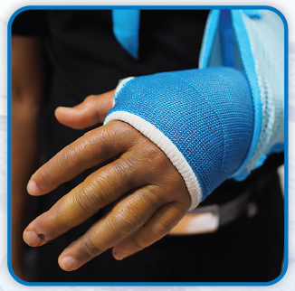
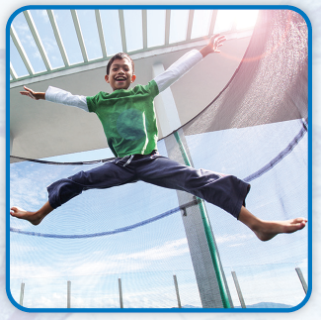
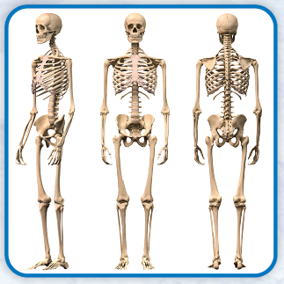
Picture Match
Part ______
Part ______
Part ______

Slide 17
Independent Practice (L) Part 1
Independent Practice
Text Comprehension Read each question. Think of the answer or look back at the text. Fill in the blank. Be sure the sentence makes sense.
Part 1
1. WHAT do bones do for the body’s shape? For the body’s shape, bones ______________________________________.
2. HOW do bones help the body? Bones help the body ____________________________________________.
3. WHAT happens to some infant bones as they grow? As they grow, some infant bones __________________________________.

Slide 18
Independent Practice (L) Part 2
Part 2
4. WHAT is the job of the top of the skull? The job of the top of the skull is to __________________________________.
5. WHERE does the spine run? The spine runs _________________________________________________.
6. WHAT do the ribs keep safe inside? The ribs keep __________________________________________________.

Slide 19
Independent Practice (L) Part 3
Part 3
7. WHY is a bone that broke set in a cast? A bone that broke is set in a cast because ____________________________
______________________________________________________________.
8. HOW much time can it take for a bone to heal? For a bone to heal, it can take ______________________________________.

Slide 20
Independent Practice (M) Story 1
More Practice Read each story. Fill in each blank with the best word.
Story 1: Kris jumped up from her nap. “Dad! We will be late. Let’s go!” “Why the rush?” Dad asked. “Mom will meet us at five. It is just three.” Kris had a wide smile as she spoke. “I had a dream that you and I were late for Mom’s play. It is safe to say that my dream was not real. And I have time to get some roses for Mom.”
1. Kris jumped up from a _____________________________________________. pan nap cap
2. Dad asked Kris, “Why the _________________________________________?” rush rest hush

Slide 21
Independent Practice (M) Story 1 — cont’d
3. Mom will meet them at __________________________________________. nine five three
4. Kris’s dream was not ___________________________________________. still meet real

Slide 22
Independent Practice (M) Story 2
Story 2: Miles sits with his sick rabbit waiting for the vet. He tells himself not to cry. “I hope the vet can help my rabbit. I cannot tell why she is sick.”
It is late, and the vet closes at five. “You are next,” the vet tells Miles.
Miles reaches into the crate. He pets his rabbit on her back to make her feel safe. “You will be fine,” Miles tells her.
1. Miles sits with his _____________________________________________. vet pet sat
2. Miles is at the vet _____________________________________________. like lean late
3. Miles makes his rabbit feel _____________________________________. safe self same

