Slide 1
Say Sounds (A–B)
Say Sounds
Phonemic Awareness Listen to the sounds or word parts as your teacher says a word slowly. Then say the word.
Letter/Sound Associations Look at the letter. Say the sound.
o i h o t
a c m l o
b a j o x
a p o d l
v g n o f

Slide 2
Read Words (C)
Read Words
New Words Say the sound. Sound out the word. Read the word.
Bob job lot
jot him box
cab cob hot
tip hit top
dot hip hop

Slide 3
Read Words (D)
Word Families Read down. Read rapidly.
mob
top
hop
pop
sop
job
cob
sob
mob
Rob
nod
rod
cod
pod
sod
10 Second Challenge
Cold Timing words read
Practice words read
Hot Timing words read

Slide 4
Read Words (E–F)
Multisyllabic Challenge Words Sound out the syllables. Read the whole word.
robin solid bobcat canvas catnap
High-Frequency Words Say. Spell. Read.
you of some from after
and no go water are

Slide 5
Spell Words (G)
Spell Words
Spelling Journal Turn to the Spelling Journal on page 151.

Slide 6
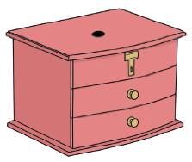
Read Text (H)
Read Text
Decodable Sentence Expansion Read each set of sentences. Then expand the last sentence by telling when. Select the picture that goes with each set.
Can you see? Can you see the robin? Can you see the robin from the top of the school? . . . , can you see the robin from the top of the school? _____

Slide 7
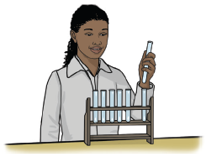
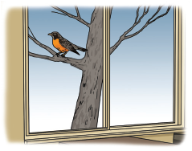
Read Text (H) — cont’d
The box had a dot. The box had a dot on the top. The box had a big dot on the top. . . . , the box had a big dot on the top. _____
Pam had a job. Pam had a job in a lab. Pam had a job in a top lab. . . . , Pam had a job in a top lab. _____

Slide 8
Independent Practice (I)
Independent Practice
More Practice 1 Fill in each blank with the best word.
1. Bob got a ________ with his cab.
jab job him
2. The top of the ________ is big.
box bad bit
3. The ________ ran from the bobcat.
fix fat fox
4. Did you see the rabbit ________?
hip hop tip
5. Nan can ________ to Bob.
nod not jot

Slide 9
Independent Practice (I) — cont’d
6. Can ________ visit the cabin with you?
bib Bob dot
7. The ________ cannot rot.
him hit ham
8. Nat got ________ of some water.
rid rip tip
9. Bob had a ________ of the school.
mop man map
10. Nan has a ________ of hats.
lot lit bit

Slide 10
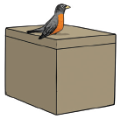
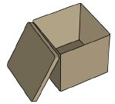

Independent Practice (J)
More Practice 2 Draw a line under the sentence that goes best with each picture.
1. A robin sat on a box.
A cat sat on a box.
2. The box had a dot.
The box has a top.
3. Pam is in the box.
Pam is in the cab.

Slide 11
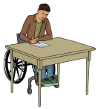
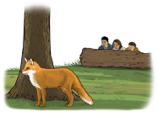
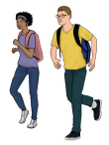
Independent Practice (J) — cont’d
4. Bob can jot on a pad.
Bob can nod at a cat.
5. The people ran from the ox.
The people see a fox.
6. Pam has a job.
Sam and Nan ran to school.

Slide 12
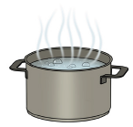
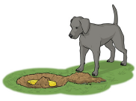
Independent Practice (J) — cont’d
7. The pot was hot.
The can was hot.
8. The dog hid the cob.
The dog ran after the robin.

