Slide 1
Say Sounds (A–B)
Say Sounds
Phonemic Awareness You will blend and segment sounds as you read and spell words.
Letter/Sound Associations Look at the letters. Say the sounds.
or ck u ea
oa ar er or
o e ar o_e
ea er ai igh
or ow er sh

Slide 2
Read Words (C)
Read Words
New Words Say the sound. Sound out the word. Read the word.
pork horn sort
herd park sport
stork lard street
pray snore store
sore chore sneak
form fern core
Irregular Word: world

Slide 3
Read Words (D)
Word Families Read down. Read rapidly.
ore
bore
sore
chore
snore
sort
port
fort
short
sport
tight
night
right
bright
flight
10 Second Challenge
Cold Timing words read
Practice words read
Hot Timing words read

Slide 4
Read Words (E–F)
Review Words Read a line of words. When your teacher gives a meaning, circle the correct word.
plate chime poach pond
plan stole chin frame
nose preach peach fame
trail tweed trade night
Words with Endings Read words with endings. 1. timing 2. traded 3. trader 4. stopping 5. trimming 6. parking 7. teaching 8. sporting 9. sorter 10. shorter

Slide 5
Read Words (G–H)
Multisyllabic Challenge Words Sound out the syllables. Read the whole word.
effort northwest support hornet instructor
transport platform organize different interest
High-Frequency Words Say. Spell. Read.
other another mother been come
some have school use your

Slide 6
Read Sentences (I)
Read Sentences
Sentences Read the sentences with phrasing.
Have you been doing your chores?
Rose put the other fern from the store by the steps.
My mother hiked for five miles, and now her feet feel very sore.
Carmen can use a cloth to absorb the water she spilled.
Loren will be your instructor for art class next week.

Slide 7
Spell Words (J)
Spell Words
Spelling Journal Turn to the Spelling Journal on page 202.

Slide 8
Decodable Informative Text (Part 1)
Decodable Informative Text Read each part. Answer your teacher’s questions and select the picture that goes with each part.
Making Flight Safe
Part 1
Teacher Reads Elrey Jeppesen was fascinated by flying. He liked it so
much that he spent years flying airplanes.
8
16
26
32
39
48
Elrey Jeppesen was born in 1907. At that time, people traveled by horse and wagon or on trains. There were not a lot of cars yet. And planes had just been invented.
When Elrey was growing up, he spent a lot of time looking at eagles flying. He could not wait to fly someday himself.

Slide 9
Decodable Informative Text (Part 1) — cont’d
55
63
72
82
84
91
102
110
119
That day came when Elrey was 14. He had his first ride in a plane. The short flight cost $4. That was a lot to pay in those days.
Elrey worked and saved his cash. When he was 18, he got flying lessons. He paid for a plane of his own. He worked by performing stunts and tricks in his plane. He worked flying planes to transport mail.

Slide 10
Comprehension Questions Part 1
Who is this passage about?
This passage is about ________________.
When was Elrey Jeppesen born?
Elrey Jeppesen was born ________________.
What did Elrey become interested in when he was growing up?
When Elrey was growing up, he became interested in ________________.

Slide 11
Decodable Informative Text (Part 2)
Part 2
Teacher Reads When Jeppesen was flying planes in the 1920s and 1930s, flying was dangerous. Pilots did not have the tools to keep them safe as they flew.
123
132
141
149
156
164
171
178
189
197
207
216
There were no maps for planes that pilots could use when they were flying. Pilots had to use road maps made for car travel. They followed railroad tracks, keeping the tracks in sight so they would not get lost. Pilots used landmarks, such as hills, rivers, and forests, to see the right way to go.
Pilots had to fly low so they could see the roads, railroad tracks, and landmarks below. Flying low was not safe. Pilots could not tell how high things were, like hills and smokestacks. Pilots might fly right into such objects.

Slide 12
Comprehension Questions Part 2
When Jeppesen started flying, why was it hard for pilots to find their way in the air?
It was hard for pilots to find their way in the air because ________________.
Why was it dangerous for pilots to fly low?
It was dangerous for pilots to fly low because ________________.

Slide 13
Decodable Informative Text (Part 3)
Part 3
Teacher Reads Jeppesen was determined to make flying safer for himself and for other pilots.
218
227
237
245
255
268
277
As Jeppesen kept flying, he wanted to make flying safer. He got a notebook and made notes and maps from his flights. He jotted down where landmarks were. He made maps of runways for planes, with notes on how to land in safe ways. He went to the top of hills and smokestacks and made notes on how high they were.

Slide 14
Decodable Informative Text (Part 3) — cont’d
279
288
297
308
320
331
339
348
350
Other pilots wanted to use Jeppesen’s notes. So he made his notes into charts. His charts helped pilots stay safe while they were flying from spot to spot. He set up a business to publish and sell his charts. As time went on, Jeppesen kept his charts up-to-date by adding important facts. Today pilots can use Jeppesen’s charts when they fly. Elrey Jeppesen made flying safer for all pilots.

Slide 15
Comprehension Questions Part 3
What was Jeppesen’s goal for flying?
Jeppesen’s goal for flying was ________________.
What did Jeppesen do to make flying safer?
To make flying safer, Jeppesen ________________.
How did Jeppesen share his notes with other pilots?
Jeppesen shared his notes with other pilots by ________________.

Slide 16
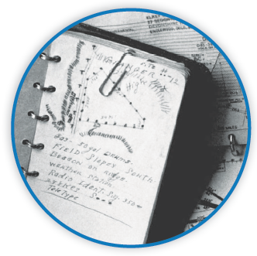
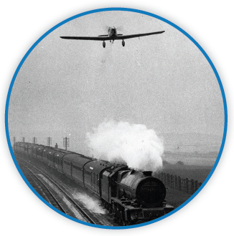
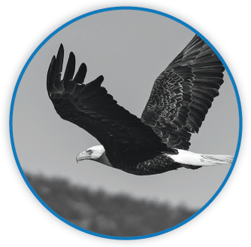
Picture Match
Part ______
Part ______
Part ______

Slide 17
Independent Practice (L) Part 1
Independent Practice
Text Comprehension Read each question. Think of the answer or look back at the text. Fill in the blank. Be sure the sentence makes sense.
Part 1
1. WHO is the topic of this text? The topic of this text is _________________________________________.
2. WHEN was Elrey Jeppesen born? Elrey Jeppesen was born in _____________________________________.
3. WHAT was Elrey interested in when he was growing up? When Elrey was growing up, he was interested in ____________________.

Slide 18
Independent Practice (L) Part 2
Part 2
4. WHY was it hard for pilots to get where they were going at the time? It was hard for pilots because __________________________________ __________________________________________________________.
5. WHY was it not safe for pilots to fly low? It was not safe for pilots to fly low because ________________________.

Slide 19
Independent Practice (L) Part 3
Part 3
6. WHAT did Jeppesen do to make flying safer? Jeppesen _____________________________________________________.
7. HOW did Jeppesen let other pilots use his notes? Jeppesen let other pilots use his notes by ____________________________.
8. HOW did Jeppesen make flying better for all pilots? Jeppesen made flying better for all pilots by __________________________.

Slide 20
Independent Practice (M) Story 1
More Practice Read each story. Answer the questions.
Story 1: “Where is Mom?” asked Corrin as she came in from the yard. “I was planting another rose bush and did not see the big thorn on the stem. It tore my shirt. I have a cut on my arm from the thorn.”
“Let’s have a look,” Corrin’s dad said. “Mom went to the store for some more rose bushes. Your arm must be sore. I can fix the cut.”
1. WHERE was Corrin when she cut her arm? Corrin was __________________________________________________.

Slide 21
Independent Practice (M) Story 1 — cont’d
2. WHAT was Corrin doing in the yard? In the yard, Corrin was ________________________________________.
3. WHAT will Corrin’s dad do for her? Corrin’s dad will fix ___________________________________________.

Slide 22
Independent Practice (M) Story 2
Story 2: Thad went into Viv’s store to get a gift for his mother. His mother wore sports caps, and Thad saw just the right cap for her. But it cost a lot. Thad said, “I may need some other plan.”
“What sort of things can you do?” asked Viv. “If you can come help me after school, I have some chores. I will pay you cash that you can use to get the cap.”
“It’s a plan!” said Thad.
1. WHY did Thad go to the store? Thad went to the store to _______________________________________.

Slide 23
Independent Practice (M) Story 2 — cont’d
2. WHAT did Viv ask Thad to do after school? Viv asked Thad to come ________________________________________.
3. HOW could Thad get the gift for his mother? To get the gift, Thad could _______________________________________.

