Slide 1
Say Sounds (A–B)
Say Sounds
Phonemic Awareness Listen to the word your teacher says. Then say the sounds or word parts in the word.
Letter/Sound Associations Look at the letters. Say the sounds.
ck d f i o
ch b p ck l
e sh r a ch
t w n u c

Slide 2
Read Words (C)
Read Words
New Words Say the sound. Sound out the word. Read the word.
Fred spot sled snap step
plot skin step
flap skid trim
stop skip crab
flag drag stem
plan Stan trip

Slide 3
Read Words (D)
Word Families Read down. Read rapidly.
trap
clap
flap
snap
strap
skip
trip
flip
snip
slip
stuck
truck
pluck
cluck
struck
10 Second Challenge
Cold Timing words read
Practice words read
Hot Timing words read

Slide 4
Read Words (E–F)
Review Words Read a line of words. When your teacher gives a meaning, circle the correct word.
this twin well wish
cash flap flag crab
clam hum drum drop
shack snack spin hint
Multisyllabic Challenge Words Sound out the syllables. Read the whole word. traffic jacket flapjack planet wagon

Slide 5
Read Words (G)
High-Frequency Words Say. Spell. Read.
my they are some after
long for from of have

Slide 6
Read Sentences (H)
Read Sentences
Sentences Read the sentences with phrasing.
There are six flags at the top of the hill.
Jen will plant some crops on that plot of land.
Val felt a chill on her skin from the wind.
Stan and Mez said they will plan for a trip in a van.
Chad said he was stuck in traffic after he left work.

Slide 7
Spell Words (I)
Spell Words
Spelling Journal Turn to the Spelling Journal on page 156.

Slide 8
Decodable Text (Part 1)
Decodable Text Read each part. Answer your teacher’s questions and select the picture that goes with each part.
Many Pets
Part 1
Teacher Reads In the first half of this story, the boys found a lost cat and
brought her home as their pet. They named the cat Mittens. The story
continues here with how the twins get a big surprise.
The twins kept Mittens, the pet cat, in a box. They fed her and got her fresh water. The twins saw that mittens was not thin. In fact, Mittens was VERY big.

Slide 9
Comprehension Questions Part 1
What did the twins notice about Mittens?
The twins noticed that Mittens was ________________.

Slide 10
Decodable Text (Part 2)
Part 2
Teacher Reads The twins become concerned about how the cat is transforming (changing), but Dad understands what is happening.
The twins got upset. Clem said to Dad, “Is it bad that Mittens is very big? Will she get stuck in that box? Will she think she is in a trap?”
Dad had to grin. “Clem, the snacks are not bad for Mittens. You will see that she has a plan.”

Slide 11
Comprehension Questions Part 2
Why were the twins upset?
The twins were upset because ________________.
What did Dad tell Clem about the snacks for Mittens?
Dad told Clem that the snacks for Mittens ________________.

Slide 12
Decodable Text (Part 3)
Part 3
Teacher Reads Keep reading to find out what happens with the cat.
After that, Clem and Devin saw that Mittens was a mom cat! In the box, they saw Mittens plus six little kittens.
Dad said to the twins, “You can pick a kitten for a pet. We will have Mittens and some of her kittens. We will have a lot of work, but we will have fun.”
“And I think the rest of the kittens can be pets for some kids we play with,” Clem said.
“Yes,” said Dad. “The kids will be glad to pick kittens as pets. You and Devin and lots of kids can have pets.”

Slide 13
Comprehension Questions Part 3
What happened to Mittens?
Mittens ________________.
What pets did Clem and Devin get to keep?
The pets that Clem and Devin got to keep were ________________.

Slide 14
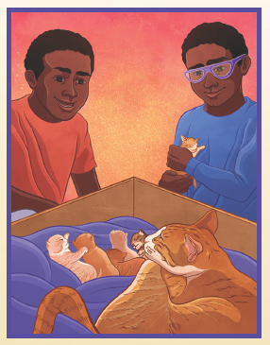
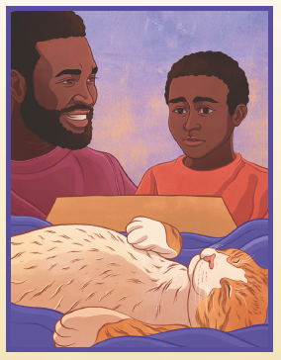
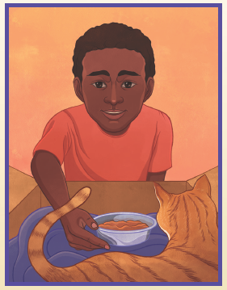
Picture Match
Passage ______
Passage ______
Passage ______

Slide 15
Independent Practice (K)
Independent Practice
More Practice 1 Fill in each blank with the best word.
1. The children wish to go on a ________.
stem trip traffic
2. Jeff dug in the sand to get a ________.
stop skip crab
3. Viv’s ________ was red from the sun.
skid step skin
4. Fred will ________ the sled up the hill.
bran clam drag
5. A ________ was on top of the school.
flap flag fled

Slide 16
Independent Practice (K) — cont’d
6. The van will ________ in the slush.
skid skin stem
7. Ann and I got ________ in traffic.
stem plot stuck
8. Nan shut the ________ of her backpack.
fun flap flag
9. Tim and Pam will ________ a trip.
plan skin drag
10. I saw the children ________ down the path.
stem trim skip

Slide 17
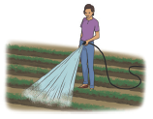
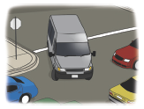
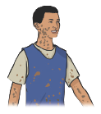
Independent Practice (L)
More Practice 2 Draw a line under the sentence that goes best with each picture.
1. Jill will dig for crabs.
Jill will water the crops.
2. The van went into the traffic.
The ox drags the big box in the sun.
3. Jeff got some mud on his skin.
Jeff got some mud on the rug.

Slide 18
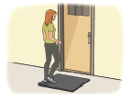
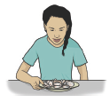

Independent Practice (L) — cont’d
4. Kat steps on the bug.
Kat steps on the mat.
5. Pat had a dish of clams.
The kitten sat on her lap.
6. Bill sits in a wagon.
Bill looks at the planets.

Slide 19

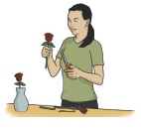
Independent Practice (L) — cont’d
7. The red cab sped into traffic.
Kit drops her red jacket.
8. Lin will snip off the stems.
Lin will plan her trip.

