Slide 1
Say Sounds (A–B)
Say Sounds
Phonemic Awareness Listen to the word your teacher says. Then say the sounds in the word.
Letter/Sound Associations Look at the letters. Say the sounds.
ea u igh ow
o igh ay a
ow i ee ai
ea ay igh oa
ee oa ai e

Slide 2
Read Words (C)
Read Words
New Words Say the sound. Sound out the word. Read the word.
light bright sigh
least show might
steal fright faint
night braid sight
sweep flight float
shown roast right
Irregular Word: eight

Slide 3
Read Words (D)
Word Families Read down. Read rapidly.
light
sight
might
flight
bright
pay
day
clay
tray
spray
meet
feet
sleet
sweet
tweet
10 Second Challenge
Cold Timing words read
Practice words read
Hot Timing words read

Slide 4
Read Words (E–F)
Review Words Read a line of words. When your teacher gives a meaning, circle the correct word.
slash slap crash rash
brisk brick chick spent
grant grass grasp swift
check prom pond print
Words with Endings Sound out the underlined base word. Read the base word with the endings.
1. showed 2. checked 3. reached 4. dreamed 5. printed
showing checking reaching dreaming printing

Slide 5
Read Words (G–H)
Multisyllabic Challenge Words Sound out the syllables. Read the whole word.
brightness frighten midnight daylight
raincoat exist tablet podcast
High-Frequency Words Say. Spell. Read.
very your where what who
down were they been use

Slide 6
Read Sentences (I)
Read Sentences
Sentences Read the sentences with phrasing.
The screen on your tablet is very bright!
What might a skunk do if you frighten it?
Where is an adult who can light the coals in the grill?
If you go down this hill, you may catch sight of a fox.
Chad has been checking when his mom’s flight will land.

Slide 7
Spell Words (J)
Spell Words
Spelling Journal Turn to the Spelling Journal on page 197.

Slide 8
Decodable Informative Text (Part 1)
Decodable Informative Text Read each part. Answer your teacher’s questions and select the picture that goes with each part.
Jobs Today
Part 1
Teacher Reads As technology improves, new jobs are created. One example is a drone operator. A drone is a small aircraft that flies without a pilot. The drone operator uses remote controls to guide the drone from the ground.
11
17
25
36
47
Some jobs of today did not exist in the past. Jobs have grown to meet people’s needs. Today people can work with drones. On land, people set the flight path for the drone. Then they send the drone up. They need to keep the drone going the right way on its flight.

Slide 9
Decodable Informative Text (Part 1) — cont’d
52
63
73
84
94
When the drone is up high, it can check on things. High up, a drone can check traffic on a highway. A drone can check on crops and send spray to help crops grow. Someday, a drone may drop off boxes on people’s front steps.

Slide 10
Comprehension Questions Part 1
Is the topic of this passage past- or present-day jobs?
The topic of this passage is ________________.
What is one example of a present-day job?
One example of a present-day job is ________________.
What is one thing a drone can do?
One thing a drone can do is ________________.

Slide 11
Decodable Informative Text (Part 2)
Part 2
Teacher Reads Many of today’s jobs need the Internet. Podcasting would be impossible to do without the Internet. Almost all podcasts are audio, or spoken words.
97
104
113
122
131
140
150
161
163
172
Some people do podcasting, which is doing shows that are put on the Internet. When people do podcasts, they may speak on topics. They may discuss bands. Some people may discuss fun spots for road trips. Some people teach things, such as fitness and how to keep chickens. To do a podcast, people follow a set of steps. Then they upload the podcast to the Internet.
After that, fans can download the podcast for free. Podcasts are a way to reach lots of people.

Slide 12
Comprehension Questions Part 2
What are podcasts?
Podcasts are ________________.
Why might someone make a podcast?
Someone might make a podcast to ________________.

Slide 13
Decodable Informative Text (Part 3)
Part 3
Teacher Reads The word app is short for application. An app lets people
do different things on phones and computers.
181
190
199
209
216
227
239
248
Some people work at dreaming up apps for tablets and phones. They invent apps that help people do tasks. With apps, people can send texts and email, plan travel, do banking, and chat with pals.
Today there are jobs that did not exist in the past. What jobs may be there for you when you are an adult? There may be jobs that do not exist yet.

Slide 14
Comprehension Questions Part 3
What is one task that an app might help people do?
One task that an app might help people do is ________________.

Slide 15
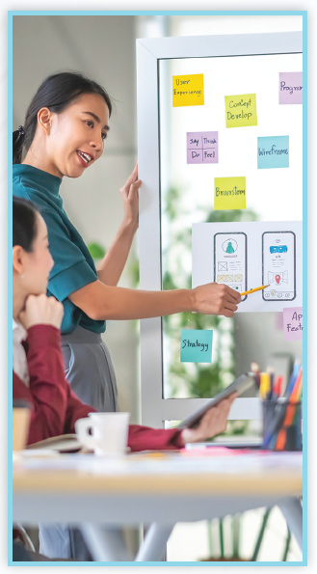

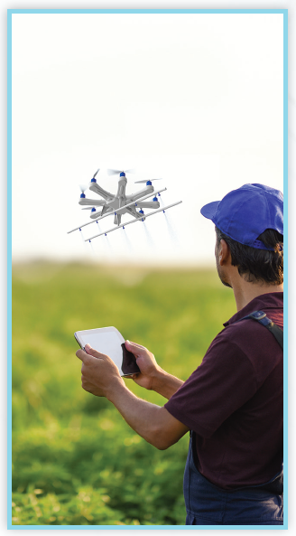
Picture Match
Part ______
Part ______
Part ______

Slide 16
Independent Practice (L) Part 1
Independent Practice
Text Comprehension Read each question. Think of the answer or look back at the text. Fill in the blank. Be sure the sentence makes sense.
Part 1
1. WHY have jobs grown? Jobs have grown to ______________________________________________.
2. WHAT can people work with today? Today, people can work with _______________________________________.
3. WHAT can a drone do when it is up high? When it is up high, a drone can _____________________________________.

Slide 17
Independent Practice (L) Part 2
Part 2
4. WHAT is podcasting? Podcasting is __________________________________________________.
5. WHAT may people do in a podcast? In a podcast, people may _________________________________________.

Slide 18
Independent Practice (L) Part 3
Part 3
6. WHAT do some people work at?
Some people work at _______________________________________.
7. WHAT do apps help people do? Apps help people __________________________________________.
8. WHAT jobs may be there for you when you grow up? When you grow up, there may be jobs that ______________________.

Slide 19
Independent Practice (M) Story 1
More Practice Read each story. Answer the questions.
Story 1: Chen and Mac went to the show last night. After the show, Mac said, “It’s just ten. We can use some snacks. I see a snack shop right there.” They went into the snack shop and sat down. Mac had ham and eggs, and Chen got a cheese bun.
1. WHEN did Mac say, “We can use some snacks”? __________________________, Mac said, “We can use some snacks.”
2. WHY did Chen and Mac go into the snack shop? They went into the snack shop to ______________________________.

Slide 20
Independent Practice (M) Story 1 — cont’d
3. WHEN did Mac have? Mac had __________________________________________________.
4. WHEN did Chen get? Chen got a ________________________________________________.

Slide 21
Independent Practice (M) Story 2
Story 2: Jan and Chuck went into the plant shop. They wished to get a tree. Jan saw a little tree in a bright red pot. “Look at the tree right there,” said Jan. “It needs some water and sunlight. What do you think of this tree?” Chuck said, “This tree will do well with your help. Let’s get it.”
1. WHERE did Jan and Chuck go? Jan and Chuck went into _______________________________________.
2. WHAT did they wish to get? They wished to get ____________________________________________.
3. WHAT did the tree need? The tree needed ______________________________________________.

