Slide 1
Say Sounds (A–B)
Say Sounds
Phonemic Awareness Listen to the sounds or word parts as your teacher says a word slowly. Then say the word.
Letter/Sound Associations Look at the letter. Say the sound.
t o i u p
i n c a r
u j a m s
h u g o b
f k u d h

Slide 2
Read Words (C)
Read Words
New Words Say the sound. Sound out the word. Read the word.
hug big bug
pup tug tag
hum cut ham
rut bun sub
sob jug rot

Slide 3
Read Words (D)
Word Families Read down. Read rapidly.
cut
gut
but
nut
hut
tub
hub
cub
sub
rub
dug
mug
jug
tug
bug
10 Second Challenge
Cold Timing words read
Practice words read
Hot Timing words read

Slide 4
Read Words (E–F)
Multisyllabic Challenge Words Sound out the syllables. Read the whole word. hubcap submit summit vivid comic
High-Frequency Words Say. Spell. Read.
into after some from very
put she saw went they

Slide 5
Spell Words (G)
Spell Words
Spelling Journal Turn to the Spelling Journal on page 152.

Slide 6
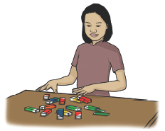
Read Text (H)
Read Text
Decodable Sentence Expansion Read each set of sentences. Then expand the last sentence by telling when. Select the picture that goes with each set.
The pup had a habit. The little pup had a bad habit. The little pup had a very bad habit. . . . , the little pup had a very bad habit. _____

Slide 7
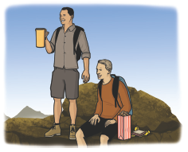
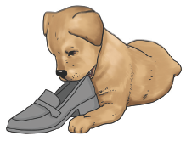
Read Text (H) — cont’d
Lin got gum. Lin got a lot of gum. Lin got a lot of gum from her dad. . . . , Lin got a lot of gum from her dad. _____
Rob and Gus had a picnic. Rob and Gus had a picnic of ham and nuts. Rob and Gus had a picnic of ham, nuts, and a jug of water. . . . , Rob and Gus had a picnic of ham, nuts, and a jug of water. _____

Slide 8
Independent Practice (I)
Independent Practice
More Practice 1 Fill in each blank with the best word.
1. Nan has ham on a ________.
bin bun bug
2. Nat ________ the fabric.
cat bug cut
3. The man put the ________ on the rug.
pup up hum
4. The ________ got into the mug.
bus rug bug
5. Bob can ________ his dog.
jug cat hug

Slide 9
Independent Practice (I) — cont’d
6. The gum can ________ in the can.
fit rat lot
7. Nan can ________ and run.
him hum ham
8. The pup ran from the ________.
big dug hut
9. Tom can ________ the pup.
mug pat rug
10. The cat and dog ________ the cap.
tug mug big

Slide 10


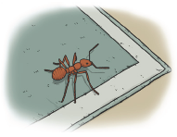
Independent Practice (J)
More Practice 2 Draw a line under the sentence that goes best with each picture.
1. The cat ran after the bug.
The cat ran into the hut.
2. Kat has a jug of water.
Kat has a sip of water.
3. The bug sat in the sun.
The bug is on the rug.

Slide 11
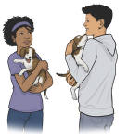

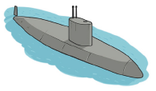
Independent Practice (J) — cont’d
4. Nan and Tim can hug pups.
Nan can hum and drum.
5. The tan pup tugs at the rug.
The tan pup sits on a rug.
6. Kat is at the summit.
The sub is in the water.

Slide 12


Independent Practice (J) — cont’d
7. Dad has a big top hat.
Jim has a little cap.
8. The little tot sobs.
The little tot sips from a cup.

