Slide 1
Say Sounds (A–B)
Say Sounds
Phonemic Awareness Listen to the sounds or word parts as your teacher
says a word slowly. Then say the word.
Letter/Sound Associations Look at the letter. Say the sound.
  rug
  u d u o f
  k u s a m
  i p u o b
  a u l g i
  c j o t h

Slide 2
Read Words (C)
Read Words
New Words Say the sound. Sound out the word. Read the word.
  up us run
  rub sod mug
  fun fan sun
  pin mud mad
  pun rug rig

Slide 3
Read Words (D)
Word Families Read down. Read rapidly.
sun
run
fun
bun
pun
rub
sub
tub
cub
hub
mug
rug
bug
hug
dug
10 Second Challenge
Cold Timing words read
Practice words read
Hot Timing words read

Slide 4
Read Words (E–F)
Multisyllabic Challenge Words Sound out the syllables. Read the whole word.
until sunup muffin rustic suntan
High-Frequency Words Say. Spell. Read.
  they very put have after
  and some see was to

Slide 5
Spell Words (G)
Spell Words
Spelling Journal Turn to the Spelling Journal on page 151.

Slide 6
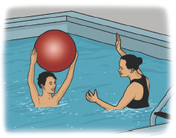
Read Text (H)
Read Text
Decodable Sentence Expansion Read each set of sentences. Then expand the last sentence by telling when. Select the picture that goes with each set.
  Gil had a muffin.
  Gil had a muffin and a bun.
  Gil had a muffin, a bun, and jam.
  . . . , Gil had a muffin, a bun, and jam. _____

Slide 7
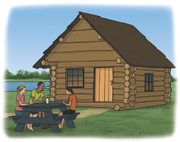
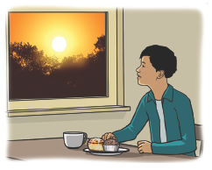
Read Text (H) — cont’d
  Gil and his mom had fun.
  Gil and his mom had fun in the sun.
  Gil and his mom had fun in the sun
  and water.
  . . . , Gil and his mom had fun in the sun _____
  and water.
  People go to the cabin.
  People go to the rustic cabin.
  People go to the rustic cabin to picnic.
  . . . , people go to the rustic cabin to picnic. _____

Slide 8
Independent Practice (I)
Independent Practice
More Practice 1 Fill in each blank with the best word.
  1. My dog is in the ________.
pun mud up
  2. Nan can run and have ________.
fin fan fun
  3. The ________ has a little mud on it.
not rug up
  4. The tot is very ________.
mad mud man
  5. The ________ is very hot.
fun sun pun

Slide 9
Independent Practice (I) — cont’d
  6. Tim and his dog can ________.
rib mug run
  7. The dog ran to ________.
up us cup
  8. Bob put water in the ________.
mug rod rub
  9. The fox hid in the ________.
lip log dog
  10. The ________ has a lid.
pot pat put

Slide 10
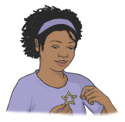
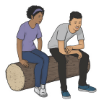
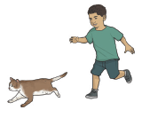
Independent Practice (J)
More Practice 2 Draw a line under the sentence that goes best with each picture.
1. Nan got a muffin.
Nan got a pin.
2. Nan and Nat sit on a rug.
Nan and Nat sit on a log.
3. The tot can run after the cat.
The tot can rub the cat.

Slide 11
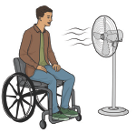
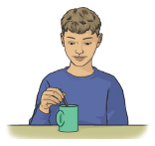
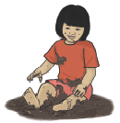
Independent Practice (J) — cont’d
  4. Bob can see the fan.
Bob can see us.
  5. He can mix in a can.
He can mix in a mug.
6. Kim was in the mud.
Kim was in the tub.

Slide 12
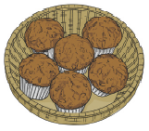
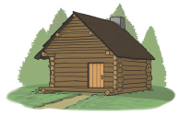
Independent Practice (J) — cont’d
7. They have fun until sunup.
They have six muffins.
8. The little cabin is rustic.
The sun is up.

