Slide 1
Say Sounds (A–B)
Say Sounds
Phonemic Awareness Listen to the sounds as your teacher
says a word slowly. Then say the word.
Letter/Sound Associations Look at the letters. Say the sounds.
  ay ch ai th
  ai sh u ch
  wh e ay sh
  th o ai i
  ay ai ck wh

Slide 2
Read Words (C)
Read Words
New Words Say the sound. Sound out the word. Read the word.
  ray mail gain
  Jay paint pant
  trail rail train
  brain play lay
  tray braid gray
  clay faint fin

Slide 3
Read Words (D)
Word Families Read down. Read rapidly.
hay
ray
stay
gray
stray
rain
gain
chain
Spain
brain
mail
rail
fail
snail
trail
10 Second Challenge
Cold Timing words read
Practice words read
Hot Timing words read

Slide 4
Read Words (E–F)
Review Words Read a line of words. When your teacher
gives a meaning, circle the correct word.
  bunch lunch luck hiss
  snack check chick nap
  hit splash lash mend
  rich which stick stack
Words with Endings Sound out the underlined base word.
Read the base word with the ending.
  1. mailed 2. painted 3. played 4. stopped 5. checked

Slide 5
Read Words (G–H)
Multisyllabic Challenge Words Sound out the syllables. Read the whole word.
  paintbrush crayon essay maintain
  railway holiday payment playoff
High-Frequency Words Say. Spell. Read.
  are look was some were
  said you how have my

Slide 6
Read Sentences (I)
Read Sentences
Sentences Read the sentences with phrasing.
  Jay said his crayons were on the desk.
  There was a big rock in the way on the trail.
  Anton cannot wait to look at the mail today.
  Did you pay the bill to fix my gray truck?
  I have a pail of red paint and a paintbrush.

Slide 7
Spell Words (J)
Spell Words
Spelling Journal Turn to the Spelling Journal on page 195.

Slide 8
Decodable Informative Text (Part 1)
Decodable Informative Text Read each part. Answer your
teacher’s questions and select the picture that goes with each part.
Mail Past and Present
Part 1
Teacher Reads People have always needed ways to get messages to
one another. Sending messages through the mail is one way to do that.
But mail delivery in the past was very different from today.
11
24
37
47
58
69
How did people get mail in the past? They did not
have a post office to go to. Mail was not put in boxes
and slots for people as it is today. People had to go get
mail. They went to spots where people met up, such
as inns and shops. They left mail there and picked up
mail at such spots. People had to wait days and days
for mail.

Slide 9
Comprehension Questions Part 1
Where did people get their mail in the past?
In the past, people got their mail ________________.
How long did people have to wait to get their mail?
People had to wait ________________.

Slide 10
Decodable Informative Text (Part 2)
Part 2
Teacher Reads Over time, new inventions made mail delivery better
and faster.
71
80
92
102
113
123
People began to set up post offices. People had
jobs to pick up and drop off mail. Back then, mail was
sent with people on horses, on mail wagons, and on
ships. Then mail began to be sent on trains and then
on planes. Today mail is sent on planes, trains, and
trucks. The wait for mail is less today than in the past.

Slide 11
Comprehension Questions Part 2
What jobs did people have when post offices were set up?
When post offices were set up, people had jobs to ________________.
How was mail sent in the past?
In the past, mail was sent ________________.
How is mail sent today?
Today, mail is sent ________________.

Slide 12
Decodable Informative Text (Part 3)
Part 3
Teacher Reads People can still use the mail to send messages. But now
they also use email, electronic mail sent over a computer network.
135
146
161
175
185
195
205
215
225
228
Today you can put mail in a mailbox. The mail will
be sent where you wish it to go. Is it fast? It is not as
fast as email. Email is sent as fast as you can tap a key.
Some people say the mail is “snail mail.” They say
that because the mail travels the way a snail travels:
NOT fast. “Snail mail” is not as fast as email.
“Snail mail” and email are ways to send mail today.
Maybe someday people will think of the best way to
send mail yet.

Slide 13
Comprehension Questions Part 3
How fast can email be sent?
Email can be sent ________________.
Why do people call the mail they put in a mailbox “snail mail”?
People call the mail they put in a mailbox “snail mail” because
________________.

Slide 14

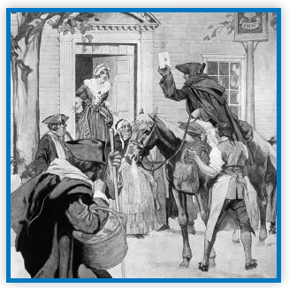
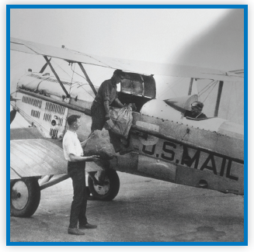
Picture Match
Part ______
Part ______
Part ______

Slide 15
Independent Practice (L) Part 1
Independent Practice
Text Comprehension Read each question. Think of the answer or look back
at the text. Fill in the blank. Be sure the sentence makes sense.
Part 1
  1. WHERE did people get mail in the past?
  In the past, people got mail __________________________________________.
  2. HOW long did people have to wait to get mail?
  People had to wait _________________________________________________.

Slide 16
Independent Practice (L) Part 2
Part 2
  3. WHAT jobs did people have when post offices were set up?
  When post offices were set up, _______________________________________.
  4. HOW was mail sent in the past?
  In the past, mail was sent ___________________________________________.
  5. HOW is mail sent today?
  Today mail is sent _________________________________________________.
  6. WHAT is the wait for mail today?
  Today the wait for mail _____________________________________________.

Slide 17
Independent Practice (L) Part 3
Part 3
  7. HOW fast can email be sent?
  Email can be sent _________________________________________________.
  8. WHY is “snail mail” the mail people put in a mailbox?
  “Snail mail” is the mail people put in a mailbox because ____________________
  ________________________________________________________________.

Slide 18
Independent Practice (M)
More Practice Read each question. Circle the answer.
  1. Can a hen mix paint?
yes no
  2. Can you wait at a bus stop?
yes no
  3. Can a pail get mad?
yes no
  4. Can mail lay on a tray?
yes no
  5. Can the rain get you wet?
yes no

Slide 19
Independent Practice (M) — cont’d
  6. Can you run on a trail?
yes no
  7. Can a ship sail in the rain?
yes no
  8. Can a dog wag its tail?
yes no
  9. Can a train hop?
yes no
  10. Can a kid look at a snail?
yes no

