Slide 1
Say Sounds (A–B)
Say Sounds
Phonemic Awareness Listen to the sounds or word parts as your teacher says a word slowly. Then say the word.
Letter/Sound Associations Look at the letter. Say the sound.
net
e l d t o
b n e a i
f w m s e
c r a g e
u h e o j

Slide 2
Read Words (C)
Read Words
New Words Say the sound. Sound out the word. Read the word.
Ed fed set
sit men red
not led lad
web met lot
let get rod

Slide 3
Read Words (D)
Word Families Read down. Read rapidly.
Ed
red
fed
led
bed
get
met
let
set
net
men
ten
pen
hen
den
10 Second Challenge
Cold Timing words read
Practice words read
Hot Timing words read

Slide 4
Read Words (E–F)
Multisyllabic Challenge Words Sound out the syllables. Read the whole word. upset exit cobweb sadden panel
High-Frequency Words Say. Spell. Read.
look down from some into
put they very saw went

Slide 5
Spell Words (G)
Spell Words
Spelling Journal Turn to the Spelling Journal on page 152.

Slide 6
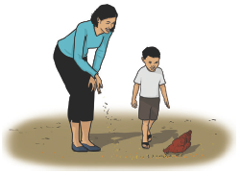
Read Text (H)
Read Text
Decodable Sentence Expansion Read each set of sentences. Then expand the last sentence by telling where. Select the picture that goes with each set.
Mel saw a bug. Mel saw a bug on a cobweb. Mel saw a bug on a cobweb and got it in her net. . . . , Mel saw a bug on a cobweb and got it in her net. _____

Slide 7
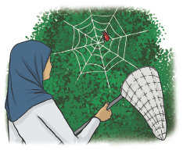
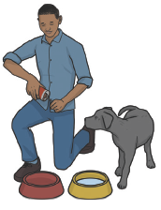
Read Text (H) — cont’d
Ed fed his dog Red. Ed fed his dog Red from a can. Ed fed his dog Red from a can and got him some water. . . . , Ed fed his dog Red from a can and _____ got him some water.
Mom looks at the red hen. Mom and Ken look at the red hen. Mom and Ken look at the red hen as it is fed. . . . , Mom and Ken look at the red hen as it is fed. _____

Slide 8
Independent Practice (I)
Independent Practice
More Practice 1 Fill in each blank with the best word.
1. The box has a ________ tag.
red fed led
2. The ________ ran.
met men let
3. Ed can ________ a cab.
get set bet
4. Sam ________ the box down.
net men set
5. Nan sat on the ________.
bed red let

Slide 9
Independent Practice (I) — cont’d
6. Jim ________ the cat.
bed fed web
7. Ed did not ________ go.
let net wet
8. Ted ________ Jed at the bus.
men met net
9. Look at the big bug in the ________.
get red web
10. Pam let Ned ________ the dog.
pet vet set

Slide 10
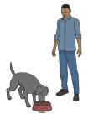
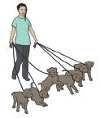

Independent Practice (J)
More Practice 2 Draw a line under the sentence that goes best with each picture.
1. Ed fed his dog.
Ed sat with his dog.
2. Pat met six people.
Pat led six pups.
3. Kim has a red bib.
Kim has a red hat.

Slide 11
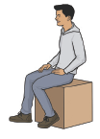
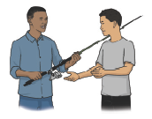
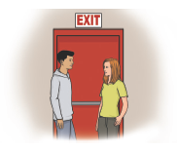
Independent Practice (J) — cont’d
4. The men sit down.
Tim sits on a box.
5. Ed let Nat have the rod.
Ed let Nat have the cap.
6. Tim met Kat in the lot.
Tim met Kat at the exit.

Slide 12
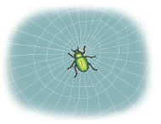
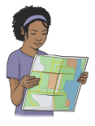
Independent Practice (J) — cont’d
7. A big bug is in the cobweb.
The tot had six bugs.
8. Nan looks at the water.
Nan looks at a map.

