Slide 1
Say Sounds (A–B)
Say Sounds
Phonemic Awareness You will blend and segment sounds as
you read and spell words.
Letter/Sound Associations Look at the letters. Say the sounds.
  ay a a_e e
  ee o ai oa
  o ow i igh
  ai igh a ee
  ea oa ow a_e

Slide 2
Read Words (C)
Read Words
New Words Say the sound. Sound out the word. Read the word.
  case flat shame
  ham rate trade
  flake date lack
  plate van fake
  sale plant vane
  fame skate crate
Irregular Word: have

Slide 3
Read Words (D)
Word Families Read down. Read rapidly.
ape
tape
shape
grape
scrape
mane
cane
lane
plane
crane
date
hate
state
slate
grate
10 Second Challenge
Cold Timing words read
Practice words read
Hot Timing words read

Slide 4
Read Words (E–F)
Review Words Read a line of words. When your teacher
gives a meaning, circle the correct word.
  trail step blown weak
  steep beat boat treat
  bowl sail seal stay
  peel pail bail sell
Words with Endings Use the reading rules to pronounce the words.
1. mating 2. matting 3. taking 4. planning 5. flaking
6. trading 7. craving 8. shaping 9. waking 10. chatting

Slide 5
Read Words (G–H)
Multisyllabic Challenge Words Sound out the syllables.
Read the whole word.
  lateness wasteland landscape shapeless nickname
  escape showcase elevate contemplate pillowcase
High-Frequency Words Say. Spell. Read.
  my by why cry dry
  some where after use have

Slide 6
Read Sentences (I)
Read Sentences
Sentences Read the sentences with phrasing.
  Why did my dog escape past the gate?
  Anton will dry the plates after I clean them.
  I have skates that I will trade for a tennis racket.
  We need to use the bug spray by the date on the can.
  Where can Estela go to get some big crates to pack
  up her things?

Slide 7
Spell Words (J)
Spell Words
Spelling Journal Turn to the Spelling Journal on page 198.

Slide 8
Decodable Narrative Text (Part 1)
Decodable Narrative Text Read each part. Answer your teacher’s
questions and select the picture that goes with each part.
Packing Up
Part 1
Teacher Reads Moving to a new residence (home) can be stressful.
There are lots of things to do, but packing can be one of the biggest jobs.
11
24
37
49
61
72
“I did not dream there was this much to do, Estela,”
said Neal. “With each box I pack and tape up, I still see
stacks of stuff. Do we need all of this?” he said with a
groan, as he set a big box on top of the heap.
“It takes a lot of work to pack,” Estela said. “But, yes,
we need it all. Keep taping! Have you seen my right
skate? It is not in its case.”

Slide 9
Comprehension Questions Part 1
Who are the main characters in this story?
The main characters in this story are ________________.
What challenge did Estela and Neal have?
Estela and Neal had to ________________.

Slide 10
Decodable Narrative Text (Part 2)
Part 2
Teacher Reads Neal was tired of packing and ready to quit, but Estela
encouraged him to keep going. The job had to get done.
79
89
101
103
113
125
139
152
“With luck, it will stay lost,” said Neal. “That will
mean less to pack. Do the dishes on that shelf go in
this crate?”
“Do not pack them yet,” Estela said. “We still have
to eat today. Let’s take a rest. We can have some bran
flakes and milk. We may as well get rid of it all. I hate
to think that we need to take it with us,” she said with
a sigh.

Slide 11
Comprehension Questions Part 2
Why didn’t they pack the dishes?
They didn’t pack the dishes because ________________.

Slide 12
Decodable Narrative Text (Part 3)
Part 3
Teacher Reads Read on to find out if the dishes are the last things Estela
and Neal need to pack.
154
164
174
184
195
210
220
223
After they ate, Neal said, “I will load some things
into the van. Can you tape up that last box?”
“Yes,” Estela said. “Then I will clean and pack the
dishes. There is not much left after that. Did you pack
all the things I had in the back? It will be a shame if we
cannot take them.” Neal just sat down and gave Estela
a sad look.

Slide 13
Comprehension Questions Part 3
How will they get the crates to their next home?
They will get the crates to their next home by putting them in
________________.
What were some of the last things they packed?
Some of the last things they packed were ________________.
Why did Neal give Estela a sad look?
Neal gave Estela a sad look because ________________.

Slide 14
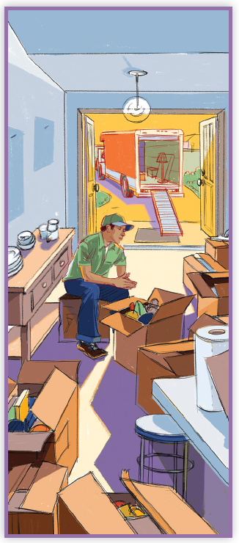
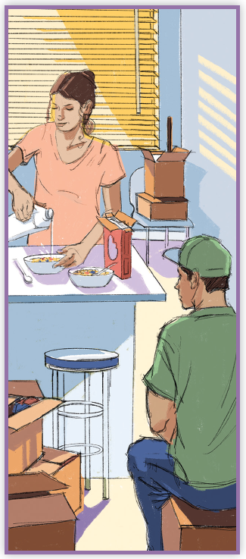
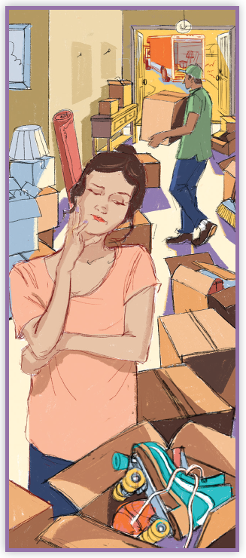
Picture Match
Part ______
Part ______
Part ______

Slide 15
Independent Practice (L) Part 1
Independent Practice
Text Comprehension Read each question. Think of the answer or look back at the text. Fill in the blank. Be sure the sentence makes sense.
Part 1
  1. WHO are the people in the story?
  The people in the story are ______________________________________.
  2. WHAT did Estela and Neal have to do?
  Estela and Neal had to _________________________________________.
  3. WHAT made Neal groan?
  Neal groaned when ___________________________________________.

Slide 16
Independent Practice (L) Part 2
Part 2
  4. WHY did they not pack the dishes?
  They did not pack the dishes because ______________________________.
  5. WHY did Estela and Neal need to eat all the bran flakes and milk?
  They needed to eat it all so that they _______________________________.

Slide 17
Independent Practice (L) Part 3
Part 3
  6. HOW will they get the crates to the next spot?
  They will get the crates to the next spot in _____________________________.
  7. WHAT were some of the last things they packed?
  Some of the last things they packed were _____________________________.
  8. WHY was Neal giving Estela a sad look?
  Neal was giving Estela a sad look because ____________________________
  ________________________________________________________________.

Slide 18
Independent Practice (M) Story 1
More Practice Read each story. Answer the questions.
  Story 1: Jade’s skates did not fit. She went to the skate sale at Pop’s Skate
  Shop. At the shop, Jade saw rows of skates. “Why do skates cost so much?”
  she asked.
  Pop said, “If you have skates you do not use, I will take them in a trade.”
  Jade made a deal and left the shop with skates in a big box.
  1. WHY did Jade need to get skates?
  Jade’s skates _________________________________________________.
  2. WHERE did Jade go?
  She went to __________________________________________________.
  3. WHAT deal did Jade make for the skates?
  Jade made a deal to ___________________________________________.

Slide 19
Independent Practice (M) Story 2
  Story 2: “Why did my dog Boss go in the mud?” Lane asked.
  Mom said, “It’s a shame, but dogs do that. You can clean Boss in the tub.”
  Lane gave Boss a bath. “Boss will shake,” said Mom. “But he will still be
  wet. Take him to sit in the sun where he can dry off. He will not dry off in
  the shade. By lunch, Boss will be dry.”
  1. WHY did Boss need a bath?
  Boss needed a bath because he __________________________________.
  2. WHAT did Mom say Boss will do right after the bath?
  Mom said right after the bath, Boss will _____________________________.
  3. WHERE can Boss dry off?
  Boss can dry off _______________________________________________.

