Slide 1
Say Sounds (A)
Say Sounds
Letter/Sound Associations Look at the letters. Say the sounds.
ow
snow down
ow or ar qu
tch oi ph ow
ow kn oy ow
ou ow oa ew

Slide 2
Read Words (B)
Read Words
New Words Say the sound. Say the word. If it isn’t a real word, try the other sound.
owl blown gowns
flown plow crowd
howl show snow
down towns flow

Slide 3
Read Words (C)
Word Families Read down. Read rapidly.
how
cow
now
chow
plow
owl
fowl
howl
growl
prowl
low
slow
flow
crow
grow
10 Second Challenge
Cold Timing words read
Practice words read
Hot Timing words read

Slide 4
Read Words (D–E)
Multisyllabic Challenge Words Sound out the syllables. Read the whole word.
showtime grownup owner chowder
downtown crowbar sundown somehow
Prefixes and Suffixes Say the word. Then say the prefix or suffix.
PREFIXES | SUFFIXES
1. | final
2. a- pro- con- de- | -ish -ness -ous -le
Expert Tip: The suffix -al creates the noun form in these words: deny ➝ denial, survive ➝ survival, arrive ➝ arrival.

Slide 5
Read Words (F–G)
Words with Prefixes and Suffixes Say the underlined affix. Read the whole word.
adore proclaim condense demote exchange behave
normal furnish frankness generous gentle numeral
final ly conversation natural ly punish ment
High-Frequency Words Say. Spell. Read.
some something somehow sometime somewhere
though woman any thought enough were hour work

Slide 6
Read Sentences (H)
Read Sentences
Sentences Read the sentences with phrasing.
They need three gowns for the show that starts in an hour.
Sang Min thought he saw his friend in the crowd.
Two large owls flew by the house sometime after sundown.
My friend and I were sure to get downtown in time for the concert, though we rushed.
“Let’s meet somewhere and have clam chowder,” Candis said after work.

Slide 7
Spell Words (I)
Spell Words
Spelling Journal Turn to the Spelling Journal on page 248.

Slide 8
Decodable Narrative Text (Part 1)
Decodable Narrative Text Read each part. Answer your teacher’s questions and select the picture that goes with each part.
Lots of Talent
Part 1
Teacher Reads A talent show is an opportunity for people to show off their special skills, such as singing a song, dancing, or playing an instrument. Talent shows may be put on to raise money for a good cause. Let’s read about one talent show.
11
22
36
47
52
“This talent show is way more work than I thought it would be,” Jasmin said to Marcus with a frown. “I thought all I’d have to do is judge the acts on stage and proclaim the winner. But I have been holding tryouts all week and there are still more to come.”
“Hold on, hold on,” said Marcus, trying to speak up.

Slide 9
Decodable Narrative Text (Part 1) — cont’d
Part 1 continued
62
72
84
95
97
108
121
132
143
Jasmin kept going. “I also have to talk Ms. Powers into printing the tickets for a low price. And I need to find someone to work the lights. I could really use your assistance, Marcus.”
“I don’t know exactly what I can do, Jasmin,” Marcus said, “but I will help any way I can. Ms. Powers owns Comics Plus, that store downtown on Page Street, right? I can go down there after school. Maybe I can convince her to print the tickets at a discount. After all, it is for a good cause.”

Slide 10
Comprehension Questions Part 1
Who are the characters in the story?
The characters are ________________.
What was Jasmin’s problem?
Jasmin’s problem was ________________.

Slide 11
Decodable Narrative Text (Part 2)
Part 2
Teacher Reads The talent show will raise money for the school jazz band, which is a good cause. When events are held for a good cause, donors may help out by providing things that are needed. Read on to find out if Ms. Powers will become a donor for the talent show.
155
164
175
187
198
209
222
229
239
At Jasmin’s house later, Marcus said, “Well, the ticket problem is solved. At first, Ms. Powers said she would give us a discount, but I explained that the talent show will raise funds for the school jazz band. Then she agreed to print the tickets for free! Somehow, I think it had something to do with the fact that her uncle is the band leader,” he said, grinning. “Anyway, what’s next on the list?”
Jasmin found her list and checked it. “We still need someone to sell tickets, someone to show people to their

Slide 12
Decodable Narrative Text (Part 2) — cont’d
Part 2 continued
249
261
271
280
293
seats, someone to work the lights, and a clean-up crew for after the show. Those are the main tasks,” she said.
“Let’s talk to some friends at school,” Marcus said. “Between the two of us, we should be able to find people for all those jobs.”

Slide 13
Comprehension Questions Part 2
What is the setting in this part of the story?
The setting is ________________.
When was the problem of getting the tickets printed solved?
The problem of getting tickets printed was solved when ________________.
What is one task Jasmin still needed someone to do?
Jasmin still needed someone to ________________.

Slide 14
Decodable Narrative Text (Part 3)
Part 3
Teacher Reads Jasmin and Marcus are working hard on the talent show.
Read on to find out if things are getting done on schedule.
296
308
319
329
341
343
351
353
365
377
389
397
The talent show was just a few days away. Jasmin had to choose the final lineup of acts. She told Marcus, “There are too many dance teams and skits about school. There must be someone out there who can do stand-up jokes or sing or something.”
Then Jasmin asked Marcus how the ticket sales were going.
“It seems a little slow,” Marcus said. “But it’s hard to tell. I think most people are waiting to get their tickets on the night of the show. You just keep working on the show itself. I’m sure we will have a big crowd.”

Slide 15
Comprehension Questions Part 3
What did Jasmin need to do with the talent show just a few days away?
Jasmin needed to ________________.
What did Marcus say about the ticket sales?
Marcus said the ticket sales seemed ________________.

Slide 16
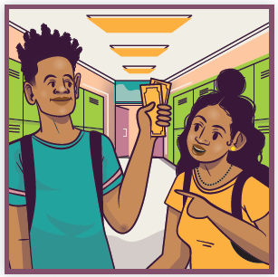
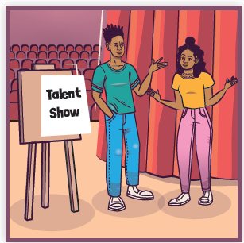
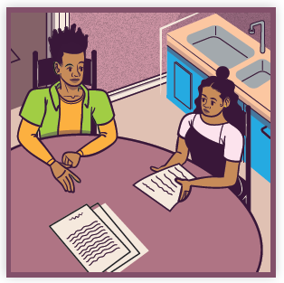
Picture Match
Part ______
Part ______
Part ______

Slide 17
Independent Practice (K) Part 1
Independent Practice
Text Comprehension Read each question. Think of the answer or look back at the text. Fill in the blank. Be sure the sentence makes sense.
Part 1
1. WHO are the people in this story? The people in this story are _______________________________________.
2. WHAT is Jasmin’s problem? Jasmin’s problem is _____________________________________________ _____________________________________________________________.

Slide 18
Independent Practice (K) Part 2
Part 2
3. WHAT is the setting in this part of the story? The setting is ____________________________________________________.
4. WHEN was the problem of getting tickets printed solved? The problem of getting tickets printed was solved when ___________________ _______________________________________________________________.
5. WHAT is one task Jasmin needed someone to do? Jasmin needed someone to ________________________________________ _______________________________________________________________.

Slide 19
Independent Practice (K) Part 3
Part 3
6. WHAT did Jasmin need to do with the talent show just a few days away? Jasmin needed to _______________________________________________.
7. WHAT did Marcus say about the ticket sales?
Marcus said the ticket sales seemed ________________________________.
8. WHAT did Marcus tell Jasmin that showed he was sure the talent show would go well?
Marcus told Jasmin to ____________________________________________.

Slide 20
Independent Practice (L)
More Practice • Activity 1 Read each story. Underline all the endings that make sense.
1. At the basketball game, the crowd got excited.
The crowd got excited when ____________.
a. the home team scored quickly
b. each player got time in the game
c. a plow came through the town
2. On Saturday, people gathered downtown.
They gathered downtown to ____________.
a. run a long race along the river
b. spend an extra hour sleeping
c. join a parade

Slide 21
Independent Practice (L) — cont’d
3. The clowns at the festival do many funny things.
Sometimes the clowns ____________.
a. show the crowd tricks
b. read the pages of a newspaper
c. dance and prance around the festival

Slide 22
Independent Practice (M)
More Practice • Activity 2 Read each list. Cross out the word or word pair that does not belong in each list.
1. screwdriver
crowbar
chowder
hammer
4. downtown
gentleman
jeweler
salesperson
7. reptile
exchange
insect
mammal
2. grown-up
somehow
teenager
preschooler
5. chowder
gingersnaps
cabbage
woman
8. spacecraft
rocket
showtime
launch pad
3. sundown
morning
sunup
powder
6. giraffe
raccoon
numeral
dolphin
9. tractor
capital
seaplane
sailboat

