Slide 1
Say Sounds (A–B)
Say Sounds
Phonemic Awareness Listen to the word your teacher says.
Then say the sounds or word parts in the word.
Letter/Sound Associations Look at the letters. Say the sounds.
  w o ck r f
  d ch l a n
  ck b e ch u
  i p sh t c

Slide 2
Read Words (C)
Read Words
New Words Say the sound. Sound out the word. Read the word.
  clam fled bran crop drip
  sled fled bran
  Fred crib sped
  brim clam flat
  snap snip twig
  clap crop drop

Slide 3
Read Words (D)
Word Families Read down. Read rapidly.
sled
fled
sped
bled
bred
crop
clop
slop
flop
drop
clip
snip
flip
slip
drip
10 Second Challenge
Cold Timing words read
Practice words read
Hot Timing words read

Slide 4
Read Words (E–F)
Review Words Read a line of words. When your teacher gives a meaning,
circle the correct word.
  thin chin chess send
  ship dish hid shell
  chat hat hand hush
  hen when went mist
Multisyllabic Challenge Words Sound out the syllables. Read the whole word.
snapshot bobsled nostril restless bottom

Slide 5
Read Words (G)
High-Frequency Words Say. Spell. Read.
  be he she where from
  play you school long down

Slide 6
Read Sentences (H)
Read Sentences
Sentences Read the sentences with phrasing.
  Where is the sled that sped down the hill?
  If you drop the eggs, they will crack.
  A bit of fuzz fell from the brim of my hat.
  There will be a bran muffin for Cam when she gets back.
  Fred said he will pick up the long twigs and put them
  into a bag.

Slide 7
Spell Words (I)
Spell Words
Spelling Journal Turn to the Spelling Journal on page 156.

Slide 8
Decodable Text (Part 1)
Decodable Text Read each part. Answer your teacher’s questions
and select the picture that goes with each part.
To Get a Pet
Part 1
Teacher Reads In this lesson and the next, twin boys want a pet. Let’s
read about how they think they can get one.
Devin and Clem are twins with a wish. They wish
to have a pet.
“Dad, can I have a pet?” Devin said.
Clem, Devin’s twin, said, “If Devin can have a pet,
can I have a pet?”

Slide 9
Decodable Text (Part 1) — cont’d
Part 1 continued
Dad said to them, “Pets can be a lot of work. We
will see.”
The twins went to play and saw a rabbit hop past.
Devin said to his twin, “I wish that rabbit was my pet.”
The rabbit ran off. “Not that rabbit,” said Clem.

Slide 10
Comprehension Questions Part 1
What did both boys want?
Both boys wanted ________________.
What did Dad say about the boys getting pets?
Dad said ________________.

Slide 11
Decodable Text (Part 2)
Part 2
Teacher Reads Wild animals are not meant to be pets. Animals that can
live in a home, such as dogs and cats, make good pets.
After the rabbit ran past, the twins saw a dog go
down the path. “Look,” said Clem. “I wish that dog was
my pet.”
“No, that is Ms. Drum’s dog,” said Devin. “We
cannot get that dog as a pet.”
Devin saw a frog and a slug. Clem saw a robin and a
chipmunk. “They cannot be pets,” Clem said.

Slide 12
Comprehension Questions Part 2
Why couldn’t Clem have the dog for his pet?
Clem couldn’t have the dog because ________________.
What other animals did Devin and Clem see that could not be pets?
Devin and Clem saw ________________.

Slide 13
Decodable Text (Part 3)
Part 3
Teacher Reads When people find a stray animal that could be a pet, it is
best to be cautious (careful) and see what the animal may need.
“Let’s go play on the hill in back,” Devin said.
At the bottom of the hill, the twins saw a cat on top
of a big rock. “That cat looks lost. She has no spot to
rest. We can get Dad to help,” said Clem.
When Dad saw the cat, he said, “Get a box and put
a cloth in it. Then the cat can sit and rest.” The twins
set up a box, and the cat went in.
“Dad,” said Clem. “Can this cat be a pet for us?”
Dad said, “Yes, she can, but we will have to work.”

Slide 14
Comprehension Questions Part 3
What stray animal did the boys find?
The boys found ________________.
What did Dad say when Clem asked if the cat can be their pet?
Dad said ________________.

Slide 15
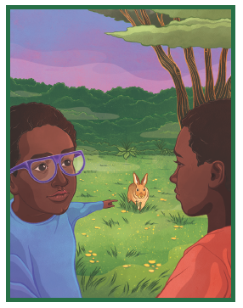
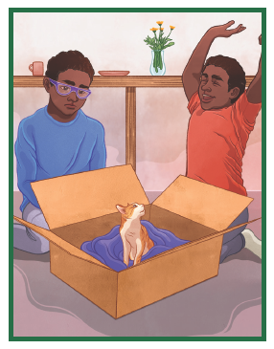
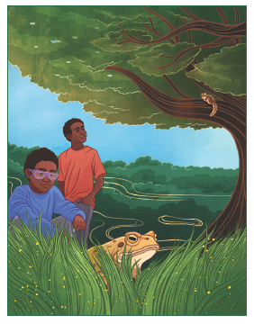
Picture Match
Passage ______
Passage ______
Passage ______

Slide 16
Independent Practice (K) Story 1
Independent Practice
More Practice 1 Read each story. Fill in each blank with the best word.
  Story 1: Kit went to bed. She put her doll in a crib. But Kit did not nap.
  She did not rest. She got up and went to Mom. Kit said, “Can I have
  some water? I will not drop it.”
  Mom said, “Yes, you can have some water, and we will have some
  bran muffins.”
  1. Kit went to ________.
school fled bed
  2. Kit put her doll in a ________.
twig sled crib
  3. Kit did not ________.
twin nap brim

Slide 17
Independent Practice (K) Story 1 — cont’d
  4. Kit will not ________ the water.
drop flat nest
  5. Kit and Mom had ________ muffins.
bran snap clam

Slide 18
Independent Practice (K) Story 2
  Story 2: Fred was on a red sled. Fred sped down the hill on the red sled.
  He got to the bottom fast. Brad saw Fred win the contest! Brad has a
  snapshot of Fred on the red sled.
  1. Fred was on a ________.
Sled shed crop
  2. Fred ________ down the hill.
led sped drop
  3. Fred got to the ________ fast.
brim restless bottom
  4. Brad saw Fred win the ________.
contest clam radish
  5. Brad has a ________ of Fred.
snapshot flat shipment

Slide 19
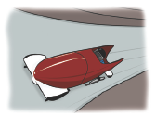


Independent Practice (L)
More Practice 2 Draw a line under the sentence that goes best
with each picture.
1. The bobsled sped down the hill.
The bobsled hit a flat rock.
2. Tess and Bess will clap.
Tess led Bess down the path.
3. Fred will sit on the twigs.
Fred will pick up the twigs.

Slide 20

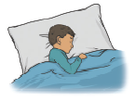

Independent Practice (L) — cont’d
  4. The van sped down the hill.
The van went to pick up the shipment.
  5. Jim will have a nap.
Jim will have a bran muffin.
6. Kat will not drop the jug.
The robin will sit in a nest.

Slide 21
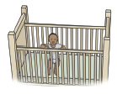
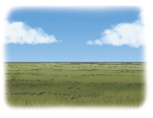
Independent Practice (L) — cont’d
7. The tot is in his crib.
The tot got up off the mat.
8. The land has lots of hills.
The land is flat.

