Slide 1
Say Sounds (A–B)
Say Sounds
Phonemic Awareness You will blend and segment sounds as you read and spell words.
Letter/Sound Associations Look at the letters. Say the sounds.
ar ur ir ck
or u ar i_e
ai ir or e
ur ch th ar
er a_e ir or

Slide 2
Read Words (C)
Read Words
New Words Say the sound. Sound out the word. Read the word.
sir bird bead
shirt curb sheet
thirst skirt sharp
purr chain churn
start blur purse
hurl cheap chirp

Slide 3
Read Words (D)
Word Families Read down. Read rapidly.
ash
cash
dash
trash
splash
mine
pine
dine
shine
twine
more
tore
chore
score
store
10 Second Challenge
Cold Timing words read
Practice words read
Hot Timing words read

Slide 4
Read Words (E–F)
Review Words Read a line of words. When your teacher gives a meaning, circle the correct word.
globe glob prize sweet
chase clap plan plain
bright swift boats boast
frail braid yeast fail
Words with Endings Read words with endings. 1. chasing 2. chaser 3. planner 4. clapped 5. sized 6. sharper 7. cheaper 8. splashing 9. churned 10. swirled

Slide 5
Read Words (G–H)
Multisyllabic Challenge Words Sound out the syllables. Read the whole word.
Thursday whirlwind sharpen disturb burden
farther birthday cheeseburger hurricane together
High-Frequency Words Say. Spell. Read.
other another mother do to
after things your put who

Slide 6
Read Sentences (I)
Read Sentences
Sentences Read the sentences with phrasing.
Who would like to come to my backyard to grill cheeseburgers?
The cat purrs when you put your hand on its back.
After Kendee fixed the other sink, she saw that her shirt was torn.
Conrad let me use his car to take my pet bird to the vet.
Please do not disturb your sister while she is doing her work.

Slide 7
Spell Words (J)
Spell Words
Spelling Journal Turn to the Spelling Journal on page 202.

Slide 8
Decodable Informative Text (Part 1)
Decodable Informative Text Read each part. Answer your teacher’s questions and select the picture that goes with each part.
Animal Tails
Part 1
Teacher Reads We often read about how parts of animal bodies help them—eyes, ears, nose, and teeth. But tails are important too. Many animals have a tail, and they use it for different purposes. Let’s learn about the purposes of some animals’ tails.
8
20
31
Sea animals with tails can use the tails to do lots of things. When a fish swishes its tail from side to side, its body curves. That helps a fish swim fast in water.

Slide 9
Decodable Informative Text (Part 1) — cont’d
34
43
53
64
74
Whales have big, firm tails that help the whales burst from the water with a high leap. When they come back down, they make a big splash and stir up the water. Some experts think whales may do this to communicate with other whales.

Slide 10
Comprehension Questions Part 1
Why does a fish swish its tail side to side?
A fish swishes its tail side to side to ________________.
What does a whale’s tail help it do?
A whale’s tail helps it ________________.
Why do some experts think whales may do this (burst from the water with a high leap)?
Some experts think whales may do this to ________________.

Slide 11
Decodable Informative Text (Part 2)
Part 2
Teacher Reads Some animals use their tails as fly swatters, tools that slap at annoying and harmful insects.
78
88
97
110
122
131
139
144
148
152
156
When bugs get close to elephants, it’s not a problem for elephants. These animals have long, thin tails with a thick bunch of fur at the end. They can flip and swirl that tail back and forth so bugs can’t bite or hurt them.
An elephant has another use for its tail. When elephants march in a line, each elephant grips another’s tail with its trunk. That way, the elephants stay together. The first elephant in line leads the rest of the herd.

Slide 12
Comprehension Questions Part 2
How can elephants use their tails to keep bugs away?
Elephants can ________________.
What is another way an elephant can use its tail?
Another way an elephant can use its tail is to ________________.

Slide 13
Decodable Informative Text (Part 3)
Part 3
Teacher Reads Some animals use their tails to grab things or for balance when they sit.
161
170
180
192
202
213
224
231
242
254
263
An opossum can grab onto things with its tail. An opossum’s tail can curl onto a branch to help the opossum. Its tail acts like a fifth leg. It helps the opossum go up a tree and then come back down.
A kangaroo has a tail that is very strong. It helps the kangaroo leap as far as 30 feet. A kangaroo can lean on its tail to sit down.
A tail serves and helps an animal in lots of ways. The next time you see an animal with a tail, ask this: What can the tail do to help the animal?

Slide 14
Comprehension Questions Part 3
What does an opossum’s tail help the opossum do?
An opossum’s tail helps the opossum ________________.
What does a kangaroo’s tail help the kangaroo do?
A kangaroo’s tail helps the kangaroo ________________.
Why are tails important to the animals that have them?
Tails are important to the animals that have them because ________________.

Slide 15
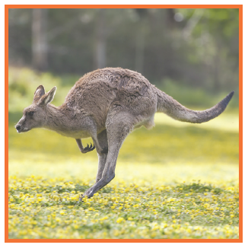
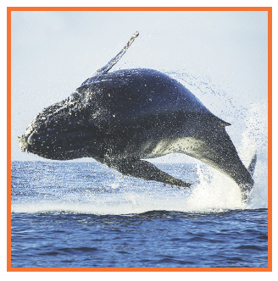
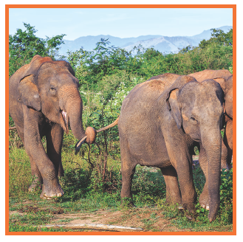
Picture Match
Part ______
Part ______
Part ______

Slide 16
Independent Practice (L) Part 1
Independent Practice
Text Comprehension Read each question. Think of the answer or look back at the text. Fill in the blank. Be sure the sentence makes sense.
Part 1
1. WHY do fish swish their tails side to side? Fish swish their tails side to side to ________________________________.
2. WHAT can a whale’s tail help it do? A whale’s tail can help it _________________________________________.
3. WHY do some experts think a whale may do this? Some experts think a whale may do this to __________________________.

Slide 17
Independent Practice (L) Part 2
Part 2
4. HOW can an elephant use its tail to get rid of bugs? An elephant can use its tail by ___________________________________
____________________________________________________________.
5. WHAT is another way an elephant can use its tail? Another way is to _____________________________________________.

Slide 18
Independent Practice (L) Part 3
Part 3
6. WHAT can an opossum’s tail help the opossum do? An opossum’s tail can help it ___________________________________.
7. WHAT can a kangaroo’s tail help the kangaroo do? A kangaroo’s tail can help it ____________________________________.
8. WHY are tails important to the animals that have them? Tails are important because ____________________________________.

Slide 19
Independent Practice (M) Story 1
More Practice Read each story. Answer the questions.
Story 1: You can turn your yard into a feeding spot for birds. This is what to do. First, see a clerk at a garden store. The clerk will help you pick feeders, seeds, and other things you might need. In your yard, put a feeder up high. Put another feeder in a different spot. Fill the feeders with seeds. Then wait for birds to come eat in your yard and burst into chirps!
1. WHERE can you feed birds? You can feed birds ______________________________________________.

Slide 20
Independent Practice (M) Story 1 — cont’d
2. HOW can a store clerk help you when you want to feed birds? A store clerk can help you ________________________________________.
3. WHAT will birds do after they eat in your yard? After they eat, birds will __________________________________________.

Slide 21
Independent Practice (M) Story 2
Story 2: The night was dark. Another storm was coming. A sharp wind was swirling the dirt in the barnyard. The wind swept bursts of snow at the barn. In the barn, the cats squirmed at first. Then they purred as they rested next to each other. Little pigs curled up in the hay with the mother pig. They all saw that things were safe in the barn.
1. WHY did the cats squirm? The cats squirmed because _____________________________________.
2. WHAT did the cats do after they squirmed? After the cats squirmed, they ____________________________________.
3. WHAT did the little pigs do? The little pigs ________________________________________________.

