Slide 1
Say Sounds (A–B)
Say Sounds
Phonemic Awareness Listen to the word your teacher says.
Then say the sounds or word parts in the word.
Letter/Sound Associations Look at the letters. Say the sounds.
  ch p sh a wh
  n o t th d
  th s u ch e
  sh wh z i g

Slide 2
Read Words (C)
Read Words
New Words Say the sound. Sound out the word. Read the word.
  shed this shop
  that thin chin
  ship chap chat
  whip chug chip
  then shut when

Slide 3
Read Words (D)
Word Families Read down. Read rapidly.
win
tin
thin
chin
shin
ten
pen
men
then
when
pick
lick
sick
thick
chick
10 Second Challenge
Cold Timing words read
Practice words read
Hot Timing words read

Slide 4
Read Words (E–F)
Review Words Read a line of words. When your teacher gives a meaning,
circle the correct word.
  lap lamp last lid
  bend bed bell hill
  hint lad land duck
  pack path bath boss
Multisyllabic Challenge Words Sound out the syllables. Read the whole word.
whiplash fishnet thickness potluck jobless

Slide 5
Read Words (G)
High-Frequency Words Say. Spell. Read.
  go no some after for
  see her the they people

Slide 6
Read Sentences (H)
Read Sentences
Sentences Read the sentences with phrasing.
  When I go to school on the bus, I sit in the back.
  After we jog to the pond, Seth and I can chat.
  Meg will whip some eggs for Dad to put in the mix.
  Did you see the hen go into the shed with her chicks?
  They go down a ramp to get off the deck of the ship.

Slide 7
Spell Words (I)
Spell Words
Spelling Journal Turn to the Spelling Journal on page 156.

Slide 8
Decodable Text (Part 1)
Decodable Text Read each part. Answer your teacher’s questions
and select the picture that goes with each part.
A Trip to Get Fish
Part 1
Teacher Reads A ship at the dock has been prepared for a fishing trip
out at sea. Supplies such as fishnets and ice chests for storing (keeping)
the fish they catch have been loaded. In this passage, we will learn that
fishing at sea can be exciting, but it can also be dangerous.
A big ship sits at the dock. Men go on the deck of the
ship to work a shift. Chet and Chad chat as they check
in. When they finish the check in, the ship chugs west
where they set fishnets in the water. A chest rests on the
deck. The men will fill the chest with fish from the nets.
With luck, they will get a lot of fish to sell.

Slide 9
Comprehension Questions Part 1
What will the men use to catch fish?
To catch fish, the men will use ________________.
What will the men fill the chest with?
The men will fill the chest with ________________.

Slide 10
Decodable Text (Part 2)
Part 2
Teacher Reads The crew of the ship fish all day. They catch many fish.
When the sun sets, Chet, Chad, and the men pick
up the fishnets from the water. They fill the chest with
bass and shellfish. Then they shut the lid. The ship will
chug back to the dock. But then, a sudden fog sends in
a thick mist. The men cannot see in the thick fog. Are
they lost?

Slide 11
Comprehension Questions Part 2
What happens when the ship heads back to the dock?
When the ship heads back to the dock, ________________.

Slide 12
Decodable Text (Part 3)
Part 3
Teacher Reads Many things, such as thick fog, can make fishing at sea
dangerous. Read on to find out something else that makes fishing at
sea dangerous.
Bump! Thud! The ship hit a very BIG rock. The
men did not see the rock in the thick fog. That rock
rips the ship and sends the men into the water. Will
the men get back to land?
Chet sees the lamp of a little ship. That little ship is
a tug. The tug can help them. The tug can pick up the
men. The tug can get the big ship back to land. That is
its job.

Slide 13
Comprehension Questions Part 3
What did the big rock do to the ship?
The big rock ________________.
What helped the men get back to land?
The men were helped by ________________.

Slide 14
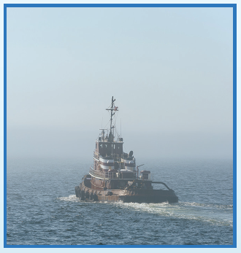
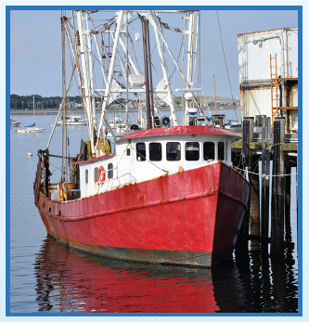
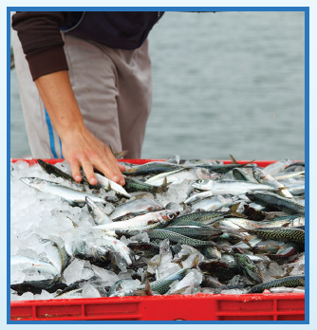
Picture Match
Passage ______
Passage ______
Passage ______

Slide 15
Independent Practice (K) Story 1
Independent Practice
More Practice 1 Read each story. Fill in each blank with the best word.
  Story 1: Chug. Chug. Chug. The big ship will chug into the inlet.
  Then the ship will dock. The men will go down the ramp to get on
  the ship. The men will get the fish off the ship. They will put the fish
  in a big box. Then they will shut the box.
  1. The ship will ________ into the inlet.
chug chap chip
  2. In the inlet, ________ ship will dock.
whip thin this
  3. The men will go down the ramp to get on
  the ________.
shed fish ship

Slide 16
Independent Practice (K) Story 1 — cont’d
  4. The men will put the ________ in a big box.
ship fish whip
  5. The men will ________ the box of fish.
chat shut bend

Slide 17
Independent Practice (K) Story 2
  Story 2: Chip is a chipmunk. He is not thin. When it is dusk, Chip gets
  nuts from the shed. Chip fills his nest with nuts. Chip cannot get nuts
  when Ben shuts the shed. Is that chipmunk a pest?
  1. Chip is not ________.
thin that shut
  2. At dusk, Chip gets nuts from the ________.
shed ship shut
  3. Chip cannot get nuts the ________ shed is shut.
whiz when whip
  4. Is ________ chipmunk a pest?
that thin then
  5. Will Ben ________ the shed?
chip chat shut

Slide 18
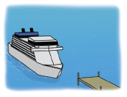
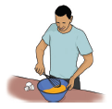
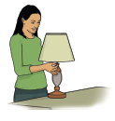
Independent Practice (L)
More Practice 2 Draw a line under the sentence that goes best
with each picture.
1. The ship will chug up to the dock.
This chap works on the ship.
2. Dad will get fish at the shop.
Dad will whip the eggs.
3. Pam shut off the lamp.
Pam cannot sit on the hot sand.

Slide 19
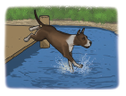
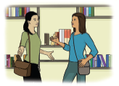
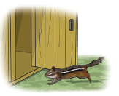
Independent Practice (L) — cont’d
  4. The dog licks the man on the chin.
The dog jumps into the pond.
  5. Jan and Lin will chat in the shop.
Jan will sip water with Lin.
6. A rabbit sat in the shed.
A chipmunk ran into the shed.

Slide 20

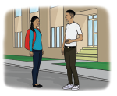
Independent Practice (L) — cont’d
7. This dish has a chip in it.
This dish has an egg on it.
8. Ron works in a shop after school.
Ron and Meg chat after school.

