Slide 1
Say Sounds (A–B)
Say Sounds
Phonemic Awareness Listen to the sounds or word parts as your teacher says a word slowly. Then say the word.
Letter/Sound Associations Look at the letter. Say the sound.
o s a i d
a g j i a
n o f i x
l t c p o
b i k m h

Slide 2
Read Words (C)
Read Words
New Words Say the sound. Sound out the word. Read the word.
cot cat tot
fox jog jig
got sop cod
cap not log
pat pot pit

Slide 3
Read Words (D)
Word Families Read down. Read rapidly.
jog
log
fog
hog
dog
cot
got
pot
tot
rot
rod
pod
cod
nod
sod
10 Second Challenge
Cold Timing words read
Practice words read
Hot Timing words read

Slide 4
Read Words (E–F)
Multisyllabic Challenge Words Sound out the syllables. Read the whole word. tactic mimic combat tonsil mascot
High-Frequency Words Say. Spell. Read.
put of from some he
my people school little water

Slide 5
Spell Words (G)
Spell Words
Spelling Journal Turn to the Spelling Journal on page 151.

Slide 6
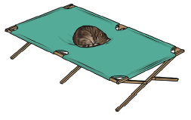
Read Text (H)
Read Text
Decodable Sentence Expansion Read each set of sentences. Then expand the last sentence by telling when. Select the picture that goes with each set.
The fox hid. The fox hid in a little log. The fox hid from the people in a little log. . . . , the fox hid from the people in a little log. _____

Slide 7

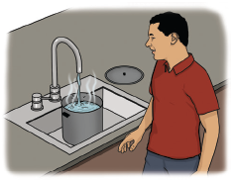
Read Text (H) — cont’d
Tom got a pot. Tom got a pot with a lid. Tom got a pot with a lid and put some hot water in it. . . . , Tom got a pot with a lid and put some _____ hot water in it.
The little cat got on the cot. The little cat got on the big cot. The little cat got on the big cot and had a nap. . . . , the little cat got on the big cot and had a nap. _____

Slide 8
Independent Practice (I)
Independent Practice
More Practice 1 Fill in each blank with the best word.
1. The fox ________ from the men.
hid hat hit
2. The ________ was sad.
fix mix tot
3. Six people ________.
jog lip bib
4. Bob and Sam ________ my cat.
pot pat cab
5. Put the ________ in a box.
ran jog cap

Slide 9
Independent Practice (I) — cont’d
6. Pam got a big ________ of water.
not pot sop
7. Sam ________ a big box.
jog got jig
8. The rat ran from the ________.
did sat cat
9. Pam is in a ________ cabin.
hat hit log
10. People nap on a ________.
cot sat not

Slide 10

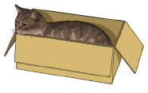

Independent Practice (J)
More Practice 2 Draw a line under the sentence that goes best with each picture.
1. The lid cannot fit on the pot.
The cod cannot fit in the pot.
2. The cat got in the cab.
The cat got in the box.
3. The tot has a little cap.
My cap is in the box.

Slide 11

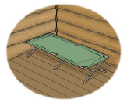

Independent Practice (J) — cont’d
4. The fox hid in the pit.
The tot pats the fox.
5. The cot is in the pot.
The cot is in the log cabin.
6. The man can sip.
The mop can sop up water.

Slide 12


Independent Practice (J) — cont’d
7. Dad got a job.
Nat jogs to school.
8. The napkin has a rip.
The canvas has big dots.

