Slide 1
Say Sounds (A–B)
Say Sounds
Phonemic Awareness Listen to the sounds as your teacher
says a word slowly. Then say the word.
Letter/Sound Associations Look at the letters. Say the sounds.
  rain day
  ai sh ch ay
  th wh a ck
  ai i ck ch
  e sh ai th
  ay ch u ay

Slide 2
Read Words (C)
Read Words
New Words Say the sound. Sound out the word. Read the word.
  fail day may
  wait wit tail
  way say sail
  maid mad stay
  pain pail play
  hay jail aid

Slide 3
Read Words (D)
Word Families Read down. Read rapidly.
sail
pail
tail
trail
snail
pain
rain
train
drain
plain
may
day
clay
play
spray
10 Second Challenge
Cold Timing words read
Practice words read
Hot Timing words read

Slide 4
Read Words (E–F)
Review Words Read a line of words. When your teacher
gives a meaning, circle the correct word.
  truck tuck tap Jeff
  blush lash shelf self
  miss Rob throb thin
  ship tick thick stick
Words with Endings Sound out the underlined base word.
Read the base word with the ending.
  1. rained 2. waited 3. sailed 4. trapped 5. missed

Slide 5
Read Words (G–H)
Multisyllabic Challenge Words Sound out the syllables.
Read the whole word.
  raindrop mailbox midday payday
  maybe away handstands seldom
High-Frequency Words Say. Spell. Read.
  were you of said have
  after from because people they

Slide 6
Read Sentences (I)
Read Sentences
Sentences Read the sentences with phrasing.
  You may get that set of drums from Ray.
  Alex’s dog Max wags his tail and then runs to us.
  You can pick up a tray from the top of the stack.
  They need to drag the hay to the shed.
  Mom and Dad said they will not have a picnic on
  Sunday because of rain.

Slide 7
Spell Words (J)
Spell Words
Spelling Journal Turn to the Spelling Journal on page 195.

Slide 8
Decodable Informative Text (Part 1)
Decodable Informative Text Read each part. Answer your
teacher’s questions and select the picture that goes with each part.
Skunks
Part 1
Teacher Reads This article focuses on how skunks defend and protect
themselves from predators by giving off, or sending out, a bad smell.
11
16
25
34
45
55
Can you spot a skunk? Maybe. But can you smell a
skunk after it sprays? Yes!
Skunks tend to stay away from people. And people
must stay away from skunks. A skunk will protect
itself if it cannot get away. It will stamp and hiss.
This tells people to back off. Some skunks lift up
in handstands!

Slide 9
Comprehension Questions Part 1
How can you tell a skunk has sprayed?
You can tell because ________________.
How are people warned that a skunk is protecting itself?
People are warned that a skunk is protecting itself when a skunk
________________.

Slide 10
Decodable Informative Text (Part 2)
Part 2
Teacher Reads Getting a whiff of skunk spray at a distance is bad,
but up close the intense (very strong) smell is overpowering. In case
you come face-to-face with a skunk, read on to learn how to avoid
skunk spray.
57
65
74
87
98
108
117
125
137
When people see a skunk, they must stand
still. If they cannot wait, they can back off,
but not in a fast way. If a skunk is upset, it will
raise its tail. It will aim its back end and spray.
A skunk has glands, like little sacs, on its back
end that can spray wet stuff that smells bad.
Some people can get sick from the smell.
It is not a faint smell. It is a very bad smell.
And that smell may last day after day.

Slide 11
Comprehension Questions Part 2
When people see a skunk, what should they do?
When people see a skunk, they should ________________.
If a skunk is upset, what might it do?
If a skunk is upset, it might ________________.
Why do people want to avoid skunk spray?
People want to avoid skunk spray because ________________.

Slide 12
Decodable Informative Text (Part 3)
Part 3
Teacher Reads A habitat is an area where an animal lives. Even though
skunks may live in different habitats, such as towns, cities, and farms,
you may never run into one. Skunks are nocturnal animals, usually only
active at night.
145
154
167
180
183
195
208
218
228
240
251
260
Seldom will people see a skunk. A skunk stays
hidden in its den in the day. A skunk may dig a den
itself. The den may be next to a shed. It may be next
to a deck.
A skunk spends the day at rest in its den. Then the
skunk will go to hunt. It looks in the grass to get grubs,
which are little bugs from eggs. The skunk snacks on
bugs that are pests. This helps people. The skunk will
snack on trash. This will not help people. It can be a
mess. At sunup, the skunk will go back to its den.
It is the best day when no skunk sprays.

Slide 13
Comprehension Questions Part 3
Why don’t people see skunks during the day?
People don’t see skunks during the day because ________________.
What may the diet of skunks include?
The diet of skunks may include ________________.
Where will a skunk go at sunup?
At sunup, a skunk will go ________________.

Slide 14
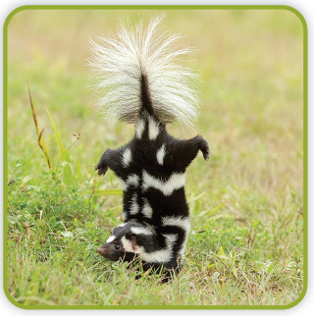
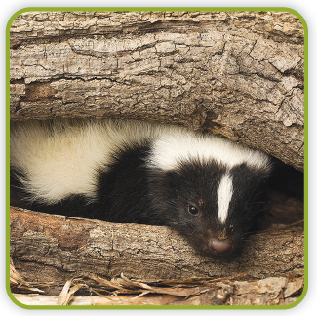
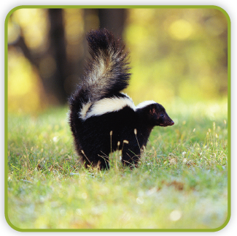
Picture Match
Part ______
Part ______
Part ______

Slide 15
Independent Practice (L) Part 1
Independent Practice
Text Comprehension Read each question. Think of the answer or look back
at the text. Fill in the blank. Be sure the sentence makes sense.
Part 1
  1. HOW can you tell when a skunk sprays?
  You can tell when a skunk sprays because you can _______________________.
  2. HOW will a skunk act to protect itself?
  To protect itself, a skunk will _________________________________________.

Slide 16
Independent Practice (L) Part 2
Part 2
  3. HOW must people act when they see a skunk?
  When people see a skunk, they must __________________________________.
  4. HOW may a skunk act if it gets upset?
  If a skunk gets upset, it may _________________________________________.
  5. WHY is it best to stay away from skunk spray?
  It is best to stay away from skunk spray because it has ____________________
  ________________________________________________________________.

Slide 17
Independent Practice (L) Part 3
Part 3
  6. WHERE is a skunk in the day?
  In the day, a skunk is ______________________________________________.
  7. WHAT can a skunk snack on?
  A skunk can snack on ______________________________________________.
  8. WHERE will a skunk go at sunup?
  At sunup, a skunk will go ___________________________________________.

Slide 18
Independent Practice (M)
More Practice Draw a line under the phrase that best completes
each sentence.
1. Ray put ________________.
a. a mop in the pail
b. a mop in the fail
2. A ship can ________________.
a. have a sail
b. have a tail
  3. Beth will ________________.
a. wait in the truck
b. wait in the pail
  4. Lin can ________________.
a. fill a rail
b. fill a pail

Slide 19
Independent Practice (M) — cont’d
5. Dad will ________________.
a. say the bill
b. pay the bill
6. The hen can ________________.
a. sit in the may
b. sit in the hay
  7. You can ________________.
a. play with the cat
b. pain with the cat

Slide 20
Independent Practice (M) — cont’d
8. The dog can ________________.
a. wag its tail
b. wag its trail
9. The man steps up to ________________.
a. get on the tray
b. get on the train
  10. We will ________________.
a. stay on the bus
b. way on the bus

