Slide 1
Say Sounds (A–B)
Say Sounds
Phonemic Awareness You will blend and segment sounds as you read and spell words.
Letter/Sound Associations Look at the letters. Say the sounds.
er o_e ar ai
ar er ow ar
ea er i_e o
er igh oa ar
igh a er e

Slide 2
Read Words (C)
Read Words
New Words Say the sound. Sound out the word. Read the word.
Bert jerk keep
harp term Herb
Bart team perch
serve sight peach
part night nerve
swerve yard card

Slide 3
Read Words (D)
Word Families Read down. Read rapidly.
wide
ride
side
slide
glide
row
low
show
snow
crow
seat
neat
heat
cheat
treat
10 Second Challenge
Cold Timing words read
Practice words read
Hot Timing words read

Slide 4
Read Words (E–F)
Review Words Read a line of words. When your teacher gives a meaning, circle the correct word.
snake snack grove shade
zone grip gripe fine
scope spine spin fin
glad glade scrap scrape
Words with Endings Read words with endings. 1. gripping 2. griping 3. scraper 4. spinning 5. finer 6. marching 7. herder 8. perched 9. marker 10. owned

Slide 5
Read Words (G–H)
Multisyllabic Challenge Words Sound out the syllables. Read the whole word.
member checkers permit pattern hamster
winter campus grasshopper carpenter assistant
High-Frequency Words Say. Spell. Read.
she he me be we
been school are work after

Slide 6
Read Sentences (I)
Read Sentences
Sentences Read the sentences with phrasing.
Please come and play checkers with me.
After trade school, Jen plans to be a carpenter.
Ms. Mondez said she will serve as a coach this term.
Bert had to swerve the car when he saw a dog in the road.
This winter, it snowed so much that we stayed home from school for a week!

Slide 7
Spell Words (J)
Spell Words
Spelling Journal Turn to the Spelling Journal on page 201.

Slide 8
Decodable Narrative Text (Part 1)
Decodable Narrative Text Read each part. Answer your teacher’s questions and select the picture that goes with each part.
Getting Jobs
Part 1
Teacher Reads The high school friends are still discussing their summer plans. Some friends haven’t yet shared their thoughts, but they will!
9
16
26
33
44
55
64
“My mom just baked some peach tarts,” Rand said. “She is the best baker. Dig in!”
Amara looked at Jen. “What do you plan to do when school is finished, Jen?” she asked.
“Well, I will go to trade school next winter. I would like to train to be a carpenter. Then I could make things like desks and shelves. I like making things!” said Jen.

Slide 9
Comprehension Questions Part 1
What did Jen plan to do after she finished high school?
After Jen finished high school, she planned to ________________.

Slide 10
Decodable Narrative Text (Part 2)
Part 2
Teacher Reads Read on to find out what Tessa’s plans are.
66
77
88
99
104
114
128
136
147
158
Amara said, “Robert will start as a clerk at the Herb Stern Market. Rand is going to State University to be a teacher, and Jen is going to be a carpenter. Tessa, what are you going to do?”
Tessa perked up. “Me? Well, I can’t go on campus yet. I think I will get a job as a clerk like Robert. After the summer, I will start at State University.”
“We should clean up the dishes and go back to the den. Then I will tell you my plans!” said Amara with a smile.

Slide 11
Comprehension Questions Part 2
What were Tessa’s summer plans?
Tessa’s summer plans were to ________________.

Slide 12
Decodable Narrative Text (Part 3)
Part 3
Teacher Reads Amara had said her plans might shock, or completely surprise, her friends. Read on to find out what she tells them about working with an expert, someone very skilled at something.
160
168
178
180
192
204
216
224
232
234
Tessa, Jen, Rand, Robert, and Amara went back to the den and sat down. “Well, Amara, tell us!” said Rand.
“I got a job as an assistant dog trainer! I will be working at a dog training school. I like dogs a lot, so it is the perfect job. I will work with an expert trainer, and she will teach me what to do.”
“Way to go, Amara!” yelled Robert. “You will be terrific!”

Slide 13
Comprehension Questions Part 3
What was Amara’s new job?
Amara’s new job was ________________.
Why was dog training the perfect job for Amara?
Dog training was the perfect job for Amara because ________________.

Slide 14
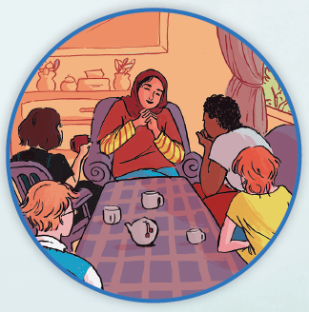
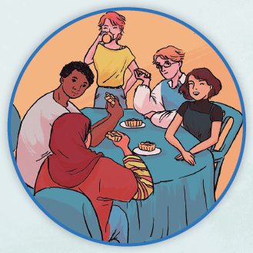
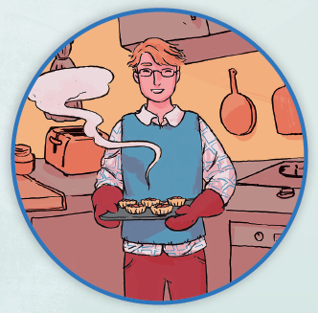
Picture Match
Part ______
Part ______
Part ______

Slide 15
Independent Practice (L) Part 1
Independent Practice
Text Comprehension Read each question. Think of the answer or look back at the text. Fill in the blank. Be sure the sentence makes sense.
Part 1
1. WHEN did Jen plan to go to trade school? Jen planned to go to trade school __________________________________.

Slide 16
Independent Practice (L) Part 1 — cont’d
2. WHAT did Jen say she would like to be? Jen said she would like to be _____________________________________.
3. WHY did Jen want to train to be a carpenter? Jen wanted to train to be a carpenter because ________________________ _____________________________________________________________.

Slide 17
Independent Practice (L) Part 2
Part 2
4. WHAT will Tessa do that is like Robert’s job plan? Like Robert, Tessa will ___________________________________________.

Slide 18
Independent Practice (L) Part 3
Part 3
5. WHAT job did Amara get? Amara got a job as ______________________________________________.
6. WHAT makes dog training the perfect job for Amara? Dog training is perfect for Amara because ____________________________.
7. WHY will Amara work with an expert trainer? An expert trainer will ______________________________________________.
8. WHAT did Robert say after Amara tells her plan? After Amara tells her plan, Robert said ________________________________.

Slide 19
Independent Practice (M) Story 1
More Practice Read each story. Answer the questions.
Story 1: Harper was a member of the swim team at school. When Harper started, she had to get up the nerve just to jump in the water. She did not want to get in. Coach Scott had a plan. He said, “Slow is better to start. You can speed up after a little bit.”
This pattern worked. After a while, it was no big deal for Harper to jump
in the water. She said, “Coach Scott helped me a lot!”
1. WHAT team was Harper on? Harper was on the ______________________________________________.

Slide 20
Independent Practice (M) Story 1 — cont’d
2. WHAT did Harper have to do to jump in the water? To jump in the water, Harper had to _________________________________.
3. WHO helped Harper get in the water? It was ____________________________ who helped Harper get in the water.

Slide 21
Independent Practice (M) Story 2
Story 2: Ervin raises sheep on a farm. He lets the herd of sheep graze on the hill. But he must check for ferns. If the sheep eat ferns, the ferns may kill the sheep.
In the winter, the sheep stay in the barn and eat hay. It is lots of work to raise sheep, but Ervin is glad to be on the farm.
1. WHAT did Ervin raise on his farm? On his farm, Ervin raised _________________________________________.
2. WHAT must Ervin check for when the sheep graze? When the sheep graze, Ervin must check for _________________________.
3. HOW did Ervin feel as he raised sheep? Ervin felt _____________________________________________________.

