Slide 1
Say Sounds (A–B)
Say Sounds
Phonemic Awareness Listen to the word your teacher says. Then say the sounds in the word.
Letter/Sound Associations Look at the letters. Say the sounds.
oa ee ow a
ai i u ay
sh ow oa ck
ea e ai oa
ow ay o ch

Slide 2
Read Words (C)
Read Words
New Words Say the sound. Sound out the word. Read the word.
coal slow flown
may mow goal
throw Gail foam
groan shown green
growth soak gray
cloak boast beast
Irregular Word: broad

Slide 3
Read Words (D)
Word Families Read down. Read rapidly.
oat
boat
coat
moat
float
tow
low
glow
blow
flow
seat
heat
neat
cheat
wheat
10 Second Challenge
Cold Timing words read
Practice words read
Hot Timing words read

Slide 4
Read Words (E–F)
Review Words Read a line of words. When your teacher gives a meaning, circle the correct word.
sprain chain lift shift
brain brass cheek faith
math feed fed flash
lean clean cream pail
Words with Endings Sound out the underlined base word. Read the base word with the ending.
1. soaked 2. mowed 3. sprayed 4. lifted 5. roamed
soaking mowing spraying lifting roaming

Slide 5
Read Words (G–H)
Multisyllabic Challenge Words Sound out the syllables. Read the whole word.
shallow shadow sailboat follow
seacoast busload railroad fishbowl
High-Frequency Words Say. Spell. Read.
been who come school down
all after was work are

Slide 6
Read Sentences (I)
Read Sentences
Sentences Read the sentences with phrasing.
Who will plant all the seeds to grow pumpkins?
I saw my shadow when I was standing in the sun.
After lunch, the kids will work to mow the grass.
Jed’s goal had been to finish painting the shed.
Sun-Yee put her hand in the shallow water to get the mud off.

Slide 7
Spell Words (J)
Spell Words
Spelling Journal Turn to the Spelling Journal on page 197.

Slide 8
Decodable Informative Text (Part 1)
Decodable Informative Text Read each part. Answer your teacher’s questions and select the picture that goes with each part.
Get a Goat!
Part 1
Teacher Reads It is not unusual to see goats on farms in the country. But now goats are coming to cities to do a new and important job.
9
17
28
39
49
Some land has lots of weeds and brush—thick, low-growing shrubs. This can be a problem. Plants and trees cannot grow in thick brush. Pests stay in the brush. People need to get rid of the weeds and brush. But some land is steep. People with trucks cannot get in to mow down the weeds and brush.

Slide 9
Decodable Informative Text (Part 1) — cont’d
57
69
78
90
This is a job for goats. They can work on steep land, eating weeds and brush. With goats, it means people will not have to spray to kill weeds. Spraying is bad for the land and bad for people.

Slide 10
Comprehension Questions Part 1
Why are weeds and thick brush a problem?
Weeds and thick brush are a problem because ________________.
When can’t people with trucks mow down the weeds and brush?
People with trucks can’t mow down the weeds and brush when ________________.
What can goats do when the land is steep?
When the land is steep, goats can ________________.

Slide 11
Decodable Informative Text (Part 2)
Part 2
Teacher Reads Some airports are using goats to provide a solution to a problem.
96
104
113
125
137
144
153
163
Brush and weeds may grow next to airport runways. This can be a problem because animals come to stay in the brush. Then the animals may get in the way of jets as they take off and land on the runways. Jets can crash because of the animals.
Goats can help with this problem. They eat the weeds and brush at the airport. With no brush left, animals will not stay next to runways.

Slide 12
Comprehension Questions Part 2
Why are brush and weeds next to airport runways a problem?
Brush and weeds next to airport runways are a problem at because ________________.
How do goats help solve this problem?
Goats help solve this problem by ________________.

Slide 13
Decodable Informative Text (Part 3)
Part 3
Teacher Reads Goats can also help with fire safety. They can help prevent wildfires.
170
181
191
203
215
225
228
238
249
260
262
272
277
When land gets little rain, it may fill up with loads of grass and brush. Then a wildfire can happen, and feed off all that grass and brush. So people need to get rid of such plants. But if the grass and brush grow on steep hills with rocks, people cannot get there to cut down the plants.
This is where goats come in. They can go where there are no roads. They can roam on steep hills to eat the grass and brush. The goal is to keep wildfires from happening.
Goats must be thrilled to have such jobs. They get paid with brush and weeds!

Slide 14
Comprehension Questions Part 3
What happens when land gets rain?
When land gets rain, ________________.
Why can’t people get rid of the grass and brush?
People can’t get rid of the grass and brush because ________________.
How do goats help to keep wildfires from happening?
Goats help to keep wildfires from happening by ________________.

Slide 15
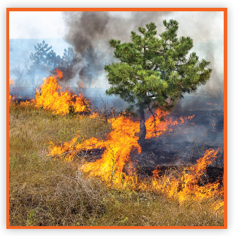
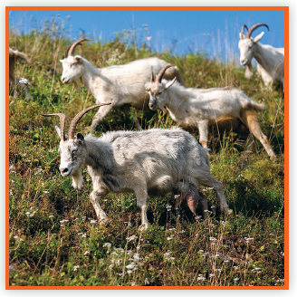
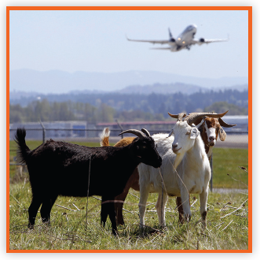
Picture Match
Part ______
Part ______
Part ______

Slide 16
Independent Practice (L) Part 1
Independent Practice
Text Comprehension Read each question. Think of the answer or look back at the text. Fill in the blank. Be sure the sentence makes sense.
Part 1
1. WHY are weeds and thick brush a problem? Weeds and thick brush are a problem because _______________________.
2. WHEN can people not mow down weeds and brush? People cannot mow down weeds and brush when ____________________.
3. WHAT can goats do when the land is steep? When the land is steep, goats can _________________________________.

Slide 17
Independent Practice (L) Part 2
Part 2
4. WHY are brush and weeds next to airport runways a problem? They are a problem because _________________________________.
5. HOW can goats help solve this problem? Goats can ________________________________________________.

Slide 18
Independent Practice (L) Part 3
Part 3
6. WHAT happens when land gets rain? When land gets rain, _________________________________________.
7. WHY is it that people cannot get rid of the grass and brush? People cannot get rid of it because ______________________________
__________________________________________________________.
8. HOW can goats help to keep wildfires from happening? Goats can help when they ____________________________________.

Slide 19
Independent Practice (M) Story 1
More Practice Read each story. Fill in each blank with the best word.
Story 1: People work on boats to get fish. The fish they get is sent from the boat to the dock. People on the dock load the fish into boxes. Then the fresh fish is sent to shops that sell the fish. People who own the shops put the fish in rows. They are glad to get lots of fresh fish.
1. People work on ________ to get fish.
beets boats bowls
2. People ________ the fish into boxes.
loan groan load
3. The fresh fish is sent to ________.
shops shows shocks
4. People put the fish in ________.
own rows flown

Slide 20
Independent Practice (M) Story 2
Story 2: Lin has been cleaning the truck. She cleans it with soap and a flow of hot water. There is a thick coat of dust on the truck. “This truck is green, not gray,” she tells Pat, who is her pal. “It will be a slow job to get it clean, but that is my goal. After all, I need to go to school in this truck!”
1. Lin’s truck needs to be ________.
cleaned mowed lifted
2. The truck has a thick ________ of dust.
road coat cast
3. Lin’s truck is ________.
cream groan green
4. A clean truck is Lin’s ________.
bowl goal goat

