Slide 1
Say Sounds (A–B)
Say Sounds
Phonemic Awareness You will blend and segment sounds as
you read and spell words.
Letter/Sound Associations Look at the letters. Say the sounds.
  ow er ch i_e
  th igh ee ck
  ar wh er oa
  a ar i ay
  er a_e ar e

Slide 2
Read Words (C)
Read Words
New Words Say the sound. Sound out the word. Read the word.
  her berg bright
  verse bark verb
  clay perk park
  clerk Clark herb
  start stern stain
  dark serve harm
Irregular Word: very

Slide 3
Read Words (D)
Word Families Read down. Read rapidly.
term
derm
perm
berm
term
bark
park
dark
shark
spark
may
say
gray
play
spray
10 Second Challenge
Cold Timing words read
Practice words read
Hot Timing words read

Slide 4
Read Words (E–F)
Review Words Read a line of words. When your teacher
gives a meaning, circle the correct word.
  lake lack close swim
  fate not note shame
  crave mine slide shrine
  shake swipe whale globe
Words with Endings Read words with endings.
1. noted 2. mining 3. closer 4. letting 5. swimmer
6. starter 7. herding 8. barking 9. trained 10. brighter

Slide 5
Read Words (G–H)
Multisyllabic Challenge Words Sound out the syllables.
Read the whole word.
  better whisper rocker sister gather
  number never person different kindergarten
High-Frequency Words Say. Spell. Read.
  could should would come some
  been who where very they

Slide 6
Read Sentences (I)
Read Sentences
Sentences Read the sentences with phrasing.
  Would you ask the clerk what that dress costs?
  You can come to the farm to gather different plants.
  The dogs will perk up when they see the treats I have.
  Where should Nilam park her van when she gets
  to the beach?
  It would have been better if the band played until ten.

Slide 7
Spell Words (J)
Spell Words
Spelling Journal Turn to the Spelling Journal on page 201.

Slide 8
Decodable Informative Text (Part 1)
Decodable Informative Text Read each part. Answer your
teacher’s questions and select the picture that goes with each part.
Dogs That Help
Part 1
Teacher Reads Service animals are dogs trained to work and do tasks for
people with disabilities. These dogs work every day to support people
with specific needs.
11
21
32
43
54
64
The term service dog is used for a dog that is
trained to do jobs for people. Service dogs help people.
A service dog may be trained to lead people who are
blind. Dogs can be trained to help people who are deaf
by letting them know if people are there. Dogs may be
trained to help people who have a hard time standing.
Dogs can get things for people.

Slide 9
Comprehension Questions Part 1
What is a service dog?
A service dog is ________________.
How may service dogs be trained to help people?
Service dogs may be trained to ________________.

Slide 10
Decodable Informative Text (Part 2)
Part 2
Teacher Reads The breed or kind of dog picked to be a service dog
depends on what the dog’s job will be. Certain breeds have proven very
good at helping people in certain ways.
70
77
87
95
103
111
122
130
137
Bigger, stronger breeds are perfect for leading
people and for helping people who have a hard time
standing and moving. Some breeds may be better
at helping people in wheelchairs. Dogs can get
things like bags and slippers for people, flip
lights on and off, and do lots of tasks like this.
Some service dogs help people shop by getting
things off shelves. When they get home,
dogs can help take socks off!

Slide 11
Comprehension Questions Part 2
What are the best jobs for bigger, stronger breeds?
The best jobs for bigger, stronger breeds are ________________.
Who are some breeds better at helping?
Some breeds are better at helping ________________.
What are some tasks that service dogs can do?
Some tasks that service dogs can do are ________________.

Slide 12
Decodable Informative Text (Part 3)
Part 3
Teacher Reads After the job is determined and the dog breed picked,
training begins.
143
152
162
171
182
192
202
213
224
234
245
255
Training for service dogs starts like all dog training.
When the dogs are pups, they are trained to sit,
stay, and come. They spend time with people and
full-grown dogs. The next part of the training is based
on the dog’s job and how the dog will help.
Dogs that will lead people who are blind are trained
to look for danger and swerve from harm to keep the
person safe. They are trained to stop if they see things
that could harm the person. Dogs that will help people
who have a hard time moving are trained to pick up
things that drop. They are trained to know the names
of things they will need to get and bring to people.

Slide 13
Decodable Informative Text (Part 3) — cont’d
266
275
283
No matter what the need, all service dogs are
trained to keep the people they serve safe.

Slide 14
Comprehension Questions Part 3
How does training for service dogs start?
Training for service dogs starts with ________________.
What is the training for dogs that lead people who are blind?
Dogs that lead people who are blind are trained to ________________.
What is the training for dogs that help people who have a hard time moving?
Dogs that help people who have a hard time moving are trained to
________________.

Slide 15
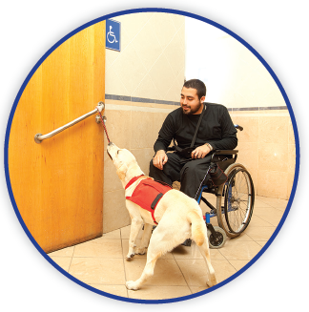
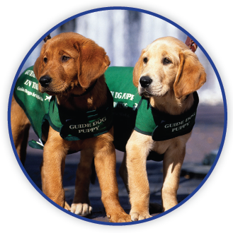
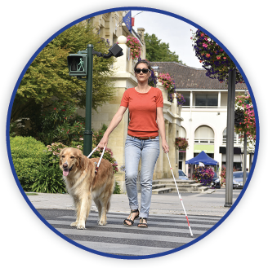
Picture Match
Part ______
Part ______
Part ______

Slide 16
Independent Practice (L) Part 1
Independent Practice
Text Comprehension Read each question. Think of the answer or look back
at the text. Fill in the blank. Be sure the sentence makes sense.
Part 1
  1. WHAT is the term “service dog” used for?
  A “service dog” is ______________________________________________.
  2. WHAT is one way service dogs may be trained to help people?
  Service dogs may _____________________________________________.

Slide 17
Independent Practice (L) Part 2
Part 2
  3. WHAT are the best jobs for bigger and stronger breeds?
  The best jobs for bigger and stronger breeds are ______________________
  _____________________________________________________________.
  4. WHO are some breeds better at helping?
  Some breeds are better at helping _________________________________.
  5. WHAT is one task that service dogs can do?
  Service dogs can _______________________________________________.

Slide 18
Independent Practice (L) Part 3
Part 3
  6. WHAT is something that training service dogs start with?
  Training starts with ______________________________________________.
  7. WHAT is the training for dogs that lead people who are blind?
  Dogs are trained to ______________________________________________.
  8. WHAT is the training for dogs that help people who have a hard time moving?
  Dogs are trained to ______________________________________________.

Slide 19
Independent Practice (M) Story 1
More Practice Read each story. Answer the questions.
  Story 1: Kim had to make up a song verse. The verse would be part of her
  grade. So it had better be her very best work. Kim made a list of some verbs.
  Then she got stuck. Perhaps she could tell of a cat that sat. At last, Kim made
  up a verse with a king who could sing. She felt that the verse should get a
  fine grade.
  1. WHY did Kim have to do her very best work?
  She had to do her very best work because ___________________________.

Slide 20
Independent Practice (M) Story 1 — cont’d
  2. WHAT did Kim put in her verse?
  In her verse, Kim put a king who could ______________________________.
  3. WHAT did Kim think of her verse?
  Kim felt that ___________________________________________________.

Slide 21
Independent Practice (M) Story 2
  Story 2: A number of crows would gather at Herm’s barn each day and perch
  on top. On this day, a little crow and a big crow had a fight. Herm had never
  seen such a thing. Should he see if he could stop the fight?
  Then some very big crows came by. The fight stopped. All the crows left
  the barn. They swerved off to perch in different trees.
  1. WHERE would the crows gather each day?
  Each day, the crows would gather _________________________________.
  2. WHEN did the fight stop?
  The fight stopped when _________________________________________.
  3. WHERE did all the crows go?
  All the crows went to ___________________________________________.

