Slide 1
Say Sounds (A–B)
Say Sounds
Phonemic Awareness Listen to the sounds or word parts as your teacher
says a word slowly. Then say the word.
Letter/Sound Associations Look at the letter. Say the sound.
  n o t s u
  i p a u o
  b u c d a
  h u o g i
  k l f a j

Slide 2
Read Words (C)
Read Words
New Words Say the sound. Sound out the word. Read the word.
  bud bid but
  cub cab tub
  cup cod hut
  not nut hot
  bus dug dog

Slide 3
Read Words (D)
Word Families Read down. Read rapidly.
nut
cut
but
hut
gut
tug
jug
hug
lug
rug
fun
bun
sun
run
pun
10 Second Challenge
Cold Timing words read
Practice words read
Hot Timing words read

Slide 4
Read Words (E–F)
Multisyllabic Challenge Words Sound out the syllables. Read the whole word.
public ribbon campus hiccup cotton
High-Frequency Words Say. Spell. Read.
  she went saw very you
  her of put he people

Slide 5
Spell Words (G)
Spell Words
Spelling Journal Turn to the Spelling Journal on page 152.

Slide 6
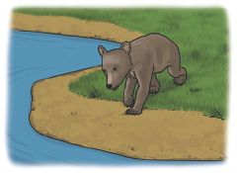
Read Text (H)
Read Text
Decodable Sentence Expansion Read each set of sentences. Then expand the last sentence by telling when. Select the picture that goes with each set.
  She had a hot dog.
  She had a hot dog and nuts.
  She had a hot dog, nuts, and a cup of hot water.
  . . . , she had a hot dog, nuts, and a cup of hot water. _____

Slide 7
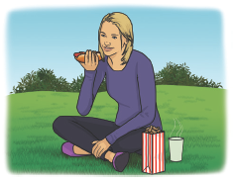
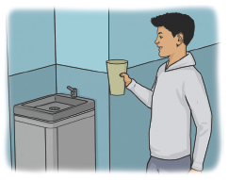
Read Text (H) — cont’d
  Tim put water in a cup.
  Tim put water in a big cup.
  Tim put water in a big cup at school.
  . . . , Tim put water in a big cup at school. _____
  The cub got up.
  The cub got up and ran to the water.
  The cub and his mom got up and ran to
  the water.
  . . . , the cub and his mom got up and ran to
  the water. _____

Slide 8
Independent Practice (I)
Independent Practice
More Practice 1 Fill in each blank with the best word.
  1. Pam went in a ________.
cat cab dog
  2. She has a ________.
nut dug mad
  3. The sun is very ________.
hut hot not
  4. People sit in the ________.
cup mug bus
  5. The ________ dug a pit.
hot dog bud

Slide 9
Independent Practice (I) — cont’d
  6. We saw the ________.
us dug cub
  7. Hot water is in the ________.
bid not tub
  8. A rug is in the ________.
not hut fun
  9. Water is not in the ________.
cup dug us
  10. The ________ is in the pot.
hot cod bid

Slide 10
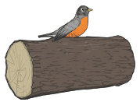
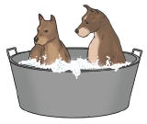
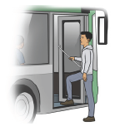
Independent Practice (J)
More Practice 2 Draw a line under the sentence that goes best with each picture.
1. The robin sat on a bud.
The robin sat on a log.
2. The dogs are in the tub.
The dogs are in the cab.
3. Tim got on the public bus.
Tim has a cotton cap.

Slide 11
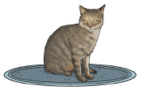
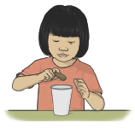

Independent Practice (J) — cont’d
  4. Her cat dug a pit.
Her cat sat on the rug.
  5. Kim put a nut in the cup.
Kim can pat the tub.
6. The sun is very hot.
The pot is very hot.

Slide 12
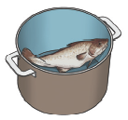
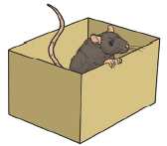
Independent Practice (J) — cont’d
7. He put the cod in the pot.
He put the cod in the mug.
8. A rat ran from the hut.
A rat got in the box.

