Slide 1
Say Sounds (A)
Say Sounds
Letter/Sound Associations Look at the letters. Say the sounds.
aw oo au oa
ee ay ow aw
oo au i igh
ai oo aw ea

Slide 2
Read Words (B)
Read Words
New Words Say the sound. Sound out the word. Read the word.
fault straw stool
dream drawn vault
claw freed shawl
flow flaw flee
Irregular Word: because

Slide 3
Read Words (C)
Word Families Read down. Read rapidly.
raw
jaw
thaw
slaw
straw
dawn
fawn
lawn
yawn
drawn
room
boom
bloom
gloom
broom
10 Second Challenge
Cold Timing words read
Practice words read
Hot Timing words read

Slide 4
Read Words (D–E)
Multisyllabic Challenge Words Sound out the syllables. Read the whole word.
applause coleslaw withdrawn sawdust drawback
autumn sweepstakes wayside bridegroom entertainment
Prefixes and Suffixes Say the word. Then say the prefix or suffix.
PREFIXES | SUFFIXES
1. return preheat | madness helpless
2. un- dis- re- pre- | -able -ful -ness -less
Expert Tip: The prefix pre- means before in these words: prepaid (paid before), preplan (plan before), preread (read before).

Slide 5
Read Words (F–G)
Words with Prefixes and Suffixes Say the underlined affix. Read the whole word.
pretend reflects dismay unhurt
speechless freshness affordable pocketful
returnable distinctness preventable unthankful ness
High-Frequency Words Say. Spell. Read.
other another brother mother where there
what put
animals care because why one

Slide 6
Read Sentences (H)
Read Sentences
Sentences Read the sentences with phrasing.
The mother hawk takes care of her chicks.
Montel saw what was in the bank vault.
Where can we put the water and fresh straw for the farm animals?
My brother wants more of that coleslaw because he likes it so much.
Paula, can you get another shawl to take in the car?

Slide 7
Spell Words (I)
Spell Words
Spelling Journal Turn to the Spelling Journal on page 240.

Slide 8
Decodable Narrative Text (Part 1)
Decodable Narrative Text Read each part. Answer your teacher’s questions and select the picture that goes with each part.
A Mistake
Part 1
Teacher Reads Jade has not seen her friend Paula since Paula’s accident. Paula had been in the hospital, but now she is recovering and resting at
home.
12
23
36
48
“We all miss you at school,” Jade said to Paula as they sat in Paula’s bedroom. “Did you get the card we sent? Ms. Flores let me choose the card because I said I was going to visit you today.” Paula nodded and gave a little smile, but she did not speak.

Slide 9
Decodable Narrative Text (Part 1) — cont’d
Part 1 continued
52
61
74
86
99
110
115
126
138
Jade said, “I have never seen you speechless before. It must be hard for you! Are you in a lot of pain?” Jade paused and then said, “I keep doing that! It’s not your fault you can’t speak. You have a broken jaw after all, but I keep asking you about things! Let’s play cards. Wave at me when you need to rest.” Paula and Jade played a card game. But then Paula waved her hand because she had to rest. Jade said she would return for another visit soon. Then she left.

Slide 10
Comprehension Questions Part 1
Who are the characters in this part of the story?
The characters in this part of the story are ________________.
What is the setting in this part of the story?
The setting in this part of the story is ________________.
Why was Paula not speaking?
Paula was not speaking because ________________.

Slide 11
Decodable Narrative Text (Part 2)
Part 2
Teacher Reads Later, Jade and her mother had a conversation about
Paula and the accident.
145
155
167
171
183
200
213
223
235
246
260
275
“Did you see Paula today?” her mother asked when Jade got home. “I understand she will need to rest for a long time—maybe until August.”
“Yes, I saw her,” Jade said. “We played cards for a while, but I left when she had to rest. I think she is in a lot of pain. She has a broken jaw and three cracked ribs. Her left arm is also sprained. That car crash caused big problems for her. She will miss a lot of school, too. Ms. Flores is recording lessons for her. Paula can play the recordings on her laptop at home, but it’s not the same as being in school with the rest of us. It must be hard to stay in bed all day,” Jade added with a sigh.

Slide 12
Comprehension Questions Part 2
Who was Jade speaking to in this part of the story?
In this part of the story, Jade was speaking to ________________.
How did Paula get hurt?
Paula got hurt ________________.
What was one problem Paula had?
One problem Paula had was ________________.

Slide 13
Decodable Narrative Text (Part 3)
Part 3
Teacher Reads Read on to find out how the accident happened and
why Paula is so badly hurt.
277
288
298
309
323
337
347
360
362
372
384
400
406
“It’s a shame,” Jade’s mother said. “A car didn’t stop in time and crashed into the car Paula’s mother was driving. Paula’s mother was not hurt because she wore a seat belt. Paula was in the back seat, but she did not have her seat belt on. She had her seat belt off to reach for a straw that fell. That’s why she got hurt! Her pain was preventable. Paula might not have been hurt so bad if she had kept her seat belt on.”
“You are right, Mom,” said Jade. “Seat belts keep people safe. Ms. Flores said there are seat belt laws in most states. I will use a seat belt each time I ride in a car. I think Paula will do that from now on.”

Slide 14
Comprehension Questions Part 3
Why did Paula get hurt in the car crash but not her mother?
Paula got hurt because ________________.
What did Paula’s problems help Jade understand?
Paula’s problems helped Jade understand that ________________.

Slide 15
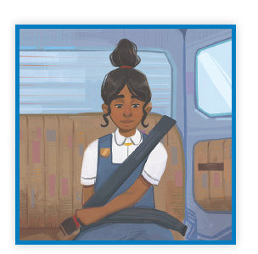
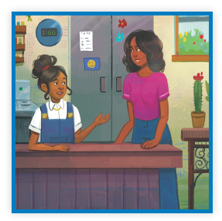
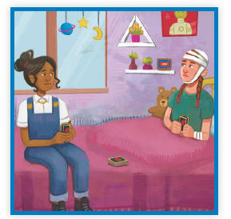
Picture Match
Part ______
Part ______
Part ______

Slide 16
Independent Practice (K) Part 1
Independent Practice
Text Comprehension Read each question. Think of the answer or look back at the text. Fill in the blank. Be sure the sentence makes sense.
Part 1
1. WHO is this part of the story about? This part of the story is about _____________________________________________
2. WHAT is the setting in this part of the story? This setting in this part of the story is _______________________________________ 3. WHY was Paula not speaking? Paula was not speaking because __________________________________________.

Slide 17
Independent Practice (K) Part 2
Part 2
4. WHO was Jade speaking to in this part of the story? In this part of the story, Jade was speaking to _________________________.
5. HOW did Paula get hurt? Paula got hurt __________________________________________________. 6. WHAT was one problem Paula had? One problem that Paula had was ___________________________________ ______________________________________________________________ ______________________________________________________________.

Slide 18
Independent Practice (K) Part 3
Part 3
7. WHY did Paula get hurt but not her mother? Paula got hurt because she ________________________________________ _______________________________________________________________.
8. WHAT did Paula’s problems help Jade understand? Paula’s problem helped Jade understand that __________________________ _______________________________________________________________.

Slide 19
Independent Practice (L)
More Practice • Activity 1 Fill in each blank with the best word.
shawl exhaust vault
hawk autumn sawdust
1. There were piles of ________ next to the lumber mill.
2. A ________ has a strong beak and sharp talons.
3. Mom put on her ________ because it got cool at dusk.
4. The season after summer is ________.

Slide 20
Independent Practice (L) — cont’d
5. The________ coming from the dump truck has
a bad smell.
6. What can you keep in a bank ________?

Slide 21
Independent Practice (M)
More Practice • Activity 2 Fill in each blank with the best word.
1. Lin will heat the grill before she puts on the meat. Lin will ________________ the grill.
pretend
preheat
prepay
2. The corn muffins were just baked. You will like the _____________ of the muffins.
freshness
madness
likeness
3. Some animals hunt in the morning darkness when
the sun has not yet come up. They hunt in
the _________________ darkness.
predawn
prevent
pretend

Slide 22
Independent Practice (M) — cont’d
4. Allen fell off his bike, but he is fine. Allen is___________________.
unhurt
unlock
unseen
5. I was so shocked by the surprise party I could not speak. I was _________________.
flawless
nameless
speechless
6. My mother will take the TV back to the store. She will __________________ the TV to the store.
report
return
refill

