Slide 1
Say Sounds (A–B)
Say Sounds
Phonemic Awareness Listen to the sounds or word parts as your teacher says a word slowly. Then say the word.
Letter/Sound Associations Look at the letter. Listen to your teacher say the sound. Then say the sound.
a i m i x
n i s a w
v d i f a
p a r t i
h l a c b

Slide 2
Read Words (C)
Read Words
New Words Say the sound. Sound out the word. Read the word.
fix ad wax
win van sap
sip mad lid
map fin fan
rat six mix

Slide 3
Read Words (D)
Word Families Read down. Read rapidly.
at
sat
fat
rat
cat
ad
sad
mad
had
bad
it
sit
fit
bit
hit
10 Second Challenge
Cold Timing words read
Practice words read
Hot Timing words read

Slide 4
Read Words (E–F)
Multisyllabic Challenge Words Sound out the syllables. Read the whole word.
tidbit limit satin valid habit
High-Frequency Words Say. Spell. Read.
my her he we on
the school water little people

Slide 5
Spell Words (G)
Spell Words
Spelling Journal Turn to the Spelling Journal on page 150.

Slide 6
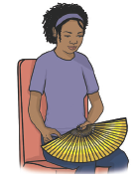
Read Text (H)
Read Text
Decodable Sentence Expansion Read each set of sentences. Then expand the last sentence by telling where. Select the picture that goes with each set.
Six people sat. Six people sat in a van. Six people sat in a tan van. Six people sat in a tan van . . . _____

Slide 7
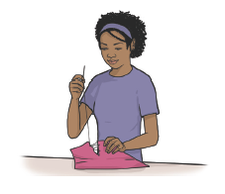
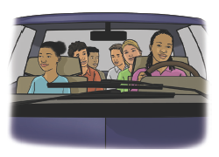
Read Text (H) — cont’d
Nan had a fan. Nan had a satin fan. Nan had a big satin fan. Nan had a big satin fan . . . _____
Nan can fix a rip. Nan can fix a little rip. Nan can fix a little fabric rip. Nan can fix a little fabric rip . . . _____

Slide 8
Independent Practice (I)
Independent Practice
More Practice 1 Fill in each blank with the best word.
1. Sam can fix the ________.
win fan ran
2. The people sat in the ________.
fin fan van
3. Nan has a big ________.
wax sap map
4. The van has a limit of ________ people.
sip six fix
5. The little rat ________ to the big rat.
fan win ran

Slide 9
Independent Practice (I) — cont’d
6. Sam can ________ the water.
sip sap map
7. We can fix the ________ in the satin.
lip lap rip
8. Dan ________ at the school.
sit six sat
9. The tin can has a ________.
lap win lid
10. The cat had a ________.
mad nap man

Slide 10

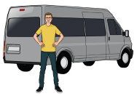
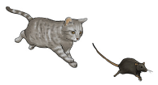
Independent Practice (J)
More Practice 2 Draw a line under the sentence that goes best with each picture.
1. The man has a map.
The man has an ad.
2. Sam can win a map.
Sam can win a van.
3. A cat ran to a rat.
A rat ran to school.

Slide 11
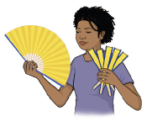


Independent Practice (J) — cont’d
4. Nan has six satin fins.
Nan has six satin fans.
5. The can has a lid.
The can has a fin.
6. Nan can nap.
Nan can sip.

Slide 12
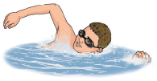
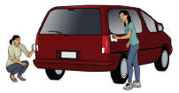
Independent Practice (J) — cont’d
7. Sam is in the van.
Sam is in the water.
8. The people can wax the van.
The people are in the van.

