Slide 1
Say Sounds (A–B)
Say Sounds
Phonemic Awareness Listen to the word your teacher says.
Then say the sounds or word parts in the word.
Letter/Sound Associations Look at the letters. Say the sounds.
  ch e s m sh
  a th n wh z
  g t sh p th
  u d i ch o

Slide 2
Read Words (C)
Read Words
New Words Say the sound. Sound out the word. Read the word.
  when chin then
  them thin shed
  whiz shut shin
  chug chum shell
  that chap this

Slide 3
Read Words (D)
Word Families Read down. Read rapidly.
rug
tug
dug
chug
shrug
back
pack
tack
shack
whack
hill
will
fill
chill
thrill
10 Second Challenge
Cold Timing words read
Practice words read
Hot Timing words read

Slide 4
Read Words (E–F)
Review Words Read a line of words. When your teacher gives a meaning,
circle the correct word.
  must rush rash mess
  kiss kick hiss wish
  tan ten tent west
  jam jump camp mitt
Multisyllabic Challenge Words Sound out the syllables. Read the whole word.
radish endless eggshell shipment basket

Slide 5
Read Words (G)
High-Frequency Words Say. Spell. Read.
  very have they of are
  water work look little put

Slide 6
Read Sentences (H)
Read Sentences
Sentences Read the sentences with phrasing.
  There are thin twigs on the path.
  Jess was very hot and had to chug lots of water.
  I have to put on this mask to act in the school play.
  Josh and Tam said they can work with us to send the shipments.
  Thelma will pick up the eggshells and put them in the basket.

Slide 7
Spell Words (I)
Spell Words
Spelling Journal Turn to the Spelling Journal on page 156.

Slide 8
Decodable Text (Part 1)
Decodable Text Read each part. Answer your teacher’s questions
and select the picture that goes with each part.
Eggs to Sell
Part 1
Teacher Reads Two friends, Shan and Thelma, own a chicken farm.
They work hard to make a living by raising hens and chicks and selling
eggs to earn money.
Shan and Thelma will sell eggs. Shan checks the
nests in the shed for eggs. Some eggs will be kept
for chicks, and some eggs Shan and Thelma will sell
for cash.
Shan will look for chips in the eggshells. She will
not pick an egg with a chip in its thin shell. Thelma
gets a big basket from the shelf. She helps Shan fill the
basket with eggs.

Slide 9
Comprehension Questions Part 1
What will Shan and Thelma do with the eggs in the basket?
Shan and Thelma will ________________.

Slide 10
Decodable Text (Part 2)
Part 2
Teacher Reads After carefully filling the basket with eggs, Shan and
Thelma prepare the eggs to be sold.
The basket of eggs will go to the hut next to the
shed. In the hut, Shan and Thelma will get a box for
eggs. They will pad the box with a thick, soft mat. This
will help the eggs not to shift. The eggshells
will not chip. Shan will pick up an egg and put it in
the box. A lot of eggs go in a box. It is work to pack
the eggs. But it is fun to sell them.

Slide 11
Comprehension Questions Part 2
How do Shan and Thelma prepare the eggs to sell?
Shan and Thelma prepare the eggs to sell by ________________.
Why did Shan and Thelma put a thick, soft mat in the box?
Shan and Thelma put a thick, soft mat in the box to ________________.

Slide 12
Decodable Text (Part 3)
Part 3
Teacher Reads After the eggs are packed in boxes, they are put on a
rack in Shan and Thelma’s van. They will take the eggs to a farm store
to be sold.
Shan and Thelma chat when they are in the van.
Thelma tells Shan, “We will get chicks from the eggs
we left back in the shed. When the chicks are big, we
will have a lot of eggs to sell. Then we will get a lot of
cash. It is work, but it is fun to have eggs to sell.”

Slide 13
Comprehension Questions Part 3
Why were some eggs not sold?
Some eggs were not sold because ________________.

Slide 14
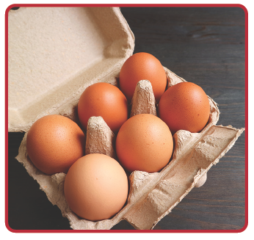
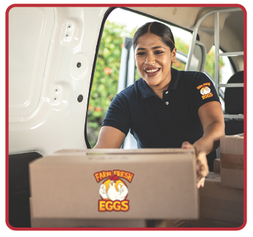
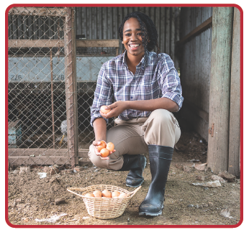
Picture Match
Passage ______
Passage ______
Passage ______

Slide 15
Independent Practice (K) Story 1
Independent Practice
More Practice 1 Read each story. Fill in each blank with the best word.
  Story 1: Lin dug and dug. She dug in the sand. It was an endless job.
  Lin dug up a thin shell. The shell will go in a bucket.
  1. Lin dug in the ________.
shin when sand
  2. It was an ________ job.
endless ship chop
  3. Lin dug up a ________.
shipment radish shell
  4. The shell was ________.
thin chin shed
  5. The shell will go in a ________.
ship bucket shut

Slide 16
Independent Practice (K) Story 2
  Story 2: Jeff has a task. He bends down to get some rocks. He puts them
  in a big box. Jeff picks up the big box of rocks. He sets the box in the shed.
  Jeff shuts the shed and then locks it.
  1. Jeff has a ________.
task chum mask
  2. Jeff bends down to get ________.
chips rocks socks
  3. Jeff puts the rocks in a ________.
shut ship box
  4. Jeff ________ up the big box.
picks chugs sets
  5. Jeff ________ the shed.
chops locks chips

Slide 17
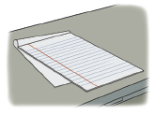
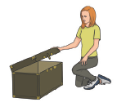
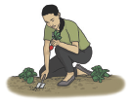
Independent Practice (L)
More Practice 2 Draw a line under the sentence that goes best
with each picture.
1. The thin pad is on the desk.
The thin rod is in the bag.
2. Kat and Tim lock the shed.
Kat shuts the lid.
3. Lin digs up a thin radish.
Lin fills the bucket with eggs.

Slide 18

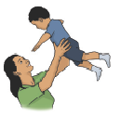
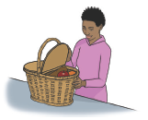
Independent Practice (L) — cont’d
  4. That red dish has a chip.
The fish is on this dish.
  5. Jeff picks up the box of rocks.
Mom picks up the tot.
6. Ann shut the basket.
Ann shut the shed.

Slide 19
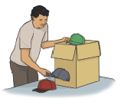

Independent Practice (L) — cont’d
7. Jack got a shipment of caps.
Jack got a shipment of socks.
8. I see some eggshells in a nest.
I see some eggshells on a dish.

