Slide 1
Say Sounds (A)
Say Sounds
Letter/Sound Associations Look at the letters. Say the sounds.
oo ea o ai
igh i oo oa
e oo ow u
ay ee sh oo

Slide 2
Read Words (B)
Read Words
New Words Say the sound. Sound out the word. Read the word.
room stool loose
root steal roof
booth mood beach
hoop lease bloom

Slide 3
Read Words (C)
Word Families Read down. Read rapidly.
room
broom
bloom
gloom
groom
tool
fool
stool
spool
drool
hoop
stoop
troop
droop
scoop
10 Second Challenge
Cold Timing words read
Practice words read
Hot Timing words read

Slide 4
Read Words (D–E)
Multisyllabic Challenge Words Sound out the syllables. Read the whole word.
dustproof mushroom loosen foolish tattoo
boosters supporters important elect candidate
Prefixes and Suffixes Say the word. Then say the prefix or suffix.
PREFIXES | SUFFIXES
1. unlock distrust | teachable handful
2. un- dis- | -able -ful
Expert Tip: The suffix -able means able to in these words:
mendable (able to mend), useable (able to use), mixable (able to mix).

Slide 5
Read Words (F–G)
Words with Prefixes and Suffixes Say the underlined affix. Read the whole word.
disown unload untwist displease
workable boastful needful harmful
disagreeable unfaithful distressing unhelpful
High-Frequency Words Say. Spell. Read.
all call hall ball fall where there now how
want put
about also were through

Slide 6
Read Sentences (H)
Read Sentences
Sentences Read the sentences with phrasing.
I have been cleaning my room all morning.
Tish likes how a day at the beach puts her in a fine mood.
Mom and I were fixing the loose gate in the backyard.
I also saw that cartoon about a foolish moose and a smart fox.
Jake can put the basketball through the hoop because he is so tall.

Slide 7
Spell Words (I)
Spell Words
Spelling Journal Turn to the Spelling Journal on page 239.

Slide 8
Decodable Informative Text (Part 1)
Decodable Informative Text Read each part. Answer your teacher’s questions and select the picture that goes with each part.
Why We Vote
Part 1
Teacher Reads When people vote, they make a choice between two
or more things. Voting can help a group come to a decision about
what to do.
11
21
34
44
58
72
When people want to choose food for a meal at home, they might have different ways of thinking about it. When kids in a classroom want to pick a game to play, they might have different ways of thinking, too. That’s where voting can help. Each person gets one vote. It is a way for each person to have a say in what a group of people will do. Voting can be important in day-to-day life.

Slide 9
Comprehension Questions Part 1
What is the topic of the text?
The topic of the text is ________________.
How can voting be important for people in a group?
Voting can be important for people in a group because ________________.

Slide 10
Decodable Informative Text (Part 2)
Part 2
Teacher Reads A candidate is a person who wants to get elected, or
chosen to serve in government. Candidates try to prove to voters that
they will do a good job if they are elected.
78
86
97
109
119
127
137
150
161
Voting is important beyond home and school, too. In the U.S., people use voting to choose leaders. A person who wants to be elected as a leader is called a candidate. Voters may need to choose from a group of candidates.
Before voting day, each candidate will make speeches, run ads, and meet with lots of voters. Each candidate wants to show that she or he is right for the job. Boosters, or supporters, help each candidate try to get votes and get elected.

Slide 11
Comprehension Questions Part 2
How do people choose leaders in the U.S.?
People choose leaders in the U.S by ________________.
What is a candidate?
A candidate is ________________.
What will a candidate do to get elected?
To get elected, a candidate will ________________.

Slide 12
Decodable Informative Text (Part 3)
Part 3
Teacher Reads In the United States, there are rules about who can vote
in elections and how they can vote.
162
173
186
198
209
221
234
245
253
265
276
288
293
As soon as U.S. citizens turn 18, they may become voters if they want to vote. On voting day, voters can go in person to vote. They might vote in a school or another public spot. Inside, people cast votes in voting booths. No one can see how other people vote. If people do not wish to vote in person, they may get to send in a vote by mail. When voting time ends, the votes for each candidate are added up. The candidate with the highest number of votes wins.
Voting is a right. It is an important thing for citizens to do, too. Each person’s vote matters. People get to choose the leaders they want. But if leaders do not do jobs well, they may not get elected again.

Slide 13
Comprehension Questions Part 3
Who can vote in U.S. elections?
To vote in U.S. elections, people must be ________________.
What are the ways that people can vote in the U.S.?
The ways people can vote in the U.S. are ________________.
Why is voting an important thing for citizens to do?
Voting is an important thing for citizens to do because ________________.

Slide 14
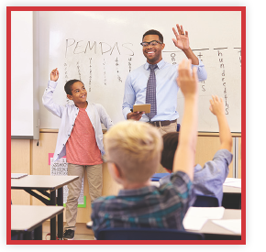
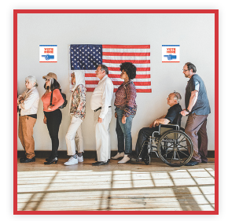
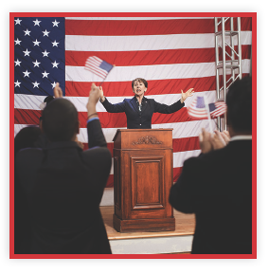
Picture Match
Part ______
Part ______
Part ______

Slide 15
Independent Practice (K) Part 1
Independent Practice
Text Comprehension Read each question. Think of the answer or look back at the text. Fill in the blank. Be sure the sentence makes sense.
Part 1
1. WHAT is the topic of this text? The topic of this text is ___________________________________________.
2. HOW can voting be important for people in a group? Voting can be important for people in a group because.

Slide 16
Independent Practice (K) Part 2
Part 2
3. HOW do people choose leaders in the U.S.? People choose leaders in the U.S. ______________________________.
4. WHAT is a candidate? A candidate is ______________________________________________. 5. WHAT will a candidate do to get elected? To get elected, a candidate will _________________________________.

Slide 17
Independent Practice (K) Part 3
Part 3
6. WHO can vote in U.S. elections? To vote in U.S. elections, people must be _________________________ __________________________________________________________.
7. WHAT are the ways that people can vote in the U.S.? In the U.S., people can vote ____________________________________. 8. WHY is voting an important thing for citizens to do? Voting is an important thing for citizens to do because ________________ ___________________________________________________________ ___________________________________________________________.

Slide 18
Independent Practice (L)
More Practice • Activity 1 Read each sentence. Underline all the endings that make sense.
1. My sister and I can ________________.
a. eat eggs with mushrooms and cheese
b. have a room on the moon
c. plant roses that bloom d. toss a basketball in a hoop

Slide 19
Independent Practice (L) — cont’d
2. After lunch, the art teacher will ________________.
a. set up her room for the next
class
b. stand on a stool to hang
paintings
c. sleep on the school roof
d. loosen the lids on the jars of
pain

Slide 20
Independent Practice (M)
More Practice • Activity 2 Fill in each blank with the best word.
1. Kim will __________________ the fishing rods from the car.
unplug unreal unload
2. After a while, Mom and Dad had a _____________ plan to fix the bathroom.
teachable workable shrinkable
3. Shereen put a _________________ of grapes in a little bowl.
skillful handful painful

Slide 21
Independent Practice (M) — cont’d
4. Not all bugs are ___________________ to plants.
Spoonful handful harmful
5. The cat stuck on a high tree branch was in _______________________.
distrust distress dislike
6. Frank will _____________________ the leash so his dog can go farther.
unpack unlock untwist
7. Lil did not want to _______________ her team by forgetting the bats and balls.
dislike distrust displease

