Slide 1
Say Sounds (A)
Say Sounds
Letter/Sound Associations Look at the letters. Say the sounds. ea
leaf thread
ea au oo dge
aw ea ee oo
ea ew ay ar
oo kn ow ea

Slide 2
Read Words (B)
Read Words
New Words Say the usual sound. Read the word. If it isn’t a real word, try the other sound.
scream death reach
steal meant cream
spread meal seat
dream sweat team

Slide 3
Read Words (C)
Word Families Read down. Read rapidly.
head
dead
bread
dread
spread
real
meal
deal
heal
steal
team
beam
dream
cream
steam
10 Second Challenge
Cold Timing words read
Practice words read
Hot Timing words read

Slide 4
Read Words (D–E)
Multisyllabic Challenge Words Sound out the syllables. Read the whole word.
weather heavy headlight homestead widespread
peanut mealtime sunbeam seafood leadership
Prefixes and Suffixes Say the prefix or suffix.
PREFIXES | SUFFIXES
1. de- com- pro- con- | -able -al -ive -ly

Slide 5
Read Words (F–G)
Words with Prefixes and Suffixes Say the underlined affix. Read the whole word.
devise compete protest confirm
adjustable dental favorable impressive
extensive amendment defensive convention
collective ly innovation meaning ful intermission
High-Frequency Words Say. Spell. Read.
all (al) also although always almost
who throughout every again want many only from

Slide 6
Read Sentences (H)
Read Sentences
Sentences Read the sentences with phrasing.
I need a clean shirt because I sweat all the way through this one.
Don’t spread the news about who the surprise party is for.
We heard that the heat wave is widespread throughout the state.
I also want to learn more about weather, so I got a book about it.
The car’s headlights are always bright enough to light up dark roads.

Slide 7
Spell Words (I)
Spell Words
Spelling Journal Turn to the Spelling Journal on page 250.

Slide 8
Decodable Narrative Text (Part 1)
Decodable Narrative Text Read each part. Answer the questions and select the picture that goes with each part.
The Best Part of a Picnic
Part 1
Teacher Reads Four friends have had fun together all summer. They are
getting together for an end-of-summer picnic. One friend finally gets his
chance to plan a picnic for the group.
8
20
31
38
47
Dustin and Heather were in Dustin’s kitchen, packing a picnic basket. “I am happy that the weather is so nice,” Heather said. “This will likely be the last picnic this summer. The summer flew by, don’t you think?”
“It sure did!” Dustin nodded in agreement. “That’s one reason why I want to make this a real feast. So far, I have

Slide 9
Decodable Narrative Text (Part 1) — cont’d
Part 1 continued
61
70
79
82
94
106
118
130
142
147
157
hot dogs and hamburgers, peaches and plums, iced tea,
gingerbread cake, and snacks. What other things do we
need?” he asked.
“We need a blanket to sit on. Maybe you should take a
sweater, too,” Heather said. “I have one in case it gets cool
later on. It’s almost noon, so Pilar and Carlos will arrive any
minute. Pilar was in charge of the food for our last picnic,
and she did an excellent job. It’s been fun taking turns with
the food, don’t you think?”
“Yes!” Dustin agreed. “Everyone got a chance to be in
charge, and today it’s my turn.”

Slide 10
Comprehension Questions Part 1
Who are the characters introduced in this part of the story?
The characters are ________________.
What is the setting in this part of the story?
The setting is ________________.
What were Dustin and Heather getting ready for?
Dustin and Heather were getting ready for ________________.

Slide 11
Decodable Narrative Text (Part 2)
Part 2
Teacher Reads Dustin and his friends take the bus to the park. Read on
to find out what they talked about on the bus.
163
174
186
195
206
221
231
243
Pilar arrived at noon, and Carlos arrived a little later. By 12:30, the friends were on Bus 15 headed to Forest Park, a large park at the north end of the city.
“I hope you have plenty of food in that basket,” Carlos said. “By the time we get to the park, I will be ready to eat!”
“That does not surprise us, Carlos. We know how much you like to eat!” Pilar said. “You have the biggest appetite of all of us!”

Slide 12
Decodable Narrative Text (Part 2) — cont’d
Part 2 continued
246
256
266
273
284
“Good food keeps me healthy,” Carlos said with a grin. “My mother thinks I am still growing. Besides, don’t forget that I run five miles a day!”
Soon the four friends were at Forest Park. They were glad to see it was not crowded.

Slide 13
Comprehension Questions Part 2
Who are the other characters introduced in this part of the story?
The other characters are ________________.
What is the setting in this part of the story?
The setting is ________________.

Slide 14
Decodable Narrative Text (Part 3)
Part 3
Teacher Reads Continue reading to find out what the four friends do on
their picnic.
290
300
313
324
335
348
“Heather, please spread the blanket out by that grill,” said Dustin. “I will set the food out, and we can play games and eat snacks until we are ready to get the grill going.”
“Pilar can be the camera person,” said Carlos. “She is so good at that, and I am in charge of eating! Just kidding—I can help Dustin set out the food.”

Slide 15
Decodable Narrative Text (Part 3) — cont’d
Part 3 continued
355
366
375
386
398
409
419
432
437
What a day it was! The friends spent a fun afternoon playing ball, snacking, and talking about life. At around 6:00, they got the grill going and cooked hot dogs and hamburgers. When it got dark, they made sure to put out the flame on the grill and got ready to leave. Everyone thought the food had been excellent. But everyone agreed that the best part of their picnic was not the food. The best part was spending time with good friends.

Slide 16
Comprehension Questions Part 3
What did the friends do to set up their picnic at the park?
The friends set up their picnic by ________________.
What did the friends do during their picnic?
During their picnic, the friends ________________.
What did the friends agree was the best part of their picnic?
The friends agreed the best part of their picnic was ________________.

Slide 17
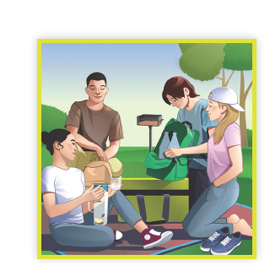
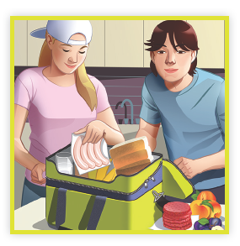
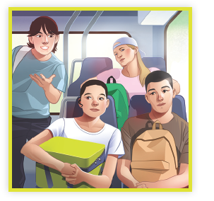
Picture Match
Part ______
Part ______
Part ______

Slide 18
Independent Practice (K) Part 1
Independent Practice
Text Comprehension Read each question. Think of the answer or look back at the text. Fill in the blank. Be sure the sentence makes sense.
Part 1
1. WHO are the people in this part of the story? The people in this part of the story are ______________________________.
2. WHAT is the setting in this part of the story? The setting in this part of the story is _______________________________. 3. WHAT were Dustin and Heather getting ready for? Dustin and Heather were getting ready for ___________________________.

Slide 19
Independent Practice (K) Part 2
Part 2
4. WHO are the other people in this part of the story? The other people in this part of the story are _________________________.
5. WHAT is the setting in this part of the story? The setting in this part of the story is _______________________________ ____________________________________________________________.

Slide 20
Independent Practice (K) Part 3
Part 3
6. WHAT did the friends do to set up their picnic at the park? The friends set up their picnic by ____________________________________ ______________________________________________________________.
7. WHAT did the friends do during their picnic? During their picnic, the friends ______________________________________ ______________________________________________________________.
8. WHAT did the friends agree was the best part of their picnic? The friends agreed the best part of their picnic was _____________________ ______________________________________________________________.

Slide 21
Independent Practice (L)
More Practice 1 • Activity 1 Read each list. Cross out the word that does not belong in each list.
1. lightning
weather
leadership
thunder
4. woodpecker
giraffe
gopher
widespread
7. homeroom
headlight
classmates
classroom
2. seaweed
dogwood
pencil
bamboo
5. breakfast
mealtime
heavy
dinner
8. football
basketball
sunbeam
soccer
3. sunbeam
moonlight
seaweed
flashlight
6. peanut
mushroom
marshmallow
homestead
9. nightgown
weather
mittens
jacket

Slide 22
Independent Practice (M)
More Practice • Activity 2 Fill in each blank with the best word.
1. If you went to a dentist, the dentist would do some ____________________ work on your teeth.
dental
final
2. If you really liked something or were very impressed by something,
it would be _____________________.
impressive
negative
3. If you had a belt that could adjust to many sizes, the belt would be_____________________.
adjustable
portable

Slide 23
Independent Practice (M) — cont’d
4. If you take a bus to and from work every day, you
_____________________ by bus.
commute
combine
5. If you had a number of books on your bookshelf, you would have
____________________ books.
formal
several
6. If you played a trumpet in a contest you would ______________ in the contest.
complete
compete

