Slide 1
Say Sounds (A–B)
Say Sounds
Phonemic Awareness Listen to the sounds or word parts as your teacher says a word slowly. Then say the word.
Letter/Sound Associations Look at the letter. Listen to your teacher say the sound. Then say the sound.
j i p b a
a s h m i
t i b d a
p a g s i
h c l k d

Slide 2
Read Words (C)
Read Words
New Words Say the sound. Sound out the word. Read the word.
bib Jim bad
ham did Dad
pad hat big
dip hit mat
gas has his

Slide 3
Read Words (D)
Word Families Read down. Read rapidly.
mat
bat
cat
hat
pat
lid
did
hid
kid
rid
big
dig
jig
pig
wig
10 Second Challenge
Cold Timing words read
Practice words read
Hot Timing words read

Slide 4
Read Words (E–F)
Multisyllabic Challenge Words Sound out the syllables. Read the whole word.
napkin picnic timid zigzag victim
High-Frequency Words Say. Spell. Read.
was are no go have
to school on and with

Slide 5
Spell Words (G)
Spell Words
Spelling Journal Turn to the Spelling Journal on page 150.

Slide 6
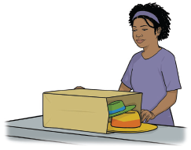
Read Text (H)
Read Text
Decodable Sentence Expansion Read each set of sentences. Then expand the last sentence by telling where. Select the picture that goes with each set.
Sid had a picnic. Sid and Dad had a picnic. Sid and Dad had a picnic on a mat. . . . , Sid and Dad had a picnic on a mat. _____

Slide 7
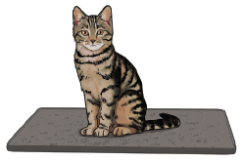
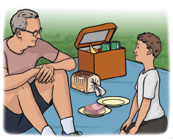
Read Text (H) — cont’d
Nan had a big hat. Nan had a big hat and a little hat. Nan had a big hat and a little hat in a bag. . . . , Nan had a big hat and a little hat in a bag. _____
Tab sat on a mat. Tab, a little cat, sat on a mat. Tab, a timid little cat, sat on a mat. . . . , Tab, a timid little cat, sat on a mat. _____

Slide 8
Independent Practice (I)
Independent Practice
More Practice 1 Fill in each blank with the best word.
1. The man ran to ________ van.
his has hit
2. Jim and Dad ________ in the water.
big bad dip
3. Sam sat on my ________.
mat six sip
4. The ________ has a rip.
sit bib sip
5. A ________ is in the pan.
tap tan ham

Slide 9
Independent Practice (I) — cont’d
6. The school is ________.
big hit did
7. The cap can ________ Liz.
fit his hat
8. Nan ________ six maps.
ad has ham
9. Jim ________ go to school.
did big hat
10. Dad has ________ in the van.
bad gas dip

Slide 10
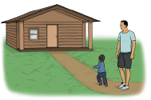


Independent Practice (J)
More Practice 2 Draw a line under the sentence that goes best with each picture.
1. Dad and Jim go on a picnic.
Dad and Jim go to the cabin.
2. Ham is in the tin.
Jim is in the hat.
3. Jim has a napkin.
Jim has a bib.

Slide 11
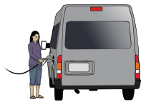
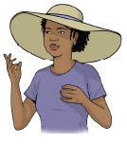

Independent Practice (J) — cont’d
4. Gas can go in the van.
Gas can go in the can.
5. Nan has a big hat.
Nan has a little pad.
6. The rabbit sits on the mat.
The cat is in the bag.

Slide 12

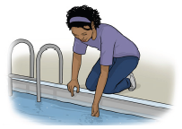
Independent Practice (J) — cont’d
7. The mat has a rip.
The bib has a rip.
8. Did Sam hit with his bat?
Did Nan dip in the water?

