Slide 1
Say Sounds (A–B)
Say Sounds
Phonemic Awareness You will blend and segment sounds as you read and spell words.
Letter/Sound Associations Look at the letters. Say the sounds.
fern
er ar oa igh
ay er i ar
a_e a er ai
ow ar ee en
o_e ea i_e u

Slide 2
Read Words (C)
Read Words
New Words Say the sound. Sound out the word. Read the word.
her fern farm
hay term train
verb herd hard
own tart Herb
clerk cloak cheek
stern smart perk

Slide 3
Read Words (D)
Word Families Read down. Read rapidly.
jar
tar
far
char
scar
date
gate
late
state
crate
right
night
fight
flight
bright
10 Second Challenge
Cold Timing words read
Practice words read
Hot Timing words read

Slide 4
Read Words (E–F)
Review Words Read a line of words. When your teacher gives a meaning, circle the correct word.
rote rot throne hard
glide stack stake shake
rip ripe plan plane
dime dim slim slime
Words with Endings Read words with endings. 1. glided 2. shaking 3. trading 4. planned 5. ripping 6. farmer 7. harder 8. trainer 9. owner 10. starter

Slide 5
Read Words (G–H)
Multisyllabic Challenge Words Sound out the syllables. Read the whole word.
perfect sherbet modern verdict lantern
enter summer gardener yesterday September
High-Frequency Words Say. Spell. Read.
my why by cry dry
come who where there what

Slide 6
Read Sentences (I)
Read Sentences
Sentences Read the sentences with phrasing.
Why do they speak to pets in such a stern way?
Who can come with me to help pick the perfect gift for my sister?
Nell will stop by the farm where they sell hay for goats.
Tessa worked hard and had her best term at school.
When will Amara say what her plan is for the summer?

Slide 7
Spell Words (J)
Spell Words
Spelling Journal Turn to the Spelling Journal on page 200.

Slide 8
Decodable Narrative Text (Part 1)
Decodable Narrative Text Read each part. Answer your teacher’s questions and select the picture that goes with each part.
Summer Plans
Part 1
Teacher Reads Five good friends are finishing their last semester, or term, of high school. They are about to graduate, earning their high school diplomas, so big changes are happening! It is the end of the school day and the friends are talking about what will come next.
12
21
34
“It is hard to make plans when it seems like we just started high school yesterday,” Tessa said. “I think the rest of my last term at Fern High will be my very best,” she added with a smile.

Slide 9
Decodable Narrative Text (Part 1) — cont’d
39
52
64
76
“I think the best part of this term is that it is the LAST term!” Jen said. “I can’t wait to be rid of verbs and math. Fern High has been OK, but it is all in the past.”

Slide 10
Comprehension Questions Part 1
Where did the friends go to school?
The friends went to ________________.
Who are two main characters in this part of the story?
Two main characters in this part of the story are ________________.
Which character enjoyed high school more, Tessa or Jen?
The character who enjoyed high school more was ________________.

Slide 11
Decodable Narrative Text (Part 2)
Part 2
Teacher Reads The five friends are walking away from their school, discussing how they could earn money after graduation. Read on to find out what one friend is planning and why.
78
89
98
109
118
130
143
151
161
“Well, it is not all in the past yet, Jen,” Rand said. “And we still have to make summer plans. If you all come home with me, I can fix some snacks, and then we can think of summer jobs we may get. There is not a lot of time left to get a job. I need a job to help pay my way at State University in September. I am going to be a teacher! What do you say? Will you all come to my home?” asked Rand.

Slide 12
Comprehension Questions Part 2
What problem are these friends facing?
These friends are facing the problem of ________________.
What did Rand want to discuss with his friends at his home?
Rand wanted to discuss ________________.

Slide 13
Decodable Narrative Text (Part 3)
Part 3
Teacher Reads Read on to find out what different ideas other friends come up with, and what Amara says about her plan.
167
176
187
201
210
222
227
237
248
251
Later on at Rand’s home, Robert said, “You may be right, Rand. This is the best time to make summer plans. Maybe I can get a part-time job as a clerk at the Herb Stern Market. Herb Stern owns the market, and he may need help this summer. At least it is a start. What will you do, Amara?”
“I think my plans are going to shock you!” Amara exclaimed. “After we eat I will tell you what I am doing!” she teased.

Slide 14
Comprehension Questions Part 3
What was Robert’s summer plan?
Robert’s summer plan was ________________.
What did Amara say her friends would think of her plans?
Amara said her plans would ________________.

Slide 15
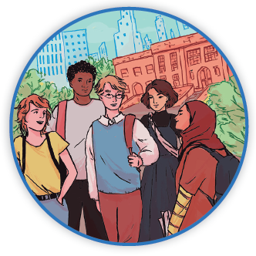
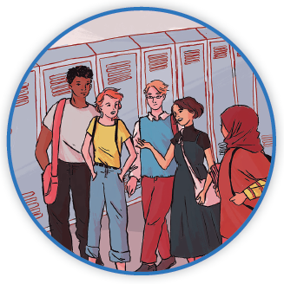
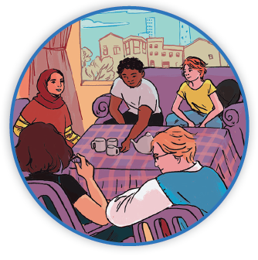
Picture Match
Part ______
Part ______
Part ______

Slide 16
Independent Practice (L) Part 1
Independent Practice
Text Comprehension Read each question. Think of the answer or look back at the text. Fill in the blank. Be sure the sentence makes sense.
Part 1
1. WHERE did the pals go to school? The pals went to ______________________________________________.

Slide 17
Independent Practice (L) Part 1 — cont’d
2. WHO are the pals in this part of the story? The pals in this part of the story are _______________________________.
3. WHAT did Tessa say that makes it seem she likes school? It seems that Tessa likes school because she said ____________________ ____________________________________________________________.

Slide 18
Independent Practice (L) Part 2
Part 2
4. WHAT problem did the pals have? The problem the pals had was they ________________________________.
5. WHY did Rand ask his pals to come to his home? Rand asked them to come to ______________________________________.
6. WHY did Rand say he needs a summer job? Rand said he needs a summer job to _______________________________.

Slide 19
Independent Practice (L) Part 3
Part 3
7. WHAT job was Robert thinking of getting? Robert was thinking of getting a job as _______________________________.
8. WHAT did Amara say the pals would think of her plans? Amara said her plans would _______________________________________.

Slide 20
Independent Practice (M) Story 1
More Practice Read each story. Answer the questions.
Story 1: Parker and Dad went to see a film yesterday. The tale was sad and made Parker cry. A pet was lost and did not come home. After looking and looking, the man saw his lost dog by the light of his lantern. The man was so glad to see his dog.
Dad saw that Parker was sad, so he gave her a hug.
“Next time, let’s see a fun film,” Parker said.
1. WHERE did Parker and Dad go yesterday? Yesterday, Parker and Dad went to _______________________________.

Slide 21
Independent Practice (M) Story 1 — cont’d
2. WHAT did the man see with his lantern? With his lantern, the man saw ___________________________________.
3. WHAT did Parker plan to see next time? Next time, Parker planned to see ________________________________.

Slide 22
Independent Practice (M) Story 2
Story 2: Jasmin entered the shop at ten. She needed a coat to stay dry in the rain. “May I see that gray raincoat?” Jasmin asked the clerk. “It looks like just what I need.”
“Why not see if it fits? Put it on,” the clerk said to her. Jasmin put on the raincoat. It was a perfect fit. “I will take this gray raincoat. Is there a gray hat that will match my raincoat?”
1. WHAT did Jasmin need? Jasmin needed _______________________________________________.
2. WHY did Jasmin get the gray raincoat? Jasmin got the gray raincoat because ______________________________.
3. WHAT did Jasmin hope to get after the raincoat? After the raincoat, Jasmin hoped to get _____________________________.

