Slide 1
Say Sounds (A)
Say Sounds
Letter/Sound Associations Look at the letters. Say the sounds.
ar igh wr ou
ee oa ew ph
au ea kn oy
oo wr ph tch

Slide 2
Read Words (B)
Read Words
New Words Look at the letter that follows c. Say the sound for c. Sound out the word. Then read the word.
prance curb couch
cliff cents prince
space crew lace
cool nice Rick

Slide 3
Read Words (C)
Word Families Read down. Read rapidly.
dance
chance
glance
trance
France
lace
face
pace
place
space
nice
rice
dice
slice
twice
10 Second Challenge
Cold Timing words read
Practice words read
Hot Timing words read

Slide 4
Read Words (D–E)
Multisyllabic Challenge Words Sound out the syllables. Read the whole word.
citrus faucet civil census
boycott moisten playwright counters
Prefixes and Suffixes Say the word. Then say the prefix or suffix.
PREFIXES | SUFFIXES
1. about | moment
2. pro- con- re- com- | -er -est -ness -less

Slide 5
Read Words (F–G)
Words with Prefixes and Suffixes Say the underlined affix. Read the whole word.
asleep respect proceed among concern expect
enjoyment shapeless mention entertainment partly memory
instruction commitment refreshment glamorously amusement
High-Frequency Words Say. Spell. Read.
old cold told could should would walk talk
work word
almost one heard live every

Slide 6
Read Sentences (H)
Read Sentences
Sentences Read the sentences with phrasing.
You can have your choice of almost any hat.
My grandmother still has her old lace wedding dress.
Mike’s sister is very nice every time we talk.
The prince told the queen he did not agree with her.
Rick should fill the glass almost to the top with cold water from the faucet.

Slide 7
Spell Words (I)
Spell Words
Spelling Journal Turn to the Spelling Journal on page 246.

Slide 8
Decodable Informative Text (Part 1)
Decodable Informative Text Read each part. Answer your teacher’s questions and select the picture that goes with each part.
What Is
Quicksand?
Part 1
Teacher Reads Imagine this. You are walking on a sandy beach. Suddenly, you feel a wet mixture of sand and water under your feet and you begin to sink into the QUICKSAND. Stories tell you that you will drown in the quicksand, but is that true? Read on to find out.
11
21
32
46
59
The real facts about quicksand are not so awful. If you happen to step into quicksand, you will begin to sink. However, you will never be sucked in all the way. Quicksand itself does not have that kind of pull or force. Plus, it is not very deep. You might sink up to your knees or waist. In fact, people cannot sink all the way under quicksand.

Slide 9
Comprehension Questions Part 1
What will happen if you step into quicksand?
If you step into quicksand, you will ________________.
What will never happen if you step into quicksand?
If you step into quicksand, you will never ________________.
Why can’t you sink all the way down in quicksand?
You can’t sink all the way down in quicksand because ________________.

Slide 10
Decodable Informative Text (Part 2)
Part 2
Teacher Reads Keep reading to find out what quicksand is made of and where it can be found.
67
77
88
101
111
119
131
142
153
165
Quicksand and normal sand are alike in some ways, but they are different in one main way. Quicksand is mixed with a lot of water. It is mostly found in places where water flows under the ground, such as by rivers, lakes, and streams.
Why do things sink in quicksand? Because quicksand is soaked with water, the grains of sand don’t stick to each other to form a solid base. Quicksand acts more like water than like normal sand that is packed solid. That is why people can float in quicksand in the same way they can float in a pool of water.

Slide 11
Decodable Informative Text (Part 2) — cont’d
Part 2 continued
170
182
193
205
219
Often, a marker is set up to alert people that quicksand is close by. That way, people can avoid the problem. However, if there is no marker and you think you see quicksand, you can test the sand with a long stick or pole. If the stick sinks, then you know you have found quicksand.

Slide 12
Comprehension Questions Part 2
How are quicksand and normal sand different?
Quicksand is different from normal sand because quicksand is ________________.
Where is quicksand mostly found?
Quicksand is mostly found in ________________.
Why do things sink in quicksand?
Things sink in quicksand because ________________.

Slide 13
Decodable Informative Text (Part 3)
Part 3
Teacher Reads If you do step into quicksand, you can escape from it. Read on to find out what you should do.
225
235
247
259
270
281
292
302
What if you step into quicksand? Many experts give this advice. The number one thing is to not get upset or worked up. Breathe deeply. If you lean back, you can soon start to make slow circles with your arms and legs. This will loosen the quicksand around you. Then you can slowly crawl out of the slushy quicksand. You may end up looking like a muddy mess, but you will have a thrilling story to tell!

Slide 14
Comprehension Questions Part 3
What should you NOT do if you step into quicksand?
If you step into quicksand, you should not ________________.
What is one thing you should do if you step into quicksand?
If you step into quicksand, one thing you should do is ________________.

Slide 15
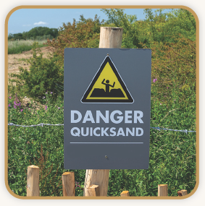
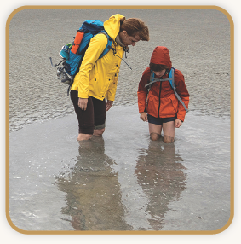
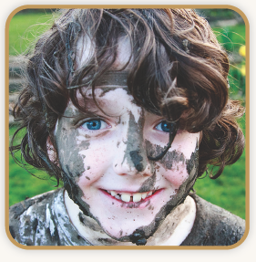
Picture Match
Part ______
Part ______
Part ______

Slide 16
Independent Practice (K) Part 1
Independent Practice
Text Comprehension Read each question. Think of the answer or look back at the text. Fill in the blank. Be sure the sentence makes sense.
Part 1
1. WHAT will happen if you step into quicksand? If you step into quicksand, you will __________________________________.
2. WHAT will never happen if you step into quicksand? If you step into quicksand, you will never _____________________________.

Slide 17
Independent Practice (K) Part 1 — cont’d
3. WHY can’t you sink all the way down in quicksand? You can’t sink all the way down because _____________________________ ______________________________________________________________.

Slide 18
Independent Practice (K) Part 2
Part 2
4. HOW are quicksand and normal sand different? Quicksand is different from normal sand because ______________________ ______________________________________________________________.
5. WHERE is quicksand mostly found? Quicksand is mostly found ________________________________________.
6. WHY do things sink in quicksand? Things sink in quicksand because __________________________________ _____________________________________________________________.

Slide 19
Independent Practice (K) Part 3
Part 3
7. WHAT should you NOT do if you step into quicksand? If you step into quicksand, you should not ___________________________.
8. WHAT should you do if you step into quicksand?
If you step into quicksand, one thing you should do is __________________ _____________________________________________________________.

Slide 20
Independent Practice (L)
More Practice • Activity 1 Read each list. Cross out the word that does not belong in each list.
1. frustrate
embarrass
disappoint
understand
4. avoid
support
ignore
escape
7. trumpet
saxophone
cinder
trombone
2. playwright
faucet
drainpipe
sewer
5. citrus
cartwheel
willow
cactus
8. pencil
teapot
marker
paper
3. artist
counter
dancer
author
6. racetrack
arcade
playground
spacecraft
9. census
lightning
thundercloud
monsoon

Slide 21
Independent Practice (M)
More Practice • Activity 2 Fill in each blank with the best word.
1. Almost all the children were ________
________ for Jewell.
asleep
except
2. Mom said, “Ameena, wait a ________.
I should finish this ________.”
moment
quickly
3. I heard that the ________ gave
Loretta lots of ________.
enjoyment
party
4. Victor has a very good ________.
He can ________ things right away.
memory
remember

Slide 22
Independent Practice (M) — cont’d
5. Calvin and Omar could not ________.
Their ________ went on all night.
disagreement
agree
6. The reporter has no choice but to ________
her ________ for the morning newspaper.
article
rewrite

