Slide 1
Say Sounds (A–B)
Say Sounds
Phonemic Awareness You will blend and segment sounds as
you read and spell words.
Letter/Sound Associations Look at the letters. Say the sounds.
  car
  ar igh ea a_e
  ee ar ow oa
  o_e ea ar i_e
  ai ar oa igh
  o_e ow o ee

Slide 2
Read Words (C)
Read Words
New Words Say the sound. Sound out the word. Read the word.
  car bark far
  farm foam Barb
  star part stay
  park peek fight
  marsh barn paint
  start steam smart

Slide 3
Read Words (D)
Word Families Read down. Read rapidly.
car
far
jar
scar
star
bark
mark
dark
shark
spark
art
part
mart
chart
smart
10 Second Challenge
Cold Timing words read
Practice words read
Hot Timing words read

Slide 4
Read Words (E–F)
Review Words Read a line of words. When your teacher
gives a meaning, circle the correct word.
  twin twine drape wide
  pride spine spin while
  stone grave blaze flat
  robe rob chase close
Words with Endings Read words with endings.
1. spinning 2. blazing 3. tapped 4. closing 5. closed
6. barked 7. farming 8. started 9. parking 10. painted

Slide 5
Read Words (G–H)
Multisyllabic Challenge Words Sound out the syllables.
Read the whole word.
  marshland harmless garden harness Martin
  scarlet benchmark telescope artistic frighten
High-Frequency Words Say. Spell. Read.
  would should could been some
  come of said very where

Slide 6
Read Sentences (I)
Read Sentences
Sentences Read the sentences with phrasing.
  Should we look at the stars with a telescope?
  Carlee asked Marcus if he could help on the farm.
  Devin is very skilled at solving problems with cars.
  People in the art class were starting to work with clay.
  It would have been fun to work in the garden with
  Martin and Val.

Slide 7
Spell Words (J)
Spell Words
Spelling Journal Turn to the Spelling Journal on page 200.

Slide 8
Decodable Narrative Text (Part 1)
Decodable Narrative Text Read each part. Answer your teacher’s
questions and select the picture that goes with each part.
Saving a Dog
Part 1
Teacher Reads In this story, three friends are in a park. As they get closer
to the marshland (an area of wet, muddy land), they see something
unexpected in the reeds.
11
22
26
38
49
60
Barb, Todd, and Arlo were going down a path in the
park. As they came to the marshland, they saw a black
dog in the reeds.
Arlo said, “Look at that dog. He has a scar on his
chest. We should stay far from him. He may bite us.”
“He is not well,” Barb said. “He needs help. I think
we should help this dog.”

Slide 9
Comprehension Questions Part 1
Who are the main characters?
The main characters are ________________.
What is the setting in this part of the story?
The setting in this part of the story is ________________.
What did the friends have to decide?
The friends had to decide ________________.

Slide 10
Decodable Narrative Text (Part 2)
Part 2
Teacher Reads The three friends are concerned, or very worried, and
need to figure out what to do about the dog.
65
75
84
89
99
110
122
124
134
147
159
The three pals went down the path away from the
marshland. When they were close to Todd’s home, he
stopped and contacted the vet.
Todd explained, “You have to help this dog. He is
at the back of the park, in the marshland. He has
a scar on his chest, and he is not well. He seems
very frightened!”
When Todd hung up, he spoke to Barb and Arlo.
“The vet will do what he can to help the dog. He will
keep the dog in his yard and look after him. But after
ten days, the dog has to be adopted.”

Slide 11
Comprehension Questions Part 2
What is the setting in this part of the story?
The setting in this part of the story is near Todd’s ________________.
What did Todd do to help the dog?
To help the dog, Todd ________________.
How did the vet promise to help the dog?
The vet promised to ________________.

Slide 12
Decodable Narrative Text (Part 3)
Part 3
Teacher Reads Keep reading to find out what happens after the ten
days have come and gone.
167
178
188
200
214
217
226
237
248
255
Barb went to the yard each day to see the dog.
Ten days passed. The next day, Arlo and Todd were
at the park to meet Barb. At last, there she was! Barb
smiled and said, “I will tell you why I am late. I had to
make a stop.”
Then Barb yelled, “Come to me, Champ!” The black
dog that had been at the vet came running to Barb.
“I would like you to meet my dog, Champ. I adopted
him!” said Barb with a big smile.

Slide 13
Comprehension Questions Part 3
What happened at the end of the story?
At the end of the story, ________________.

Slide 14
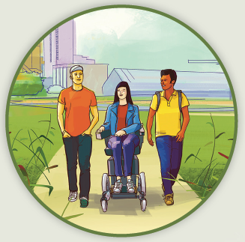
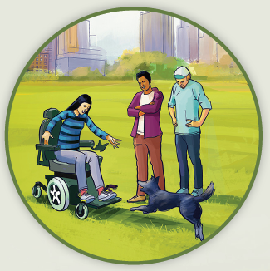
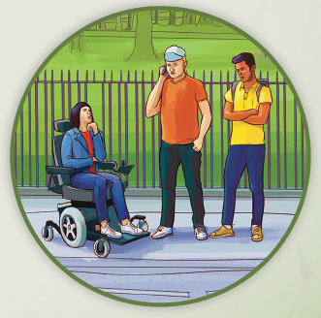
Picture Match
Part ______
Part ______
Part ______

Slide 15
Independent Practice (L) Part 1
Independent Practice
Text Comprehension Read each question. Think of the answer or look back at the text. Fill in the blank. Be sure the sentence makes sense.
Part 1
  1. WHO are the people in the story?
  The people in the story are ______________________________________.
  2. WHAT is the setting in this part of the story?
  The setting in this part of the story is _______________________________.
  3. WHAT did Barb say they should do?
  Barb said they should ___________________________________________.

Slide 16
Independent Practice (L) Part 2
Part 2
  4. WHAT is the setting in this part of the story?
  The setting in this part of the story is ________________________________.
  5. WHAT did Todd do to help the dog?
  To help the dog, Todd ___________________________________________.
  6. WHAT will the vet do for the dog?
  The vet will ___________________________________________________.
  7. WHAT has to happen after ten days?
  After ten days, ________________________________________________.

Slide 17
Independent Practice (L) Part 3
Part 3
  8. WHAT happened at the end of the story?
  At the end of the story, ___________________________________________.

Slide 18
Independent Practice (M) Story 1
More Practice Read each story. Answer the questions.
  Story 1: Mark and his dad left the art show at ten. It was not far from home.
  Dad drove down a dark road. They should get home in just a little while. But
  then the car came to a stop. Mark and Dad could see some jets of steam rise
  from the car. “It looks like we may have to jog home, Dad!” said Mark.
  1. WHERE had Mark and Dad been?
  Mark and Dad had been at ____________________________________.
  2. HOW long should it take them to get home?
  It should take them __________________________________________.
  3. WHAT could Mark and Dad see rise from the car?
  Mark and Dad could see ______________________________________.

Slide 19
Independent Practice (M) Story 2
  Story 2: Carleen and Mom went on a camping trip. They drove to the same
  park where they had been lots of times. Each day, they swam and hiked.
  Each night, they looked at the stars and slept in a tent.
  At the end of the trip, Mom said, “We should start to pack up the car.”
  Carleen said, “Camping is fun. The hard part is going home.”
  1. WHERE did Carleen and Mom go camping?
  They went camping at ___________________________________________.
  2. WHAT did they look at each night?
  Each night, they looked at ________________________________________.
  3. WHY did Carleen say going home was hard?
  She said going home was hard because _____________________________
  _____________________________________________________________.

