Slide 1
Say Sounds (A–B)
Say Sounds
Phonemic Awareness Listen to the word your teacher says.
Then say the sounds or word parts in the word.
Letter/Sound Associations Look at the letters. Say the sounds.
  rock path dish
  ck m th i r
  n u sh d a
  th c e ck p
  b f j sh o

Slide 2
Read Words (C)
Read Words
New Words Say the sound. Sound out the word. Read the word.
  math neck dash
  pack path cash
  peck bath fish
  rock dish moth
  pick Jack rack

Slide 3
Read Words (D)
Word Families Read down. Read rapidly.
kick
Nick
lick
sick
pick
pack
Jack
rack
back
tack
cash
dash
mash
rash
sash
10 Second Challenge
Cold Timing words read
Practice words read
Hot Timing words read

Slide 4
Read Words (E–F)
Review Words Read a line of words. When your teacher gives a meaning,
circle the correct word.
  mess met him hill
  off on fix fox
  fed Jeff jazz has
  tan nut putt egg
Multisyllabic Challenge Words Sound out the syllables. Read the whole word.
dishrag bathtub within vanish racket

Slide 5
Read Words (G)
High-Frequency Words Say. Spell. Read.
  for put my they where
  long saw you work water

Slide 6
Read Sentences (H)
Read Sentences
Sentences Read the sentences with phrasing.
  Where is the red dish for the ham?
  Jack saw the cat vanish into the den.
  The children and Mom had to jog down the long path.
  I will get my hat from the rack and pack it in my bag.
  You will have to dash to the bus to get on it!

Slide 7
Spell Words (I)
Spell Words
Spelling Journal Turn to the Spelling Journal on page 154.

Slide 8
Decodable Text (Passage 1)
Decodable Text Read each passage. Answer your teacher’s questions and select the picture that goes with each passage.
Passage 1
A Wish for Fish
Teacher Reads Jevon, the main character in the passage, is going fishing. Like all fishermen, he is hoping for good luck.
Jevon went down to the inlet to fish. “I see fish in
the water,” he said. “Will I get my wish to get a big fish?
Will I have luck?”
Jevon sat down on the dock. He got a rod from
his pack and put it into the water. He sat and said,
“Where are the fish?”
Then a fish bit. Jevon got his wish. A BIG fish!
A big bass!

Slide 9
Comprehension Questions Passage 1
What was Jevon’s wish?
Jevon’s wish was ________________.
When did Jevon’s wish come true?
Jevon’s wish came true when ________________.

Slide 10
Decodable Text (Passage 2)
Passage 2
In a Rush
Teacher Reads It was Jin’s first day of school and she was very excited as she hurried down the path. But an accident awaits her.
Jin was in a rush to get to the school campus. She
ran down the path and did not see the rock. Down
she went. She got a gash on her leg when she fell. She
was upset.
Nick saw Jin go down and ran to her. “I can see the
cut,” Nick said. “It is not bad. They will fix it at school.”

Slide 11
Comprehension Questions Passage 2
Why did Jin fall down?
Jin fell down because ________________.
What did Nick tell Jin?
Nick told Jin that ________________.

Slide 12
Decodable Text (Passage 3)
Passage 3
A Bit of Luck
Teacher Reads People often say that dogs are our best friends.
Let’s see how one dog helps its owner.
Zack went with his dog Ash to play. As they
went down the path, Zack saw a tennis racket.
“Rush and get it, Ash,” Zack said. Zack got the racket
from Ash. “It is my dad’s!” Zack said. He went to hug
Ash and pat him on the back. “Ash, you got it back!”

Slide 13
Comprehension Questions Passage 3
What did Zack see as he went down the path?
Zack saw ________________.
How did Ash, the dog, help Zack?
Ash helped Zack by ________________.

Slide 14
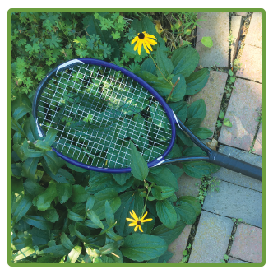
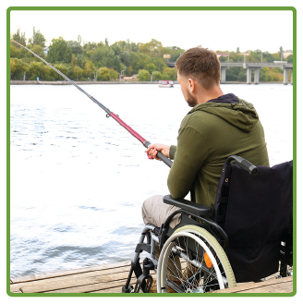
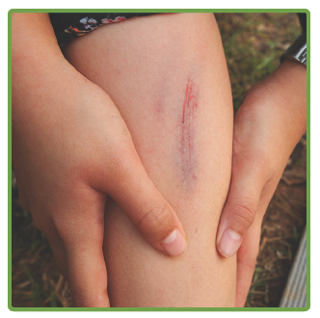
Picture Match
Passage ______
Passage ______
Passage ______

Slide 15
Independent Practice (K)
Independent Practice
More Practice 1 Fill in each blank with the best word.
  1. Jill jogs on the ________.
path peck math
  2. The mutt will have a ________.
bath path rack
  3. Nick put the racket in his ________.
tack pack rock
  4. Meg put the dishrag on the ________.
peck pick rack
  5. Nat can ________ down the path.
dish dash cash

Slide 16
Independent Practice (K) — cont’d
  6. The ________ is in the box.
cash path bath
  7. Jack will work on his ________.
math moth pick
  8. Pam has a cut on her ________.
rush neck dash
  9. The kids dug up a big ________.
wish math rock
  10. Ken saw some ________ in the water.
fish path back

Slide 17



Independent Practice (L)
More Practice 2 Draw a line under the sentence that goes best
with each picture.
1. The red dish is on the
rack.
The red dishrag is on the rack.
2. A moth is within the net.
A van is within the net.
3. Bess plays with the tennis
racket.
Bess plays with her doll.

Slide 18
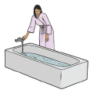
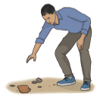
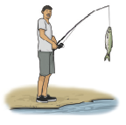
Independent Practice (L) — cont’d
  4. Nick will toss a rock into
  the water.
Mom will fill the bathtub.
  5. Dan will pick up a rock.
Dad will pack the van.
6. Jack gets a fish.
The tot gets a bath.

Slide 19


Independent Practice (L) — cont’d
7. The hen can peck the log.
The hen can kick at the rock.
8. Jill has math at school.
Jill has a fish on the dish.

