Slide 1
Say Sounds (A–B)
Say Sounds
Phonemic Awareness Listen to the sounds or word parts as your teacher
says a word slowly. Then say the word.
Letter/Sound Associations Look at the letter. Say the sound.
  s i l o t
  a f e g u
  h e o j i
  u m b a d
  z u o c p

Slide 2
Read Words (C)
Read Words
New Words Say the sound. Sound out the word. Read the word.
  lass hill less
  gill loss Jess
  Bess off moss
  miss toss doll
  fill Jeff boss

Slide 3
Read Words (D)
Word Families Read down. Read rapidly.
hill
bill
till
Will
sill
yell
sell
bell
fell
Nell
boss
loss
Ross
toss
moss
10 Second Challenge
Cold Timing words read
Practice words read
Hot Timing words read

Slide 4
Read Words (E–F)
Multisyllabic Challenge Words Sound out the syllables. Read the whole word.
laptop fitness gossip dismiss hilltop
High-Frequency Words Say. Spell. Read.
  be we after where went
  play said children with her

Slide 5
Spell Words (G)
Spell Words
Spelling Journal Turn to the Spelling Journal on page 153.

Slide 6
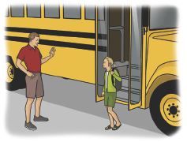
Read Text (H)
Read Text
Decodable Sentence Expansion Read each set of sentences. Then expand the last sentence by telling when or where. Select the picture that goes with
each set.
  The children will play.
  The children will play with the kittens.
  The children will play with the little kittens.
  . . . , the children will play with the little kittens. _____

Slide 7
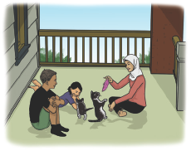
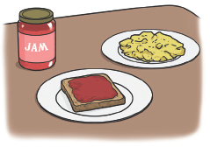
Read Text (H) — cont’d
  I can have jam.
  I can have jam and a bun.
  I can have jam and a bun after I have an egg.
  . . . , I can have jam and a bun after I have an egg. _____
  Tiff got off the bus.
  Tiff got off the bus and saw her dad.
  Tiff got off the bus, saw her dad, and ran to him.
  . . . , Tiff got off the bus, saw her dad, and ran
  to him. _____

Slide 8
Independent Practice (I)
Independent Practice
More Practice 1 Fill in each blank with the best word.
  1. Bess has a ________.
toss tell doll
  2. The mutt ran up the ________.
off hill loss
  3. Jess can ________ the cup.
well loss toss
  4. Don will ________ his mutt.
moss miss fill
  5. Can you ________ the muffins?
less tell pass

Slide 9
Independent Practice (I) — cont’d
  6. The ________ will fuss.
Jeff fill boss
  7. Jeff got ________ the bus.
well off jazz
  8. Bess ________ down the hill.
fell moss bill
  9. We will get ________ ham.
fuss loss less
  10. Dev can ________ the cup with water.
gill fill bell

Slide 10
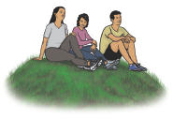
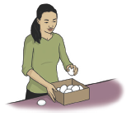
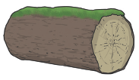
Independent Practice (J)
More Practice 2 Draw a line under the sentence that goes best with each picture.
1. People run down from
the hilltop.
People sit down on the
hilltop.
2. Lin will fill the pan
with water.
Lin will fill the box with eggs.
3. Moss is on the hill.
Moss is on the log.

Slide 11
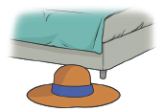
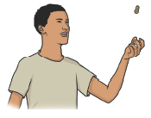

Independent Practice (J) — cont’d
  4. The hat fell off the bed.
The doll fell off the bed.
  5. Jeff can toss the nut.
Jeff can toss the mitt.
6. Bess is ill and will miss
school.
Jess is my tomcat.

Slide 12

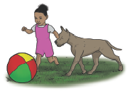
Independent Practice (J) — cont’d
7. Jill is upset at the loss.
My boss saw moss on the hill.
8. The tot sat with her doll.
The tot plays with her dog.

