Slide 1
Say Sounds (A–B)
Say Sounds
Phonemic Awareness Listen to the word your teacher says.
Then say the sounds or word parts in the word.
Letter/Sound Associations Look at the letters. Say the sounds.
  f d ch a g
  sh c e t b
  n ck i u th
  p o s k l

Slide 2
Read Words (C)
Read Words
New Words Say the sound. Sound out the word. Read the word.
  bran grin spot
  snip trap slim
  drip grip slip
  crop clam flip
  frog skin stop

Slide 3
Read Words (D)
Word Families Read down. Read rapidly.
clash
crash
flash
slash
trash
drill
grill
skill
spill
still
flop
stop
crop
drop
plop
10 Second Challenge
Cold Timing words read
Practice words read
Hot Timing words read

Slide 4
Read Words (E–F)
Review Words Read a line of words. When your teacher gives a meaning,
circle the correct word.
  chill hill crab club
  shock snap block wind
  glad drag flat fuzz
  spot vent plot grab
Multisyllabic Challenge Words Sound out the syllables. Read the whole word.
drumstick rocket plastic drastic ballad

Slide 5
Read Words (G)
High-Frequency Words Say. Spell. Read.
  from water very after where
  saw some into down long

Slide 6
Read Sentences (H)
Read Sentences
Sentences Read the sentences with phrasing.
  Ben dug up a clam from the very wet sand.
  Mom had a big grin when she saw the pups play.
  I saw a frog hop from a rock into the pond.
  Rick was set to flip some flapjacks in the pan.
  After the rain, Chen saw where water drips into the bucket.

Slide 7
Spell Words (I)
Spell Words
Spelling Journal Turn to the Spelling Journal on page 157.

Slide 8
Decodable Text (Part 1)
Decodable Text Read each part. Answer your teacher’s questions
and select the picture that goes with each part.
Gram and Cass
Part 1
Teacher Reads Cass is still not happy that her grandmother has come
to stay with her and her brother, Greg, while her dad is away. Cass only
watches as Greg and Gram plant things in the garden.
When Cass got up from bed, she was still glum.
She had not slept well. She went down to see Gram and
Greg. They put plants in the spot Dad had set up.
“I can tell it is fun,” Cass said to herself, but she still
did not go to help them. She just sat with her chin on
her hand.

Slide 9
Comprehension Questions Part 1
Why didn’t Cass join Gram and Greg in planting?
Cass didn’t join Gram and Greg in planting because ________________.

Slide 10
Decodable Text (Part 2)
Part 2
Teacher Reads An accident is about to change how Cass feels. Let’s find
out what happens.
Cass saw Greg jump up and yell. She ran to Greg
and Gram as they went up the steps to go in.
“Greg cut his hand on some glass,” Gram tells Cass.
“He did not see it where he dug.”
When Cass saw Greg’s cut, she was upset and felt
sick. “Can I help, Gram?” Cass asks. “That cut looks
bad.” Cass saw Gram sit down to fix Greg’s cut.

Slide 11
Comprehension Questions Part 2
What accident occurred?
The accident that occurred was ________________.
How did Cass feel when she saw what happened to Greg?
When Cass saw what happened to Greg, she felt ________________.

Slide 12
Decodable Text (Part 3)
Part 3
Teacher Reads After Gram cleaned and covered Greg’s cut, she told him
a funny story to calm him down. Cass smiled as Gram talked. Then Gram
went to wash her hands.
Greg was upset but glad for Gram’s help.
Cass sat with Greg. “I am glad that Gram is a
big help. You must rest, Greg,” Cass said. “I will go
see Gram.”
Cass went to help Gram with lunch. “I will not be
sad and glum, Gram. Greg and I are glad that Dad had
you help us.” Cass went to Gram to hug her. “I am glad
you are with us.”

Slide 13
Comprehension Questions Part 3
Why did Cass hug Gram?
Cass hugged Gram because ________________.

Slide 14
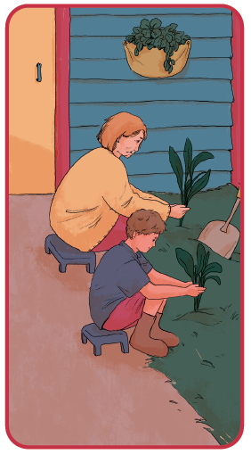
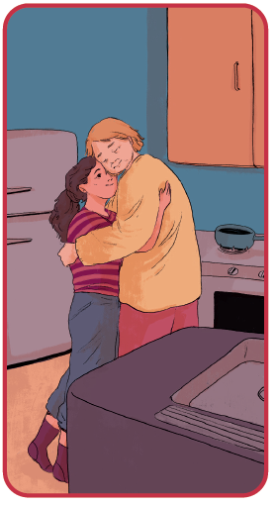
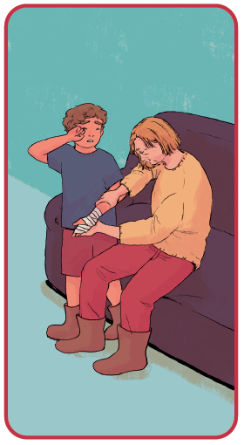
Picture Match
Passage ______
Passage ______
Passage ______

Slide 15
Independent Practice (K)
Independent Practice
More Practice 1 Fill in each blank with the best word.
  1. I saw Tom pick up the ________.
grin twig slim
  2. Jeff got a ________ on his jacket.
step spot flip
  3. We saw Jan ________ in the mud.
club twin slip
  4. Ten children went on the ________.
trip trap twig
  5. Lin has a hat with a ________.
slip sled brim

Slide 16
Independent Practice (K) — cont’d
  6. Water will ________ into the bucket.
drip plum clam
  7. Pam is ________ to win.
grin glad grip
  8. Brin’s ________ will look red from the sun.
skin spin skip
  9. Shep can ________ the pan fast.
flip frog plot
  10. I will ________ the bag shut.
skip snap stop

Slide 17
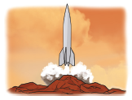
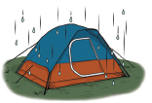

Independent Practice (L)
More Practice 2 Draw a line under the sentence that goes best
with each picture.
1. Don and Jan went on a trip.
The rocket will land on that spot.
2. The water will drip into the tent.
We set a trap in the cabin.
3. Nan must grip the clam bucket.
The pup licks the water from his dish.

Slide 18

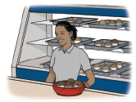

Independent Practice (L) — cont’d
  4. The pig will step on the twig.
Rick had a big grin.
  5. Tess sells bran muffins.
The drumstick is on the dish.
6. The twins sit on the sled.
The twins will step into the water.

Slide 19


Independent Practice (L) — cont’d
7. Lin set the wig in the box.
Lin is glad to win.
8. Stan and Peg put up a log cabin.
Stan mends the rip.

