Slide 1
Say Sounds (A–B)
Say Sounds
Phonemic Awareness You will blend and segment sounds as you read and spell words.
Letter/Sound Associations Look at the letters. Say the sounds.
oa igh a ay
igh ai ow a_e
ee e a_e i
ea o oa ee
ai ow ay oa

Slide 2
Read Words (C)
Read Words
New Words Say the sound. Sound out the word. Read the word.
name safe take
same Sam pane
mate pan rack
rake mat flame
gate cane can
rat late rate

Slide 3
Read Words (D)
Word Families Read down. Read rapidly.
name
tame
game
shame
flame
take
rake
lake
snake
flake
mate
late
gate
state
crate
10 Second Challenge
Cold Timing words read
Practice words read
Hot Timing words read

Slide 4
Read Words (E–F)
Review Words Read a line of words. When your teacher gives a meaning, circle the correct word.
feast heat fast bled
strain cost train grown
sweep claim coast pray
clam swept bleed weep
Words with Endings Use the reading rule to pronounce the words. 1. naming 2. taking 3. raking 4. shaking 5. skating

Slide 5
Read Words (G–H)
Multisyllabic Challenge Words Sound out the syllables. Read the whole word.
gateway classmate translate mistake
update estimate muffin handmade
High-Frequency Words Say. Spell. Read.
long song strong because how
were what people where your

Slide 6
Read Sentences (I)
Read Sentences
Sentences Read the sentences with phrasing.
Is Gabe the name of your classmate?
Russ will not take the path where the tree fell down.
I asked Dad to play a song as we made lunch.
People were waiting at the gate because it was still shut.
How strong do you feel after raking all the leaves?

Slide 7
Spell Words (J)
Spell Words
Spelling Journal Turn to the Spelling Journal on page 198.

Slide 8
Decodable Narrative Text (Part 1)
Decodable Narrative Text Read each part. Answer your teacher’s questions and select the picture that goes with each part.
The Sale
Part 1
Teacher Reads These friends decided to sell items their families no longer needed to help raise money to go to day camp. Setting up a sale like this takes a lot of time and effort. The friends are hopeful that they will sell many items and earn enough for day camp.
9
21
34
45
56
Neena, Willow, Jay, and Dan spent all week cleaning things for the sale. At the end of the week, they had a lot to sell. Jay’s dad gave them a big gray coat, and Willow’s mom gave them lots of plants to sell. “At least it’s not all junk,” Jay said. “People may stop and take a look.”

Slide 9
Decodable Narrative Text (Part 1) — cont’d
58
65
75
“Willow is making muffins,” Neena said. “She thinks that’s the best way to make people stop and shop. She may be right.”

Slide 10
Comprehension Questions Part 1
How do the friends prepare items for the sale?
The friends prepare items for the sale by ________________.
How does Willow hope to make people stop and shop?
Willow hopes to make people stop and shop by ________________.

Slide 11
Decodable Narrative Text (Part 2)
Part 2
Teacher Reads It is time for the sale. Read on to find out if customers come and buy anything.
80
92
102
114
128
138
149
162
The day of the sale came at last. Jay put up a handmade ad. Willow sat at the gate and gave muffins and milk to people. Mrs. Hill left with six pans and the lamp with a dent in its shade. A man in a truck got the gray coat. Lots of people were taking plants. When Jay saw Neena sell the mattress with lumps, he said, “I may have to take it all back. This stuff may not be junk if people can think of a way to use it!”

Slide 12
Comprehension Questions Part 2
What is one item that the friends sell?
One item that the friends sell is ________________.

Slide 13
Decodable Narrative Text (Part 3)
Part 3
Teacher Reads Keep reading to find out if the friends earn enough money to pay for day camp.
171
184
197
200
211
224
Neena kept the cash in a box. At the end of the day, she said, “Take a look at this!” There was a lot of cash in the box.
“You were right, Neena,” Jay said. “I think it’s safe to say that we can all go to day camp, thanks to the sale.”

Slide 14
Comprehension Questions Part 3
What does Neena have in the box at the end of the day?
In the box at the end of the day, Neena has ________________.
What happens after the sale?
After the sale, the friends ________________.

Slide 15
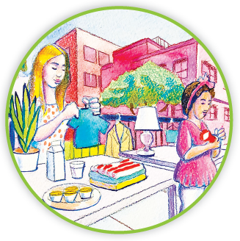
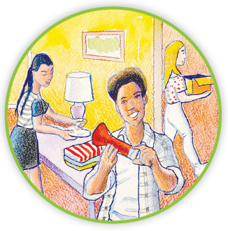
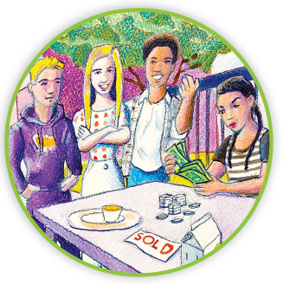
Picture Match
Part ______
Part ______
Part ______

Slide 16
Independent Practice (L) Part 1
Independent Practice
Text Comprehension Read each question. Think of the answer or look back at the text. Fill in the blank. Be sure the sentence makes sense.
Part 1
1. HOW did the pals get things set for the sale? To get things set for the sale, the pals ______________________________.
2. WHAT was Jay thinking after the things for sale were cleaned? Jay was thinking the things for sale were ____________________________.
3. WHAT was Willow’s plan to make people stop and shop? Willow’s plan was to ____________________________________________.

Slide 17
Independent Practice (L) Part 2
Part 2
4. WHAT was something the pals did sell? The pals did sell _______________________________________________.
5. WHAT did Jay say after Neena sells the mattress? Jay said _____________________________________________________.

Slide 18
Independent Practice (L) Part 3
Part 3
6. WHAT is in the box at the end of the day?
At the end of the day, the box had _____________________________.
7. WHERE did the cash in the box come from? The cash in the box came from _______________________________.
8. WHAT can the pals do thanks to the sale? Thanks to the sale, the pals can ______________________________.

Slide 19
Independent Practice (M) Story 1
More Practice Read each story. Answer the questions.
Story 1: “It’s late,” Jim said at six. “We need to eat. You get the grill, Mel, and I will get the fish.” Mel set the coals on the grill. She made a flame and grilled the fish.
“Let me put the fish on the plates,” said Jim. After they ate, he said, “You make the best fish, Mel.”
1. WHEN did Jim say, “It’s late”? __________________________________________, Jim said “It’s late.”
2. WHAT did Jim get? Jim got ___________________________________________________.
3. HOW did Mel make a flame? Mel made a flame with ______________________________________.

Slide 20
Independent Practice (M) Story 2
Story 2: “Will you play this game with me, Donnell? It will be fun,” Jaylee said. She held up the game case.
“What is the name of your game?” Donnell asked. Jaylee’s game was “Trade Off.” Donnell had the same game. He and Jaylee spent the day playing “Trade Off.” They had fun.
Jaylee said, “We can rate this game high on the list of games to play.”
1. WHAT did Jaylee ask Donnell to do? Jaylee asked Donnell to __________________________.
2. HOW long did Jaylee and Donnell play the game? Jaylee and Donnell played the game ______________________________.
3. HOW did Jaylee rate the game? Jaylee rated the game _________________________________________.

