Slide 1
Say Sounds (A–B)
Say Sounds
Phonemic Awareness Listen to the word your teacher says. Then say the sounds or word parts in the word.
Letter/Sound Associations Look at the letters. Say the sounds.
th p o sh k
m ck a t r
sh u c e th
w h ck l i

Slide 2
Read Words (C)
Read Words
New Words Say the sound. Sound out the word. Read the word.
path back hush
wish with tack
bath mash kick
tuck cash rush
rash lock luck

Slide 3
Read Words (D)
Word Families Read down. Read rapidly.
rock
lock
dock
sock
mock
hush
rush
mush
gush
rush
fish
dish
wish
Tish
fish
10 Second Challenge
Cold Timing words read
Practice words read
Hot Timing words read

Slide 4
Read Words (E–F)
Review Words Read a line of words. When your teacher gives a meaning, circle the correct word.
pass pat sit tip
sob boss bed den
bug gum get tag
yes kiss kit log
Multisyllabic Challenge Words Sound out the syllables. Read the whole word. backlog backpack packet punish ticket

Slide 5
Read Words (G)
High-Frequency Words Say. Spell. Read.
into for some from put
play children the long you

Slide 6
Read Sentences (H)
Read Sentences
Sentences Read the sentences with phrasing.
The children will be back at six.
Desh, the dog, will get into the tub for a bath.
Seth put a lock on his bag and went to play.
I got a tack from the box to put up my map.
Mom will put some water in the dish for the cat.

Slide 7
Spell Words (I)
Spell Words
Spelling Journal Turn to the Spelling Journal on page 154.

Slide 8
Decodable Text (Passage 1)
Decodable Text Read each passage. Answer your teacher’s questions and select the picture that goes with each passage.
Passage 1
A Pet Fish
Teacher Reads Seth and Matt, who are good friends, are headed home
on a bus after shopping at a pet store. Let’s learn about the new pet.
Seth and Matt got on the bus and sat down. Seth had a little fish in a bag.
Seth said, “My wish was to have a pet, but my mom said I cannot have a pet unless it is little.”
“I got a little fish. It will be a fun pet. I got my wish, a pet! My mom got her wish, a little pet!”

Slide 9
Comprehension Questions Passage 1
What was Seth’s wish?
Seth’s wish was ________________.
What pet did Seth get?
Seth got a ________________.

Slide 10
Decodable Text (Passage 2)
Passage 2
Rick’s Mud Bath
Teacher Reads Rick was rushing to meet his friends. Often when we rush to do something, mishaps happen. Let’s find out what mishap happens to Rick.
Rick was in a rush to see his pals. He did not see the water on the path and fell. He had mud up to his neck. The water and mud got on him and on his backpack.
“Gosh!” said Rick. “I have had a mud bath! I will get rid of the mud in the bathtub.”

Slide 11
Comprehension Questions Passage 2
What mishap did Rick have?
Rick’s mishap was that he ________________.
How will Rick clean up after his mishap?
Rick will clean up by ________________.

Slide 12
Decodable Text (Passage 3)
Passage 3
The Lost Ticket
Teacher Reads Tish and Mack have just finished dinner at a restaurant.
Now they have to catch a train home, but something stops them!
“We have to go, Tish,” Mack said. “I have my ticket. I am set to go.”
Tish had a look of panic. “Where is my ticket? It is not in my jacket pocket. It is not in my backpack. I cannot go unless I have a ticket,” said Tish.
Mack said, “You had it as we sat down. Is it hidden? Pick up the dish, Tish.”
“Look, Mack,” Tish said. “My ticket! Luck is with us.”

Slide 13
Comprehension Questions Passage 3
What did Tish need to ride on the train?
To ride on the train, Tish needed ________________.
Where was Tish’s ticket hidden?
Tish’s ticket was hidden ________________.

Slide 14
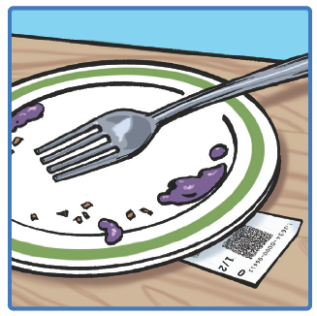
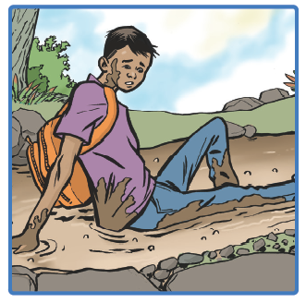
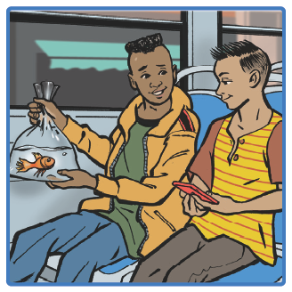
Picture Match
Passage ______
Passage ______
Passage ______

Slide 15
Independent Practice (K)
Independent Practice
More Practice 1 Fill in each blank with the best word.
1. Jan will ________ the cash in a box.
luck lock lick
2. Jack will ________ the rock.
kick path with
3. The tot will get a ________.
hush bath tuck
4. Jeff has a rash on his ________.
wish back lock
5. The dog ran down a ________.
kick with path

Slide 16
Independent Practice (K) — cont’d
6. The cat will ________ up the tree.
hush wish rush
7. Dad will tell the children to ________.
rash path hush
8. Bess can ________ her doll in bed.
tuck with bath
9. Can we go ________ Nat?
lock path with
10. The children ________ to see the sunset.
wish fish dish

Slide 17


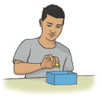
Independent Practice (L)
More Practice 2 Draw a line under the sentence that goes best with each picture.
1. Sal will lock the bus.
The children sit on the bus.
2. Bess put the doll in the bath.
Bess gets the moth with a net.
3. Nat put the tack in a box.
Nat will rush to school.

Slide 18

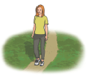

Independent Practice (L) — cont’d
4. The man has tickets in his backpack.
Jill has cash to get the tickets.
5. Kat went down the path.
The dog can rush down the path.
6. Tom will kick the rock.
The dog will get a bath.

Slide 19


Independent Practice (L) — cont’d
7. The racket is in the backpack.
The dishrag is on the rack.
8. Dad will tuck us into bed.
Dad will lock the van.

