Slide 1
Say Sounds (A–B)
Say Sounds
Phonemic Awareness You will blend and segment sounds as you read and spell words.
Letter/Sound Associations Look at the letters. Say the sounds.
corn
er ea or i_e
ee oa ar e
ow or ir igh
or a_e ar ch
ir i or ck

Slide 2
Read Words (C)
Read Words
New Words Say the sound. Sound out the word. Read the word.
for corn fort
fern worn cart
sport spark storm
north speed star
coach horse tore
shore need wore

Slide 3
Read Words (D)
Word Families Read down. Read rapidly.
corn
horn
born
thorn
sworn
fort
port
short
snort
sport
tore
wore
bore
chore
store
10 Second Challenge
Cold Timing words read
Practice words read
Hot Timing words read

Slide 4
Read Words (E–F)
Review Words Read a line of words. When your teacher gives a meaning, circle the correct word.
shave strike stick slight
stock stroke shape screech
strain throat stain strap
slip stream throne smoke
Words with Endings Read words with endings. 1. shaving 2. slipped 3. striking 4. skater 5. spotter 6. spending 7. stormed 8. coached 9. sparked 10. painter

Slide 5
Read Words (G–H)
Multisyllabic Challenge Words Sound out the syllables. Read the whole word.
corner order popcorn morning dinner
shelter performer peppermint different landscapes
High-Frequency Words Say. Spell. Read.
my by cry fly why
your down who little what

Slide 6
Read Sentences (I)
Read Sentences
Sentences Read the sentences with phrasing.
You should put your backpack in the corner.
What time have you been getting up in the morning?
Why are you driving north when you should be going west?
After we go swimming at the shore, we dry off in the sun.
Lonzo will need to be up by seven to get to school on time.

Slide 7
Spell Words (J)
Spell Words
Spelling Journal Turn to the Spelling Journal on page 201.

Slide 8
Decodable Narrative Text (Part 1)
Decodable Narrative Text Read each part. Answer your teacher’s questions and select the picture that goes with each part.
Lonzo’s Problem
Part 1
Teacher Reads Going to school is important. It’s a school day, but Lonzo is still in bed. He tells his mom he may have a sore throat, but that may not be true. Maybe there is something else going on with him.
9
11
22
34
44
55
“Come on, Lonzo! You will be late for school,” Mom yelled.
“I can’t go to school today,” Lonzo said. “I feel sick. I should stay home and rest. I may have a sore throat.”
Lonzo’s mom gave him a stern look. She felt his cheek and said, “You may have a sore throat. What do you mean may? You have a sore throat, or you do not.”

Slide 9
Comprehension Questions Part 1
Who are the main characters in this story?
The main characters in this story are ________________.
What reason for staying home did Lonzo tell his mother?
The reason for staying home that Lonzo told his mother was that ________________.

Slide 10
Decodable Narrative Text (Part 2)
Part 2
Teacher Reads Lonzo might be using a sore throat as an excuse. Sometimes people pretend to be sick when they are afraid of something or because they feel bad about something.
67
78
90
101
103
112
123
“Well,” Lonzo said, “it’s not a lot sore, just sort of sore.” He gave his mom a look. “Do you think I snore at night?” he asked. “That may make it sore. What do you think?”
“I think you better explain why you would make up this tale,” said Mom. “Your throat is not sore. Start with that!”

Slide 11
Comprehension Questions Part 2
How do you know Mom did not think Lonzo had a sore throat?
Mom did not think Lonzo had a sore throat because ________________.

Slide 12
Decodable Narrative Text (Part 3)
Part 3
Teacher Reads Read on to find out the real reason why Lonzo doesn’t want to go to school and what happens.
125
133
146
155
167
177
188
199
211
Lonzo stopped to think, then said, “Well, you see, it’s my art class. I did fine when we had to paint landscapes. But the teacher has started us on clay. I have to make a clay stork today and I just can’t. When I try, my stork looks more like a horse.
“I got a sneak peek at Jeff ’s stork last week,” Lonzo said. “His looks like a stork! When he sees mine, he will tease me for the rest of the day. Please, please let me stay home!”

Slide 13
Decodable Narrative Text (Part 3) — cont’d
214
223
234
245
249
261
275
282
293
302
“Well, Lonzo,” Mom said. “What is important is that you work hard and do your best work. Will you have time to work on the stork today? Maybe you can spend more time on it.”
Lonzo had to think for a bit. Then he said, “I could do that. I will keep working on it. I can tell Jeff I have more work to do on my stork.”
Mom smiled. “That seems like a plan to me. Time to get going or you will be late for school.”

Slide 14
Comprehension Questions Part 3
What was Lonzo’s real problem?
Lonzo’s real problem was that ________________.
How did Lonzo try to solve his problem?
Lonzo tried to solve his problem by ________________.
What happened at the end of the story?
At the end of the story, Lonzo had to ________________.

Slide 15
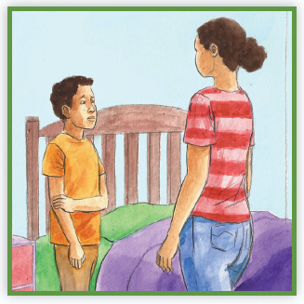
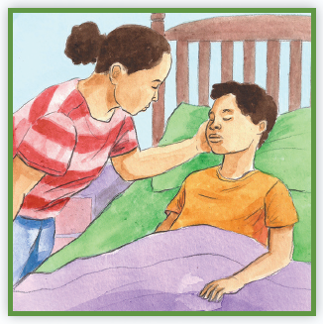
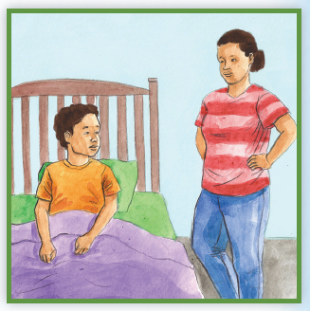
Picture Match
Part ______
Part ______
Part ______

Slide 16
Independent Practice (L) Part 1
Independent Practice
Text Comprehension Read each question. Think of the answer or look back at the text. Fill in the blank. Be sure the sentence makes sense.
Part 1
1. WHO are the people in this story? The people in this story are _____________________________________.
2. WHY did Lonzo tell Mom he had to stay home from school? Lonzo said he had to stay home because __________________________.
3. WHAT did Mom say to Lonzo when she felt his cheek? Mom said ___________________________________________________.

Slide 17
Independent Practice (L) Part 2
Part 2
4. WHY did Lonzo say his throat may be sore? Lonzo said his throat may be sore because __________________________.
5. WHAT did Mom say Lonzo had better do? Mom said Lonzo had better explain ________________________________.

Slide 18
Independent Practice (L) Part 3
Part 3
6. WHAT was Lonzo’s real problem? Lonzo’s real problem was _________________________________________.
7. WHY did Lonzo think a sore throat would fix his problem?
Lonzo was thinking it would fix his problem because ____________________ _______________________________________________________________.
8. WHAT happened at the end of the story? At the end of the story, ___________________________________________.

Slide 19
Independent Practice (M) Story 1
More Practice Read each story. Fill in each blank with the best word.
Story 1: Andee and her dad like to sail. By nine in the morning, they had put the boat in the water and sailed north. The day seemed dry, but a brisk wind came up and it rained. The storm rocked the boat back and forth.
Her dad said, “The storm will pass in a short time.”
When the wind slowed down a little, Andee and her dad sailed back to shore. They were safe!
1. WHAT did the storm do to the boat? The storm __________________________________________________.

Slide 20
Independent Practice (M) Story 1 — cont’d
2. WHAT did Andee’s dad say the storm would do? Andee’s dad said the storm would ________________________________.
3. WHERE did Andee and her dad sail to? Andee and her dad sailed _______________________________________.

Slide 21
Independent Practice (M) Story 2
Story 2: Lil and Josh were bored. Mom said, “Make a fort in the yard?”
Lil and Josh got twigs and sticks. They made the fort by the corner of the porch. Josh put in his kite, and Lil put in her little stuffed horse. It started to rain. “Things will stay dry in the fort,” said Josh as they ran inside.
1. WHERE did Lil and Josh make the fort? Lil and Josh made the fort _______________________________________.
2. WHAT did Josh and Lil put in the fort? In the fort, Josh and Lil put ______________________________________.
3. WHAT will happen to the things in the fort when it rains? When it rains, the things in the fort ________________________________ ____________________________________________________________.

