Slide 1
Get Ready for i-Ready Lessons!
Personalized Instruction K-5
It’s important to prepare your students to successfully engage in online lessons and motivate them to try their best. Use the grade-level presentation prior to i-Ready Personalized Instruction to introduce students to the i-Ready experience and explain why lessons are important to their learning.
Presentations Included:
Tips:
Review the presentation ahead of time to internalize the slides and note any additional guidance you want to provide.
Feel free to adjust the presentation for your students. Skip slides when needed.
There may be variations across schools and districts. Review the notes at the bottom of some slides that clarify what features may or may not be available.
For additional tips and tools, search personalized instruction on Central.i-Ready.com.
Kindergarten
Grades 1–2
Grades 3–5

Slide 2



Get Ready for i-Ready!
Kindergarten

Slide 3
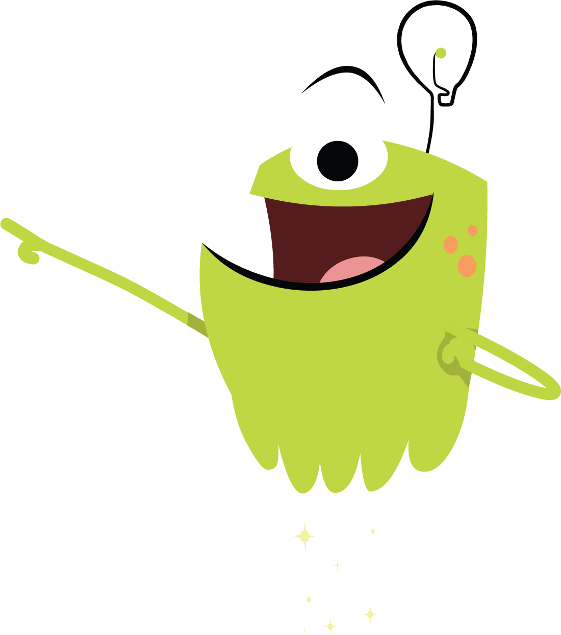
Why i-Ready Online Lessons?
Online lessons will:
Show what you know and what you’re still learning
Help you learn what you need
Let me know how you are doing and how I can help

Slide 4

Why should you try your best?
You will learn something new.
You will be better prepared for class.
You can show what you know on the next Diagnostic.

Slide 5
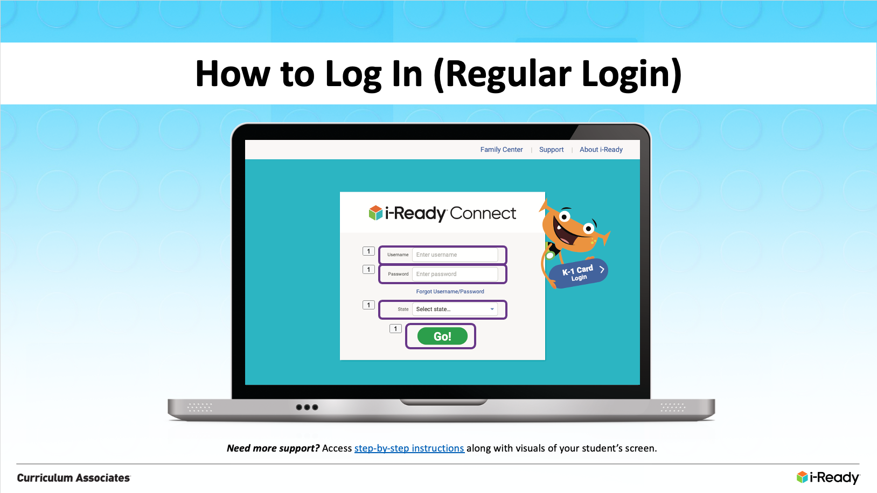
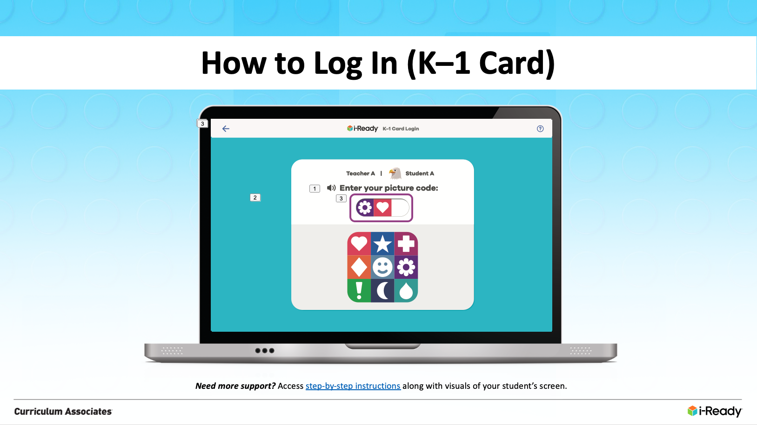
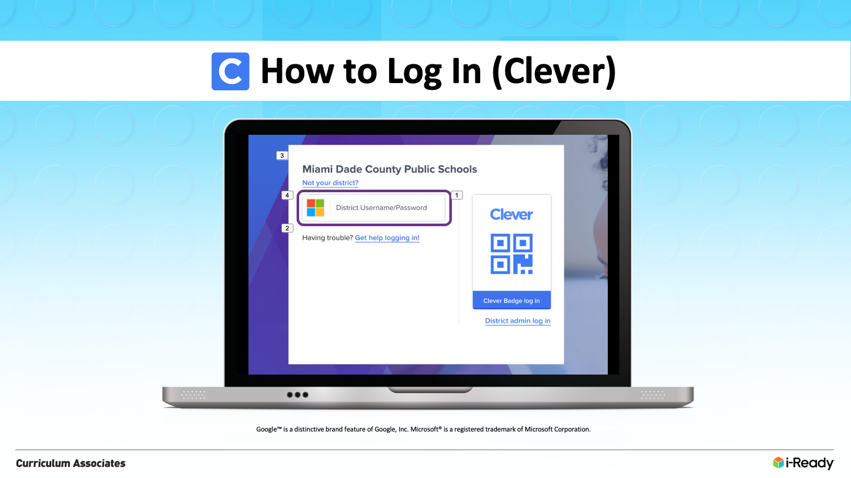
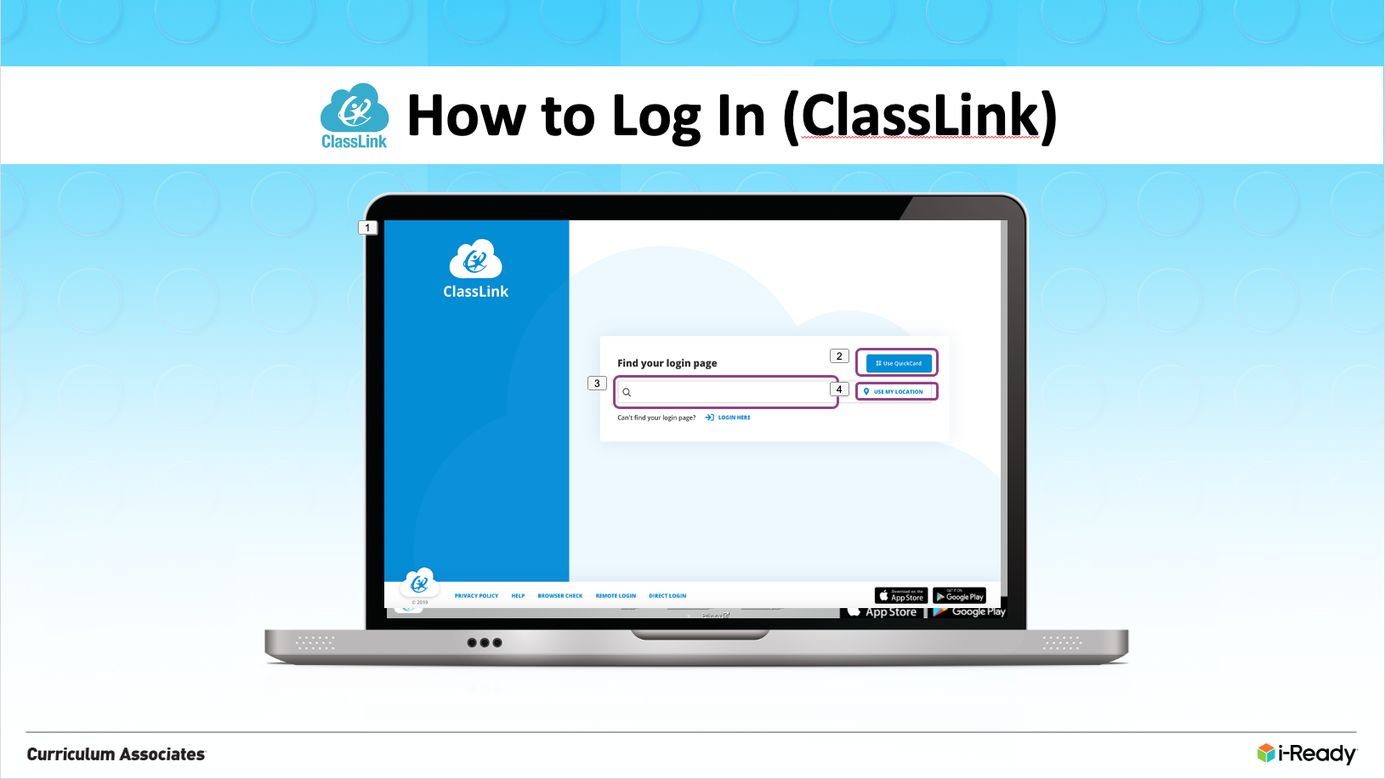
How to Log In
Schools have different ways they ask their students to log in to i-Ready. Choose which of the next four slides applies to your students and use that slide in your presentation.
Slide 6: Regular Login
Slide 7: K–1 Card
Slide 8: Clever
Slide 9: ClassLink

Slide 6
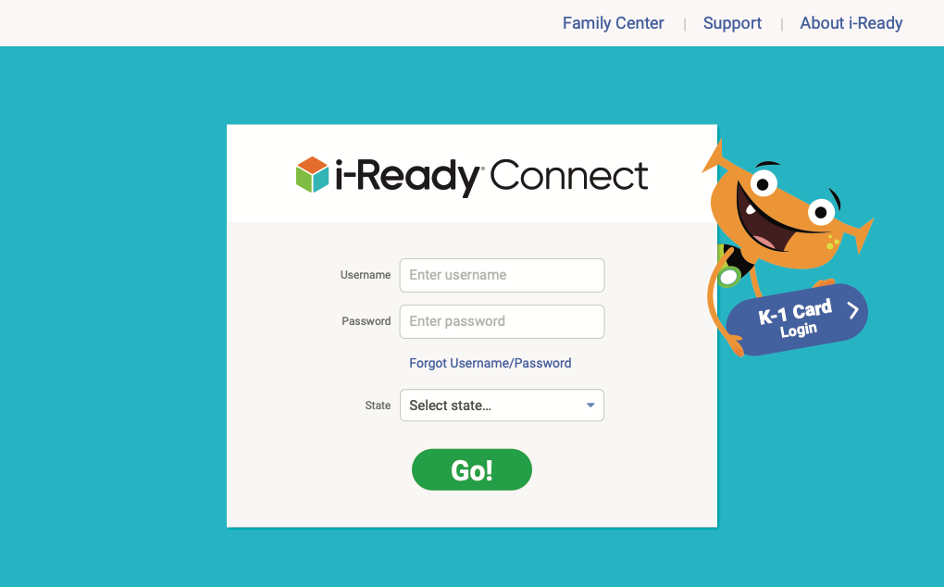
How to Log In (Regular Login):
Need more support? Access step-by-step instructions along with visuals of your student’s screen.
Notes:
Enter your username.
Enter your password.
Select your state.
Click Go!

Slide 7
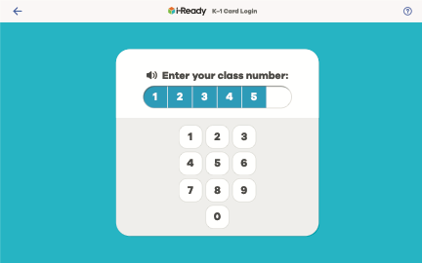
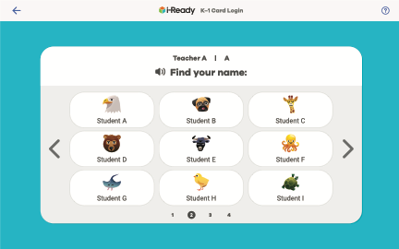
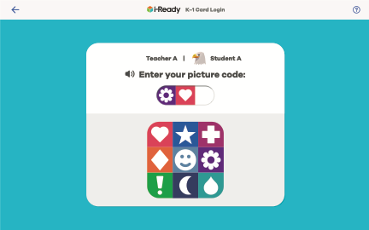
How to Log In (K–1 Card):
Need more support? Access step-by-step instructions along with visuals of your student’s screen.
Notes:
Click on K–1 Card Login.
Enter your class number.
Find your name.
Enter your picture code.

Slide 8

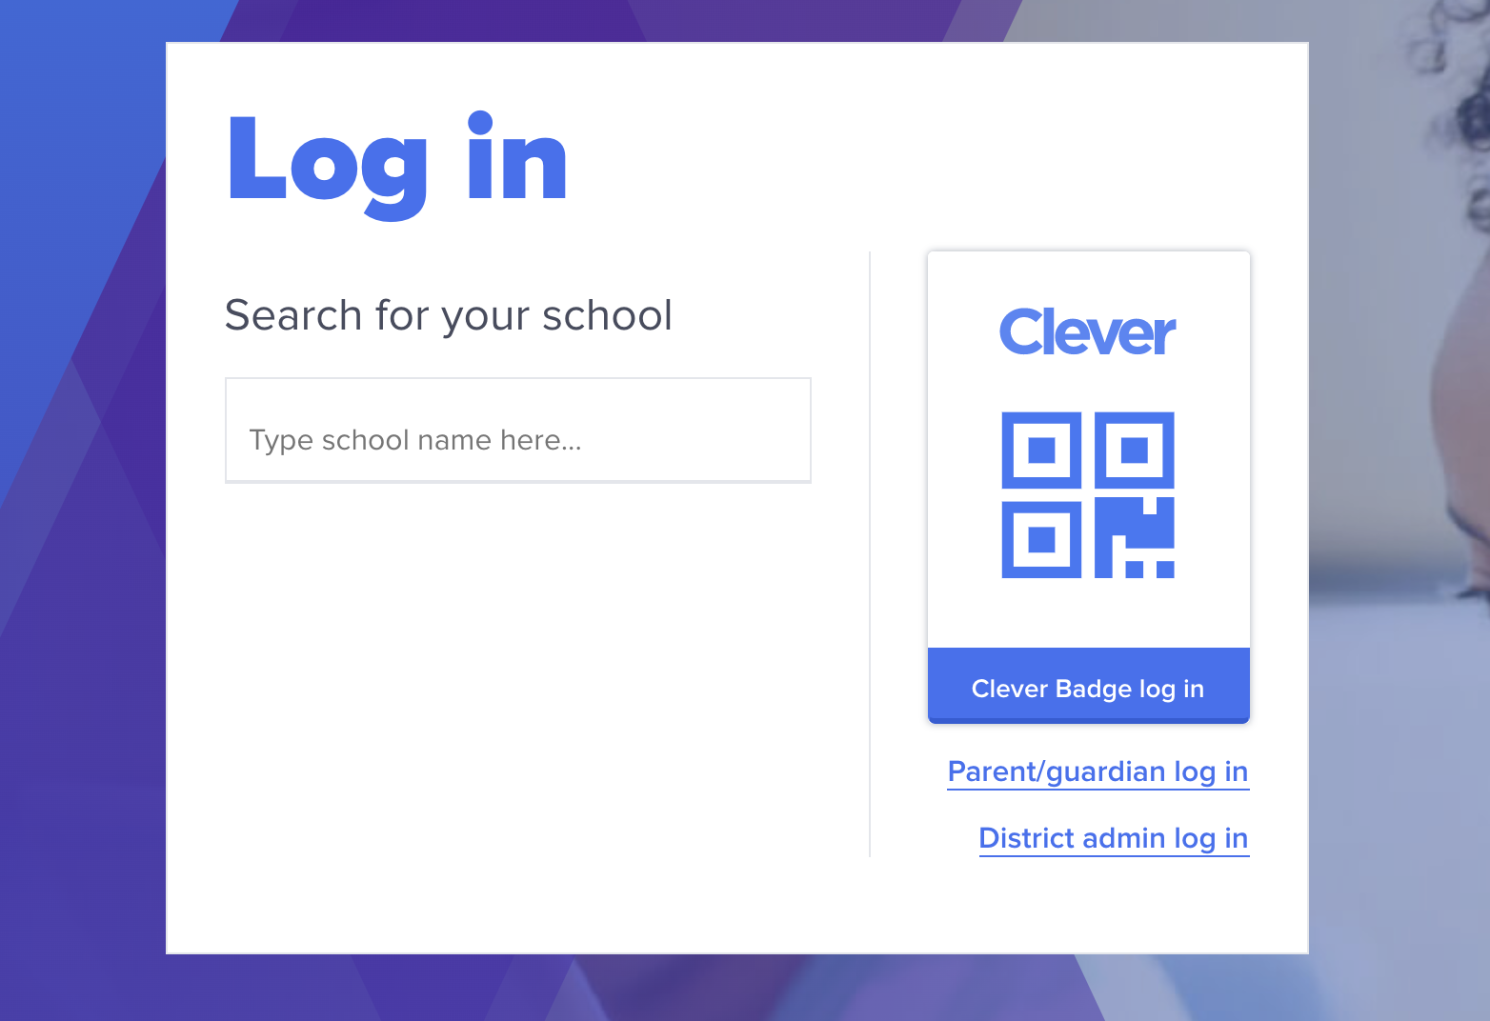
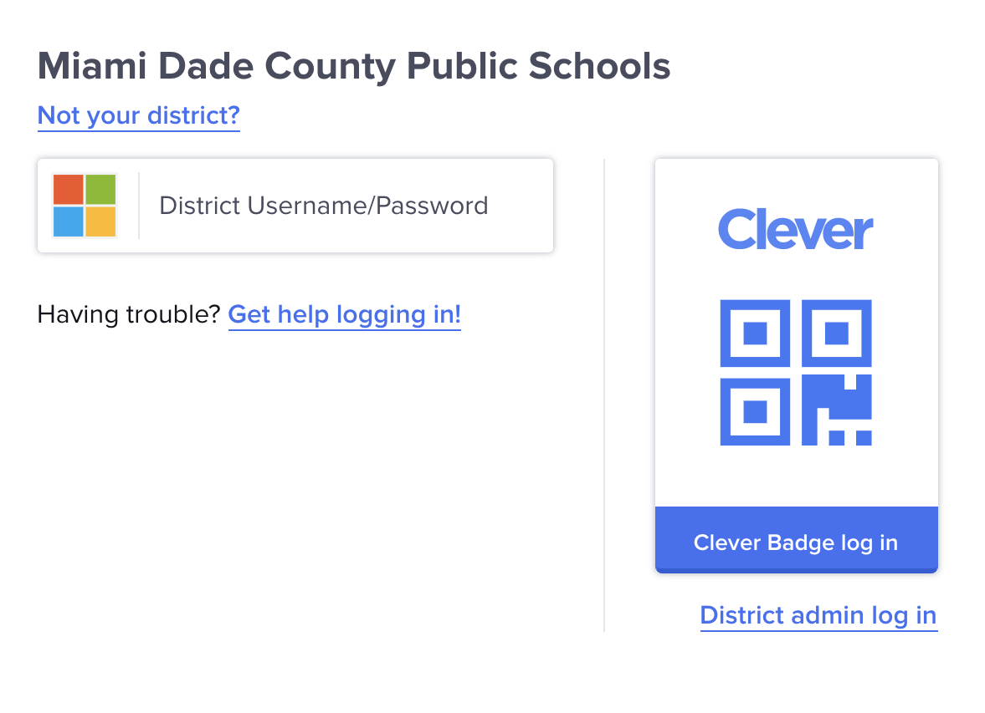
How to Log In (Clever):
Google™ is a distinctive brand feature of Google, Inc. Microsoft® is a registered trademark of Microsoft Corporation.
Notes:
Visit Clever.com and click “Log in as a student.”
If your student has a Clever Badge: Click “Clever Badge Log In” to scan their card.
If your student does NOT have a Clever Badge: Type your school name in the box provided.
Note: There may be multiple schools with the same name, so be sure to select the school associated with your student’s district.
Click on the Login icon (most districts use Google™ or Microsoft®). Enter your student’s username and password.

Slide 9

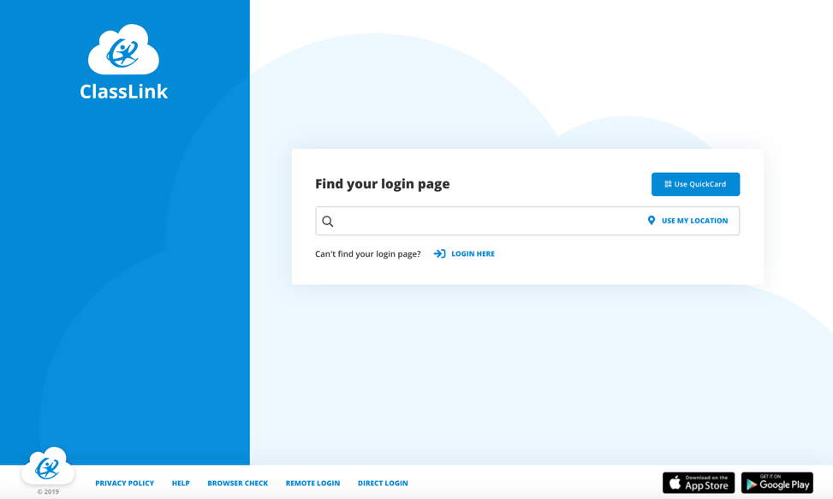
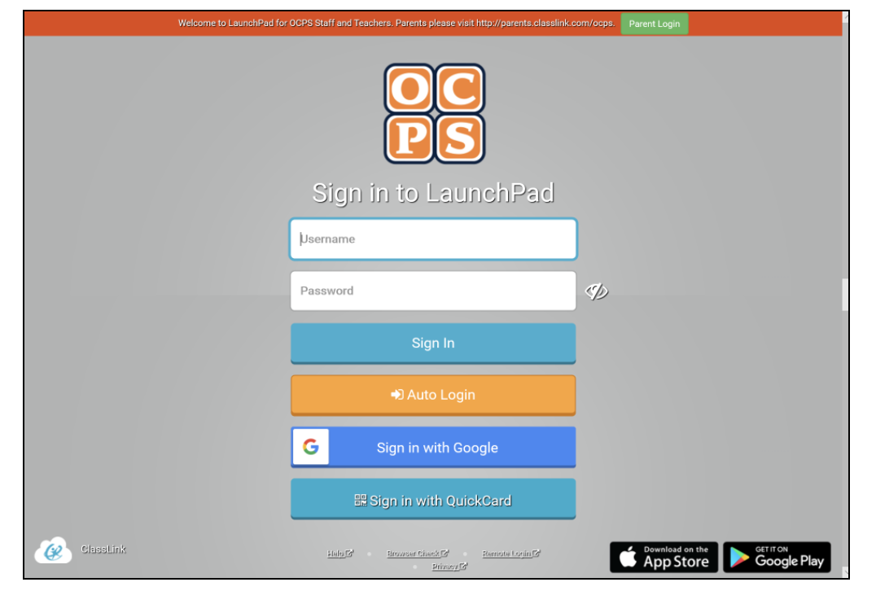
How to Log In (ClassLink):
Notes:
Option 1: If you have your student’s school organization URL . . .
1. Log in using it. It may look like this: https://launchpad.classlink.com/[YourSchoolOrganization]
2. Enter your student’s username and password.
Option 2: If you do NOT have your student’s school organization URL . . .
Log in to LaunchPad.ClassLink.com
2A. Click on “Use QuickCard” if your student was given a personal QuickCard.
2B. Search for your school’s login page by entering the school name in the search bar.
2C. In addition, click “Use My Location” to allow the browser to access the closest schools based on your location.
Enter your student’s username and password or scan their QuickCard.

Slide 10
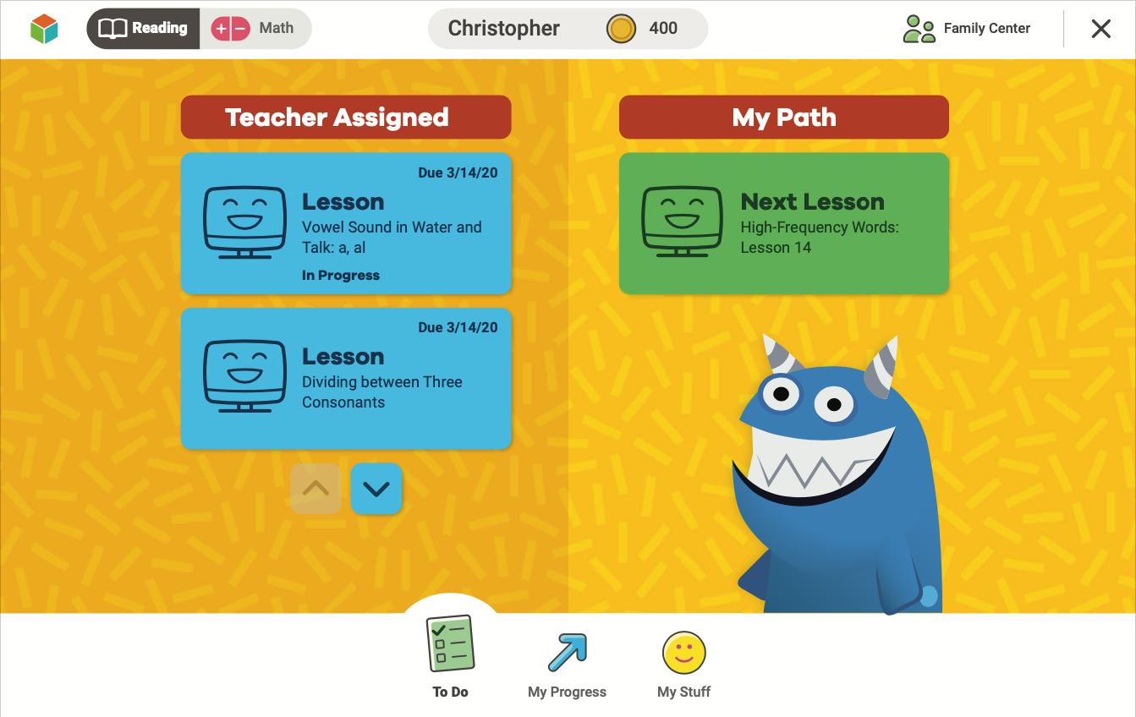
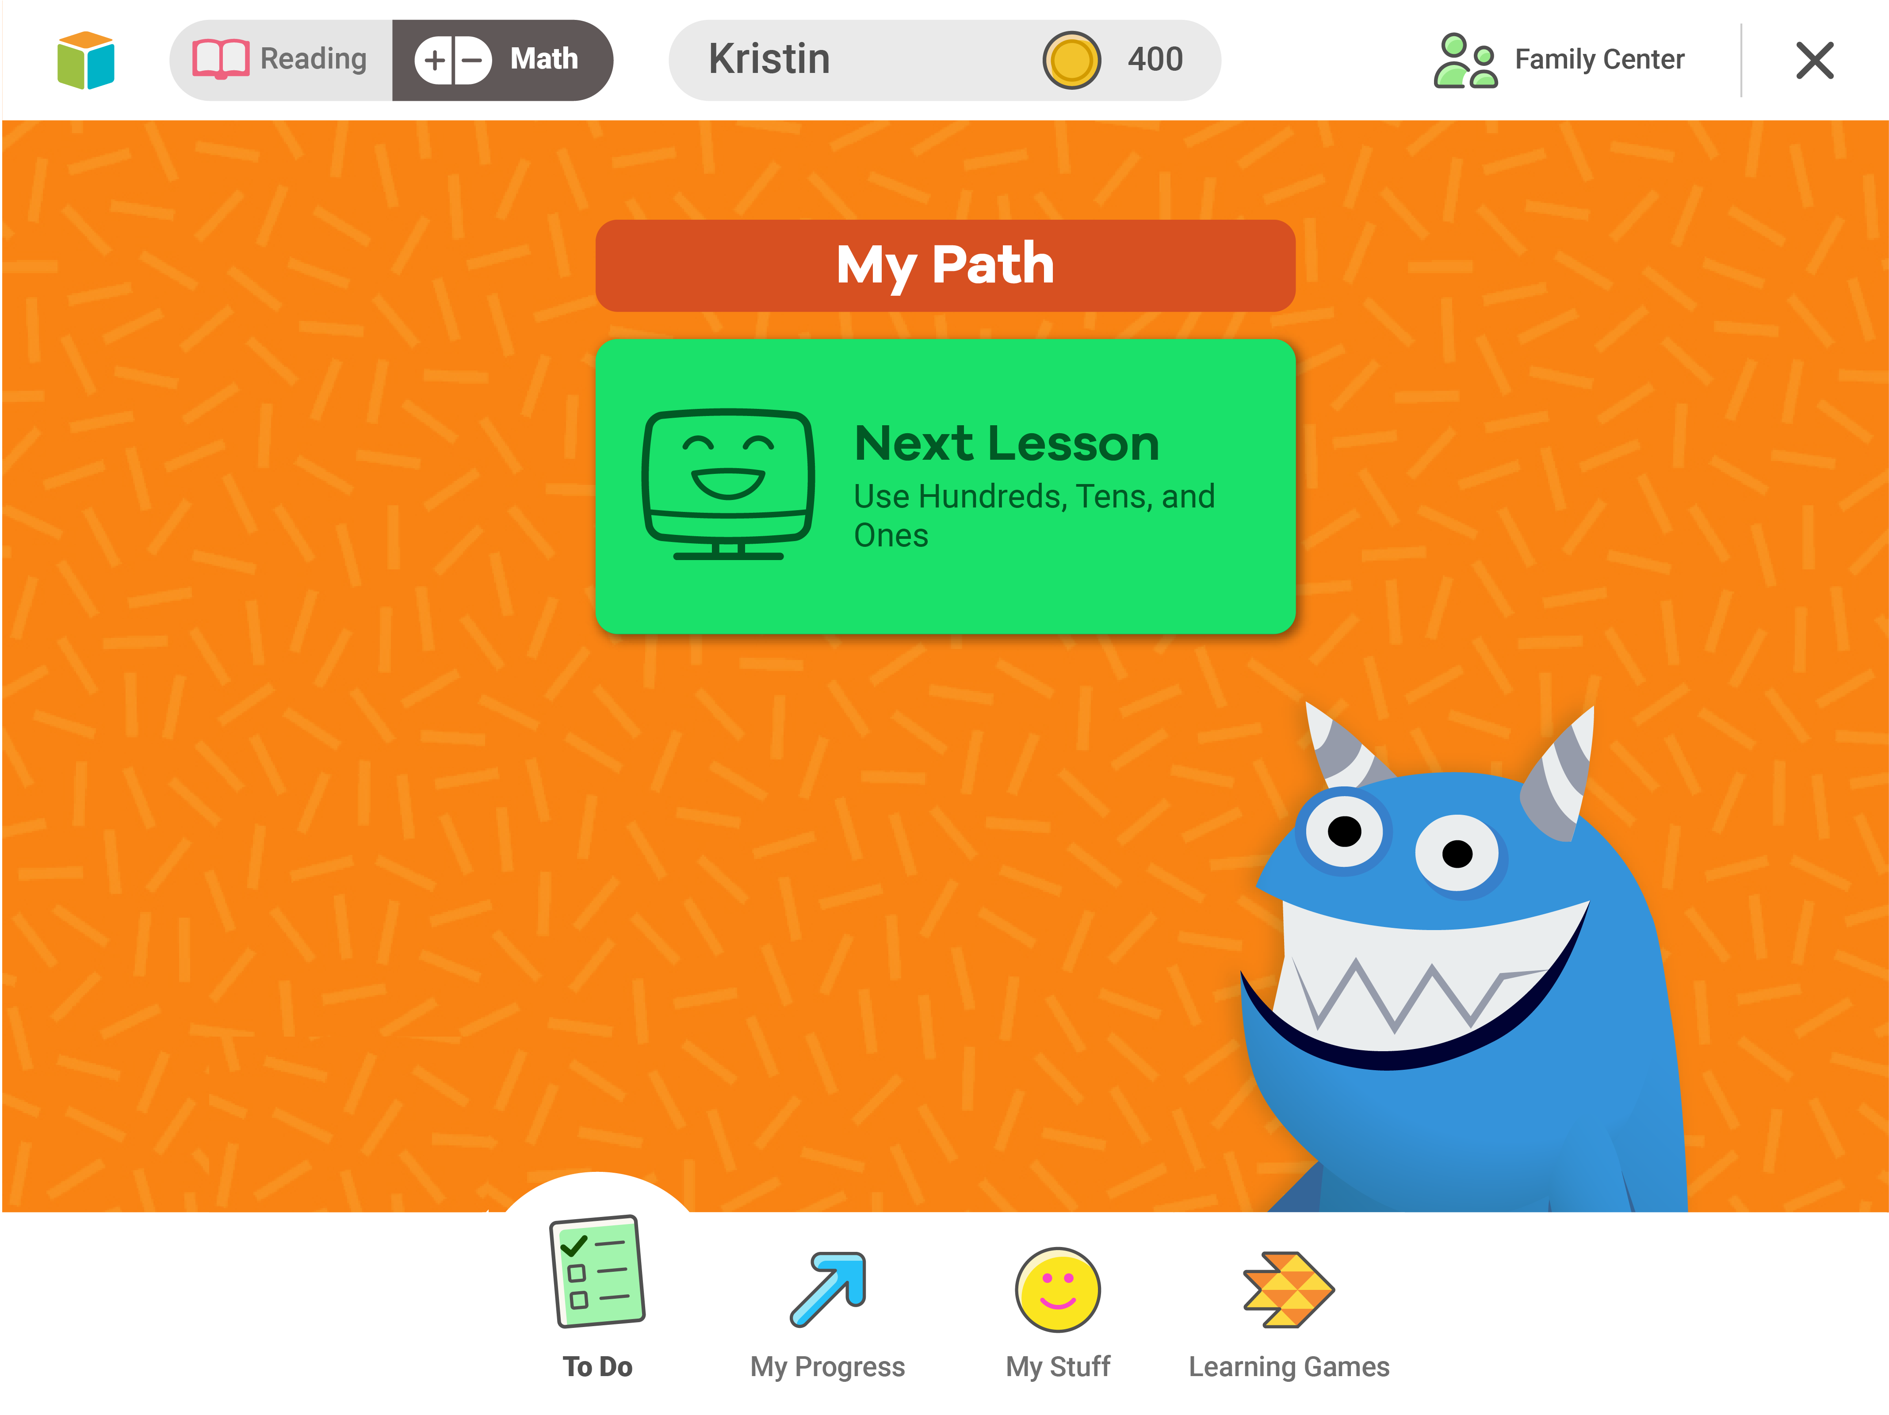
Your Dashboard
You can pick Math or Reading.
It will tell you what you need to do.
On the bottom, you may have some of these different choices:
To Do
My Progress
My Stuff
Learning Games

Slide 11
Your Dashboard
Optional
The green is your lesson path.
The blue are Teacher-Assigned Lessons.

Slide 12
To Do
Click here to see your lessons and assignments.

Slide 13
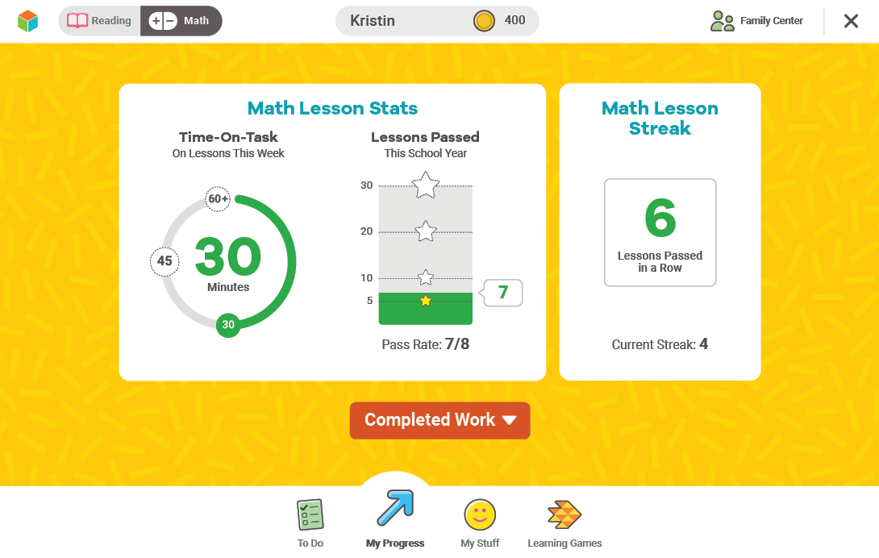
My Progress
You will see stats.
Time-On-Task tells you how many minutes you’ve spent on lessons.
Lessons Passed tells you how many lessons you’ve passed.
Lesson Streak tells you how many lessons you’ve passed in a row.
Next, we’ll talk about Completed Work.

Slide 14
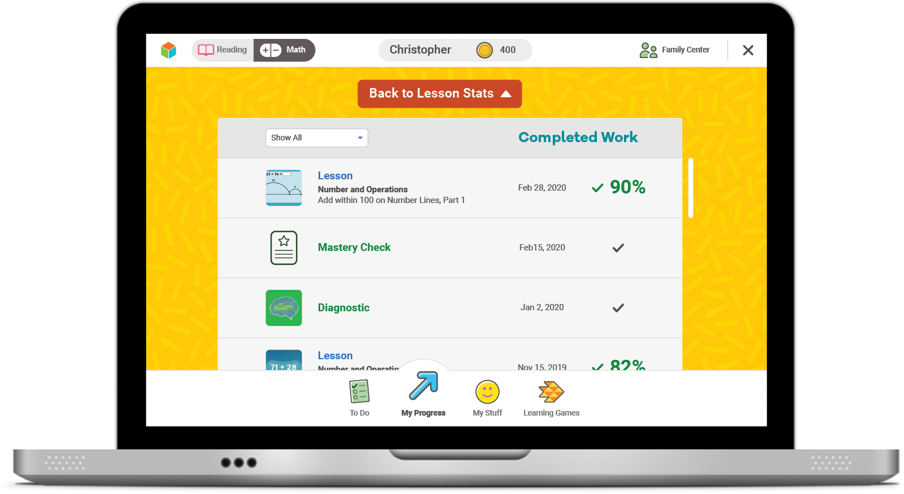
Completed Work
Shows you your past work

Slide 15
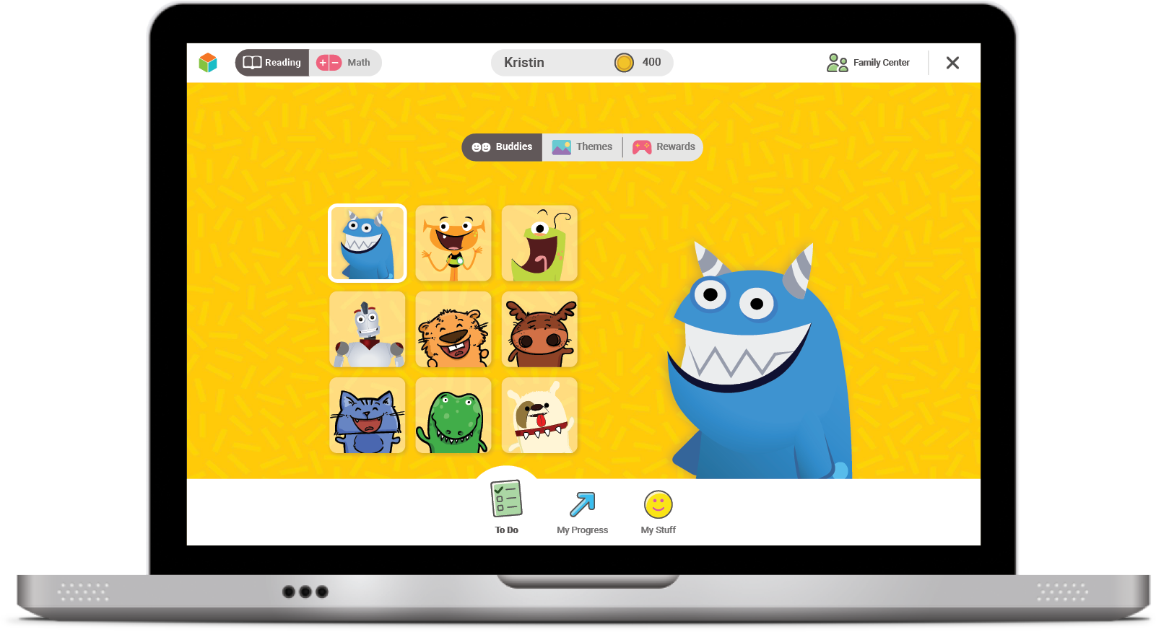
My Stuff
You can pick your background theme and play games with coins here.

Slide 16
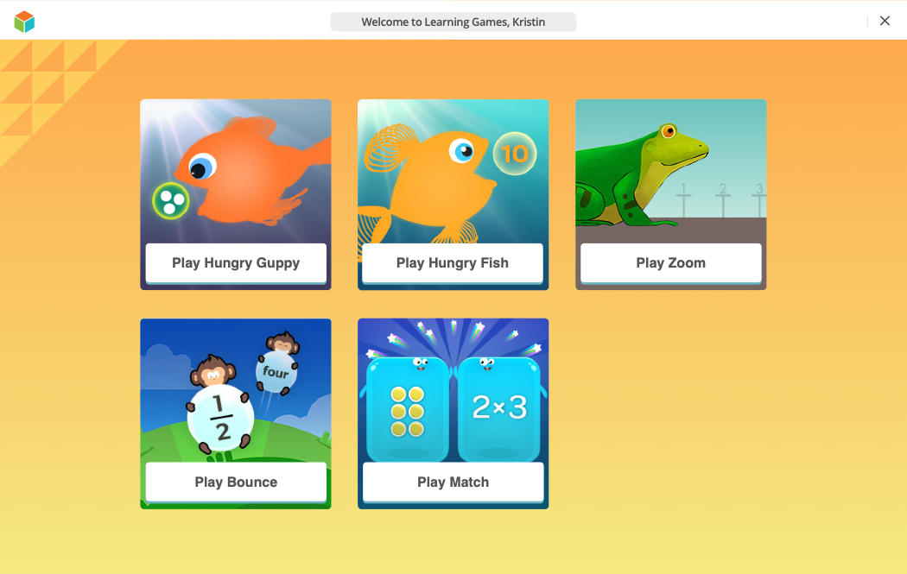
Learning Games
Optional
Click the fish icon. These are games to help you with math.
Only play Learning Games when you finish lessons.

Slide 17

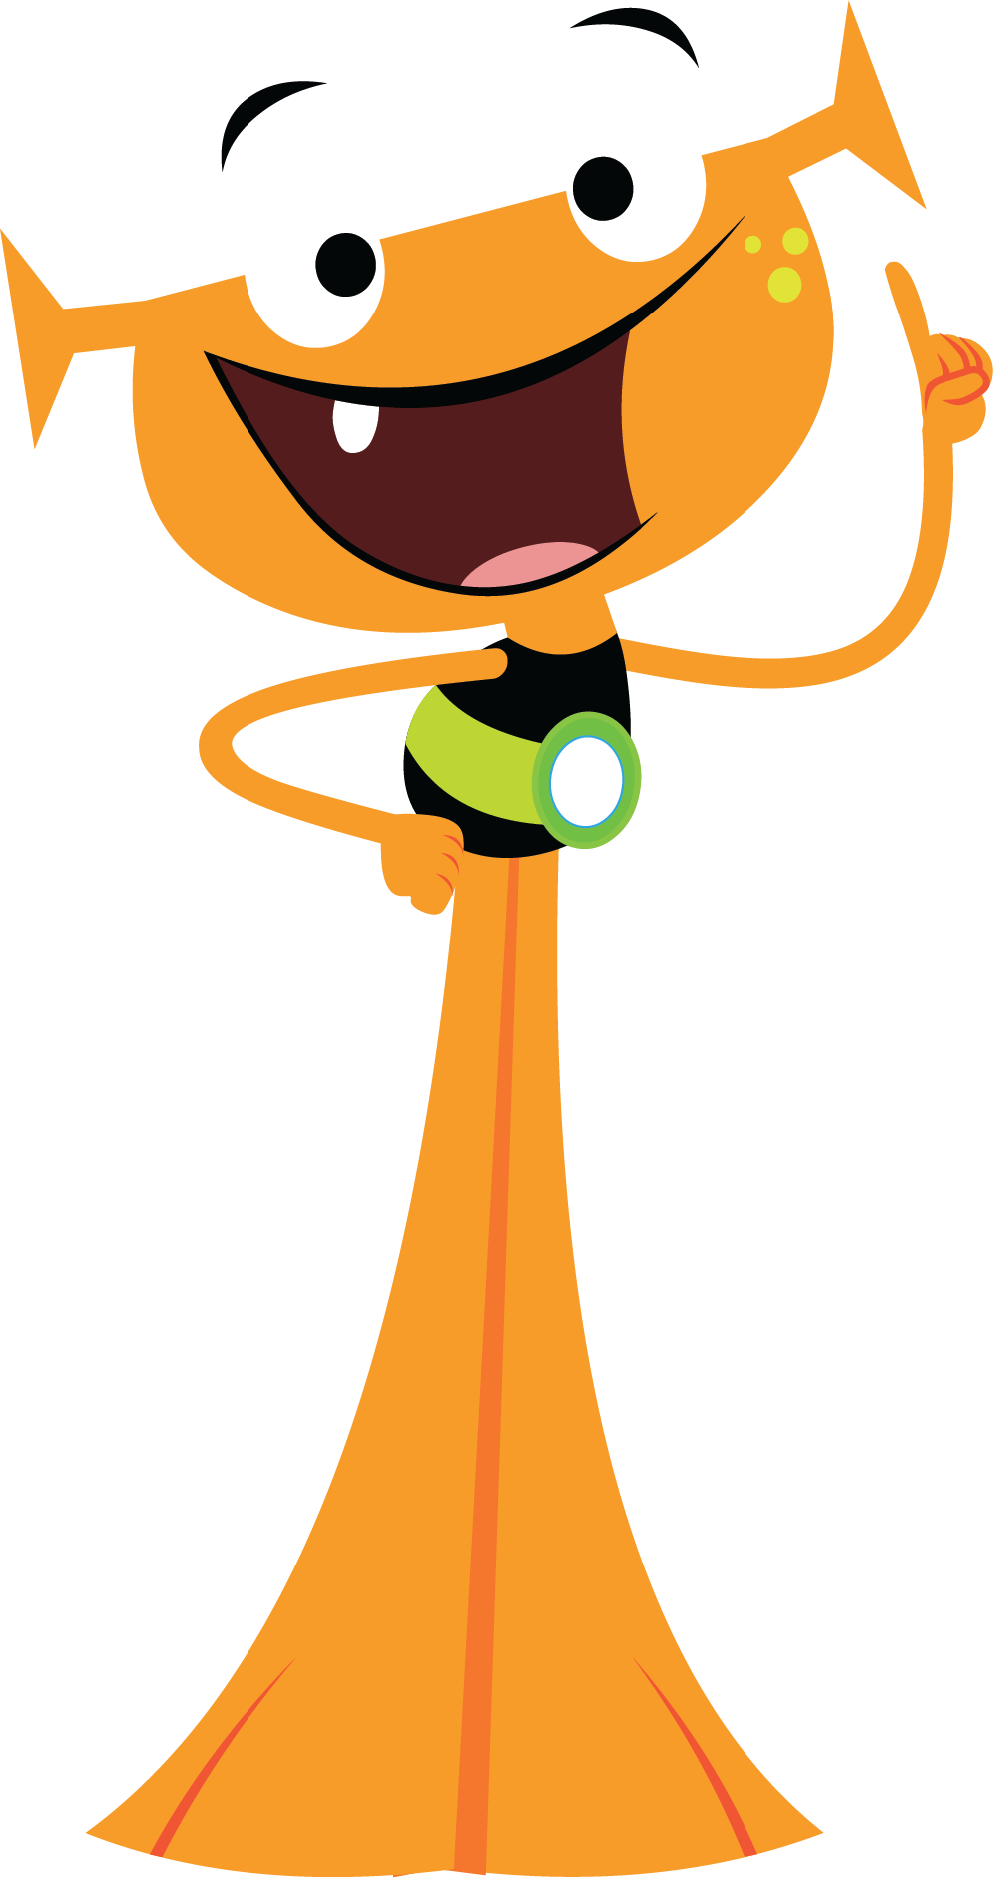


Helpful Tips
Take your time and do not rush.
Try your best and don’t let others help you.
For Math—Show your work on paper for every problem.

Slide 18



Helpful Tips
For Reading—Read each passage carefully, and reread the passage when necessary.
Check your work before going to the next question.

Slide 19
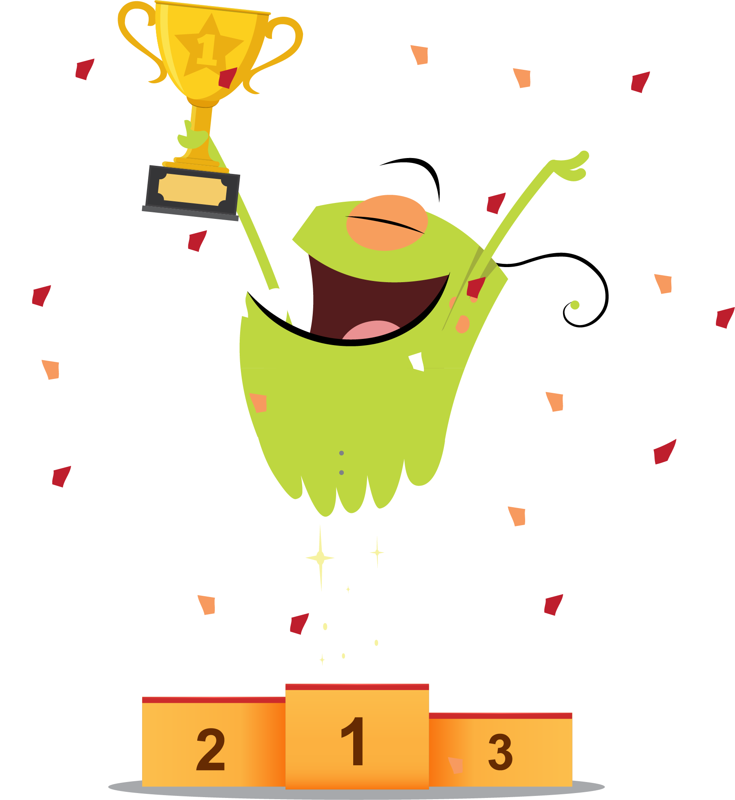
Goals
Optional
This year, we have i-Ready goals:
Class goals
Individual goals

Slide 20
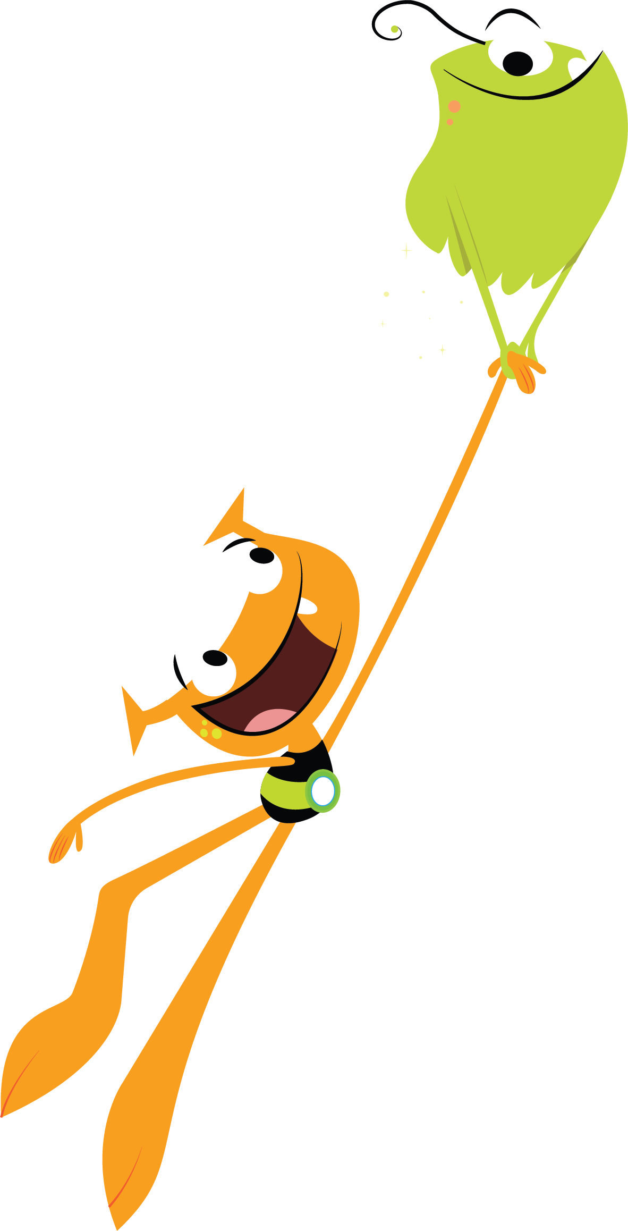
Reflection
Why is it important for us to try our best during i-Ready lessons?
What habits can we use?

Slide 21

You Will Rock It!

Slide 22

Get Ready for i-Ready!
Grades 1–2

Slide 23
Why i-Ready Online Lessons?
Online lessons will:
Show what you know and what you’re still learning
Help you learn what you need
Let me know how you are doing and how I can help

Slide 24
Why should you try your best?
You will learn something new.
You will be better prepared for class.
It will help get you ready for the next grade.
You can show what you know on the next Diagnostic.

Slide 25
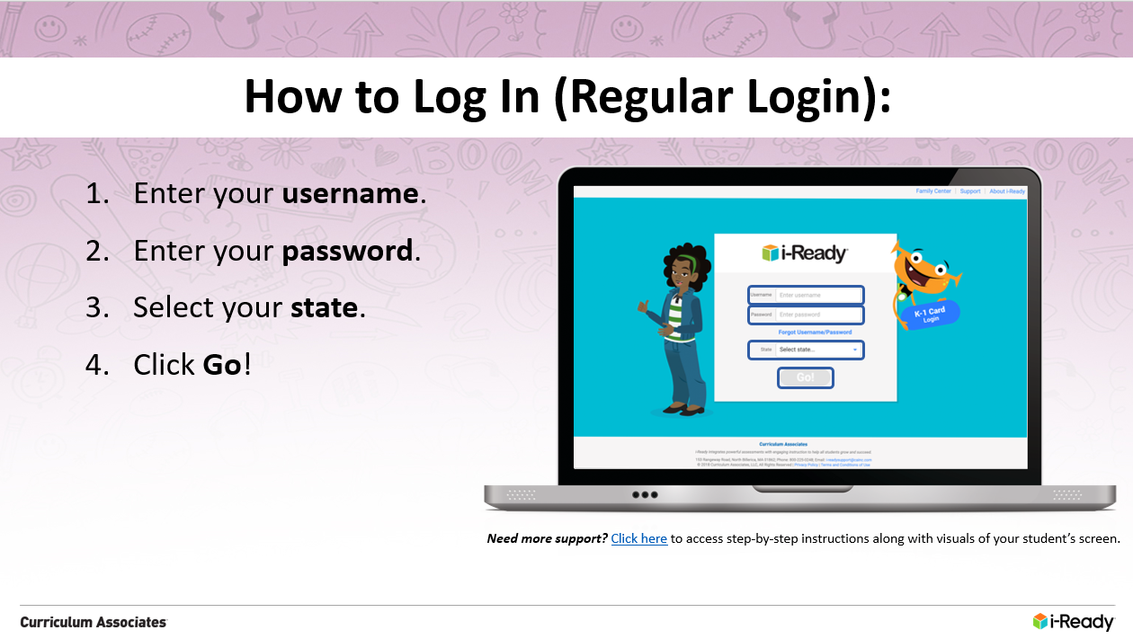
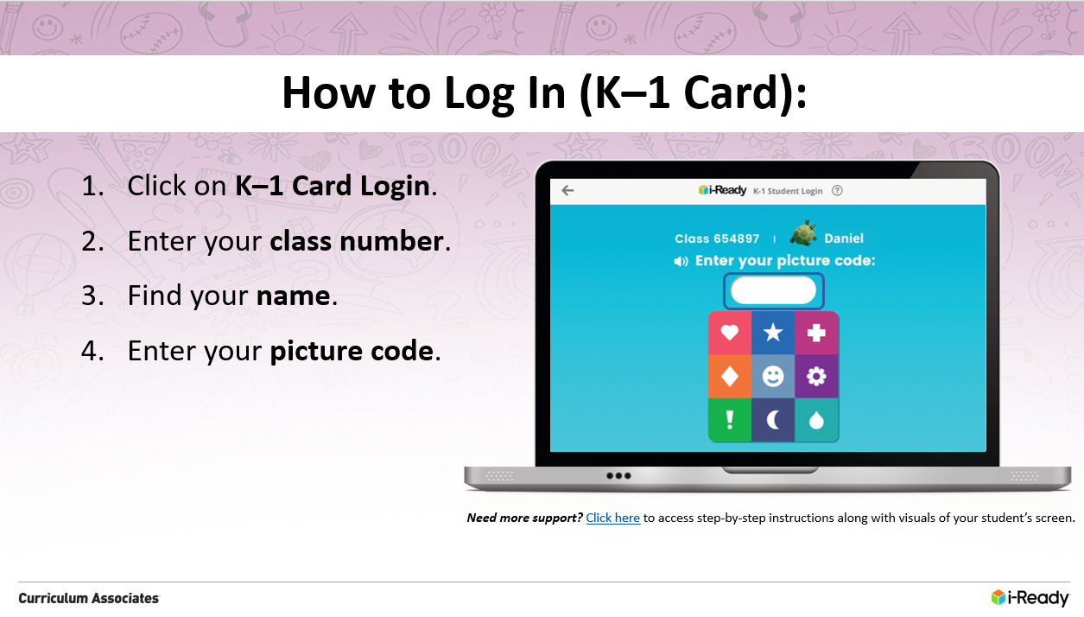
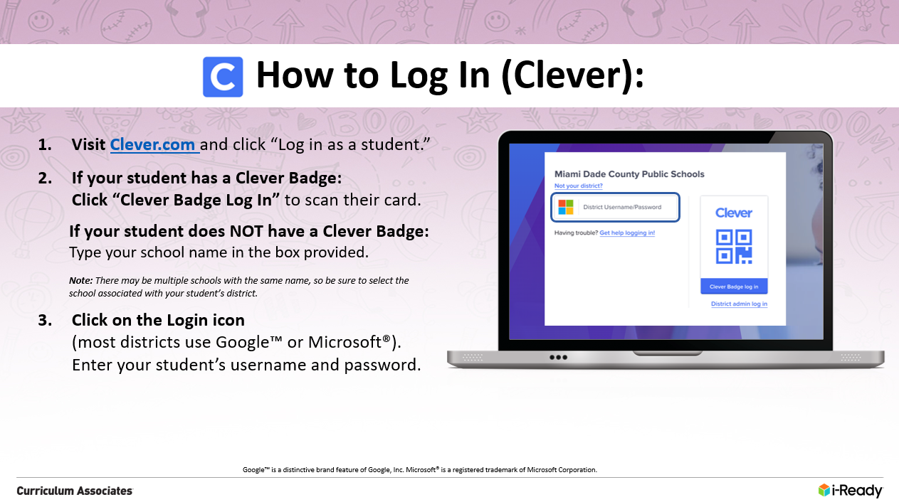
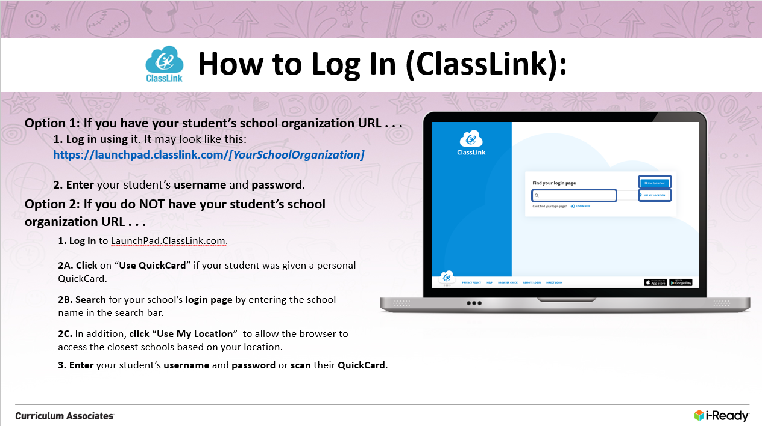
How to Log In
Schools have different ways they ask their students to log in to i-Ready. Choose which of the next four slides applies to your students and use that slide in your presentation.
Slide 26: Regular Login
Slide 27: K–1 Card
Slide 28: Clever
Slide 29: ClassLink

Slide 26
How to Log In (Regular Login):
Enter your username.
Enter your password.
Select your state.
Click Go!
Need more support? Click here to access step-by-step instructions along with visuals of your student’s screen.

Slide 27
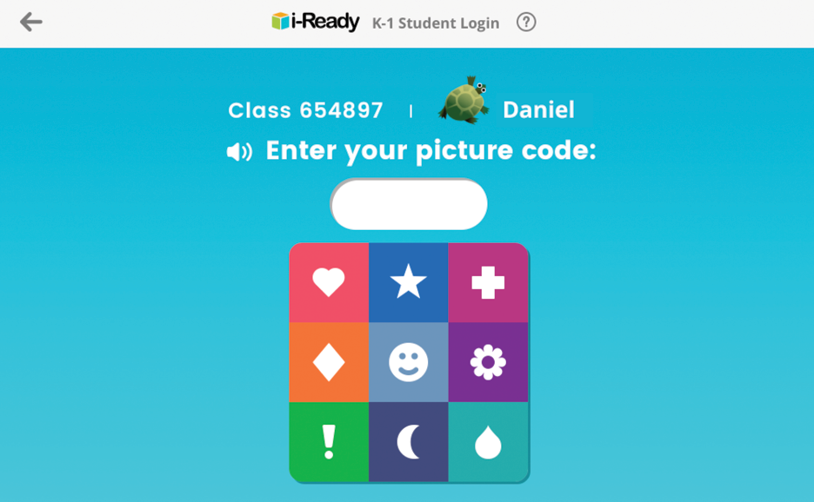
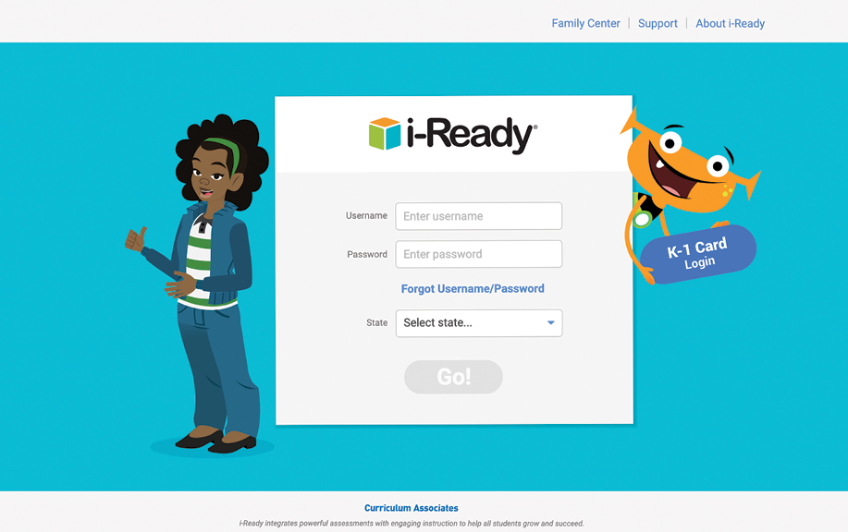
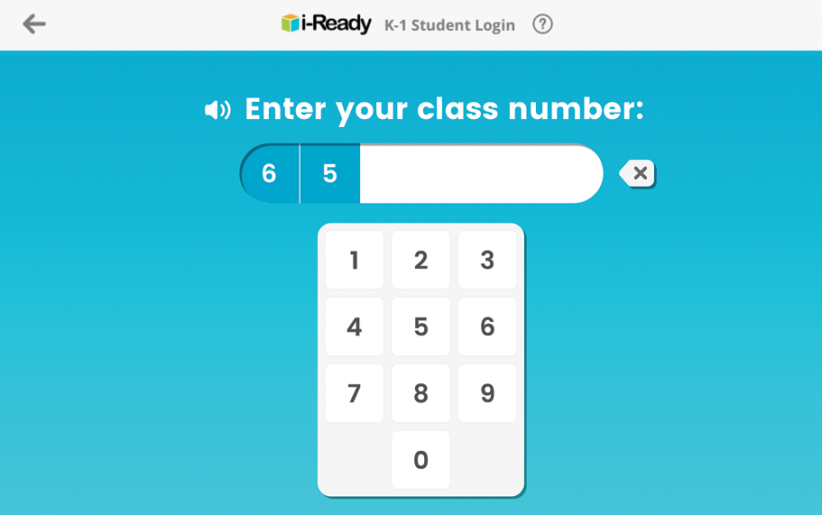
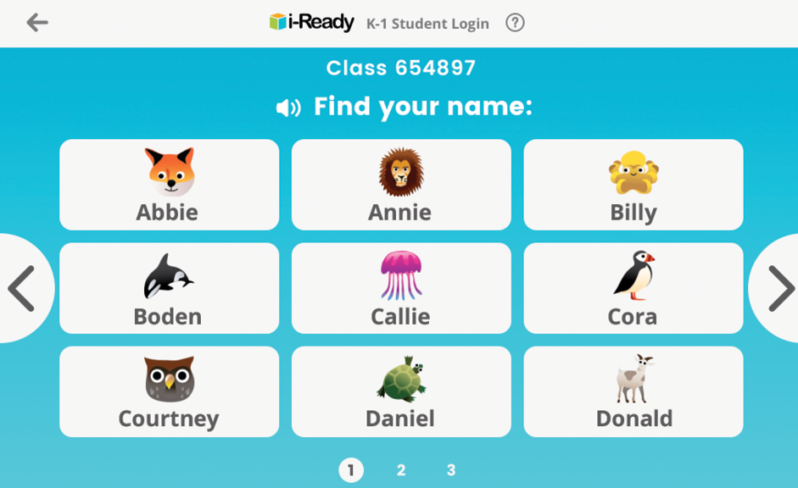
How to Log In (K–1 Card):
Click on K–1 Card Login.
Enter your class number.
Find your name.
Enter your picture code.
Need more support? Click here to access step-by-step instructions along with visuals of your student’s screen.

Slide 28
How to Log In (Clever):
Visit Clever.com and click “Log in as a student.”
If your student has a Clever Badge: Click “Clever Badge Log In” to scan their card.
If your student does NOT have a Clever Badge: Type your school name in the box provided.
Note: There may be multiple schools with the same name, so be sure to select the school associated with your student’s district.
Click on the Login icon (most districts use Google™ or Microsoft®). Enter your student’s username and password.
Google™ is a distinctive brand feature of Google, Inc. Microsoft® is a registered trademark of Microsoft Corporation.

Slide 29
How to Log In (ClassLink):
Option 1: If you have your student’s school organization URL . . .
1. Log in using it. It may look like this: https://launchpad.classlink.com/[YourSchoolOrganization]
2. Enter your student’s username and password.
Option 2: If you do NOT have your student’s school organization URL . . .
1. Log in to LaunchPad.ClassLink.com.
2A. Click on “Use QuickCard” if your student was given a personal QuickCard.
2B. Search for your school’s login page by entering the school name in the search bar.
2C. In addition, click “Use My Location” to allow the browser to access the closest schools based on your location.
3. Enter your student’s username and password or scan their QuickCard.

Slide 30
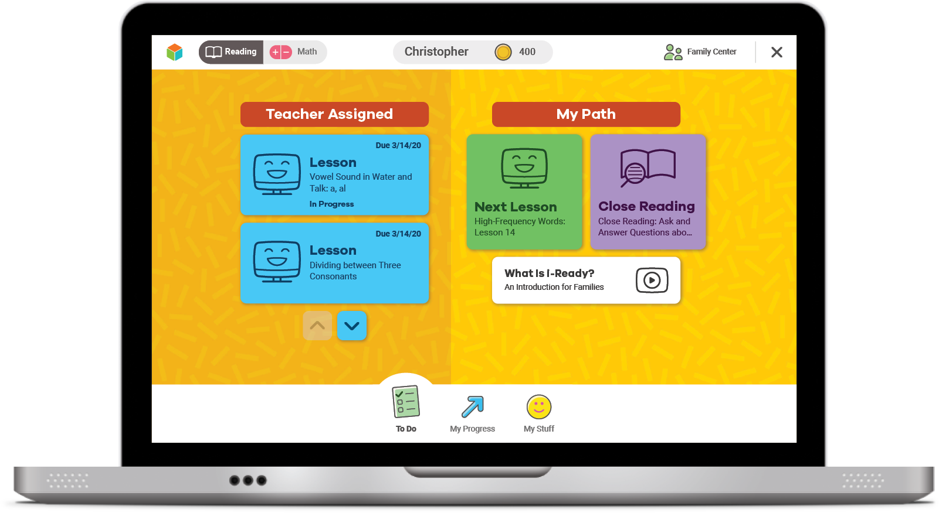
Your Dashboard
You can pick Math or Reading.
It will tell you what you need to do.
On the bottom, you may have some of these different choices:
To Do
My Progress
My Stuff
Learning Games

Slide 31
Your Dashboard
Optional
The green is your lesson path.
The blue are Teacher Assigned Lessons.
You might also see Close Reading lessons.

Slide 32
To Do
Click here to see your lessons and assignments.

Slide 33
My Progress
You will see stats.
Time-On-Task tells you how many minutes you’ve spent on lessons.
Lessons Passed tells you how many lessons you’ve passed.
Lesson Streak tells you how many lessons you’ve passed in a row.
Next, we’ll talk about Completed Work.

Slide 34
Completed Work
Shows you your past lessons and quiz scores, and you may see your Diagnostic score

Slide 35
My Stuff
You can pick your background, change your password, and play games with coins here.

Slide 36
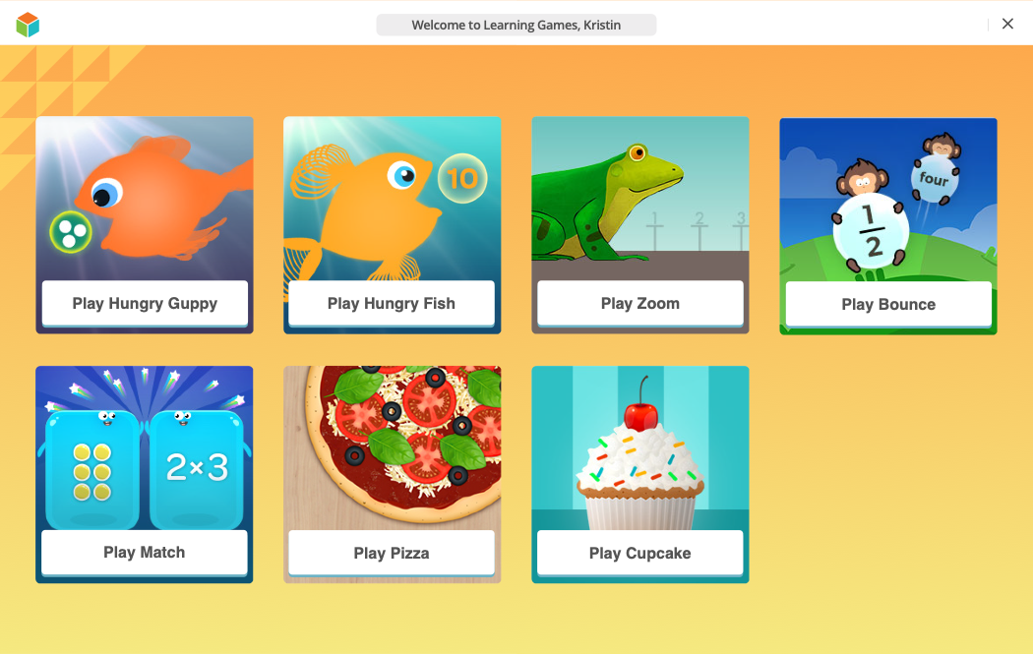
Learning Games
Optional
Click on the fish icon. These are games to help increase your math fluency.
You should only play Learning Games once you meet your online lesson goals.
Learning Games do not count toward your Time-On-Task.

Slide 37
Helpful Tips
Take your time and do not rush.
Try your best and don’t let others help you.
For Math—Show your work on paper for every problem.

Slide 38
Helpful Tips
For Reading—Read each passage carefully, and reread the passage when necessary.
Check your work before going to the next question.

Slide 39
Goals
Optional
This year, we have i-Ready goals:
Class goals
Individual goals

Slide 40
Reflection
Why is it important for us to try our best during i-Ready lessons?
What habits can we use?

Slide 41
You Will Rock It!

Slide 42

Get Ready for i-Ready!
Grades 3–5

Slide 43
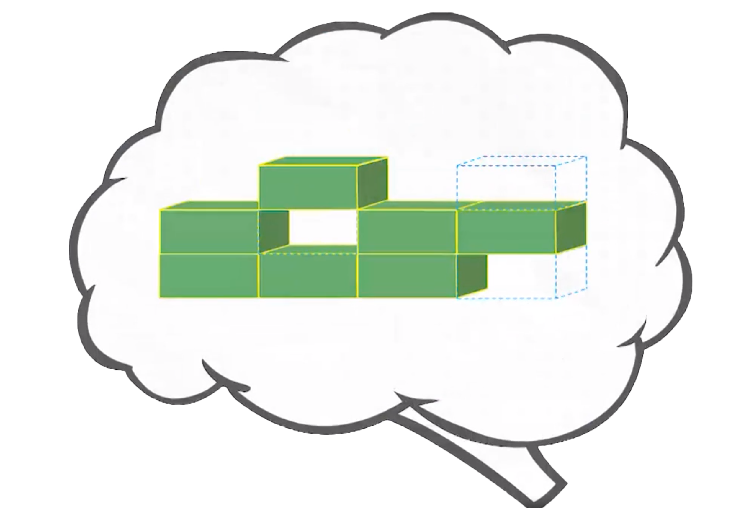
Why i-Ready Online Lessons?
Online lessons will:
Show what you know and what you’re still learning
Help you learn what you need
Let me know how you are doing and how I can help

Slide 44
Why should you try your best?
You will learn something new.
You will be better prepared for class.
It will help get you ready for the next grade.
You can show what you know on the next Diagnostic.

Slide 45
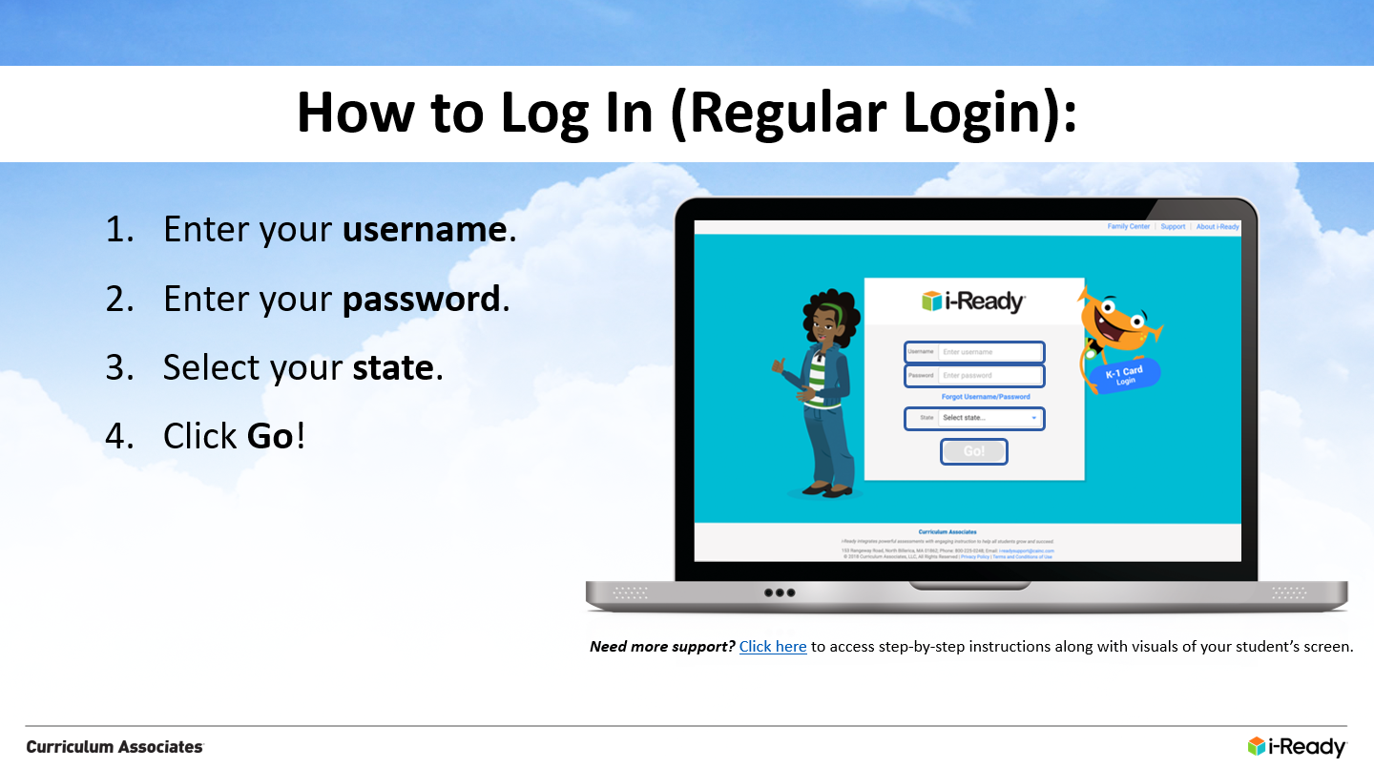
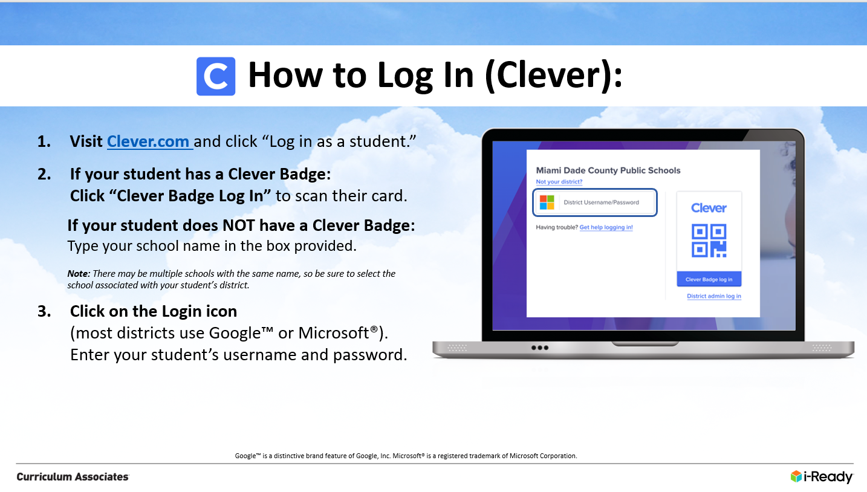
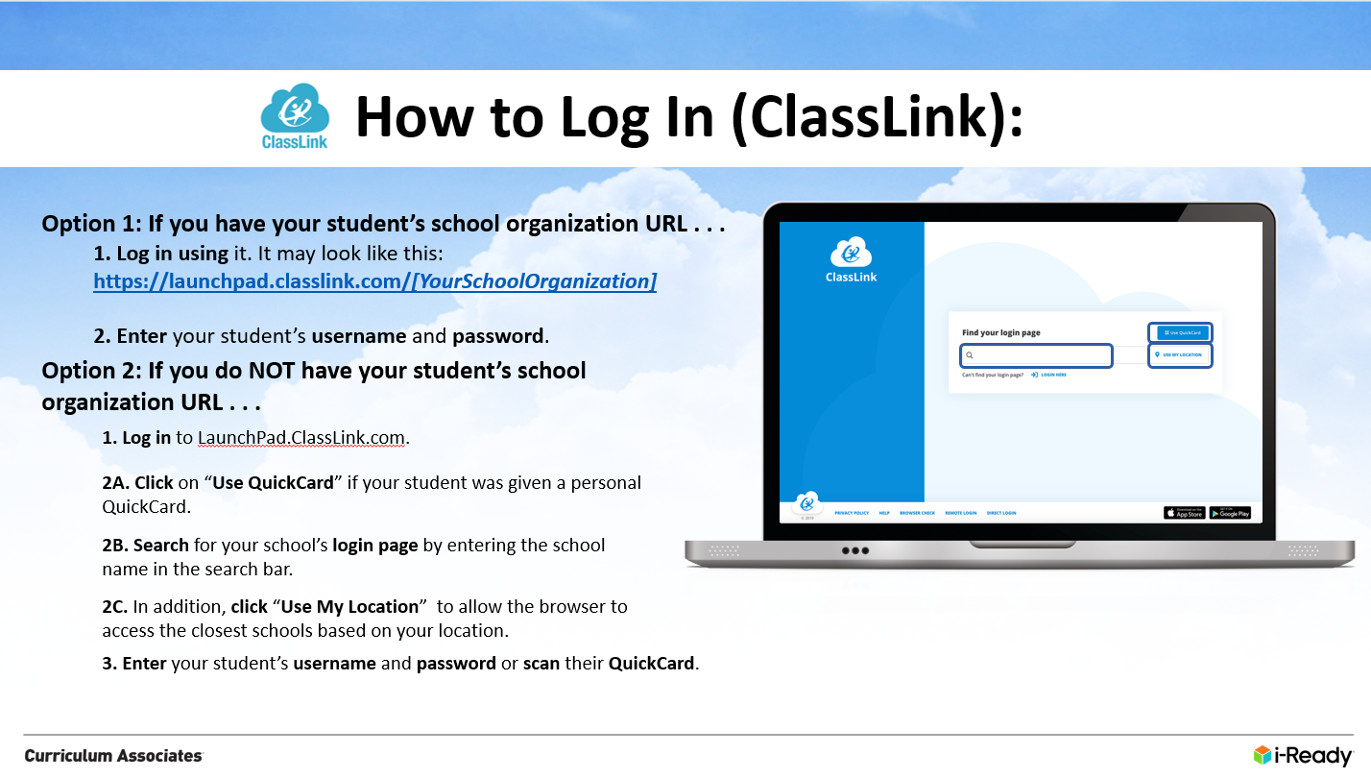
How to Log In
Schools have different ways they ask their students to log in to i-Ready. Choose which of the next three slides applies to your students and use that slide in your presentation.
Slide 46: Regular Login
Slide 47: Clever
Slide 48: ClassLink

Slide 46
How to Log In (Regular Login):
Enter your username.
Enter your password.
Select your state.
Click Go!
Need more support? Click here to access step-by-step instructions along with visuals of your student’s screen.

Slide 47
How to Log In (Clever):
Visit Clever.com and click “Log in as a student.”
If your student has a Clever Badge: Click “Clever Badge Log In” to scan their card.
If your student does NOT have a Clever Badge: Type your school name in the box provided.
Note: There may be multiple schools with the same name, so be sure to select the school associated with your student’s district.
Click on the Login icon (most districts use Google™ or Microsoft®). Enter your student’s username and password.
Google™ is a distinctive brand feature of Google, Inc. Microsoft® is a registered trademark of Microsoft Corporation.

Slide 48
How to Log In (ClassLink):
Option 1: If you have your student’s school organization URL . . .
1. Log in using it. It may look like this: https://launchpad.classlink.com/[YourSchoolOrganization]
2. Enter your student’s username and password.
Option 2: If you do NOT have your student’s school organization URL . . .
1. Log in to LaunchPad.ClassLink.com.
2A. Click on “Use QuickCard” if your student was given a personal QuickCard.
2B. Search for your school’s login page by entering the school name in the search bar.
2C. In addition, click “Use My Location” to allow the browser to access the closest schools based on your location.
3. Enter your student’s username and password or scan their QuickCard.

Slide 49
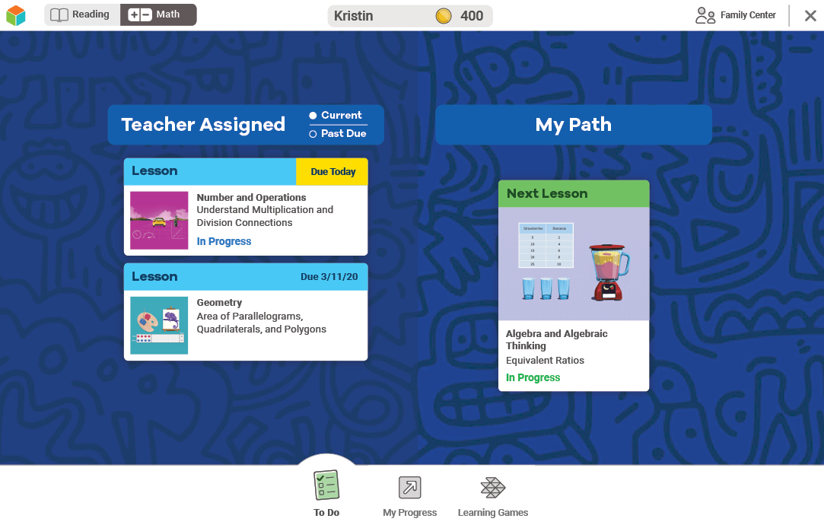
Your Dashboard
You can pick Math or Reading.
It will tell you what you need to do.
On the bottom, you may have some of these different choices:
To Do
My Progress
My Stuff
Learning Games

Slide 50
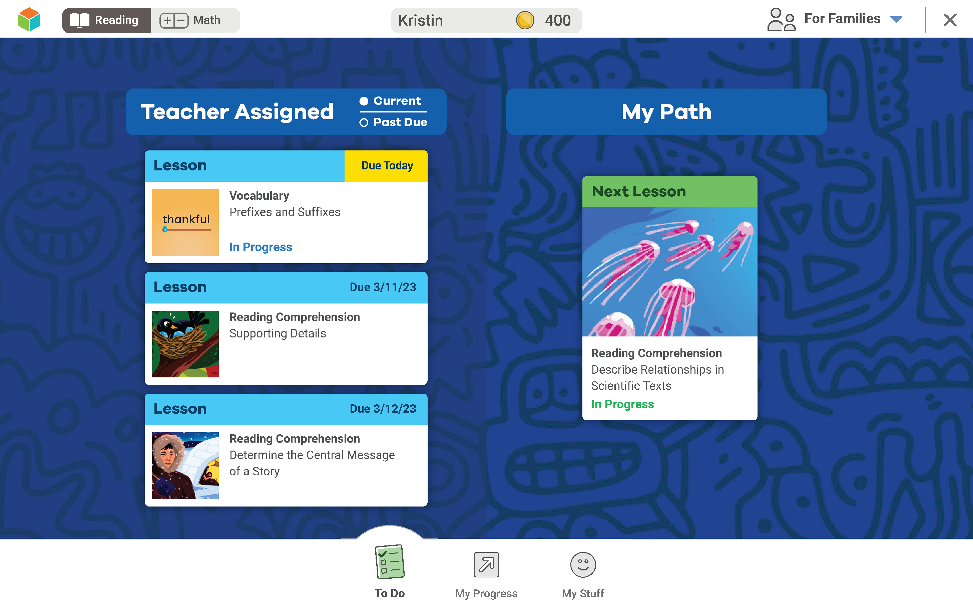
Your Dashboard
Optional
The green is your lesson path.
The blue are Teacher Assigned Lessons.
You might also see Close Reading lessons.

Slide 51
To Do
Click here to see your lessons and assignments.

Slide 52
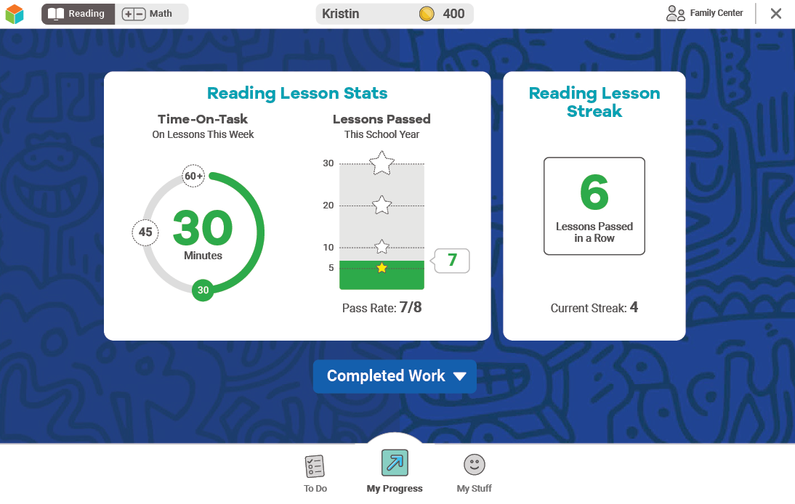
My Progress
You will see stats.
Time-On-Task tells you how many minutes you’ve spent on lessons this week.
Lessons Passed tells you how many lessons you’ve passed this school year.
Lesson Streak tells you how many lessons you’ve passed in a row.
Next, we’ll talk about Completed Work.

Slide 53
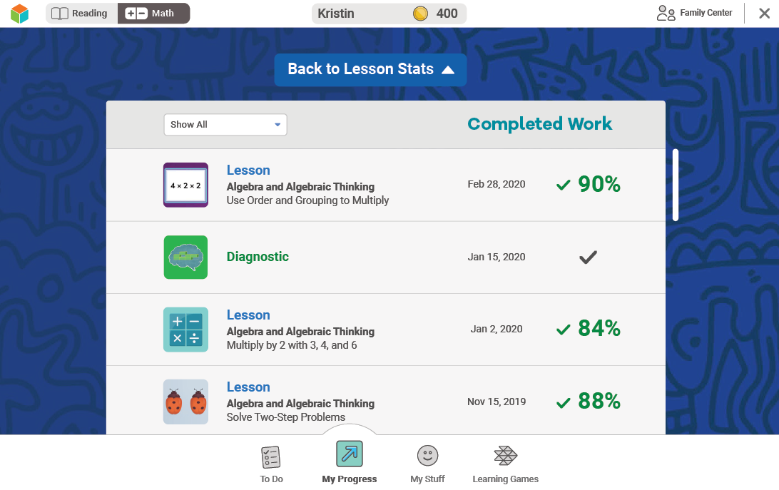
Completed Work
Shows you your past lessons and quiz scores, and you may see your Diagnostic score

Slide 54
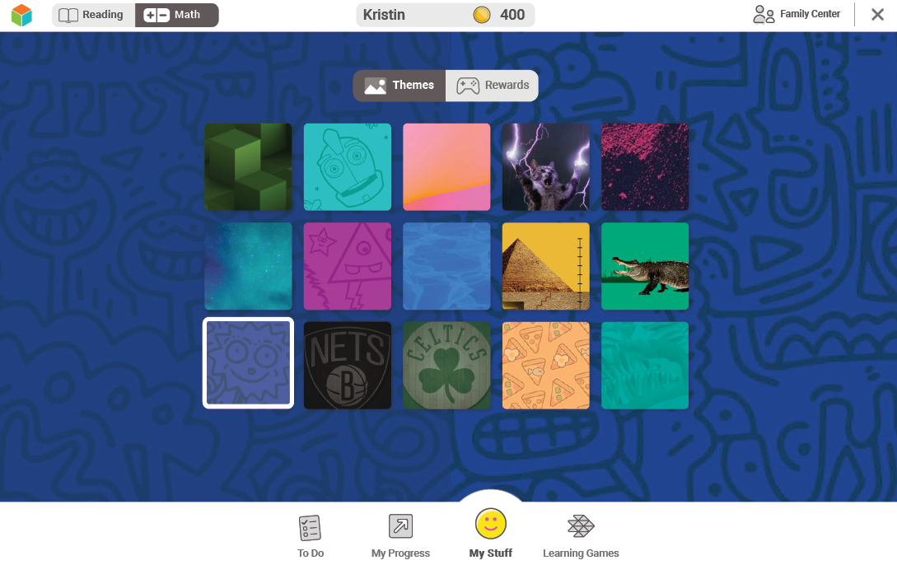
My Stuff
You can pick your background, change your password, and play games with coins here.

Slide 55
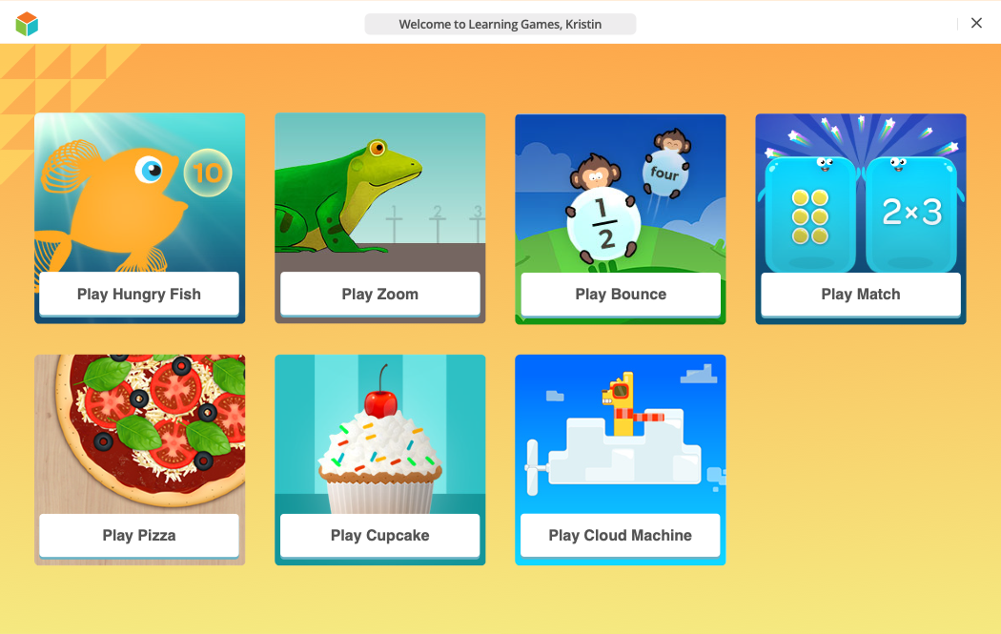
Learning Games
Optional
Click on the fish icon. These are games to help increase your math fluency.
You should only play Learning Games once you meet your online lesson goals.
Learning Games do not count toward your Time-On-Task.

Slide 56
Helpful Tips
Take your time and do not rush.
Try your best and don’t let others help you.
For Math—Show your work on paper for every problem.
For Reading—Read each passage carefully, and reread the passage when necessary.
Check your work before going to the next question.

Slide 57
Goals
Optional
This year, we have i-Ready goals:
Class goals
Individual goals

Slide 58
Reflection
Why is it important for us to try our best during i-Ready lessons?
What habits can we use?

