Slide 1
Say Sounds (A–B)
Say Sounds
Phonemic Awareness Listen to the word your teacher says.
Then say the sounds or word parts in the word.
Letter/Sound Associations Look at the letters. Say the sounds.
  a d ck sh p
  th s o l sh
  t ck i e g
  u th m ck b

Slide 2
Read Words (C)
Read Words
New Words Say the sound. Sound out the word. Read the word.
  duck dock bath
  path deck sack
  mash sock mesh
  sash tack mush
  lick pick gush

Slide 3
Read Words (D)
Word Families Read down. Read rapidly.
tick
Rick
wick
pick
kick
sack
Mack
lack
hack
pack
luck
tuck
duck
buck
yuck
10 Second Challenge
Cold Timing words read
Practice words read
Hot Timing words read

Slide 4
Read Words (E–F)
Review Words Read a line of words. When your teacher gives a meaning,
circle the correct word.
  fill fell fan man
  dig doll lot less
  mutt mat fuss sip
  hit hiss loss net
Multisyllabic Challenge Words Sound out the syllables. Read the whole word.
backup polish publish bucket hammock

Slide 5
Read Words (G)
High-Frequency Words Say. Spell. Read.
  was she down saw for
  little water work play long

Slide 6
Read Sentences (H)
Read Sentences
Sentences Read the sentences with phrasing.
  The dog will play with the long sash.
  A duck was in the water at the dock.
  She will fix the rip in the sock.
  Kellis will sit in the little hammock after school.
  Tish will pick up as much as she can off the deck.

Slide 7
Spell Words (I)
Spell Words
Spelling Journal Turn to the Spelling Journal on page 154.

Slide 8
Decodable Text (Passage 1)
Decodable Text Read each passage. Answer your teacher’s questions
and select the picture that goes with each passage.
Passage 1
Duck Fun
Teacher Reads Sal and his children took a family trip to the park.
When they arrived at the park, they found the pond.
Sal and his children went down to the water. “Hush,”
said Sal. “Look at the ducks peck at bugs hidden in the
path. Look at the ducks in the water.”
The children saw the ducks on the path. They saw
fish in the water.
The children said, “Dad, this is fun.”

Slide 9
Comprehension Questions Passage 1
Where did the family go?
The family went ________________.
What is one thing the family saw there?
One thing the family saw there was ________________.

Slide 10
Decodable Text (Passage 2)
Passage 2
Math Work
Teacher Reads Kevin has been having difficulty with math. However, he
has been working hard. Let’s read to see how he did on his math test.
After school, Kevin went down the path with Tess. “I
did well in math, Tess,” Kevin said. “I had to work and
work. But I did pass. I had a lot of luck.”
Tess said, “No, Kevin, it is not luck to pass math. You
did it with work. It was not luck, Kevin, but work.”

Slide 11
Comprehension Questions Passage 2
What did Kevin tell Tess about math?
Kevin told Tess that ________________.
What was Tess’s message to Kevin?
Tess’s message to Kevin was ________________.

Slide 12
Decodable Text (Passage 3)
Passage 3
Mud on the Van
Teacher Reads A family has just returned from a drive through the
woods. Though they enjoyed the drive, the roads were very muddy.
Yuck! The van is a mess. Mud is on the top and on
the back of the van. The van will get a bath.
I will fill a bucket with water and get a rag. I will
work to get rid of the mud. After the bath, I will polish
the van.
The van cannot be a mess!

Slide 13
Comprehension Questions Passage 3
What happened to the van?
The van ________________.
How will the problem be solved?
The problem will be solved by ________________.

Slide 14

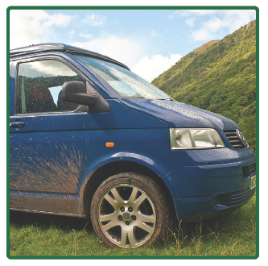
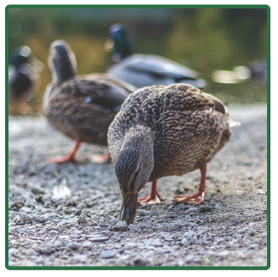
Picture Match
Passage ______
Passage ______
Passage ______

Slide 15
Independent Practice (K)
Independent Practice
More Practice 1 Fill in each blank with the best word.
  1. Nick went down the ________.
bath path mash
  2. Bess will play on the ________.
deck lick sock
  3. Mom has a pet ________.
mush duck luck
  4. Jan sat on a big ________.
hush bath rock
  5. The cat will ________ its leg.
deck bath lick

Slide 16
Independent Practice (K) — cont’d
  6. Nick put eggs in a ________.
sack math gush
  7. You can ________ six fish.
luck pick rash
  8. Helen has a ________ for the cat.
mash dock dish
  9. Jeff will ________ a bag.
with pack wish
  10. The children ________ to school.
tack rush mesh

Slide 17
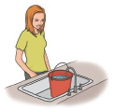

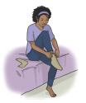
Independent Practice (L)
More Practice 2 Draw a line under the sentence that goes best
with each picture.
1. Kat will fill the bucket with water.
Kat will fill the sack with tacks.
2. The pup has a bath in the tub.
The pup will lick the dish.
3. Nan has on a red sash.
Nan has on a tan sock.

Slide 18
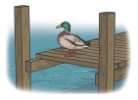

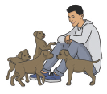
Independent Practice (L) — cont’d
  4. The duck is on the dock.
The duck is in the tub.
  5. Rick will pick up the pup.
Rick will pick up the sack.
6. Tim will pick a dog.
Tim will dash down the path.

Slide 19
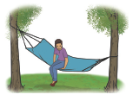
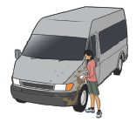
Independent Practice (L) — cont’d
7. Jill sat on the dock.
Jill sat on the hammock.
8. The water will gush into the bucket.
Jan will polish the van.

