Slide 1
Fluency
Flight
An Introduction for
Families and Caregivers
Notes:
Gist: This presentation is designed to introduce Fluency Flight to the families and caregivers who support students in your class. It describes how Fluency Flight works, why building math fact fluency and automaticity is important, and how students can get the most out of Fluency Flight.
Suggested script: “Hello and welcome to Open House/Math Night! I’m <your name here>, and I’m the <grade level here> math teacher. This year, we’ll be using Fluency Flight to help students develop math fact fluency and automaticity, so I wanted to take a few minutes to introduce you to it, show you how it works, and explain how it is going to help students with math.”

Slide 2
What is Fluency Flight?
Fluency Flight is a new supplemental program to help students develop math fact fluency and automaticity.
Math Fact Fluency:
The ability to solve core arithmetic problems accurately, efficiently, and flexibly through recall and the application of strategies
Math Fact Automaticity:
The ability to accurately recall math facts in three seconds or less
Addition and Subtraction Facts within 20
Multiplication and Division Facts with Operands to 12
Notes:
Gist: Fluency Flight is a supplemental math program.
Suggested Script: “Fluency Flight is a new supplemental math program we’ll use this year to help students develop math fact fluency and automaticity. It combines the latest scientific research with best practices in digital games to create an experience where students build confidence and skill while having fun. Math fact fluency and automaticity are what you’re probably thinking about when you talk about students knowing their math facts or learning their times tables.”

Slide 3

Why is this important?
Math fact fluency is a part of every state’s standards.
Improving math fact fluency makes math easier for students.
Fluency Flight aligns with state standards that relate to procedural reliability and recall for basic math facts.
Students can focus on new aspects of problem solving instead of thinking through basic facts.
Students feel more confident with a strong foundation in their math facts.
These standards outline the addition/subtraction (Grades K–2) and multiplication/division (Grades
2–5) facts students need to be proficient in for their grade level.
Notes:
Gist: Math fact fluency is important because it’s a part of the standards and makes math easier for students in the long run.
Suggested script: “So why are we doing this? There are two main reasons. First, math fact fluency is a part of every state’s standards. Developing this crucial set of skills is a well-established, widely recognized component of grade-level work. Second, improving math fact fluency makes math easier for students now and in the long run. Students with math fact fluency and automaticity feel more confident and can focus on new aspects of problem solving instead of devoting their thinking to calculating basic facts.”

Slide 4

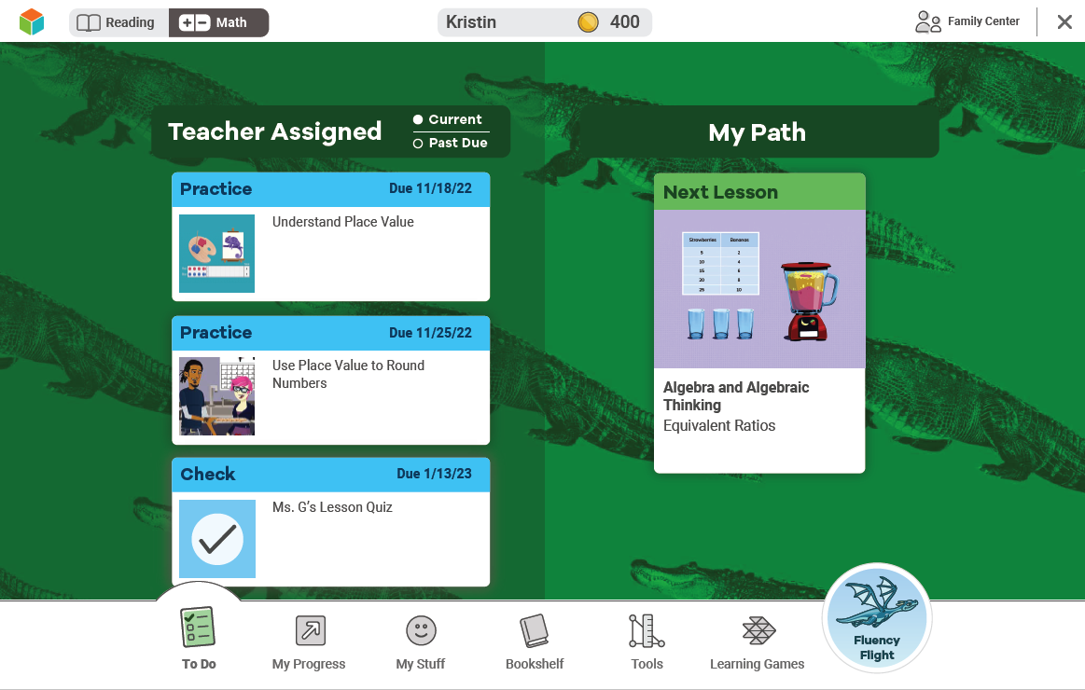
How to Use Fluency Flight
Step 1: Log in to your student’s i-Ready account.
Step 2: Click on the blue dragon icon.
1
2
Notes:
The gist: Students access Fluency Flight from the student dashboard. Just click on the blue dragon icon.
Suggested script: “So how do students use Fluency Flight? Students log in to their i-Ready account like they always have and then click on the blue icon on the bottom right of their dashboard.”

Slide 5
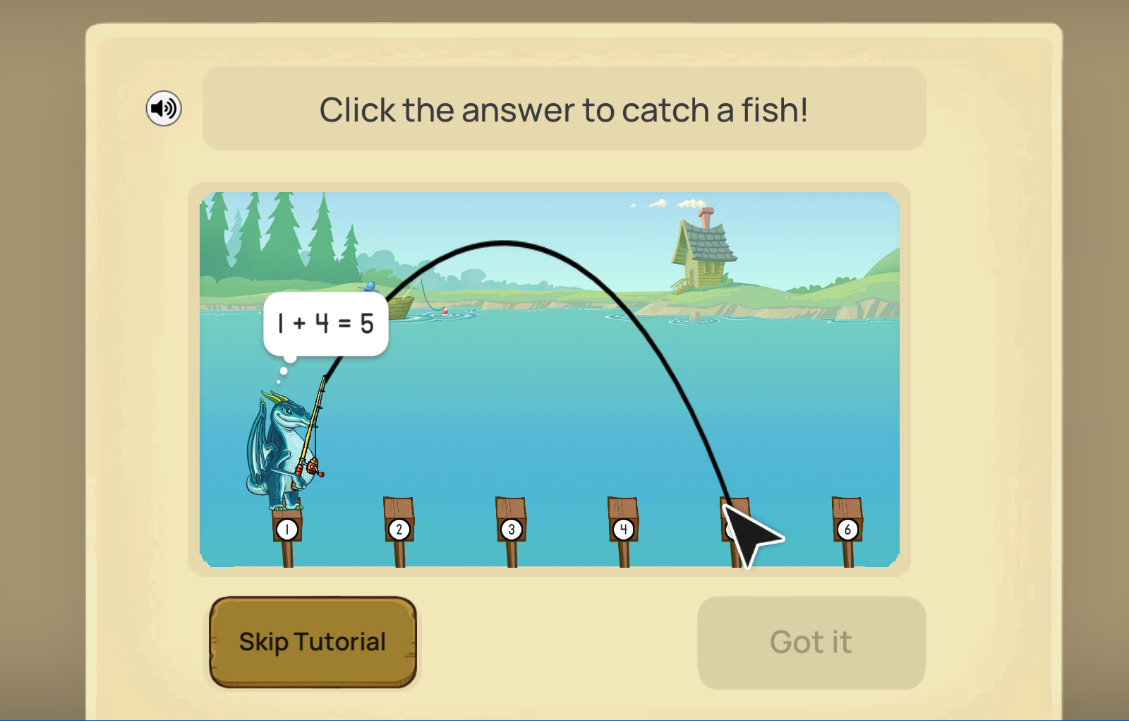
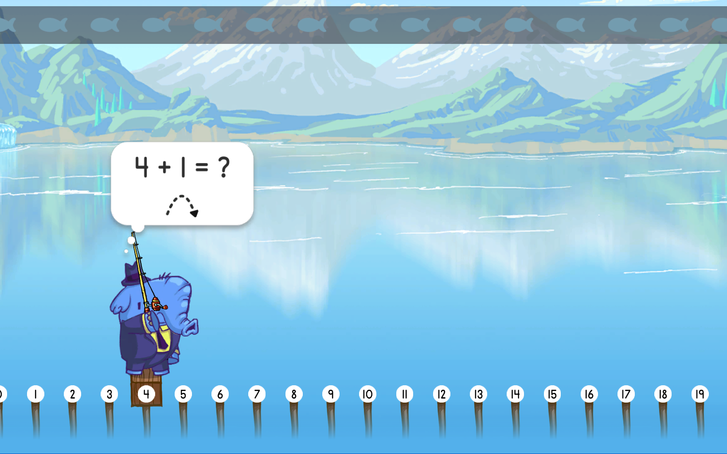
How to Use Fluency Flight
Students’ first activity starts automatically.
The activity they see depends on where they are in their math facts journey and will change to match their progress.
Which facts
students see also changes based on their progress.
Notes:
The gist: The first Fluency Flight activity starts automatically. What students see depends on what facts they’re working on.
Suggested script: “The first Fluency Flight activity starts automatically. Which activity students see depends on where they are in their math fact learning journey, so students may see a different activity than their peers. As they become fluent and automatic with more facts, students may see new activities and new facts within them.”

Slide 6
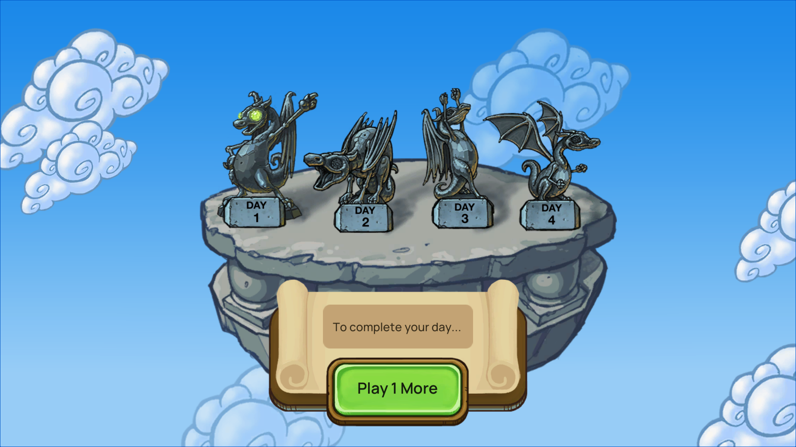
How to Use Fluency Flight
Once students finish their first activity, they’ll see this prompt.
Notes:
The gist: Students need to complete two activities to finish each day.
Suggested script: “When students finish their first activity, they’ll see this prompt. They need to complete one more activity to finish the day. When they click on ‘Play 1 More,’ it takes them to where . . ."

Slide 7
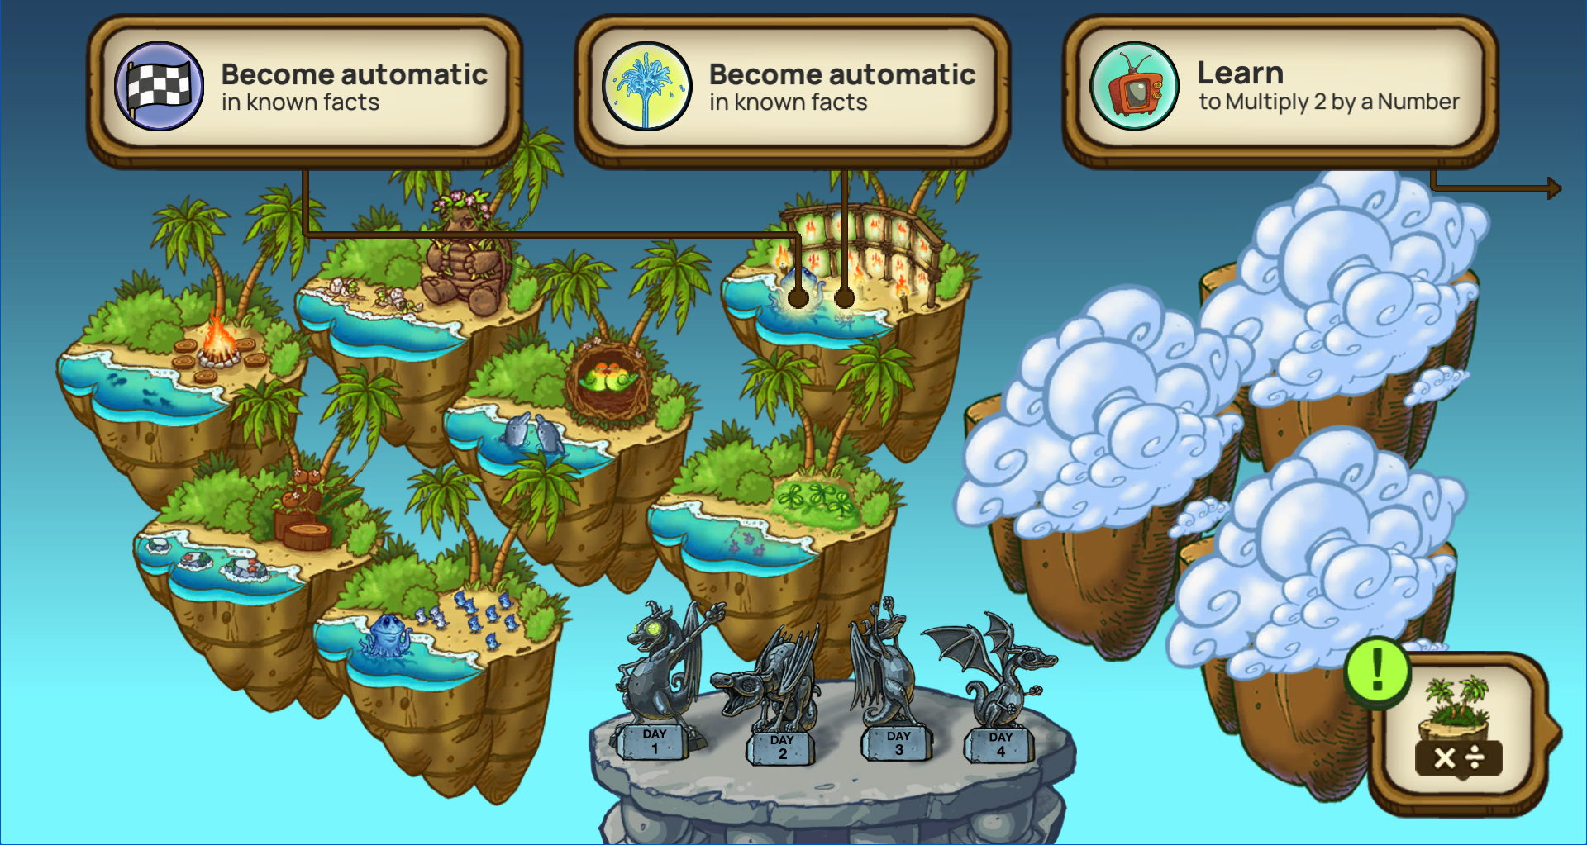
How to Use Fluency Flight
Students choose their second activity.
Students should click on the name to choose an activity.
Notes:
The gist: Students can choose their second activity. Students click on the description/name of the activity to choose it.
Suggested script: “. . . they get to choose their second activity. They can decide to learn new facts or try to become automatic in what they’ve already learned. To start the second activity, students should click on the speech bubble not the island it points to.”

Slide 8
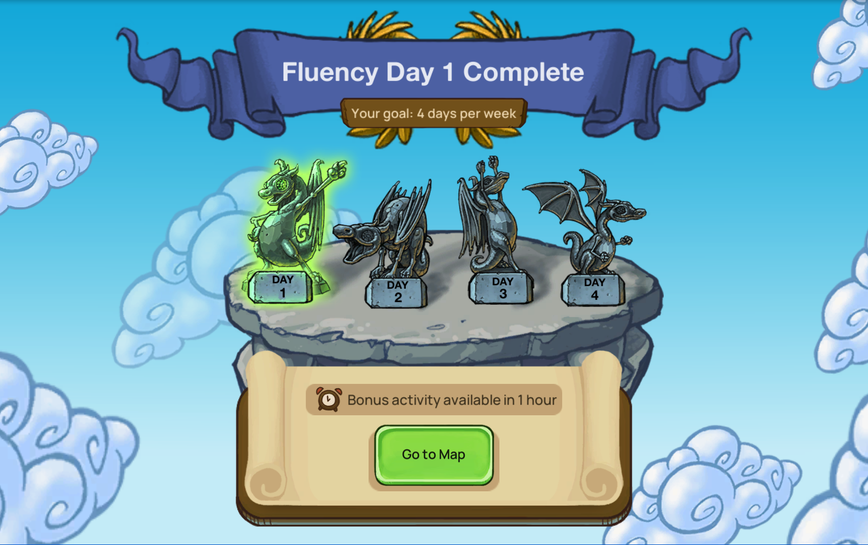
How to Use Fluency Flight
Once students have finished two activities, they’ve completed Fluency Flight for the day!
A bonus activity is available for some grades. It’s helpful but not required.
Notes:
The gist: Here’s what it looks like when students have completed the day’s work in Fluency Flight.
Suggested script: “Once students have finished their second activity, they’ve hit their Fluency Flight goal for the day.”

Slide 9
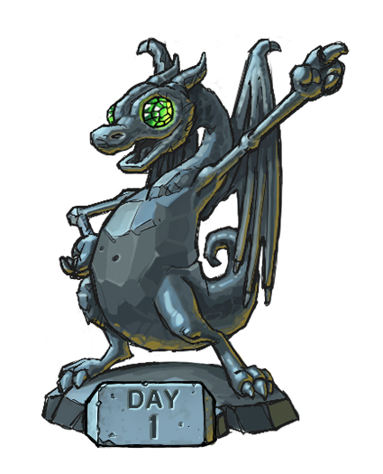
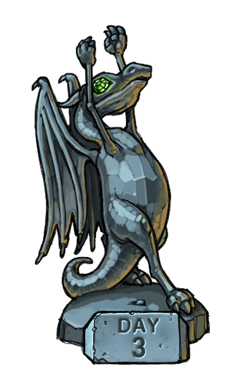
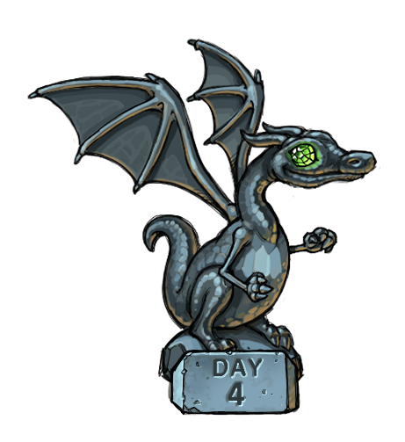

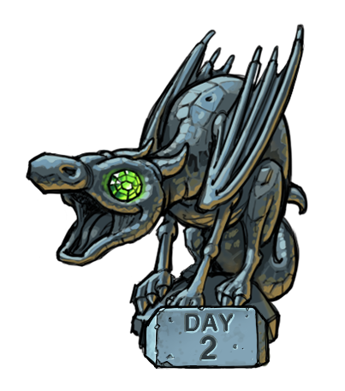
How much time should students spend on Fluency Flight?
Eight minutes
per day
Four days
per week
Notes:
The gist: Students only need to spend eight minutes per day, four days per week on Fluency Flight.
Suggested script: “How much time should students spend on Fluency Flight? It takes about eight minutes for students to finish two activities, and we want students to use Fluency Flight four days per week. Research has shown that practice like Fluency Flight’s approach to math fact fluency and automaticity means that short sessions spaced out over time can lead to long-lasting learning that makes a difference in students’ knowledge.”

Slide 10
How Fluency Flight Works
Students progress through four stages of learning.
Basic Understanding:
Understand the meaning of the operations.
Build mental models.
Learn strategies through demonstrations.
Concrete representations
Automaticity:
Solve math problems accurately and quickly.
Similar to the Accuracy stage, but speed encouragement is introduced
1
2
3
4
Accuracy:
Solve math fact problems accurately with no time requirement.
More abstract content, including symbolic problem representations
Maintenance:
Retain Automaticity of facts.
Content is the same as the Automaticity stage but is provided on increasingly spaced intervals.

Slide 11
What are the benefits of the four-stage approach?
The content students see meets them where they are in the learning process.
Speed encouragement is only introduced when students are ready for it, meaning fluency practice is more effective and less stressful for students.
Students build conceptual understanding as a foundation for their automaticity, deepening future learning.
The maintenance stage preserves students’ learning, making their fluency work even more worthwhile.
Notes:
Gist: The four-stage approach allows the content to meet students where they are in the learning process.
Suggested script: “The benefits of the four-stage approach are: allows students to see content that meets them where they are in the learning process; doesn’t pressure students on speed, so it’s not stressful; builds conceptual understanding; and provides maintenance.”

Slide 12
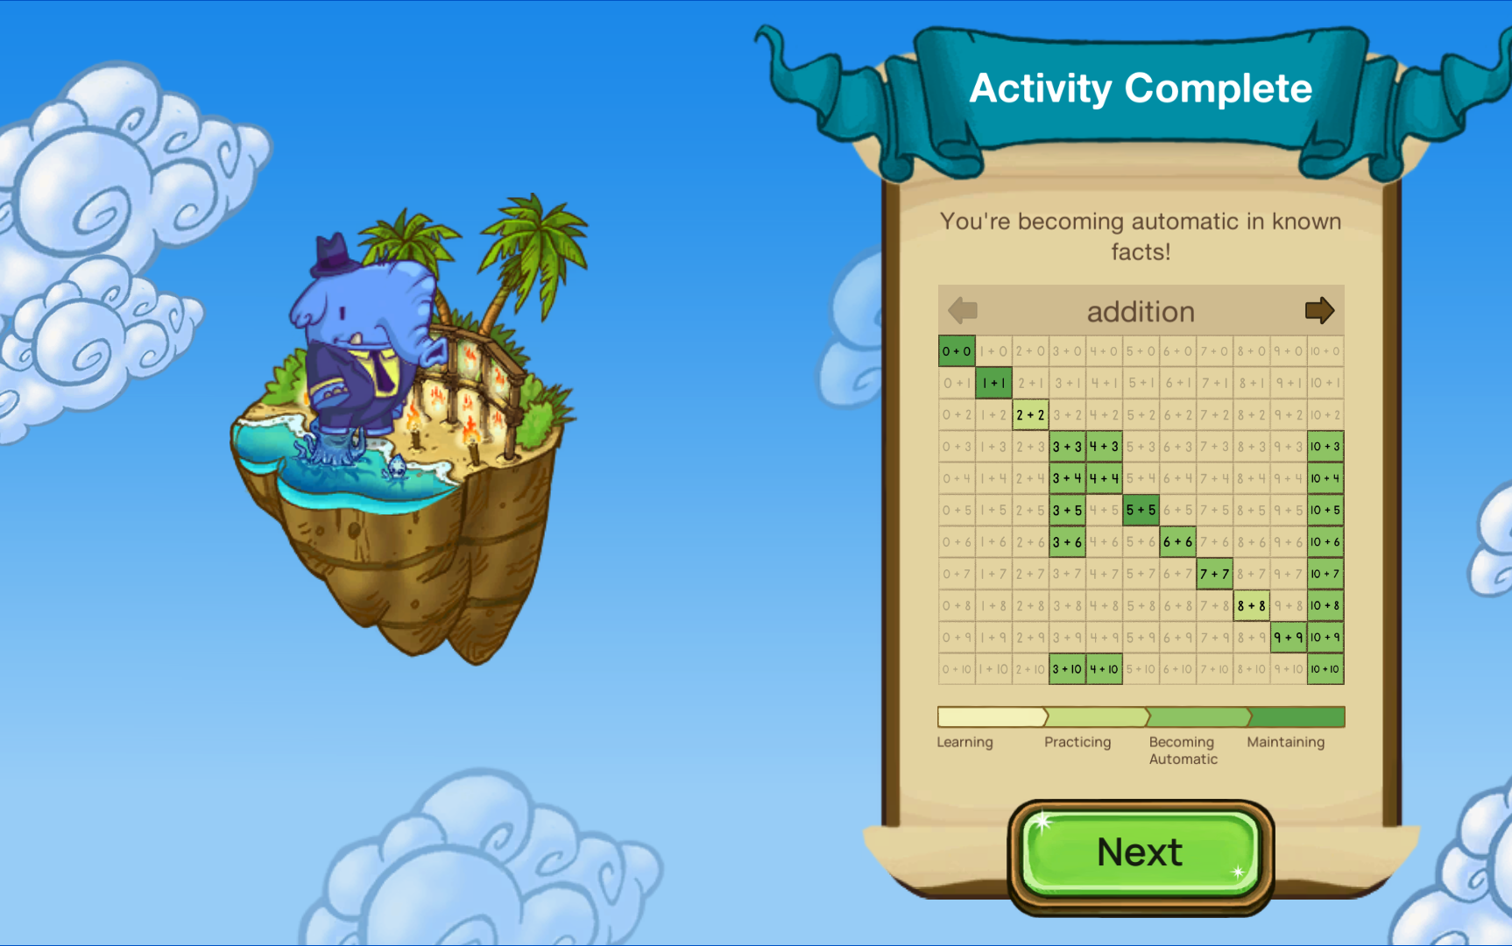
How can I tell what my student has learned?
After each activity, students can see where they are with each fact they just practiced.
As students learn and become
automatic with more facts, the
floating islands on their Fluency
Flight dashboard will change.
  Clouds will move to show new islands.
  Islands will have more trees and water.
Students will also see new facts
as they learn old facts, so new
facts mean new learning!
Notes:
Gist: Families can see students’ progress in the variety of problems they see and the changes in the Fluency Flight islands.
Suggested Script: “There are two ways in the program that you can see that your student is progressing. First, as students become fluent and automatic with more math facts, more islands will be revealed on the main Fluency Flight page, and those islands will become more complex with more trees and water. Second, as students progress, they’ll see new math facts. Fluency Flight adjusts what students see based on the fluency and automaticity that students demonstrate, so students practice what they need to practice.”

Slide 13
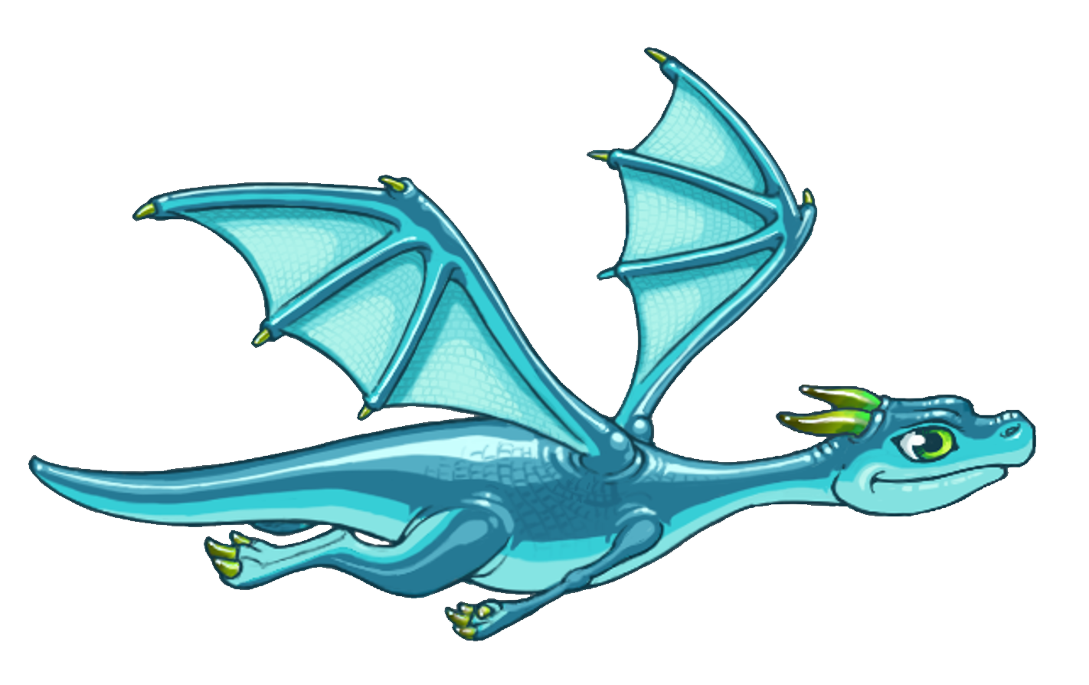
How to help students with Fluency Flight this year.
Encourage them to complete four days every week.
Celebrate their effort and their growth.
Keep practice fun!
Notes:
Gist: Here’s a summary of how families and guardians can help students with their math class.
Suggested Script: “A major benefit of Fluency Flight is that it makes math fact fluency and automaticity work largely automatic. You can best help your student by encouraging them to complete two activities, four days a week (so, eight minutes, four days per week), celebrating their effort and their growth by keeping practice fun.”

