Slide 1
Say Sounds (A–B)
Say Sounds
Phonemic Awareness Listen to the sounds or word parts as your teacher says a word slowly. Then say the word.
Letter/Sound Associations Look at the letter. Say the sound.
f e s l i
o g h a z
p m w j e
i a t u k
g b z e u

Slide 2
Read Words (C)
Read Words
New Words Say the sound. Sound out the word. Read the word. loss sell huff buzz
off miss fill
hill mass pass
less jazz kiss
puff putt Jeff
egg will mitt

Slide 3
Read Words (D)
Word Families Read down. Read rapidly.
pass
bass
sass
mass
Cass
fill
pill
hill
will
bill
toss
moss
loss
boss
Ross
10 Second Challenge
Cold Timing words read
Practice words read
Hot Timing words read

Slide 4
Read Words (E–F)
Multisyllabic Challenge Words Sound out the syllables. Read the whole word. sunset kitten eggnog signal cactus
High-Frequency Words Say. Spell. Read.
play be said some where
down saw children from after

Slide 5
Spell Words (G)
Spell Words
Spelling Journal Turn to the Spelling Journal on page 153.

Slide 6
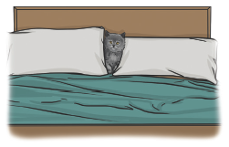
Read Text (H)
Read Text
Decodable Sentence Expansion Read each set of sentences. Then expand the last sentence by telling when. Select the picture that goes with each set.
The kitten ran. The kitten ran and hid. The kitten ran and hid in the bed. . . . , the kitten ran and hid in the bed. _____

Slide 7
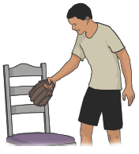
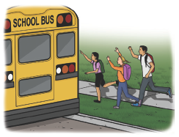
Read Text (H) — cont’d
Some children will miss the bus. Some children will miss the bus to school. Some children will miss the bus to school and panic. . . . , some children will miss the bus to __ _____ school and panic.
Jeff got his mitt. Jeff got his mitt to play. Jeff got his mitt and bat to play. . . . , Jeff got his mitt and bat to play. _____

Slide 8
Independent Practice (I)
Independent Practice
More Practice 1 Fill in each blank with the best word.
1. The men jog up the ________.
fill hill will
2. The lid is ________ the pan.
off puff Jeff
3. Jeff ________ fill the pan.
dill ill will
4. Pam will have ham and an ________.
pass egg jazz
5. Nan has her ________ to play with us.
kiss hill mitt

Slide 9
Independent Practice (I) — cont’d
6. Jan can ________ the pot with water.
fill fell tell
7. Lin will ________ some nuts in a bag.
toss bass moss
8. Don plays ________ after school.
jazz bell egg
9. Where is ________?
off Jeff toss
10. Sid will ________ the red pen to Ken.
pass boss lass

Slide 10

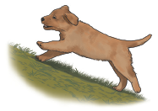
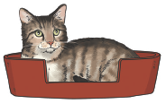
Independent Practice (J)
More Practice 2 Draw a line under the sentence that goes best with each picture.
1. An egg and ham are in the pan.
An egg and a pen are in the box.
2. The pup runs up the hill.
The pup sits on the hill.
3. The kitten is in the box.
The cat is in the bed.

Slide 11
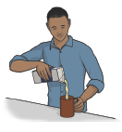
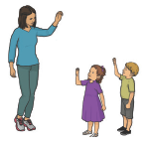

Independent Practice (J) — cont’d
4. Ed fills the mug with eggnog.
Ed fills the box with hats.
5. Jan will pass him in the cab.
Jan will miss the little children.
6. Jeff ran off with my mitt.
Lin will kiss her cat.

Slide 12
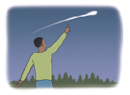
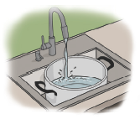
Independent Practice (J) — cont’d
7. Don saw a mass of people.
Don saw a comet.
8. Fill the can with some eggs.
Fill the pot with some water.

