Slide 1
Say Sounds (A–B)
Say Sounds
Phonemic Awareness You will blend and segment sounds as you read and spell words.
Letter/Sound Associations Look at the letters. Say the sounds.
i ai a oa
a_e igh ow ee
i_e oa o_e o
ow a ee i_e
e o_e ay ea

Slide 2
Read Words (C)
Read Words
New Words Say the sound. Sound out the word. Read the word.
pave pill pile
fine fin shade
ram those frame
smoke rope smock
pine pin side
Sid spoke drive

Slide 3
Read Words (D)
Word Families Read down. Read rapidly.
poke
woke
smoke
spoke
stroke
nine
vine
pine
whine
twine
same
game
tame
blame
frame
10 Second Challenge
Cold Timing words read
Practice words read
Hot Timing words read

Slide 4
Read Words (E–F)
Review Words Read a line of words. When your teacher gives a meaning, circle the correct word.
treat road train hail
dream grain groan grow
stay show sheep ship
stem stream might high
Words with Endings Use the reading rules to pronounce the words. 1. griping 2. gripping 3. shining 4. fitting 5. piling 6. digging 7. driving 8. swiping 9. swimming 10. tripping

Slide 5
Read Words (G–H)
Multisyllabic Challenge Words Sound out the syllables. Read the whole word.
daytime tightrope teammate flagpole mealtime
tadpole holiday dumplings seasoning contact
High-Frequency Words Say. Spell. Read.
long song strong how because are you saw do work

Slide 6
Read Sentences (I)
Read Sentences
Sentences Read the sentences with phrasing.
Izzee, how can you help Mom with the roses?
Do you think you will have time to work with me?
Shane and I screamed when we saw a big snake.
David said he ate all those hot dumplings that Grandma made.
Dad was late for work because the bus he takes came late.

Slide 7
Spell Words (J)
Spell Words
Spelling Journal Turn to the Spelling Journal on page 199.

Slide 8
Decodable Narrative Text (Part 1)
Decodable Narrative Text Read each part. Answer your teacher’s questions and select the picture that goes with each part.
Splitting Time
Part 1
Teacher Reads When children, parents, grandparents, and even great-grandparents live together, each generation has something to share with others. But living together is not always easy.
9
18
29
In May, David’s mom and dad asked Grandma to stay with them on West Street. Things went fine… at least some of the time. David saw that Mom and Grandma did not do all things in the same way.

Slide 9
Decodable Narrative Text (Part 1) — cont’d
39
48
56
67
72
80
90
Some of the time, Grandma made the filling for dumplings. But when Mom made the filling, Grandma said, “They will not taste right like that. You need to add a lot of seasoning.”
Grandma seasoned the filling her way. To David, they were the best dumplings he’d had in his life. He did not tell Mom that.

Slide 10
Comprehension Questions Part 1
What is the setting of this story?
The setting of this story is ________________.
Who are the two main characters in the story?
The two main characters in the story are ________________.
What did Grandma and Mom disagree about?
Grandma and Mom disagreed about ________________.

Slide 11
Decodable Narrative Text (Part 2)
Part 2
Teacher Reads Life on West Street is altered, or changed, after Grandma arrives. Read on to see what happens when David is expected to share his cell phone with Grandma.
96
105
114
125
131
140
144
155
165
176
David and Grandma were fine until the day Mom said, “Grandma’s phone broke. But she needs a phone to stay in contact with people. You will have to split time with Grandma on your phone.”
“For real, Mom?” David asked. His phone was all his until Grandma came.
“Yes,” said Mom, and there was no way to stop it.
David liked to chat with his pals on his phone. They sent texts with jokes. David said that he made the best jokes.

Slide 12
Comprehension Questions Part 2
What problem did David have?
David’s problem was that ________________.

Slide 13
Decodable Narrative Text (Part 3)
Part 3
Teacher Reads Having to share the cell phone makes David feel frustrated (upset). Grandma and David will need to work out a solution.
178
187
199
206
216
224
234
247
When Grandma was on the phone, David had to wait for her to finish. He kept checking to see when it was his time to get the phone.
David got the phone back. “I missed a text from Mike,” groaned David. He scanned the text: “Where RU?” David texted back, “My bad. I left the phone on my desk.” He did not tell his pals that he split his phone time with Grandma.

Slide 14
Decodable Narrative Text (Part 3) — cont’d
251
260
270
283
294
306
313
Grandma and David split time with the phone for a while. Then came a day when Grandma came home with a phone of her own. “I got on the same plan as you,” she said. David gave Grandma a big smile. It had not been so bad to split time with the phone after all. He was glad she came to stay.

Slide 15
Comprehension Questions Part 3
Why did David feel frustrated and upset about sharing his phone?
David felt frustrated and upset about sharing his phone because ________________.
What happens in the end?
In the end, ________________.

Slide 16
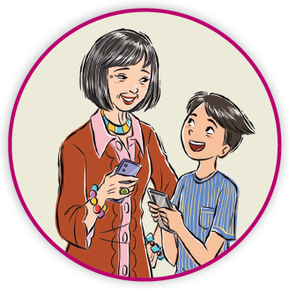
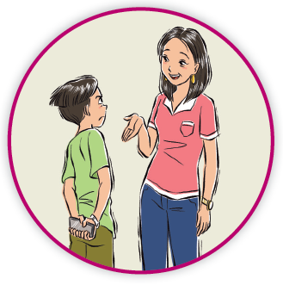
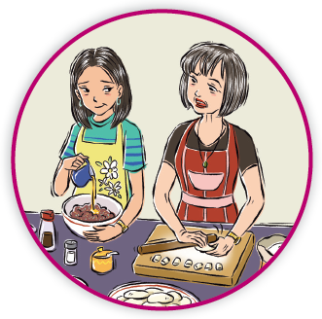
Picture Match
Part ______
Part ______
Part ______

Slide 17
Independent Practice (L) Part 1
Independent Practice
Text Comprehension Read each question. Think of the answer or look back at the text. Fill in the blank. Be sure the sentence makes sense.
Part 1
1. WHAT is the setting of the story? The setting of the story is ______________________________________.
2. WHO are the main people in the story? The main people in the story are ________________________________.
3. WHAT was not the same in Mom’s dumplings and Grandma’s dumplings? When Mom made dumplings, she _______________________________.

Slide 18
Independent Practice (L) Part 2
Part 2
4. WHAT happened to Grandma’s phone? Grandma’s phone ___________________________________________.
5. WHAT problem did David have? David’s problem was that _____________________________________.
6. WHAT did David use his phone for? David used his phone ________________________________________.

Slide 19
Independent Practice (L) Part 3
Part 3
7. WHY did David not tell his pals he split time on the phone with Grandma? David did not tell his pals because he _____________________________ ___________________________________________________________.
8. HOW was David’s problem fixed? David’s problem was fixed when _________________________________.

Slide 20
Independent Practice (M) Story 1
More Practice Read each story. Answer the questions.
Story 1: Kate woke up with a plan. She was going to pick grapes today. She saw that the grapes were ripe on the vine. Kate spoke to Edwin. “Will you come help me? After we pick those grapes, we can make some fine jam.” Edwin said, “I will help you pick grapes, Kate.” Then he added, “But I do not like grape jam, so it will all be yours.”
1. WHERE were the grapes? The grapes were ___________________________________________.

Slide 21
Independent Practice (M) Story 1 — cont’d
2. WHAT did Kate plan to do with the grapes? Kate planned to make ________________________________________.
3. WHY did Edwin say that all the jam will be Kate’s? Edwin said all the jam will be Kate’s because ______________________ __________________________________________________________.

Slide 22
Independent Practice (M) Story 2
Story 2: Gran came to my home. “Nailee, please take this pass to a game show. It is a gift for you,” Gran said. She gave me the pass. “I hope you have a fun time.”
When I saw the pass, I was glad. I said, “Thank you, Gran. I do like game shows. It will be a fun day. In fact, it may be the best day of my life!”
1. WHAT did Gran get for Nailee? Gran got Nailee ________________________________________________.
2. HOW did Nailee feel when she got the pass from Gran? When Nailee got the pass, she felt _________________________________.
3. WHY did Nailee say it might be the best day of her life? She said that because she ________________________________________.

