Slide 1
Say Sounds (A–B)
Say Sounds
Phonemic Awareness Listen to the sounds or word parts as your teacher says a word slowly. Then blend say the word.
Letter/Sound Associations Look at the letter. Say the sound.
m e p a n
a o h l e
e g t u o
u j d b i
f k h r c

Slide 2
Read Words (C)
Read Words
New Words Say the sound. Sound out the word. Read the word.
get pet hem
bed hum pen
pan leg log
lug bet bat
ten jet jot

Slide 3
Read Words (D)
Word Families Read down. Read rapidly.
pet
bet
jet
wet
yet
ten
Ben
hen
den
pen
leg
beg
peg
Meg
beg
10 Second Challenge
Cold Timing words read
Practice words read
Hot Timing words read

Slide 4
Read Words (E–F)
Multisyllabic Challenge Words Sound out the syllables. Read the whole word.
hectic helmet hidden denim puppet
High-Frequency Words Say. Spell. Read.
where went have her with
some children into look down

Slide 5
Spell Words (G)
Spell Words
Spelling Journal Turn to the Spelling Journal on page 152.

Slide 6

Read Text (H)
Read Text
Decodable Sentence Expansion Read each set of sentences. Then expand the last sentence by telling where. Select the picture that goes with each set.
Nan put down the pan. Nan put down the pan of water. Nan put down the cat’s pan of water. . . . , Nan put down the cat’s pan of water. _____

Slide 7
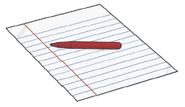
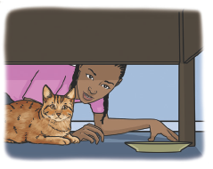
Read Text (H) — cont’d
The puppet had legs. The puppet had fabric legs. The puppet had fabric legs and a denim cap. . . . , the puppet had fabric legs and a denim cap. _____
I have a pen. I have a big pen. I have a big red pen to jot with. . . . , I have a big red pen to jot with. _____

Slide 8
Independent Practice (I)
Independent Practice
More Practice 1 Fill in each blank with the best word.
1. Meg ________ her pet.
red bed fed
2. The pig is in the ________.
hen pen ten
3. Look at the big ________.
jet wet set
4. The ________ got wet.
ten hen wed
5. Where did my ________ go?
met pet let

Slide 9
Independent Practice (I) — cont’d
6. The cat sat on my ________.
beg let leg
7. Ben and Meg ________ Ed at school.
net met set
8. The dog did not go to the ________.
vet jet get
9. The children can ________ some water.
set get let
10. The man met up with ________ people.
men hem ten

Slide 10

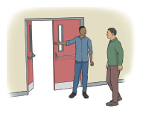
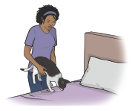
Independent Practice (J)
More Practice 2 Draw a line under the sentence that goes best with each picture.
1. Jen can fix her hem.
Jen can jot with a red pen.
2. Ed met some children.
Ed let the man in.
3. Nan set her pet on the log.
Nan set her pet on the bed.

Slide 11
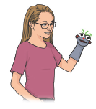
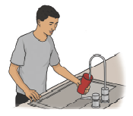

Independent Practice (J) — cont’d
4. Kit has a fun puppet.
Kit has a red bag.
5. Nat can jog to school.
Nat can get some water.
6. Ten men get in a jet.
The man has ten pens.

Slide 12


Independent Practice (J) — cont’d
7. The ham is in a pan.
The bun is in a pan.
8. The bug has six legs.
The bug is in a cobweb.

