Slide 1
Say Sounds (A–B)
Say Sounds
Phonemic Awareness You will blend and segment sounds as you read and spell words.
Letter/Sound Associations Look at the letters. Say the sounds.
bird curve
ur ar a ir
ow igh o_e er
ea ir ur or
ir i_e er ee
ar i ir ur

Slide 2
Read Words (C)
Read Words
New Words Say the sound. Sound out the word. Read the word.
fir turn term
burn fur for
dirt dart girl
hurt stir star
thud first spurt
sport fort churn

Slide 3
Read Words (D)
Word Families Read down. Read rapidly.
dirt
shirt
flirt
skirt
dirt
hurt
Kurt
spurt
blurt
hurt
more
sore
shore
chore
score
10 Second Challenge
Cold Timing words read
Practice words read
Hot Timing words read

Slide 4
Read Words (E–F)
Review Words Read a line of words. When your teacher gives a meaning, circle the correct word.
drive drip blade bleach
glad slope slop creek
stale might math steal
snail bleed coach kite
Words with Endings Read words with endings. 1. begging 2. driver 3. slopping 4. sloping 5. drumming 6. turned 7. chirped 8. burner 9. hurting 10. clacking

Slide 5
Read Words (G–H)
Multisyllabic Challenge Words Sound out the syllables. Read the whole word.
further surprise thirteen hamburger different
pattern frighten attract predators communicate
High-Frequency Words Say. Spell. Read.
other mother another use your
little said been there you

Slide 6
Read Sentences (I)
Read Sentences
Sentences Read the sentences with phrasing.
Please come to the first art club meeting.
There is a nest of chirping birds in the fir tree.
I want to ride my bike further on the other trail.
Linette has been working as a nurse for just thirteen days.
Drivers must make another right turn to get on the highway.

Slide 7
Spell Words (J)
Spell Words
Spelling Journal Turn to the Spelling Journal on page 202.

Slide 8
Decodable Informative Text (Part 1)
Decodable Informative Text Read each part. Answer your teacher’s questions and select the picture that goes with each part.
How Do Birds Communicate?
Part 1
Teacher Reads All living things communicate in some way. Birds have many ways to communicate, including songs, calls, and actions.
7
15
22
Some birds chirp, some tweet, some honk, some cry “chick-a-dee.” All birds communicate. They communicate in different ways and with different goals.

Slide 9
Decodable Informative Text (Part 1) — cont’d
24
34
46
58
62
73
84
96
Birds may sing to communicate. A lot of the birds that sing are male. A bird’s song has sets of notes that the bird sings in a pattern. The bird may sing the same song lots of times.
Birds sing to claim a home and keep it safe. They are telling other birds not to get close. And male birds sing to attract a mate. A male bird sings to show off that it is strong.

Slide 10
Comprehension Questions Part 1
What is one way that birds communicate?
One way that birds communicate is by ________________.
What does a bird’s song contain?
A bird’s song contains ________________.
What is one purpose of a bird’s song?
One purpose of a bird’s song is to ________________.

Slide 11
Decodable Informative Text (Part 2)
Part 2
Teacher Reads A bird’s song can sound like music. A bird’s call is different from a song. Keep reading to find out about the difference.
100
109
122
133
144
154
165
175
179
190
201
Birds may use calls to communicate. A call is shorter than a song. There is less of a pattern in a call than in a song. A call may be just a note.
Birds use calls for lots of things. Birds use calls to frighten off predators. A bird call tells other birds of risks. Calls can track down a mate or chicks. Birds use calls to keep flock members close to each other when they are in flight.
When birds see things to eat, they use calls to tell others. Chicks in a nest use calls to say “feed me.” They are begging for things to eat.

Slide 12
Comprehension Questions Part 2
What is one way a bird call is different from a bird song?
One way a bird call is different from a bird song is ________________.
What is one reason a bird uses a call?
One reason a bird uses a call is to ________________.
Why do bird chicks in a nest use a call?
Bird chicks in a nest use a call to ________________.

Slide 13
Decodable Informative Text (Part 3)
Part 3
Teacher Reads Besides songs and calls, birds may use actions to communicate. One kind of bird uses action to make a sound like a drum.
208
216
227
240
251
260
272
282
292
301
310
313
Birds may communicate with actions. A bird may fake being hurt to lead a predator far from its nest. Male birds may put on a show or a display to attract a mate. One sort of male bird sweeps its wings back and forth fast, making a drumming sound. It makes the sound to attract a mate and to keep its home safe. A different sort of male bird attracts a mate by clapping the parts of its bill closed, making a clacking sound.
In order to stay safe, birds need to communicate. Songs, calls, and actions are important ways for birds to do that.

Slide 14
Comprehension Questions Part 3
In addition to songs and calls, how do birds communicate?
In addition to songs and calls, birds communicate with ________________.
What is the main reason birds communicate with actions?
The main reason birds communicate with actions is to ________________.

Slide 15
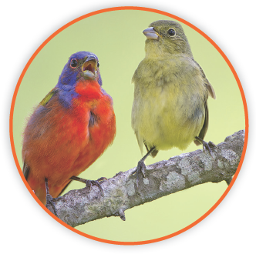
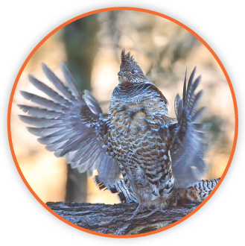
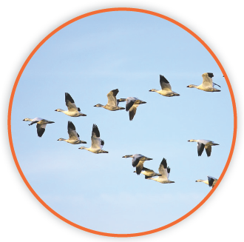
Picture Match
Part ______
Part ______
Part ______

Slide 16
Independent Practice (L) Part 1
Independent Practice
Text Comprehension Read each question. Think of the answer or look back at the text. Fill in the blank. Be sure the sentence makes sense.
Part 1
1. WHAT is a way birds communicate? A way birds communicate is by ___________________________________.
2. WHAT is a bird’s song made up of? A bird’s song is made up of ______________________________________.
3. WHY may a bird sing? A bird may sing to _____________________________________________.

Slide 17
Independent Practice (L) Part 2
Part 2
4. HOW is a bird call different from a bird song? A bird call is ________________________________________________.
5. WHY may a bird use a call? A bird may use a call to _______________________________________ __________________________________________________________.
6. WHY do bird chicks in a nest use a call? Bird chicks in a nest use a call to _______________________________.

Slide 18
Independent Practice (L) Part 3
Part 3
7. WHAT is another way birds communicate? Another way birds communicate is _________________________________.
8. WHAT is the main reason birds communicate with actions? The main reason birds communicate with actions is to _________________.

Slide 19
Independent Practice (M) Story 1
More Practice Read the story. Answer the questions.
Story 1: Min was going to surprise her mother for her birthday. Min would use cash she had been saving in her purse. She went to the bake shop. When it was her turn, there were no cakes left. Min rushed home. She had to work fast to stir some batter and bake a cake. Min’s mother came and said, “Look! I got a cake for my own birthday. You and I can eat it!”
1. WHY did Min plan to surprise her mother? Min planned to surprise her mother because _________________________
_____________________________________________________________.

Slide 20
Independent Practice (M) Story 1 — cont’d
2. WHY did Min not get a cake at the bake shop? Min did not get a cake there because _______________________________.
3. WHAT surprise did Min’s mother have when she came home? When Min’s mother came home, she had ____________________________.

Slide 21
Independent Practice (M) Story 2
Story 2: Shirlee and Ann were twin girls who looked the same. When they were little, they dressed the same way. They wore matching shirts and skirts. Then each girl got a matching pink purse. The girls’ mother said they looked sweet. Dressing to match had been fun when they were little, but not when they turned thirteen. There was no matching after that.
1. WHO were Shirlee and Ann? Shirlee and Ann were __________________________________________.
2. HOW did the girls dress when they were little? When they were little, the girls dressed ____________________________.
3. WHEN did dressing alike stop being fun? Dressing alike stopped being fun when _____________________________.

