Slide 1
Say Sounds (A–B)
Say Sounds
Phonemic Awareness You will blend and segment sounds as
you read and spell words.
Letter/Sound Associations Look at the letters. Say the sounds.
  a_e igh oa ai
  ay ow ee e
  a u igh i
  ea oa o a_e
  igh ee ai ow

Slide 2
Read Words (C)
Read Words
New Words Say the sound. Sound out the word. Read the word.
  state ate brave
  fate at plane
  brake fat plan
  glad whale shape
  clap lane grape
  snake slap wave

Slide 3
Read Words (D)
Word Families Read down. Read rapidly.
ate
gate
rate
skate
plate
sale
male
whale
scale
stale
wave
cave
save
shave
brave
10 Second Challenge
Cold Timing words read
Practice words read
Hot Timing words read

Slide 4
Read Words (E–F)
Review Words Read a line of words. When your teacher gives a meaning,
circle the correct word.
  throw snail steal speech
  cheat flow flee wheat
  peach paint pack clay
  right soak seek tray
Words with Endings Use the reading rules to pronounce the words.
1. taping 2. tapping 3. chasing 4. batting 5. clapping
6. rating 7. waving 8. mapping 9. taming 10. shaping

Slide 5
Read Words (G–H)
Multisyllabic Challenge Words Sound out the syllables.
Read the whole word.
  shipmate statement upgrade exhale basement
  dedicate demonstrate habitats insects female
High-Frequency Words Say. Spell. Read.
  long song strong how because
  were there down very what

Slide 6
Read Sentences (I)
Read Sentences
Sentences Read the sentences with phrasing.
  Can that big, long shape in the water be a whale?
  What else can I eat with grapes for a snack?
  They looked down the path and saw a snake.
  How strong was the gust of wind that came from the west?
  Montez will fix the van’s brakes because the van is not safe.

Slide 7
Spell Words (J)
Spell Words
Spelling Journal Turn to the Spelling Journal on page 198.

Slide 8
Decodable Informative Text (Part 1)
Decodable Informative Text Read each part. Answer your
teacher’s questions and select the picture that goes with each part.
The World of
Red Foxes
Part 1
Teacher Reads As we read about red foxes, the most common type of
fox, let’s see what we learn about this fascinating animal. One thing we
know is that foxes are quite smart: they use their intelligence to help
them survive.
10
20
Red foxes are slim with long, thin legs. They have
bright red coats that can have gray spots. They can
have spots of black on their feet and ears. The long,

Slide 9
Decodable Informative Text (Part 1) — cont’d
31
41
53
56
66
thick tails foxes have help them stand and run. Red
foxes can run at high speeds—up to 30 mph—but not
for very long.
Red foxes are skilled at swimming as well. When do
they swim? They may swim to hunt ducks and fish.

Slide 10
Comprehension Questions Part 1
How do long, thick tails help red foxes?
Red foxes’ long, thick tails help them ________________.
What are two ways that red foxes can move?
Red foxes can move by ________________.
What is one reason that red foxes swim?
One reason that red foxes swim is to ________________.

Slide 11
Decodable Informative Text (Part 2)
Part 2
Teacher Reads Red foxes are able to live in different habitats
(environments), such as forests, mountains, and even towns and cities.
Read on to find out how their eating habits help them adjust to life in
different places.
76
86
97
108
119
129
141
152
165
Red foxes eat lots of things, which helps them do
well in lots of habitats. When they can, red foxes eat
meat. They will chase after a rabbit and feast on it.
But if they cannot have meat, they take what they can
get! They may eat insects, snails, eggs, and plants. Red
foxes living by people may eat what is left in trash cans.
Red foxes eat until they are full. Then they save the
rest and stash it in a safe spot, such as beneath a rock.
What a smart thing to do!

Slide 12
Comprehension Questions Part 2
Why do red foxes do well in different habitats?
Red foxes do well in different habitats because ________________.
What foods may be in a red fox’s diet?
The following foods may be in a red fox’s diet: ________________.

Slide 13
Decodable Informative Text (Part 3)
Part 3
Teacher Reads Red foxes spend most of their time alone, without other
foxes, except when they are bringing up their babies. Female foxes have
babies, which are called pups, kits, or cubs. Keep reading to learn more
about fox pups.
171
183
194
207
220
231
241
In the spring, the female fox has her pups in a den.
She may keep the same den for years. When the pups
are very little, they can’t see a thing. All they do is eat
and sleep. Then at 4 to 5 weeks, they begin to leave the
den with the female. As the weeks pass, the pups keep
growing. They run, jump, and play-fight in the same
way that dog pups do.

Slide 14
Decodable Informative Text (Part 3) — cont’d
246
255
266
277
288
294
The male and female take the pups on hunting
trips. At 16 weeks, the pups can hunt and chase after
things. In the fall, the pups leave the den. The pups
have grown up to be strong, fast, smart foxes that will
do well in the next habitat.

Slide 15
Comprehension Questions Part 3
Where do fox pups spend the first weeks of their lives?
Fox pups spend the first weeks of their lives in ________________.
How do the fox pups learn to hunt?
The fox pups learn to hunt on ________________.

Slide 16
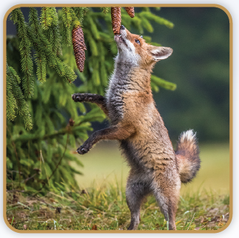
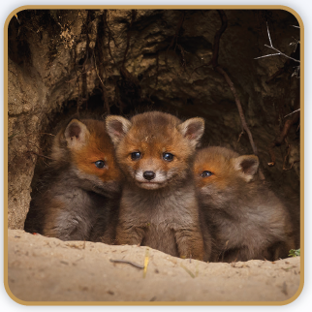
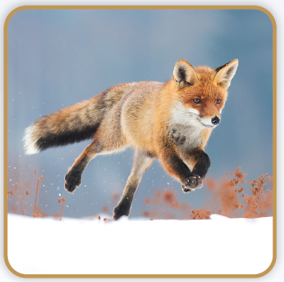
Picture Match
Part ______
Part ______
Part ______

Slide 17
Independent Practice (L) Part 1
Independent Practice
Text Comprehension Read each question. Think of the answer or look back
at the text. Fill in the blank. Be sure the sentence makes sense.
Part 1
  1. HOW do long, thick tails help red foxes?
  Long, thick tails help red foxes ___________________________________.
  2. HOW do red foxes go from spot to spot?
  To go from spot to spot, red foxes _________________________________.
  3. WHY may red foxes swim?
  Red foxes may swim to _________________________________________.

Slide 18
Independent Practice (L) Part 2
Part 2
  4. WHAT helps red foxes do well in lots of habitats?
  Red foxes do well because _____________________________________.
  5. WHAT may red foxes eat?
  Red foxes may eat ___________________________________________.

Slide 19
Independent Practice (L) Part 3
Part 3
  6. WHERE do fox pups stay when they are very little?
  When fox pups are very little, they stay ______________________________.
  7. HOW do fox pups act like dog pups?
  Fox pups act like dog pups when they _______________________________.
  8. WHO helps fox pups hunt when they are little?
  When fox pups are little, they get help hunting from ____________________.

Slide 20
Independent Practice (M) Story 1
More Practice Read each story. Answer the questions.
  Story 1: “I have to meet Justin’s plane at three. See you!” Tess said as she
  sped down the steps.
  Tess waited at the gate, but Justin’s plane came in late. When Tess saw
  Justin, she gave him a hug and said, “I am glad to see you. Let’s get your bag
  and then we can go. What bag did you take?”
  “My bag is black,” Justin said. Then he asked, “Can you help me spot it?”
  1. WHY was Tess in a rush?
  Tess was in a rush to __________________________.

Slide 21
Independent Practice (M) Story 1 — cont’d
  2. WHERE did Tess wait?
  Tess waited __________________________.
  3. WHAT did Justin ask Tess to do?
  Justin asked Tess to __________________________.

Slide 22
Independent Practice (M) Story 2
  Story 2: “Dave, did you eat all the muffins on this plate?” Seth asked. He
  groaned. “I made them to take to class!”
  “Yes, I did,” said Dave. “I ate them late last night. What a treat!”
  “I will get muffins at the bake shop on the way to class,” Seth said.
  “I will take you there,” Dave said. “I ate them, so I will pay for them!”
  1. WHEN did Dave eat the muffins?
  Dave ate the muffins ______________________________.
  2. WHAT will Dave do to help Seth?
  To help Seth, Dave will _____________________________.
  3. WHY did Dave want to help Seth?
  Dave helped Seth because __________________________.

